Slide 1
Chapter 3 Customer Relationship Management LOYALYT &CRM

Slide 3
Empathy is important!

Slide 4
CRM
Customer relationship management (CRM) is a combination of people, processes and technology that seeks to understand a company’s customers.
It is an integrated approach to managing relationships by focusing on customer retention and relationship development.
A process that addresses all aspects of identfying customers, creating customer knowledge, building customer relationships and, shaping their perceptions of the organisation and its products (Payne & Frow,2005).

Slide 5
the walls between customer and company are torn down.
Regis McKenna, adopted the concept of «real-time marketing» CRM targets the buildings of infrastructure which may be used to develop long term customer-supplier relationships.

Slide 6
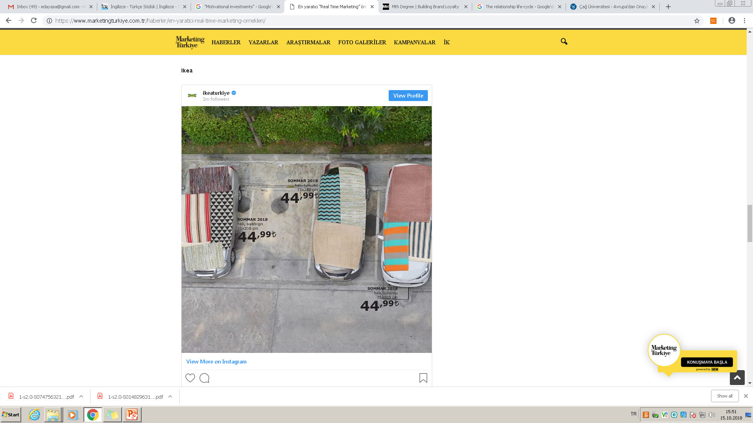

Slide 7
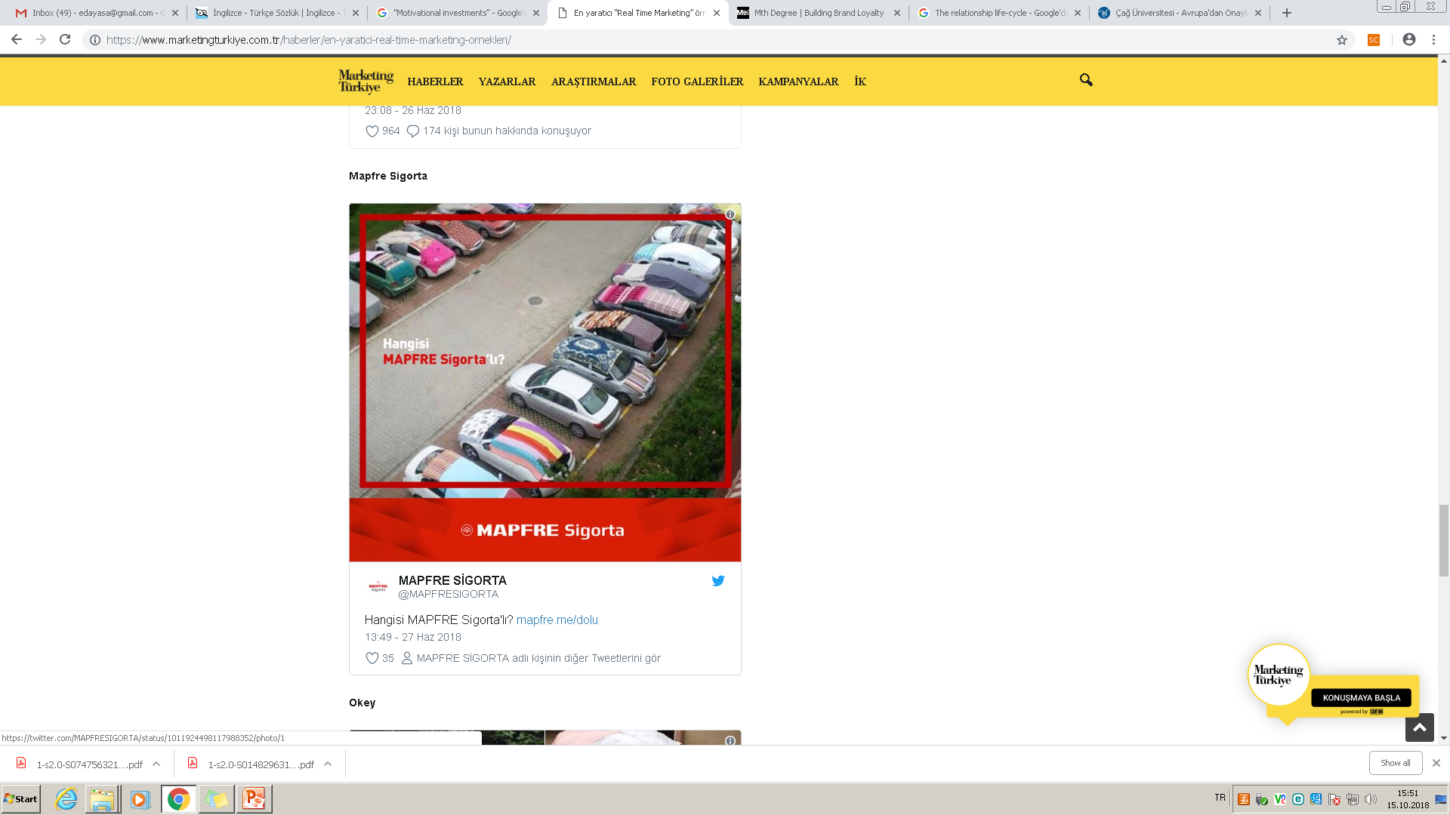

Slide 8
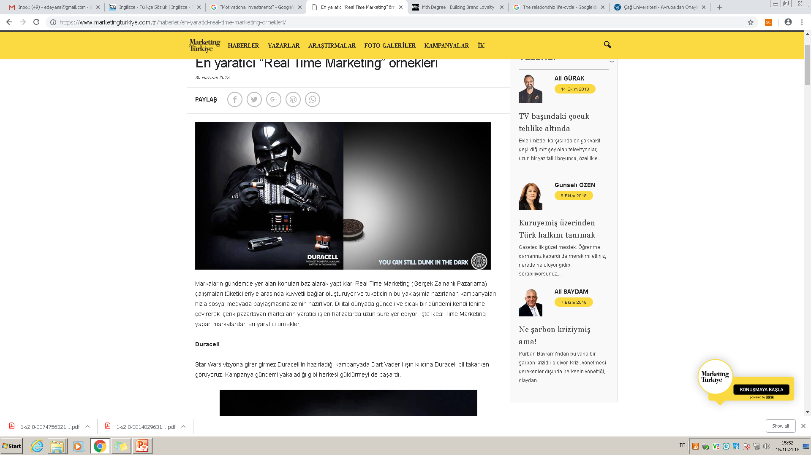

Slide 9
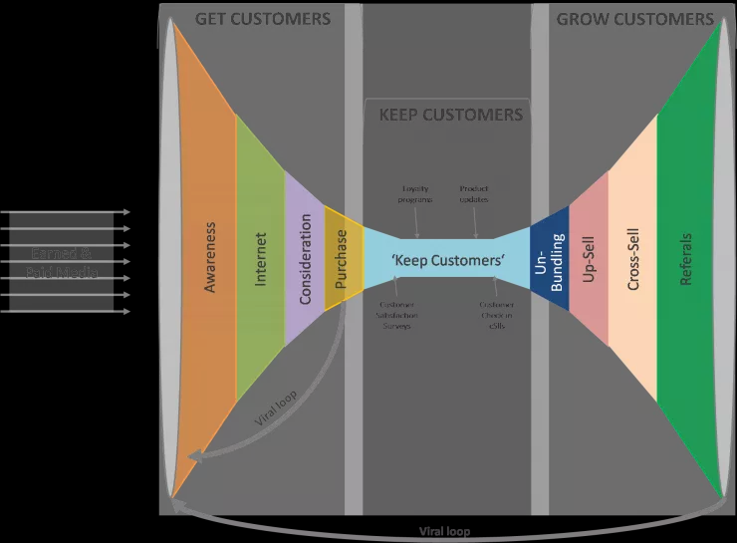
CRM

Slide 10
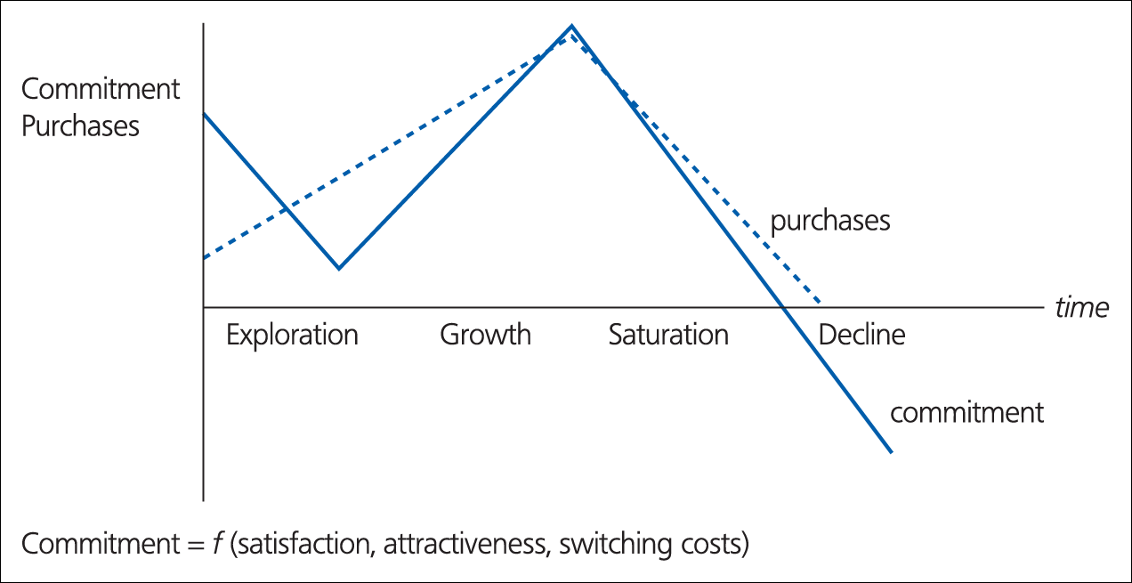
Figure 1.3 The relationship life-cycle
Source: Peelen et al. (1996).

Slide 11
The phases in relationship life cycle
Exploratory: the customer sees the promises made during communication fullfilled for the first time. The first impression make an important impression on the customer’s relations. The level of satisfaction is still relatively low the customers have little or no experience of the products or servicee supplier. The switching costs are still relativelly low.
The Growth: (3 months to 2 years): is charactarised by a sharp rise in the number of purchases. Customers would like to get to know the supplier’s products the satisfaction will be increased, the supplier is now examined more for its performance.

Slide 12
…
The Saturation (usually after more than two years) highest number of purchaes, from suppliers and and the highest commitment degree, not many changes are occuring in either, behavior of purchases, the goodwill has been built up with the customer. Trust grows, switching costs increase.
The Decline phase: number of transactions starts to decrease, at ant time in the phases customers may enter into decline phase. Type of customer and the reduction in the need for the products will be decreased. No longer they neey a product such this .

Slide 13
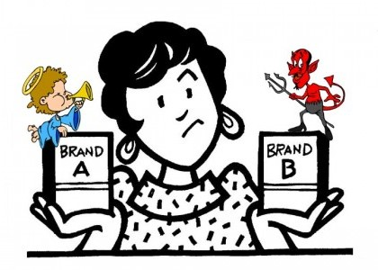
Loyalty
Is a deeply held commitment to rebuy or repatronise a preferred product-service consistently in the future, thereby causing repetitive same brand, or same brand- set purchasing, despite situational influences and marketing efforts having the potential to cause switching behaviour.
Switching behavior: where purchasing is seen as an either/or decision- either the customer stays with you (loyalty) or turns against you.

Slide 16
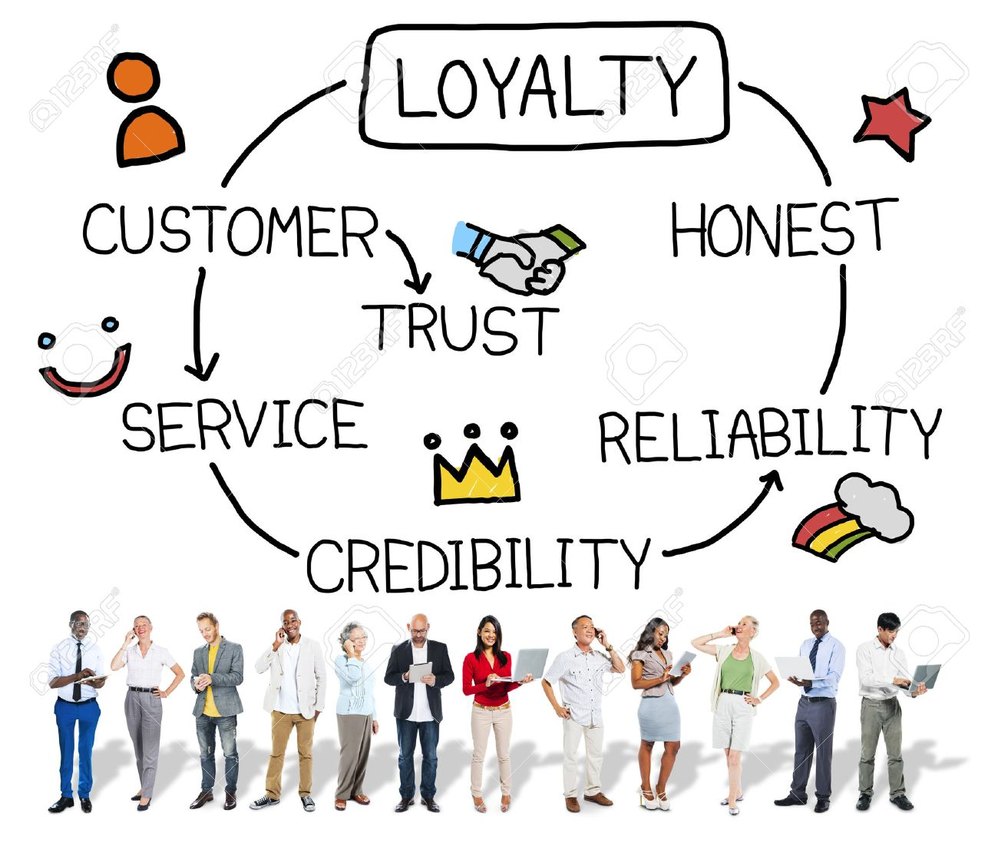

Slide 17
Antecedents to loyalty
There are two distinct viewpoints as to the antecedents to loyalty.
In Figure 3.2. loyalty is seen as more often built on ‘hard’ dimensions, such as value for money, convenience, reliability, safety and functionality, and that these are the prime drivers for product or service choice (Christopher, 1996, p. 60).

Slide 18
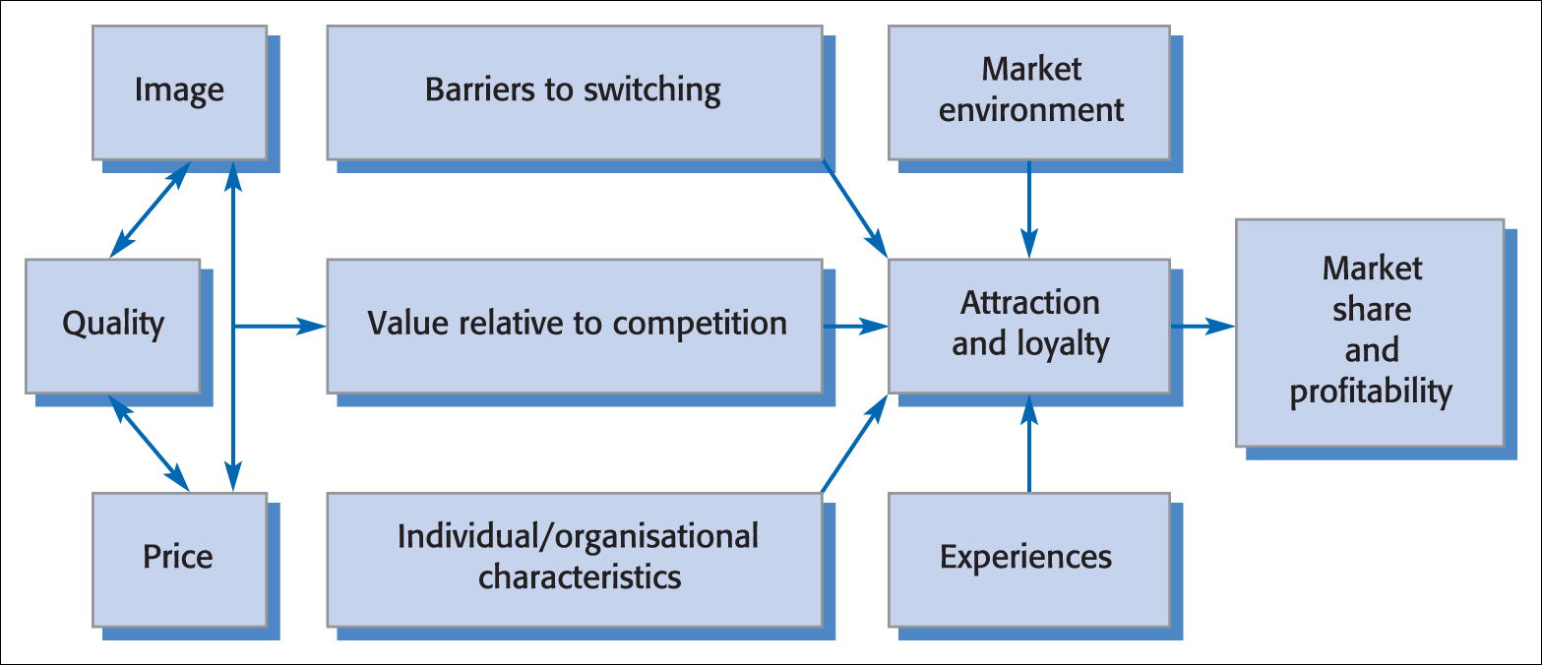
Figure 3.2 Customer loyalty: an integrated model
Source: Adapted from Fredericks and Salter, 1998, p. 64.

Slide 19
An alternative view by Dick and Basu (1994, p. 99).
‘softer’, more intangible factors such as emotion and satisfaction are seen to affect attitude in a decisive way.
Customer loyalty is viewed principally as a result of the bond between an individual’s relative attitude and repeat patronage, again mediated by social norms and situational influences or experiences (Figure 3.3).

Slide 20
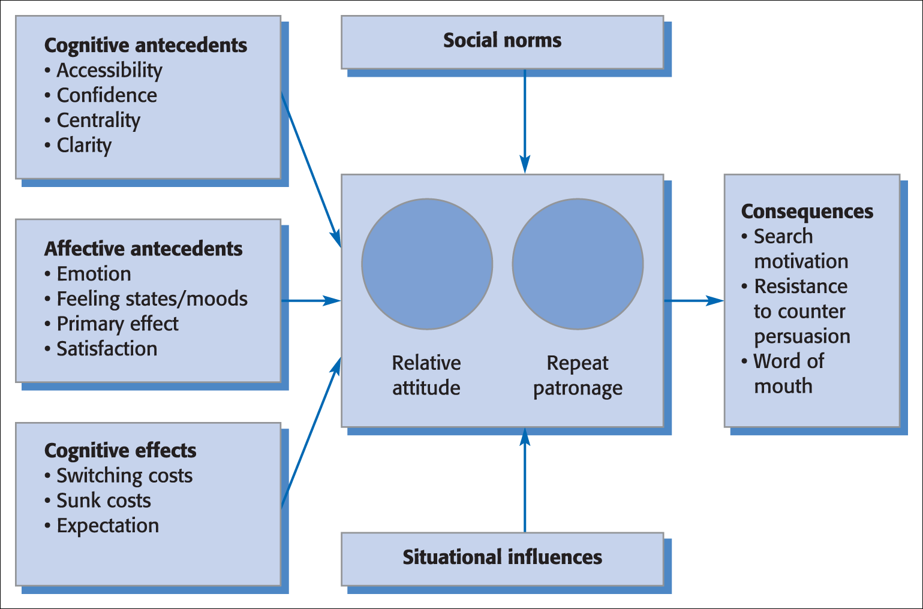
Figure 3.3 Framework for customer loyalty
Source: Adapted from Dick and Basu, 1994, p. 100.

Slide 21
Both models suggest that customer satisfaction sustains loyalty.
The presumption is that loyalty is built upon satisfaction derived from a positive differentiation achieved by providing superior customer service .

Slide 23
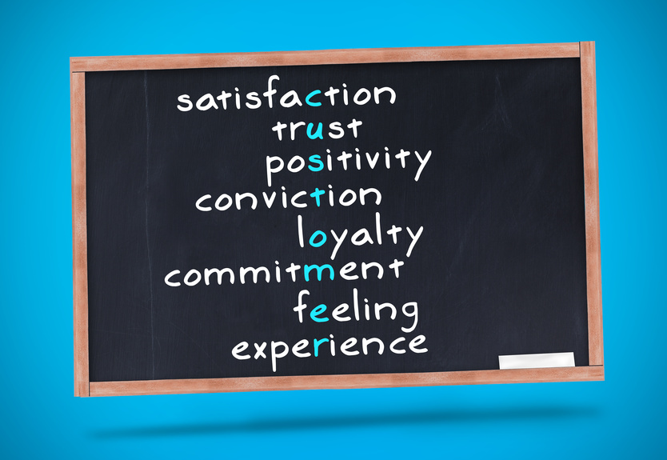
İt is important...

Slide 24
Some rules:
Get the right people to spread the message…
A successful word of mouth campaign depens not just on how many people get the message, but on who is spreading and receiving it.
The richest interactions between customer and product often take place during the purchase process.
Effective communication is important…
Today’s customers appear to have lower expectations for a one and done transactions!

Slide 25
A Communication process

Slide 26
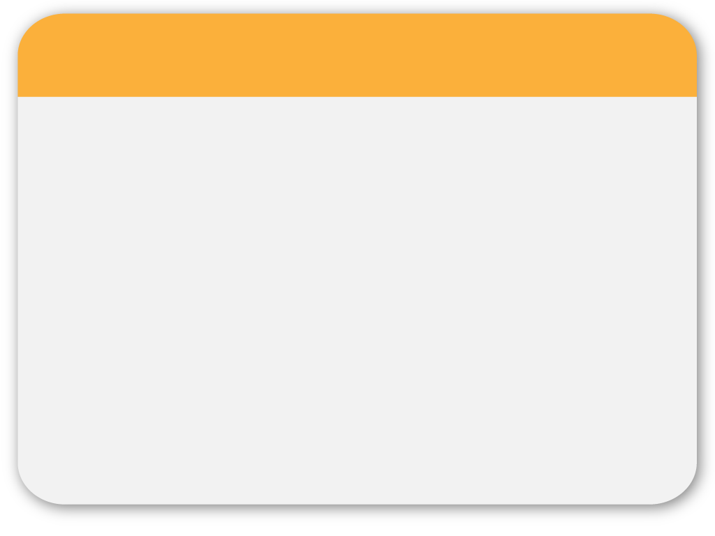
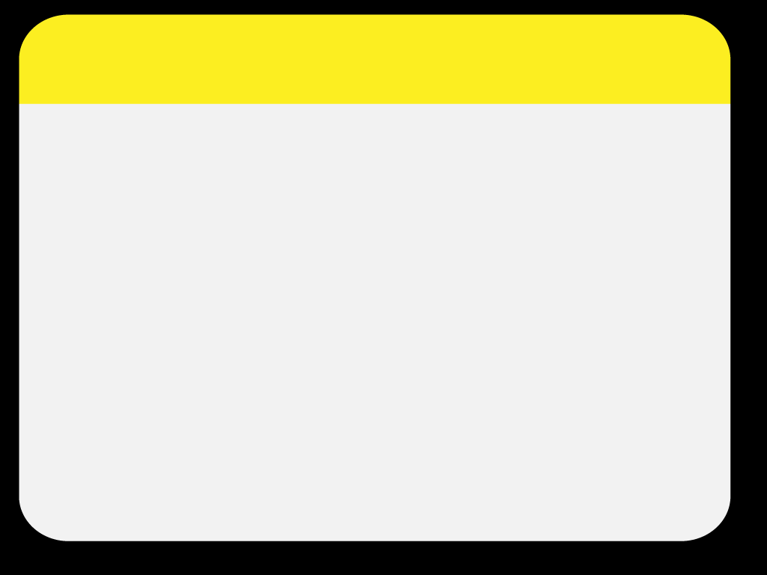
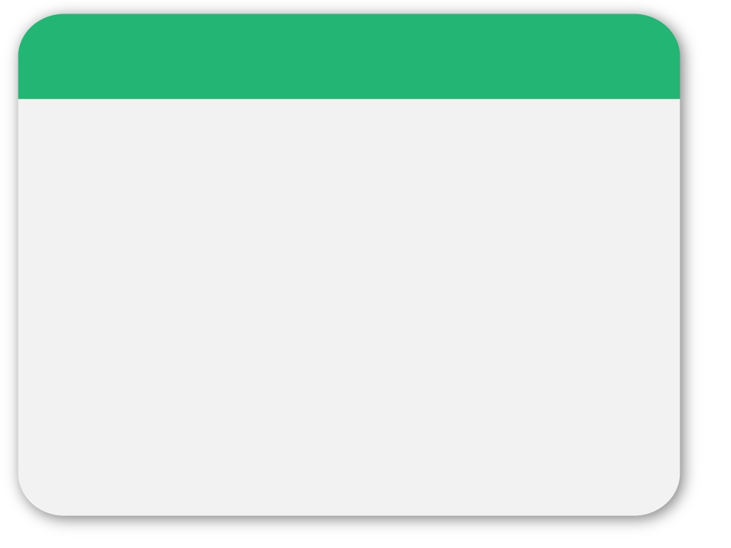
03
PowerPoint picture page
Notes:
26

Slide 28
The next chapters…
Market oriented strategies (Treacy & Wiersame, 1996)
Leacky Bucket Theory/ Customer Lifetime Value,
ET AL.

Slide 29
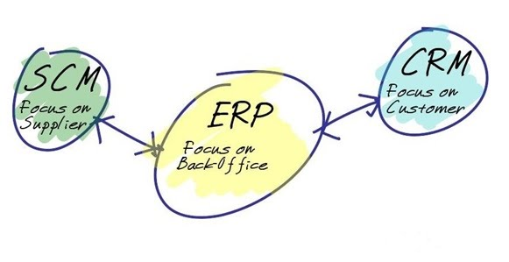
Treacy AND Wiersema (1996)
Company want to amaze its customers!, push the limits

