Slide 1
New Technologies for Business
Fatih Koç

Slide 2
New Technologies, why and how?
M – M – M cycle
M – P – M cycle
P – P – P cycle
M: money ; P : product
*Creative Destruction
* Blue Pale DOT (Carl Sagan : Cosmos)

Slide 3
Layers of Earth
Everything in Earth's system can be placed into one of four major subsystems: land, water, living things, or air.
The Atmosphere--contains all the air in Earth's system. It extends from less than 1 m below the planet's surface to more than 10,000 km above the planet's surface
The Biosphere --contains all the planet's living things. This sphere includes all of the microorganisms, plants, and animals of Earth.
The Hydrosphere -- contains all the solid, liquid, and gaseous water of the planet. It ranges from 10 to 20 kilometers in thickness.

Slide 4
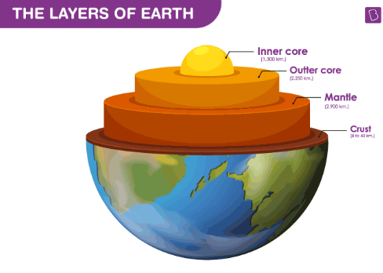
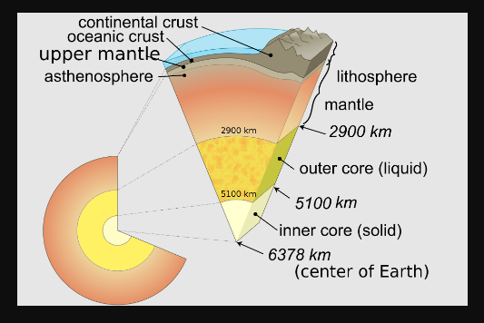
Layers of Earth
The Lithosphere--contains all of the cold, hard solid land of the planet's crust (surface), the semi-solid land underneath the crust, and the liquid land near the center of the planet
Mantle is 2.900 KM in depth

Slide 5
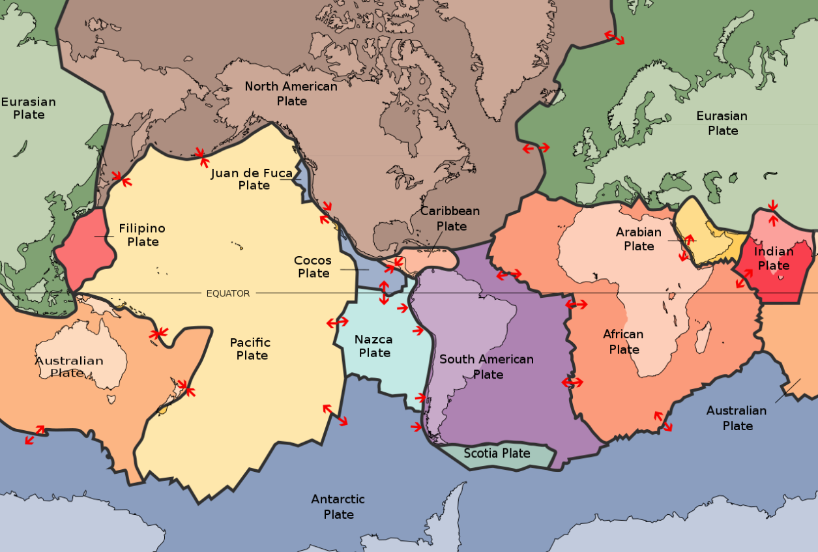
Tectonic Plates (in mantle: depth 2.900 KM)

Slide 6
High-frequency
Active
Auroral
Research
Program
is a scientific endeavor aimed at studying the properties and behavior of the ionosphere.
H A A R P
Ionosphere:"The ionosphere stretches roughly 50 to 400 miles above Earth's surface, right at the edge of space. Along with the neutral upper atmosphere, the ionosphere forms the boundary between Earth's lower atmosphere — where we live and breathe — and the vacuum of space."

Slide 7
Why Was HAARP Developed?
The High-frequency Active Auroral Research Program began in 1990 as a congressional initiative to expand our knowledge of the earth's upper atmosphere and their effects on radio wave propagation. Particular emphasis was placed on being able to understand and use it to enhance communications and surveillance systems for both civilian and defense purposes.
Between 1990 and 2014, HAARP was a jointly managed program of the United States Air Force (USAF) and United States Navy. Its goal was to research the physical and electrical properties of the Earth’s ionosphere, which can affect our military and civilian communication and navigation systems.

Slide 8
Who Owns HAARP?/How does it work?
Responsibility for the HAARP facilities and equipment formally transferred from the military to UAF on Aug. 11, 2015.
Scientists at HAARP use HF radio transmitters to heat small regions of the ionosphere and observe the effects (including ionospheric heating). For traditional space research using ground-based observations or experiments on sounding rockets, it can take an extremely long time (days, weeks, even years) to get the desired natural overhead conditions. Satellites can amass much larger databases but it is difficult to coordinate the satellite with the desired phenomena.
With a facility like HAARP, it is possible to perform an experiment at will to create plasma structures and irregularities, use the ionosphere like an antenna to excite low frequency waves, create weak luminous aurora-like glows and a variety of other experiments.

Slide 9
Can I visit HAARP?
UAF (University of Alaska Fairbanks) recognizes there is a great interest in the scientific work of the facility and the university continues the tradition of holding an annual open house when anyone is welcome to visit the site.
HAARP technology has nothing to do with Lithosphere or mantle, it observes Ionosphere.
It only observes and can not create earthquakes!

Slide 10
Some Concepts
Return on Investment
Antinatalism (philosophy)
ROI of child making < zero
New Tech to be alive:
Useful for human life
ROI > zero; and high

Slide 11
But there are some technologies about earthquakes. Maybe it can’t create them but can help us to survive!
What are they?

Slide 13
The Levitating Foundation

Slide 14
Shock Absorbers

Slide 15
Pendulum Power
Damping can take many forms. Another solution, especially for skyscrapers, involves suspending an enormous mass near the top of the structure. Steel cables support the mass, while viscous fluid dampers lie between the mass and the building it's trying to protect. When seismic activity causes the building to sway, the pendulum moves in the opposite direction, dissipating the energy.
Taipei 101, which refers to the number of floors in the 1,667-foot-high (508-meter-high) skyscraper, uses a tuned mass damper to minimize the vibrational effects associated with earthquakes and strong winds. At the heart of the system is a 730-ton (660-metric-ton), gold-colored ball suspended by eight steel cables. It's the largest and heaviest tuned mass damper in the world.

Slide 16
Replacable Fuses
Researchers from Stanford University and the University of Illinois have been experimenting with a similar concept in the quest to build an earthquake-resistant building. They call their idea a controlled rocking system because the steel frames that make up the structure are elastic and allowed to rock on top of the foundation. But that by itself wouldn't be an ideal solution.
In addition to the steel frames, the researchers introduced vertical cables that anchor the top of each frame to the foundation and limit the rocking motion. Not only that, the cables have a self-centering ability, which means they can pull the entire structure upright when the shaking stops. The final components are the replaceable steel fuses placed between two frames or at the bases of columns. The metal teeth of the fuses absorb seismic energy as the building rocks. If they "blow" during an earthquake, they can be replaced relatively quickly and cost-effectively to restore the building to its original, ribbon-cutting form.

Slide 17
Rocking Core-Wall

Slide 18
Seismic Invisibility Cloak
Engineers believe they can fashion the "cloak" out of 100 concentric plastic rings buried beneath the foundation of a building [source: Barras]. As seismic waves approach, they enter the rings at one end and become contained within the system. Harnessed within the "cloak," the waves can't impart their energy to the structure above. They simply pass around the building's foundation and emerge on the other side, where they exit the rings and resume their long-distance journey. A French team tested the concept in 2013.

Slide 19
Shape Memory Alloy
Generic Name Brands: YTONG, Selpak, Frijidare.
Enter the shape memory alloy, which can endure heavy strains and still return to its original shape. Many engineers are experimenting with these so-called smart materials as replacements for traditional steel-and-concrete construction. One promising alloy is nickel titanium, or nitinol, which offers 10 to 30 percent more elasticity than steel [source: Raffiee]. In one 2012 study, researchers at the University of Nevada, Reno, compared the seismic performance of bridge columns made of steel and concrete with columns made of nitinol and concrete. The shape memory alloy outperformed the traditional materials on all levels and experienced far less damage [source: Raffiee].

Slide 20
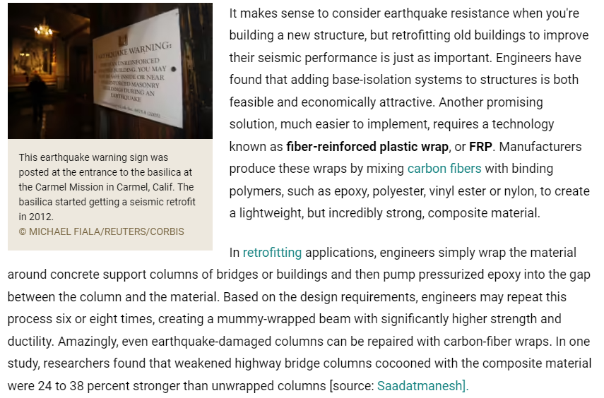
Carbon Fiber Wrap

Slide 21
Bio materials
Mussel
To stay attached to their precarious perches, mussels secrete sticky fibers known as byssal threads. Some of these threads are stiff and rigid, while others are flexible and elastic. When a wave crashes on a mussel, it stays put because the flexible strands absorb the shock and dissipate the energy. Researchers have even calculated the exact ratio of stiff-to-flexible fibers -- 80:20 -- that gives the mussel its stickiness [source: Qin]. Now it's a matter of developing construction materials that mimic the mussel and its uncanny ability to stay put.
Spider
Another interesting thread comes from the south end of spiders. We all know that, pound for pound, spider silk is stronger than steel (just ask Peter Parker), but MIT scientists believe that it's the dynamic response of the natural material under heavy strain that makes it so unique. When researchers tugged and pulled on individual strands of spider silk, they found the threads were initially stiff, then stretchy, then stiff again. It's this complex, nonlinear response that makes spider webs so resilient and spider thread such a tantalizing material to mimic in the next generation of earthquake-resistant construction.

Slide 22
Cardboard Tubes
Even cardboard can become a sturdy, durable construction material. Japanese architect Shigeru Ban has designed several structures that incorporate cardboard tubes coated with polyurethane as the primary framing elements. In 2013, Ban unveiled one of his designs -- the Transitional Cathedral -- in Christchurch, New Zealand. The church uses 98 giant cardboard tubes reinforced with wooden beams [source: Slezak]. Because the cardboard-and-wood structure is extremely light and flexible, it performs much better than concrete during seismic events. And if it does collapse, it's far less likely to crush people gathered inside. All in all, it makes you want to treat the cardboard tubes nestled in your toilet paper roll with a little more respect.

Slide 23
“Machines will be able to do everything a human can do. In 20 years…”
Herbert A. Simon (said in 1965)
“After a generation, the problem of creating artificial intelligence will be largely resolved.”
Marvin Minsky (said in 1970)

Slide 24
Computer passes Turing Test if the human questioner can’t understand whether the computer is not human.

Slide 25
Jeopardy and AI
https://www.youtube.com/watch?v=P18EdAKuC1U

Slide 26
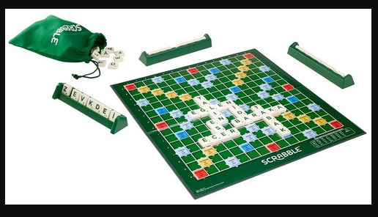
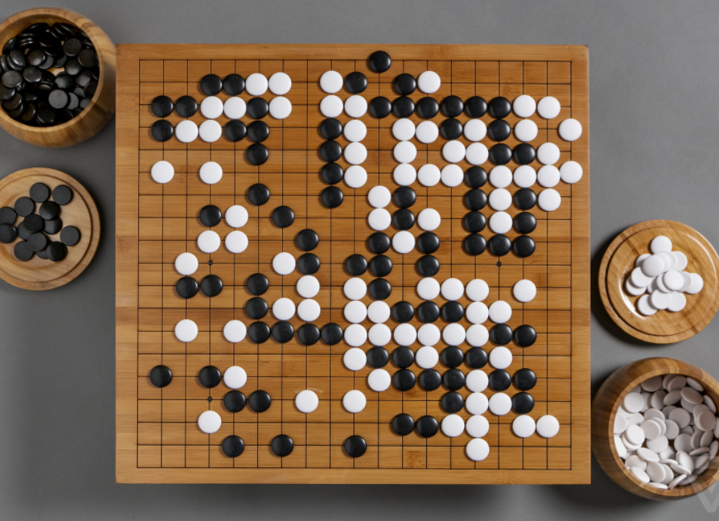
CHESS BACKGAMMON SCRABBLE GO

Slide 27
ALPHAGO

Slide 28
STARCRAFT

Slide 29
Some Definitons
Super Human: a machine reaches the highest level to beat human in a game
A path for a computer to become super human
Game theory: Do you know the game of rock, paper, scissors? There is no single strategy to win this game, right? StarCraft game is like that. Artificial intelligence needs to improve itself by constantly collecting strategic information.
Imprecise information: Games such as Chess and Go are based on certain information. Players see and know everything on the board. However, games like StarCraft also contain imprecise information. So it requires constant exploration.
Long-term planning: As in real life, the relationship between cause and effect is not instantaneous in this game. Long-term planning skills need to be developed.
Real-time: StarCraft is a real-time strategy game, unlike the sequential games on the board. Players need to make moves simultaneously and continuously.
Large space: There are 64 spatial points in chess and 361 in Go. In StarCraft, you have to control many different buildings and objects at the same time at hundreds of points. In addition, the actions taken are not as simple as moving a stone. You can perform hierarchical and non-uniform actions.

Slide 30
Types of A.I.
Narrow A.I
Makes basic tasks
General A.I
cognitive abilities such as language, memory and wayfinding
Artificial Super Intelligence
creativity, social skills and wisdom

Slide 32
Generative AI
The innovations backed by Gen AI
AGI
Autonomous systems
Edge AI
The innovations that will accelerate Gen AI
Causal AI
Neurosymbolic AI
Responsible AI

Slide 33
Backed by Gen AI
Artificial Super Intelligence (ASI): A type of intelligence (currently in the hypothesis stage) in which a machine can perform any mental task that a human can perform.️
Autonomous systems: Self-managing physical or software systems that fulfil their tasks within a limited space and exhibit three basic characteristics: automation, learning and efficiency: Autonomy, learning and agency.
Edge AI: Refers to the embedding of AI techniques in non-IT products, IoT endpoints, gateways and edge servers. This covers use cases for consumer, commercial and industrial applications such as automated vehicles, enhancing the capabilities of medical diagnostics and streaming video analytics.

Slide 34
Accelerate GEN AI
Causal artificial intelligence: Identifies and uses cause-and-effect relationships to move beyond correlation-based predictive models and towards AI systems that can prescribe actions more effectively and act more autonomously.
Neurosymbolic AI: A form of compound artificial intelligence that combines machine learning methods and symbolic systems to build more robust and reliable artificial intelligence models. It provides a reasoning infrastructure to solve a wider range of business problems more effectively.
Responsible AI: An umbrella term that encompasses the considerations of making appropriate business and ethical choices when adopting AI. It encompasses organisational responsibilities and practices that ensure the development and operation of positive, accountable and ethical AI.

Slide 35
Difference between CHATGPT and SimSimi
Answer of ChatGPT:
Introduction: "I and SimSimi cannot be compared since we are different artificial intelligence systems. Both of us are designed for different purposes.
ChatGPT: I am a general-purpose language model and can converse with people on various topics.
Simsimi: SimSimi, on the other hand, is designed as an entertainment and chat application.
Conclusion: Therefore, which application is better depends on your personal preferences and needs."

Slide 36
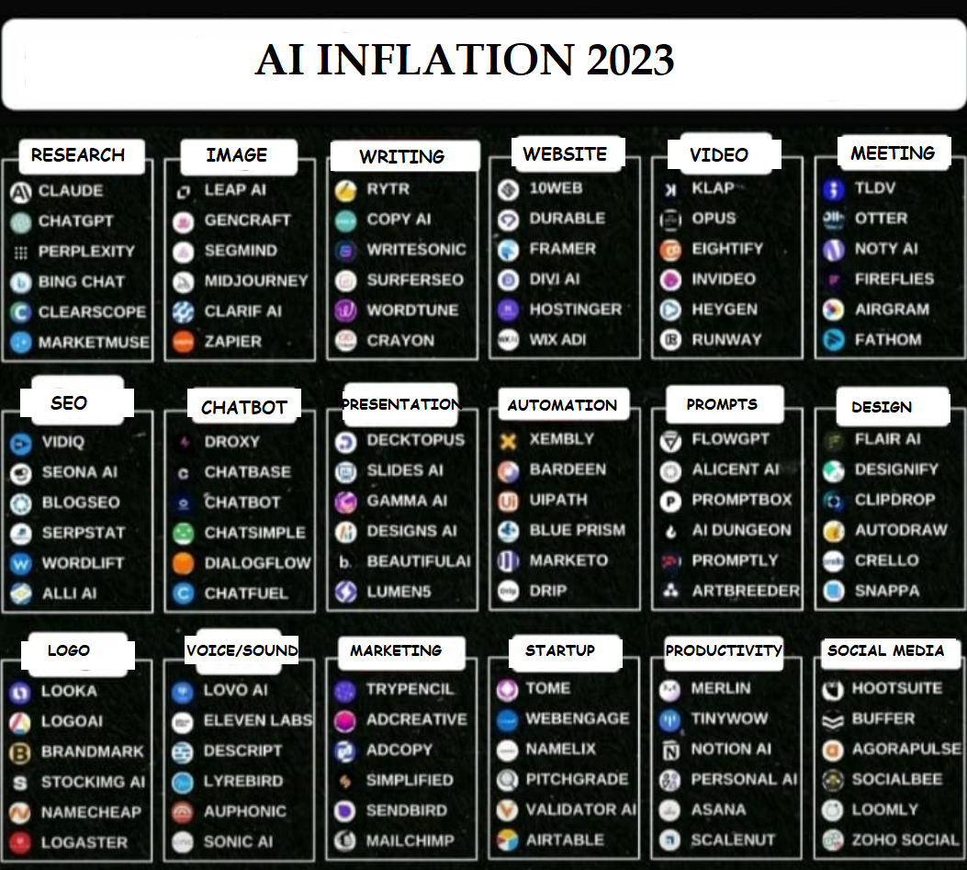

Slide 37
Four paradigms of science through four paradigm shifters;
Experience
Theory Hyptohesis / Law
H0 : -x :Birds cant fly
H1 : x : Birds can fly
Computer science (Quantum Computers)
Big data (Seeing the big picture / Thinking outside of the box)

Slide 38
Even as the Industrial Revolution forever changed the trajectory of human progress, leading voices of the 19th century remained divided on how it could affect workers.

Slide 40
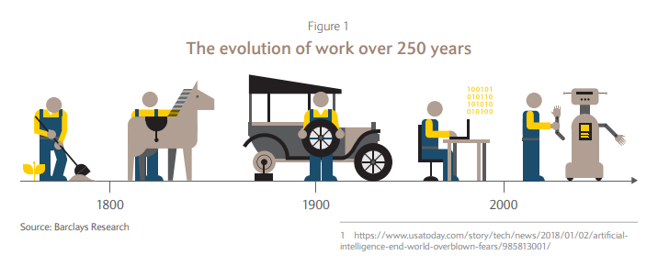

Slide 41
Sensori-motor skills:
Moravec’s paradox.
He points out the contradiction raised by the realization that for artificial intelligence, reasoning that normally requires
high-level brain activity requires very little computing power,
while low-level sensori-motor skills (such as moving arms and legs) require incredibly high computing power.

Slide 42
The issue that artificial intelligence has difficulty in putting into practice is not the subjects (for example, cooking) and skills (for example, playing chess) that an individual learns in his life, but the inherited sensori-motor skills that emerged in the evolutionary process (for example, jumping rope).
However, many people find it very difficult to solve a mathematical problem, play mind games, and understand engineering concepts. In fact, all these phenomena mentioned are temporary abilities learned in the last stages of the evolutionary process.

Slide 43
Actions that an average 4-year-old child can perform without difficulty (recognizing a face, recognizing voices, walking across the room…) actually meet the most complex engineering problems for artificial intelligence.

Slide 44
As the next generation of intelligent machines is developed, the jobs of those in professions such as stock analysts and petrochemical engineers will be threatened; The professions of gardeners, receptionists and cooks have been safe for decades.

Slide 45
Cognitive functionality:
Every social media site has added thousands of content moderators in recent years, including titans such as Facebook and Instagram. One would expect these technological leaders to use machines for this purpose, so why do they keep hiring human moderators?
Right or Wrong?
Racism

Slide 46
What is AI?
https://www.youtube.com/watch?v=2ePf9rue1Ao

Slide 47
A.I. is the study of how to make computers do things at which, at the moment, people are better.
Artificial Intelligence is a way of making a computer, a computer-controlled robot, or a software think intelligently, in the similar manner the intelligent humans think.

Slide 48
AI is accomplished by studying how human brain thinks, and how humans learn, decide, and work while trying to solve a problem, and then using the outcomes of this study as a basis of developing intelligent software and systems.

Slide 49
What if machines could learn on their own?
It would completely change what they can and cannot do, including in the field of work. Thanks to the confluence of several conditions, we may now be at this breakthrough point.

Slide 50
Polanyi’s Paradox:
Everyone knows more than they can tell. You may not be able to tell a machine how to ride a bike or feel the emotion, but you know how it is. An important paradox used in artificial intelligence development.

Slide 51
The automation process, which began in the 1900s, was replaced by digitalization. How the institutions that failed to adapt to this situation in the 1900s had to undergo transformation, today the institutions that cannot digitize their processes will not be sustainable.

Slide 52
Recommendations for Robotic Process Automation and AI Projects
Be sure to evaluate your processes before you get into robotic process automation, complete simple improvements that will be improved and simplified
Manage demand from business process owners. RPA should not be the default answer. Calculate current costs for solutions that are presently in use and consider which will be eliminated by the implementation of the RPA strategy.

Slide 53
Robotic process automation should be considered as a digital workforce that works 24/7. It is necessary to plan this period well in order to obtain continuous efficiency. Make and track the daily work plans of your digital employees.

Slide 54
Establish a central team to monitor your employees. This team should always follow the results of the study and plan the daily work schedule. Previous and new processes of problem management 1 Transformation of Business Model in Finance Sector with Artificial...
• Promote your RPA project well within the organization, ensuring that all units benefit from the benefits. Thus, the process of determining the processes carried out manually will be accelerated.

Slide 55
• Be prepared for the negative reactions of employees. The RPA can be seen as a threat to the employees. Establish your communication correctly. Ensure that the threat is not perceived as an opportunity. Inform your employees about how to use automation and how RPA tools work

Slide 56
Monitor new automation trends continuously. RPA projects will also disappear with new opportunities.
Find people who can see automation opportunities and contribute to the development of these skills.

