Slide 1

E-commerce 2019: Business. Technology. Society.
Fifteenth Edition, Global Edition
Chapter 1
Introduction to
E-commerce
Copyright © 2020 Pearson Education Ltd. All Rights Reserved
Notes:
If this PowerPoint presentation contains mathematical equations, you may need to check that your computer has the following installed:
1) MathType Plugin
2) Math Player (free versions available)
3) NVDA Reader (free versions available)

Slide 2
Learning Objectives
1.1 Understand why it is important to study e-commerce.
1.2 Define e-commerce, understand how e-commerce differs from e-business, identify the primary technological building blocks underlying e-commerce, and recognize major current themes in e-commerce.
1.3 Identify and describe the unique features of e-commerce technology and discuss their business significance.
1.4 Describe the major types of e-commerce.
1.5 Understand the evolution of e-commerce from its early years to today.
1.6 Describe the major themes underlying the study of e-commerce.
1.7 Identify the major academic disciplines contributing to e-commerce.
Notes:
Slide 2 is list of textbook LO numbers and statements

Slide 3
Everything On Demand: The “Uberization” of E-commerce
Class Discussion
  Have you used Uber or any other on-demand service companies?
  What is the appeal of these companies for users and providers?
  Are there any negative consequences to the increased use of on-demand services like Uber and Airbnb?

Slide 4
The First Thirty Seconds
First two decades of e-commerce
  Just the beginning
  Rapid growth and change
Technologies evolve at exponential rates
  Disruptive business change
  New opportunities
Why study e-commerce
  Understand opportunities and risks
  Analyze e-commerce ideas, models, issues

Slide 5
Introduction to E-commerce
Use of Internet to transact business
  Includes Web, mobile browsers and apps
More formally:
  Digitally enabled commercial transactions between and among organizations and individuals

Slide 6
The Difference between E-commerce and E-business
E-business:
  Digital enabling of transactions and processes within a firm, involving information systems under firm’s control
  Does not include commercial transactions involving an exchange of value across organizational boundaries

Slide 7
Technological Building Blocks Underlying E-commerce
Internet
World Wide Web
  H T M L
  Deep Web versus “surface” Web
Mobile platform
  Mobile apps

Slide 8
Insight on Technology: Will Apps Make the Web Irrelevant?
Class Discussion
  What are the advantages and disadvantages of apps, compared with websites, for mobile users?
  What are the benefits of apps for content owners and creators?
  Will apps eventually make the Web irrelevant? Why or why not?

Slide 9
Major Trends in E-commerce
Business trends include:
  All forms of e-commerce show very strong growth
Technology trends include:
  Mobile platform has made mobile e-commerce reality
Societal trends include:
  Increased online social interaction and sharing

Slide 10
Unique Features of E-commerce Technology (1 of 2)
Ubiquity
Global reach
Universal standards
Information richness
Notes:
Additional concepts and terminology include: Information asymmetry, menu costs, marketplaces and marketspaces, transaction costs, cognitive energy, market entry costs, search costs, price discovery, network externalities.

Slide 11
Unique Features of E-commerce Technology (2 of 2)
Interactivity
Information density
Personalization/customization
Social technology
Notes:
Additional concepts and terminology include price transparency, cost transparency, and price discrimination.

Slide 12
Types of E-commerce
Business-to-Consumer (B2C)
Business-to-Business (B2B)
Consumer-to-Consumer (C2C)
Mobile e-commerce (M-commerce)
Social e-commerce
Local e-commerce

Slide 13
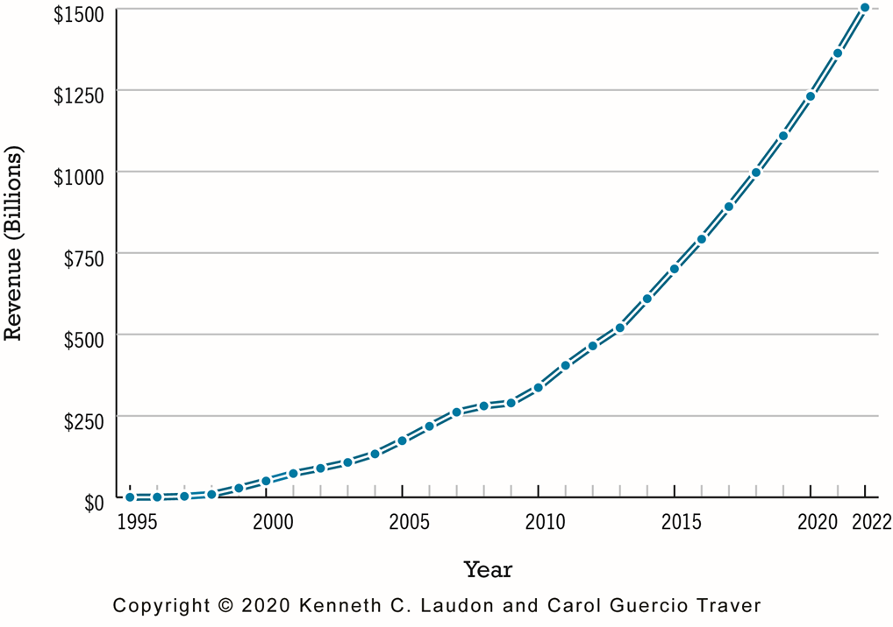
Figure 1.5 The Growth of B2C E-commerce in the United States
Notes:
Figure 1.5, Page 22.
In the early years, B2C e-commerce was doubling or tripling each year. Although B2C e-commerce growth in the United States slowed in 2008–2009 due to the economic recession, it resumed growing at about 13% in 2010 and since then, has continued to grow at double-digit rates. In 2018, revenues from B2C e-commerce are expected to reach almost $1 trillion.
SOURCES: Based on data from eMarketer, Inc., 2018c, 2018d; U.S. Census Bureau, 2018a; authors’ estimates.
Full description: A graph shows growth of B2C e-commerce in the United States during the time period 19 95 to 20 22. The x-axis shows years from 19 95 to 20 22 in increments of 5 years. The y-axis shows revenue in billions of dollars, ranging from 0 to 1 thousand 500 in increments of 250. The graph shows the years and the corresponding revenue as follows. 19 95, 0. 2000, 50 billion dollars. 2005, 170 billion dollars. 20 10, 300 billion dollars. 20 15, 700 billion dollars. 20 20, 1200 billion dollars. 20 22, 1500 billion dollars. All data are approximate.

Slide 14
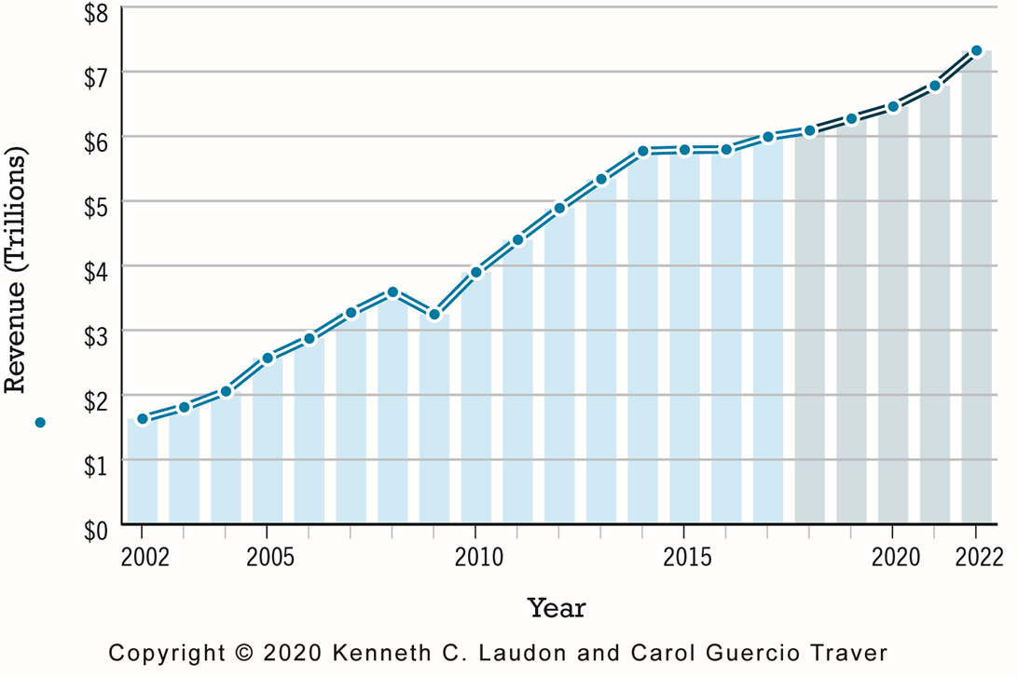
Figure 1.7 The Growth of B2B E-commerce in the United States
Notes:
Figure 1.7, Page 24.
B2B e-commerce in the United States is about 10 times the size of B2C e-commerce. In 2022, B2B e-commerce is projected to be reach around $7.3 trillion. (Note: Does not include EDI transactions.)
SOURCES: Based on data from U.S. Census Bureau, 2018b; authors’ estimates.
Full description: A graph shows the growth of B 2 B e-commerce in the United States between 2002 and 20 22, including some projected data. The x-axis shows years between 2002 and 20 22. The y-axis shows revenue in trillions of dollars, ranging from 0.0 to 8.0 in increments of 1.0. The graph shows the years and the corresponding revenue as follows: 2002, 1.8 trillion dollars. 2005, 2.6 trillion dollars. 20 10, 4.0 trillion dollars. 20 15, 5.8 trillion dollars. 20 20, 6.5 trillion dollars. 20 22, 7.4 trillion dollars. All data are approximate.

Slide 15
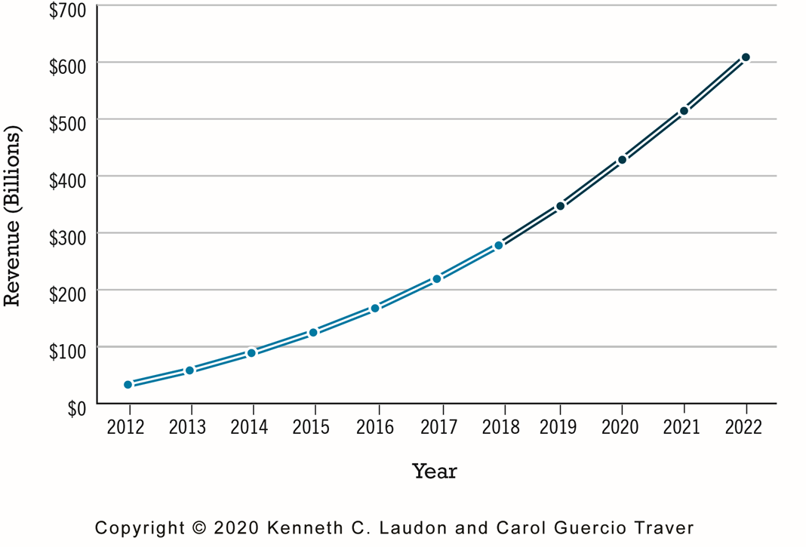
Figure 1.8 The Growth of M-commerce in the United States
Notes:
Figure 1.8, page 25.
In the last five years, m-commerce has increased astronomically, from just $32.8 billion in 2012 to almost $280 billion in 2018, and it is anticipated that it will continue to grow by over 20% a year over the next five years as consumers become more and more accustomed to using mobile devices to purchase products and services.
SOURCE: Based on data from eMarketer, Inc., 2018e, 2018f.
Full description: A graph shows the growth of m-commerce in the United States, with actual figures depicted for years 20 12 to 20 17, and projected figures for 20 18 to 20 22. The x-axis shows years from 20 12 to 20 22 in increments of 1 year. The y-axis shows revenue in billions of dollars, ranging from 0 to 700 in increments of 100. The graph shows the years and the corresponding revenue as follows: 20 12, 32.8 billion dollars. 20 13, 65 billion dollars. 20 14, 95 billion dollars. 20 15, 120 billion dollars. 20 16, 185 billion dollars. 20 17, 220 billion dollars. 20 18, 290 billion dollars. 20 19, 350 billion dollars. 20 20, 420 billion dollars. 20 21, 510 billion dollars. 20 22, 605 billion dollars. All values are in approximates only.

Slide 16
E-commerce: A Brief History (1 of 4)
Precursors
  Baxter Healthcare modem-based system
  Order entry systems
  Electronic Data Interchange (E D I) standards
  French Minitel

Slide 17
E-commerce: A Brief History (2 of 4)
1995–2000: Invention
  Sale of simple retail goods
  Limited bandwidth and media
  Euphoric visions of
    Friction-free commerce
    First-mover advantages
  Dot-com crash of 2000
Notes:
Additional concepts include disintermediation, monopoly profits, switching costs, network effects, disrupting traditional channels.

Slide 18
E-commerce: A Brief History (3 of 4)
2001–2006: Consolidation
  Emphasis on business-driven approach
  Traditional large firms expand presence
  Start-up financing shrinks
  More complex products and services sold
  Growth of search engine advertising
  Business web presences expand

Slide 19
E-commerce: A Brief History (4 of 4)
2007–Present: Reinvention
  Rapid growth of:
    Web 2.0, including online social networks
    Mobile platform
    Local commerce
    On-demand service economy
  Entertainment content develops as source of revenues
  Transformation of marketing

Slide 20
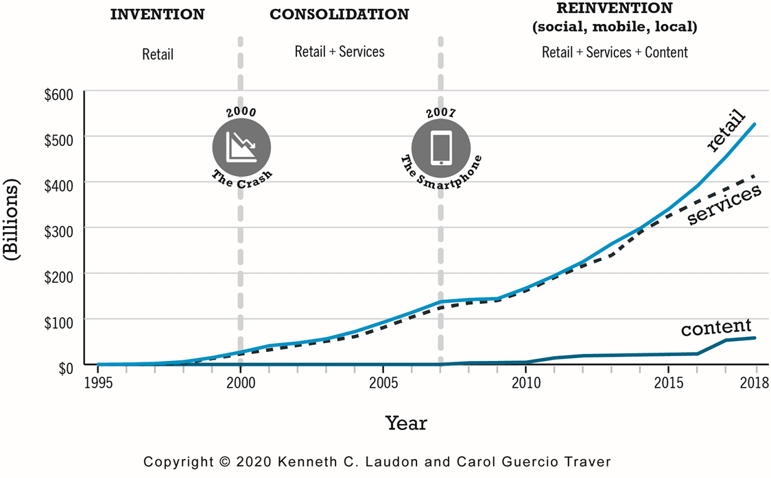
Figure 1.10 Periods in the Development of E-commerce
Notes:
Figure 1.10, page 28.
Full description: A graph shows the years 19 95 to 20 18 divided into three periods in the development of e-commerce, Invention, Consolidation, and Reinvention. The x-axis depicts years from 19 95 to 20 18 in increments of 5 years. The y-axis shows dollars in billions, ranging from 0 to 600 in increments of 100. The period from 19 95 to 2000 is labeled Invention, Retail. The period from 2001 to 2007 is labeled Consolidation, Retail and Services. The period from 2007 onward is labeled Reinvention, social, mobile, and local, Retail, Services, and Content. The graph labels 2000 the year of the crash and 2007 the year of the smartphone. A line curve labeled retail begins at zero from 19 95 onward and increases gradually after 19 98. It reaches around 140 billion in 2007 and then rapidly increases from there on to reach 530 billion by the year 20 18. Another line curve labeled services begins from the year 19 98 and increases gradually over the years, reaching around 100 billion in 2006 and ending at 405 billion in 20 18. A third line curve labeled content begins from the year 19 98 and remains near zero until 20 10. It then increases very slowly and reaches close to 80 billion in the year 20 18.

Slide 21
Insight on Business: Rocket Internet
Class Discussion
  What are the benefits of investing in a company that Rocket Internet has launched?
  Is an incubator the best solution for start-ups to find funding? Why or why not?
  Why is Rocket Internet controversial?

Slide 22
Assessing E-commerce (1 of 2)
Stunning technological success
Early years a mixed business success
  Few early dot-coms have survived
  Online sales growing rapidly
Many early visions not fulfilled
  Price dispersion
  Information asymmetry
  New intermediaries

Slide 23
Assessing E-commerce (2 of 2)
Other surprises
  Fast-follower advantages
  Start-up costs
  Impact of mobile platform
  Emergence of on-demand e-commerce

Slide 24
Understanding E-commerce: Organizing Themes
Technology:
  Development and mastery of digital computing and communications technology
Business:
  New technologies present businesses with new ways of organizing production and transacting business
Society:
  Intellectual property, individual privacy, public welfare policy

Slide 25
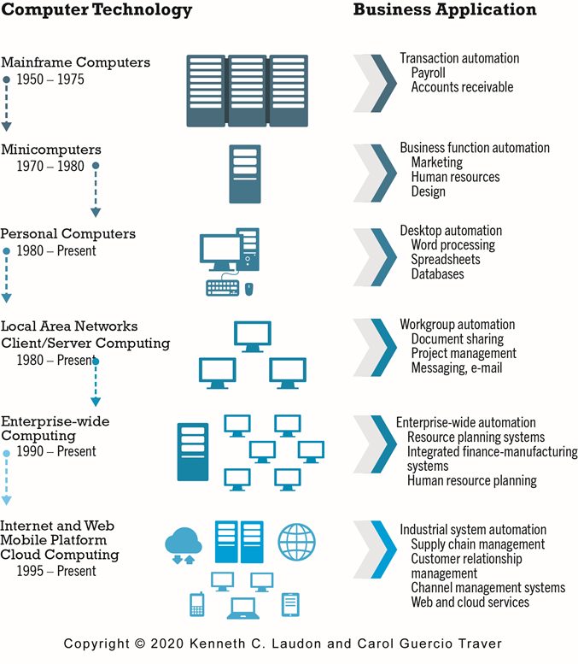
Figure 1.11 The Internet and the Evolution of Corporate Computing
Notes:
Figure 1.11, page 38.
The Internet and Web, and the emergence of a mobile platform held together by the Internet cloud, are the latest in a chain of evolving technologies and related business applications, each of which builds on its predecessors.
Full description: A figure illustrates the major stages in the development of corporate computing and the role of the Internet in this evolution. There are two columns. One column contains each category of computer technology and the years in use. The other contains business applications. The information is as follows. Mainframe computers were in use predominantly from 19 50 to 19 75, and were used for transaction automation applications such as payroll, and accounts receivable. Minicomputers were in use predominantly from 19 70 to 19 75, and were used for business function automation applications such as marketing, human resources, and design. Personal computers have been used since 19 80 to the present, and are used for desktop automation business applications such as word processing, spreadsheets, and databases. Local area networks, which includes client and server computing, have been used since 19 80 to the present, and are used for workgroup automation business applications such as document sharing, project management, messaging, and e-mail. Enterprise-wide computing has been in use since 19 90 to the present, and is used for enterprise-wide automation business applications such as resource planning systems, integrated finance manufacturing systems, and human resource planning. Internet and Web, which includes mobile platform and cloud computing, has been in use since 19 95 to the present, and is used for industrial system automation business applications such as supply chain management, customer relationship management, channel management systems, and web and cloud services.

Slide 26
Insight on Society: Facebook and the Age of Privacy
Class discussion:
  Why are social networks interested in collecting user information?
  What types of privacy invasion are described in the case? Which is the most privacy-invading, and why?
  How is e-commerce different from traditional markets with respect to privacy? Don’t merchants always want to know their customer?
  How do you protect your privacy online?

Slide 27
Academic Disciplines Concerned with Technology
Technical
  Computer science, management science, information systems
Behavioral
  Information systems research, economics, marketing, management, finance/accounting, sociology

Slide 28
Careers in E-commerce
Position: Category specialist in E-commerce Retail Program
Qualification/Skills
Preparing for the Interview
Possible Interview Questions

Slide 29
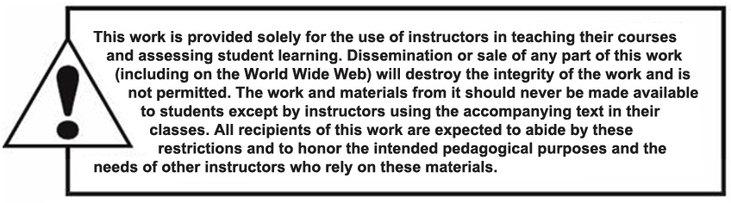
Copyright

