Slide 1
New Technologies for Business
Fatih Koç

Slide 2
Space Tech
Orbital Economy
Out of Earth times: Commercialized Space:
Ethics Approach:
Bill Gates: Should we spend money on Earth more than space? Is it necessary?
https://www.spacecapital.com/
https://app.powerbi.com/view?r=eyJrIjoiNGY4MWI4OWEtMjNmZS00OTM3LWE5M2QtYTgxZTdjODk3YTllIiwidCI6IjYzMDZkMTJjLTEwODMtNGNhOS04Yjk2LTdjYzM3ODcwMWIzMiIsImMiOjN9

Slide 3
SpaceX Starlink Project
Starlink is a satellite internet constellation operated by SpaceX providing satellite Internet access to most of the Earth.
The constellation consists of over 1600 satellites in mid-2021, and will eventually consist of many thousands of mass-produced small satellites in low Earth orbit (LEO), which communicate with designated ground transceivers.
While the technical possibility of satellite internet service covers most of the global population, actual service can be delivered only in countries that have licensed SpaceX to provide service within any specific national jurisdiction. As of November 2021, the beta service offering is available in 21 countries.
USA, Canada, United Kingdom, Germany, New Zealand, Australia, Austria, France, Netherlands, Belgium, Denmark, Ireland, Switzerland, Portugal, Chile, Poland, Italy, Czech Republic, Mexico, Sweden and Croatia.

Slide 4
SpaceX Starlink Project
The cost of the decade-long project to design, build, and deploy the constellation was estimated by SpaceX in May 2018 to be at least US$10 billion.
On 15 October 2019, the United States Federal Communications Commission (FCC) submitted filings to the International Telecommunication Union (ITU) on SpaceX's behalf to arrange spectrum for 30,000 additional Starlink satellites to supplement the 12,000 Starlink satellites already approved by the FCC.
By 2021, SpaceX had entered into agreements with Google Cloud Platform and Microsoft Azure to provide on-ground compute and networking services for Starlink

Slide 5
Starlink Criticisms
Astronomers have raised concerns about the constellations' effect on ground-based astronomy and how the satellites will add to an already jammed orbital environment.
SpaceX has attempted to mitigate these concerns by implementing several upgrades to Starlink satellites aimed at reducing their brightness during operation.
The satellites are equipped with krypton-fueled Hall thrusters which allow them to de-orbit at the end of their life. Additionally, the satellites are designed to autonomously avoid collisions based on uplinked tracking data.

Slide 6
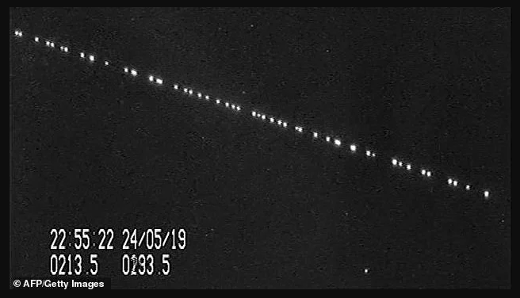
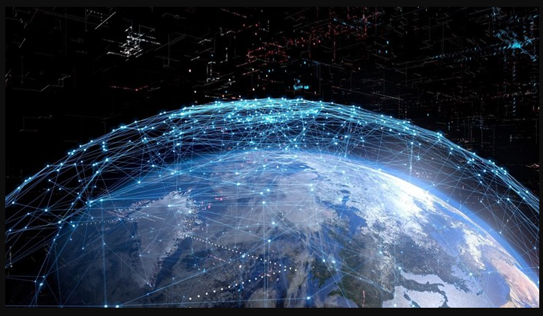
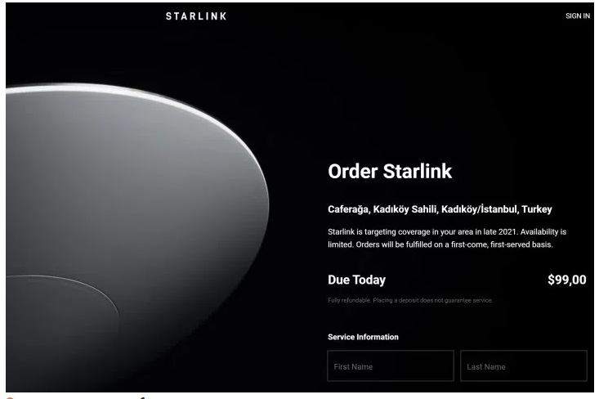
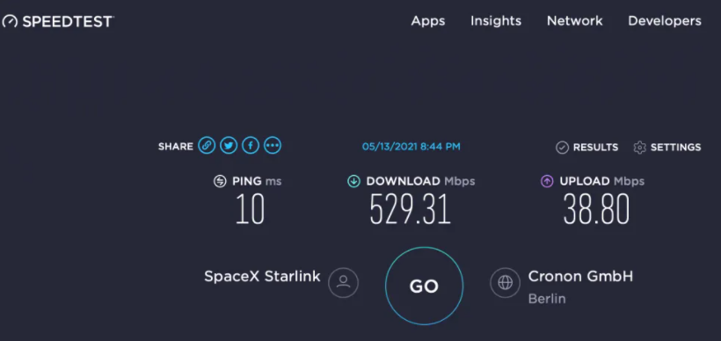

Slide 7
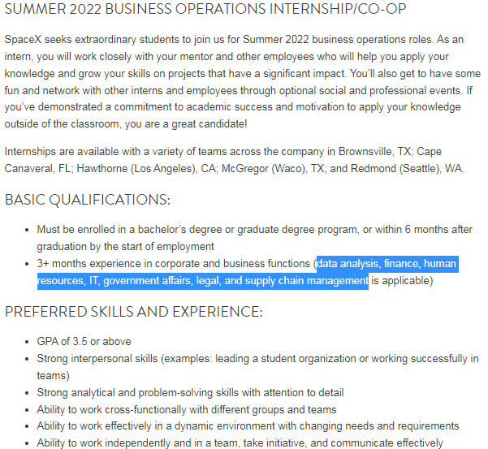
SpaceX Internship Opportunity
https://boards.greenhouse.io/spacex/jobs/5526161002?gh_jid=5526161002

Slide 8
James Webb Telescope
The James Webb Space Telescope (JWST) is a space telescope being jointly developed by NASA, the European Space Agency (ESA), and the Canadian Space Agency (CSA). It is planned to succeed the Hubble Space Telescope as NASA's Flagship astrophysics mission
Will provide improved infrared resolution and sensitivity over Hubble, and will enable a broad range of investigations across the fields of astronomy and cosmology, including observing some of the most distant events and objects in the universe, such as the formation of the first galaxies, and detailed atmospheric characterization of potentially habitable exoplanets.

Slide 9
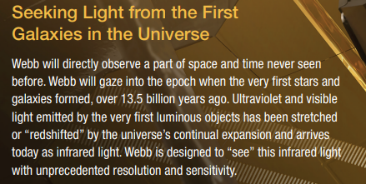
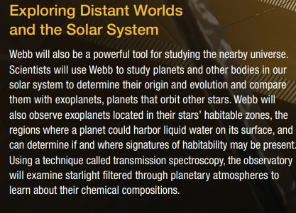
James Webb Space Telescope

Slide 10
James Webb Space Telescope
About one million miles away from Earth and undergo six months of commissioning in space—unfolding its mirrors, sunshield, and other smaller systems; cooling down; aligning; and calibrating.
Astronomers worldwide will then be able to conduct scientific observations to broaden our understanding of the universe. Webb will also complement the science achieved by other NASA missions.

Slide 11
Double Slit Experiment
What is QUANTUM PHYSICS?
Put simply, it's the physics that explains how everything works: (PoE = Physics of Everything)
The best description we have of the nature of the particles that make up matter and the forces with which they interact. Quantum physics underlies how atoms work, and so why chemistry and biology work as they do.

Slide 12
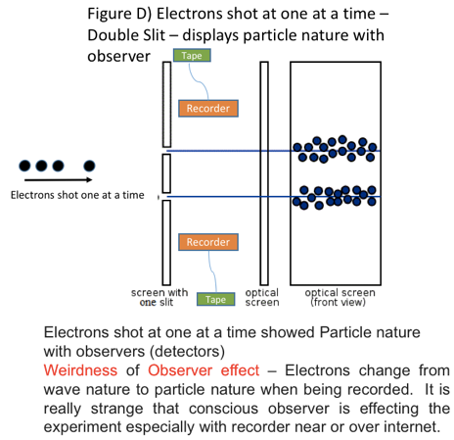
Double Slit Experiment

Slide 13
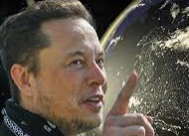
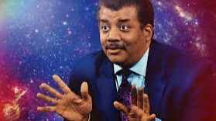
Simulation Theory
Elon Musk: we are living in a reality with a chance of 0,01%
Neil deGrasse Tyson: it's 'very likely' the universe is a simulation.
What is simulation theory?
Is it realistic?
Are there any proofs?
Are we real?
Who cares reality?

Slide 14
Simulation Theory
Imagine the metaverse, and the computers changing rapidly in 30 to 40 years. Even they can simulate universe.
Blind people’s vision view.
Mind controlled arm robot control:
https://youtu.be/rSQNi5sAwuc
In other words, it will be inevitable that all these technologies will come together in the not-too-distant future to enable simulations that can fool our brains perfectly.
The superhuman universe: universe created from hyper-realistic computer simulations

Slide 15
Simulation Theory
3 Assumptions:
1- Everything in the Universe Must Be Simulated
2- Man's Place in the Universe Should Not Be Special
3- Technology Should Not Progress in a Destructive Direction
That is all realted with the evolution of human.
If they are all true we can be in a simulation…

Slide 16
Simulation Theory
Perhaps we are even simulating the histories of even more superintelligent species that will emerge in our evolutionary future. This is similar to the simulations we run to see how the genes of our ape ancestors evolved. If this is true, you, we, everyone and everything are just computer code.
This argument was written by the Swedish philosopher Nick Bostrom (Swedish: Niklas Boström) at Oxford University in 2001 and published in 2003, "Do You Live in a Computer Simulation?" It was suggested in the article titled.

Slide 17
Simulation Theory
In his article, Bostrom says that the probability of one of the following 3 possibilities to be true is very close to 100%:
Probability-1: The proportion of human-level civilizations that can reach the transhuman stage is very low.
theoretical impossibilities, technological inadequacies, practical problems, the evolutionary limit of intelligence, wars, massacres and more...

Slide 18
Simulation Theory
Probabibility-2: Civilizations that have reached the posthuman stage are not interested in creating simulations of their own evolutionary history for some reason.
For example, considering the number of extremely distressing evils on Earth, they may not want to be responsible for them and may avoid simulations for a supreme ethical reason.

Slide 19
Simulation Theory
Probability 3: We are the Product of a Simulation!
Double Slit Experiment: At the quantum scale, there is a problem called the measurement problem, where events become defined only when they are observed or measured. (processing power)
Planck Distance and the Planck Time:
Pixelation Problem
Deja vu and Other Mental/Physical Problems:
Matrix Phenomena

Slide 20
Simulation Theory - Criticism
Sean Caroll argues that if you have a hierarchy of (Inception-like) realities in which each simulation launches its own simulation, then there would be a reduction in computational ability at each subsequent level. This means that each simulated universe would be simpler than the universe in which it was created.
So, while you would still be able to produce simulations, and presumably even very impressive simulations, the lowest levels in these wouldn’t have the sophistication to host truly conscious entities. There is the possibility, nonetheless, according to Carroll, that we live in one of these “low levels of reality”.

Slide 21
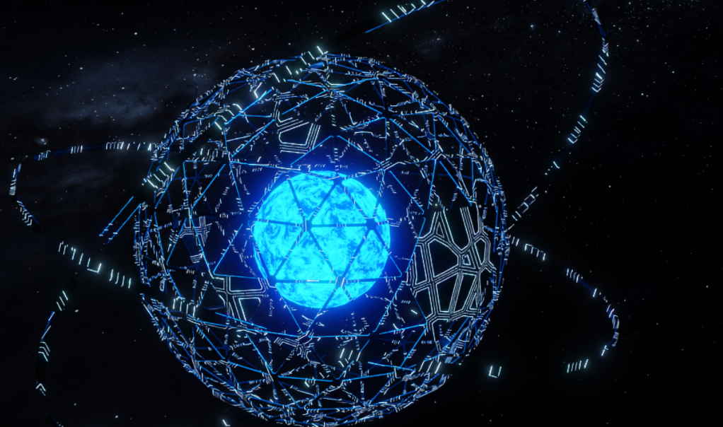
Simulation Theory – Criticism to Criticism
Dyson Sphere:
Using the Dyson Sphere, it is possible to make available all the thermonuclear energy of stars.
That's enough energy to create hyperrealistic simulations for an intergalactic civilization.

Slide 22
Kardashev Scales
The Kardashev scale has three designated categories, these are:
A Type I civilization, also called a planetary civilization, can use and store all of the energy available on its planet.
A Type II civilization, also called a stellar civilization, can use and control energy at the scale of its planetary system.
A Type III civilization, also called a galactic civilization, can control energy at the scale of its entire host galaxy.

Slide 23
Current status of human civilization
Where value K is a civilization's Kardashev rating and P is the power it uses, in watts
In 2019, the total world energy consumption was 14864.9 Mtoe (175,249 TWh), equivalent to an average power consumption of 20.0 TW or 0.73 on Sagan's interpolated Kardashev scale.
K = 0.73

