Slide 1
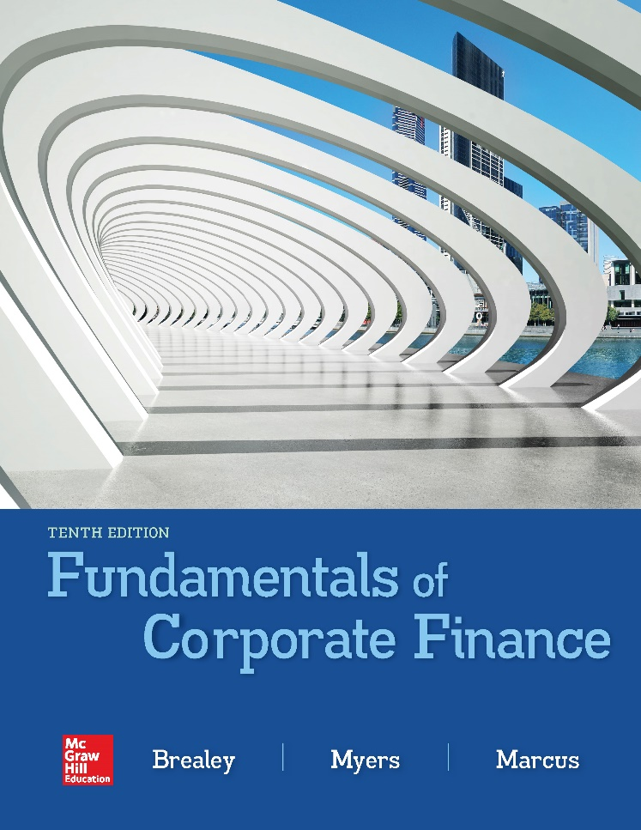

Slide 2
Topics Covered
12.1 Measuring Market Risk
12.2 What Can You Learn from Beta?
12.3 Risk and Return
12.4 The CAPM and the Opportunity Cost of Capital
Notes:
2

Slide 3
Measuring Market Risk (1 of 5)
Market Portfolio
Portfolio of all assets in the economy
In practice a broad stock market index is used to represent the market
Beta
Sensitivity of a stock’s return to the return on the market portfolio
Notes:
3

Slide 4
Measuring Market Risk (2 of 5)
Example
Turbot-Charged Seafoods has the following % returns on its stock, relative to the listed changes in the % return on the market portfolio. The beta of Turbot-Charged Seafoods can be derived from this information.
Notes:
4

Slide 5
Measuring Market Risk (3 of 5)
Example (continued)
Month | Market Return % | Turbot Return %
1 | +1 | +0.8
2 | +1 | +1.8
3 | +1 | −0.2
4 | −1 | −1.8
5 | −1 | +0.2
6 | −1 | −0.8
Notes:
5

Slide 6
Measuring Market Risk (4 of 5)
Example (continued)
When the market was up 1%, Turbot’s average % change was +0.8%
When the market was down 1%, Turbot’s average % change was -0.8%
The average change of 1.6 % (-0.8 to 0.8) divided by the 2% (-1.0 to 1.0) change in the market produces a beta of 0.8
$$β=\frac{1.6}{2}=0.8$$
Notes:
7

Slide 7
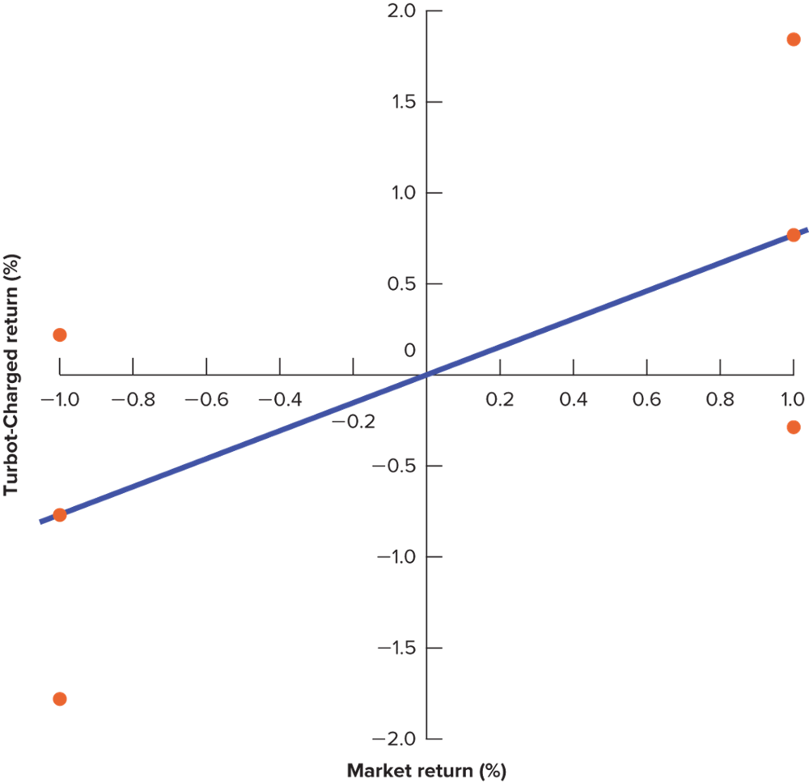
Measuring Market Risk (5 of 5)
Example (continued)
Notes:
8

Slide 8
Portfolio Betas (1 of 5)
Diversification decreases variability from unique risk, but not from market risk
The beta of your portfolio will be an average of the betas of the securities in the portfolio
If you owned all of the S&P Composite Index stocks, you would have an average beta of 1.0
Notes:
9

Slide 9
Portfolio Betas (2 of 5)
β
Betas calculated with price data from January 2013 thru December 2017
Notes:
9

Slide 10
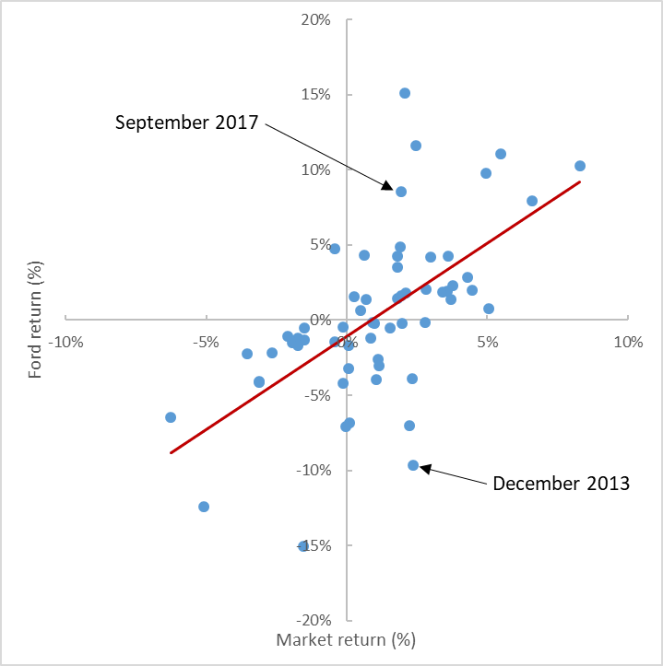
Portfolio Betas (3 of 5)
β
Notes:
9

Slide 11
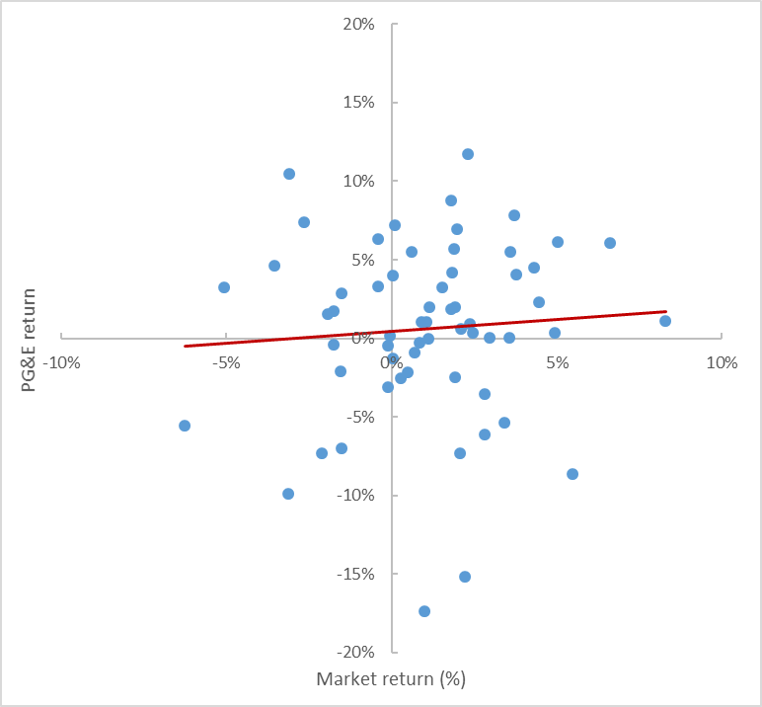
Portfolio Betas (4 of 5)
β
Notes:
9

Slide 12
Portfolio Betas (5 of 5)
$$Portfolio beta=\left(fraction of portfolio in stock 1×beta of stock 1\right)+\left(fraction of portfolio in stock 2×beta of stock 2\right)$$

Slide 13
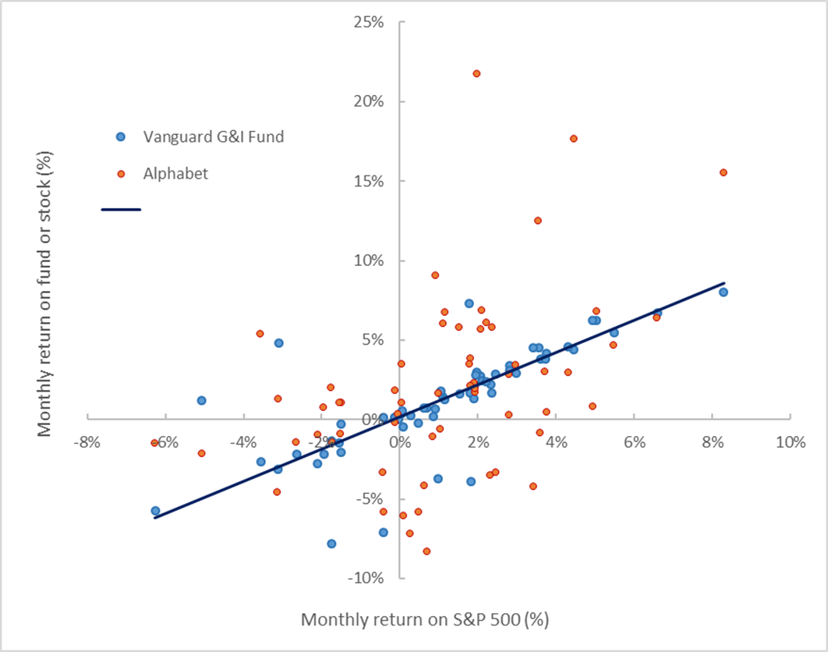
Risk and Return (1 of 6)

Slide 14
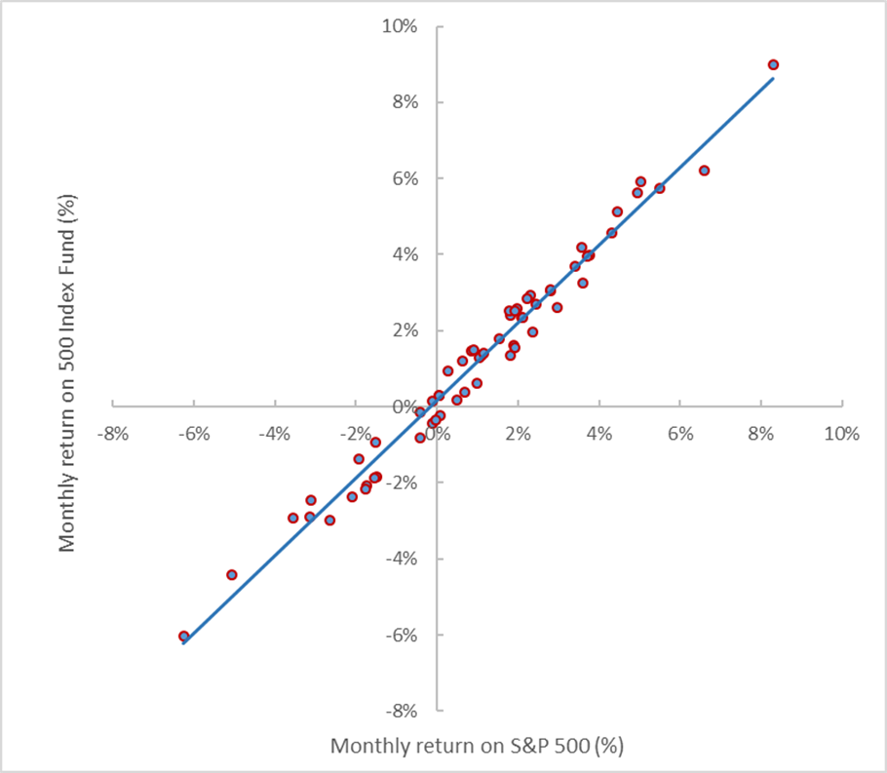
Risk and Return (2 of 6)

Slide 15
Risk and Return (3 of 6)
Market Risk Premium
Difference between market return and return on risk-free Treasury bills.
Market Portfolio
Notes:
11

Slide 16
Risk and Return (4 of 6)
CAPM
Theory of the relationship between risk and return which states that the expected risk premium on any security equals its beta times the market risk premium
Market risk premium = rm - rf
Risk premium on any asset = r - rf
Expected return = rf + β(rm - rf)
Notes:
13

Slide 17
Risk and Return (5 of 6)
Example
The return on the stock market is 10% and the risk free rate of return is 3%. What is the risk premium for a stock that has a beta of 0.5? What is the expected return of the stock?
Market risk premium = rm - rf = .10 - .03 = .07
Risk premium on any asset = r - rf = .5 × .07 = .035
Expected return = rf + β(rm - rf) = .03 + .035 = .065
Notes:
13

Slide 18
Risk and Return (6 of 6)
Example (continued)
Graph the stock as well as a stock with a beta of .2 and the market portfolio
Notes:
15

Slide 19
Capital Asset Pricing Model
R = r_{f} + β(r_{m} - r_{f})
CAPM

Slide 20
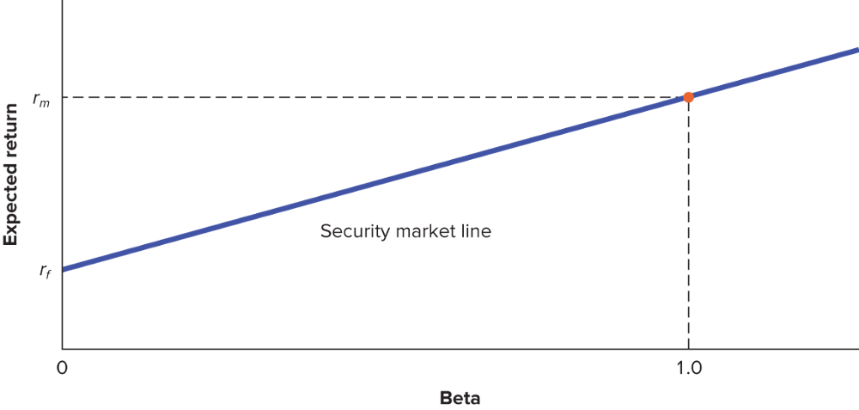
Security Market Line
SML equation = r_{f} + β(r_{m} - r_{f})

Slide 21
Stock Expected Returns
E(r)
Notes:
9

Slide 22
Testing the CAPM (1 of 2)
Beta vs. Average Risk Premium
Avg Risk Premium 1931-2017
30
20
10
0
Investors
SML
Market Portfolio
Portfolio Beta
1.0

Slide 23
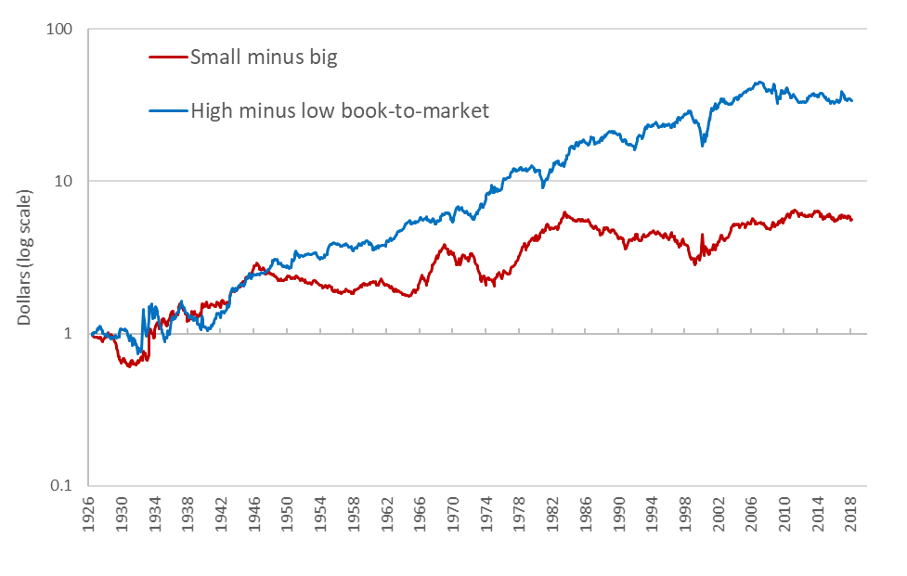
Testing the CAPM (2 of 2)
Return vs. Book-to-Market

Slide 24
Capital Budgeting and Project Risk (1 of 3)
The project cost of capital depends on the use to which the capital is being put
Therefore, it depends on the risk of the project and not the risk of the company
Company cost of capital
Opportunity cost of capital for investment in the firm as a whole
The company cost of capital is the appropriate discount rate for an average-risk investment project undertaken by the firm
Notes:
16

Slide 25
Capital Budgeting and Project Risk (2 of 3)
Example
Based on the CAPM, ABC Company has a cost of capital of 17%. [4 + 1.3(10)]. A breakdown of the company’s investment projects is listed below. When evaluating a new dog food production investment, which cost of capital should be used?
1/3 nuclear parts mfr. β = 2.0
1/3 computer hard drive mfr. β = 1.3
1/3 dog food production β = 0.6
Average β of assets = 1.3
Notes:
19

Slide 26
Capital Budgeting and Project Risk (3 of 3)
Example
Based on the CAPM, ABC Company has a cost of capital of 17%. [4 + 1.3(10)]. A breakdown of the company’s investment projects is listed below. When evaluating a new dog food production investment, which cost of capital should be used?
r = 4 + 0.6(14 - 4) = 10%
10% reflects the opportunity cost of capital on an investment given the unique risk of the project
Notes:
20

