Slide 1
Pricing Strategies

Slide 2
Objectives
Describe the three alternative pricing strategies and when each strategy is most appropriate (best to employ).
Explain how prices are quoted/stated.
Identify the five pricing policy decisions marketers must make.
Discuss the relationship of price to consumer perceptions of quality.

Slide 3
Objectives
Contrast competitive bidding/offering and negotiated prices.
Explain the importance of transfer pricing.
Compare the three alternative global pricing strategies.
Relate the concepts of cannibalization (to take sales away from an existing product by selling or being sold as a similar but new product usually from the same manufacturer), bundle /package pricing, and bots* to online pricing strategies.
*A shopping bot is an online price comparison software tool which automatically searches the products of many different online stores to locate the most affordable rates for customers.

Slide 4
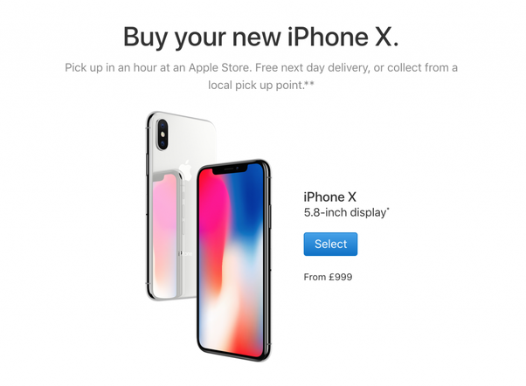
Skimming/creaming off Pricing Strategy
- Use of a high price relative to competitive offerings
- Commonly used as a market entry price for distinctive goods or services with little or no initial competition
- Permits marketers to control demand but also attracts competitors

Slide 5
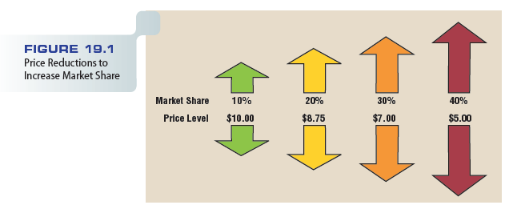
Figure 19.1 – Price Reductions to Increase Market Share

Slide 6
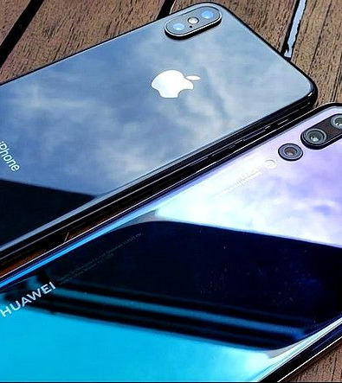
Penetration Pricing Strategy
Use of a relatively low entry price compared with competitive offerings
Price level may increase to match competitors, once the product has recognition/awareness in the market
Sometimes called market-minus pricing

Slide 7
Penetration Pricing Strategy
Works best for goods and services that have:
Highly elastic demand
Low production and marketing costs
A high likelihood/probability of attracting/alluring strong competitors

Slide 8
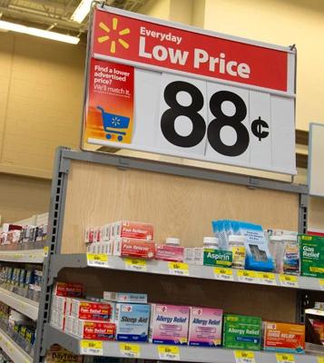
Everyday Low Pricing (EDLP)
Strategy devoted to continuous low prices as opposed to relying on short-term, price-cutting tactics
Example – Walmart’s, A101
Used by retailers selling to consumers and by manufacturers in dealing with channel members
Grocery stores, oppose EDLP strategies

Slide 9
Everyday Low Pricing (EDLP)
Disadvantages of EDLP:
Easy for competitors to match
Unless demand is elastic, reduces/lowers revenue throughout industry
May generate image of questionable quality

Slide 10
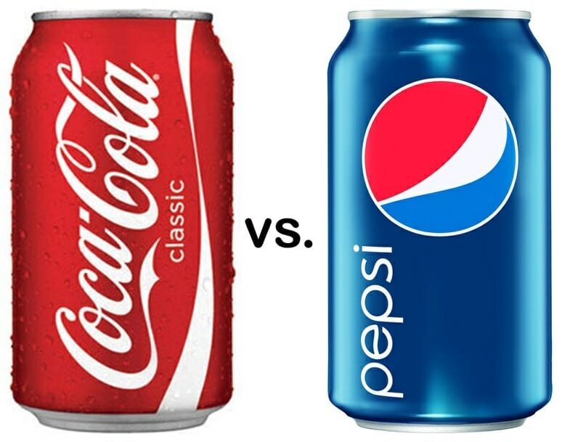
Competitive Pricing Strategy
Designed to deemphasize/ understate price as a competitive variable by pricing a good or service at the level of comparable offerings

Slide 11
Competitive Pricing Strategy
Opening price point - Setting an opening price below that of the competition
Example – Exxen
Prices can drop when competitors continually match each other
Forces firms to compete based on nonprice variable in the marketing mix

Slide 12
Price Quotations
List price - Established price normally quoted to potential buyers
Reductions from list price
Market price - Price a consumer or marketing intermediary pays for a product after subtracting/deducting any discounts, allowances/cuts, or rebates/givebacks from the list price

Slide 13
Reductions from List Price
Cash discount - Price reduction offered to a consumer, business user, or marketing intermediary in return for prompt payment of a bill
Trade discount - Payment to a channel member or buyer for performing marketing functions

Slide 14
Reductions from List Price
Quantity discount - Price reduction granted for a large-volume purchase
Cumulative quantity discount - Price discount determined by amounts of purchases over stated time periods
Noncumulative quantity discount - Price reduction granted on a one-time-only basis

Slide 15
Reductions from List Price
Allowance/cut - Specified deduction from list price, including a trade-in or promotional allowance
Trade-in
Promotional allowance
Minimum advertised pricing (MAP)
Rebate

Slide 16
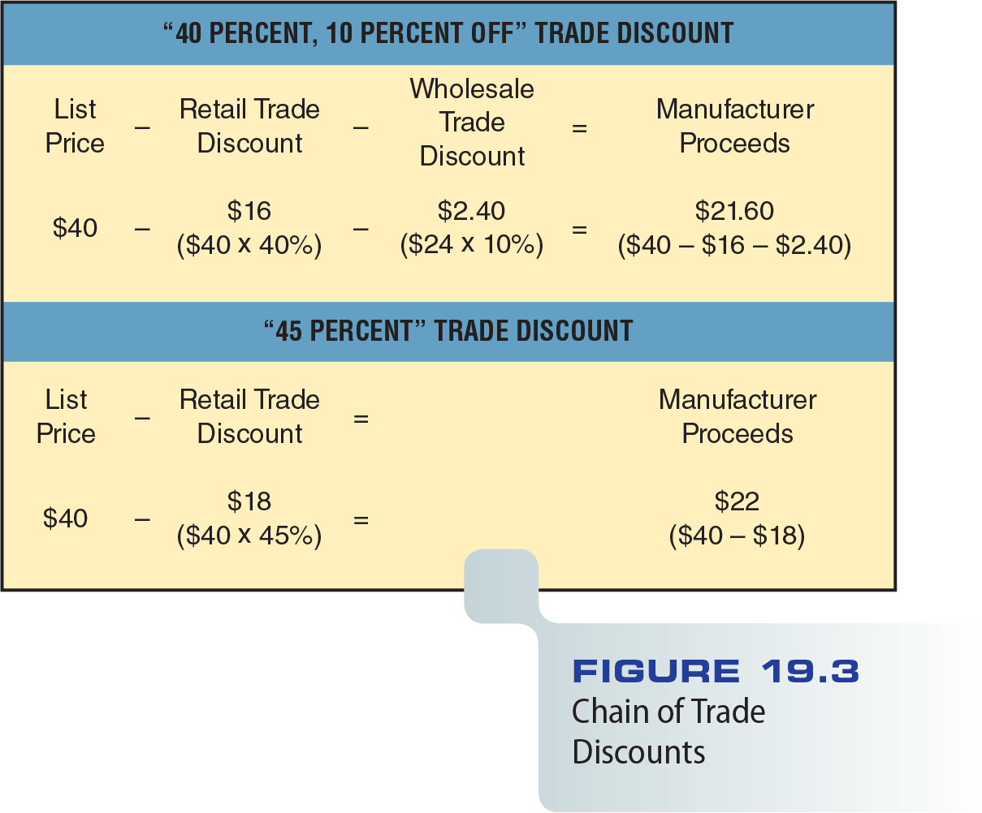
Figure 19.3 – Chain of Trade Discounts

Slide 17
Geographic Considerations
Strongly influences a firm’s ability/ capability to deliver orders in a cost-effective manner at the right time and place
Affects the marketer’s ability to receive additional inventory quickly in response to demand fluctuations/changes
Three ways to handle transportation costs: buyer pays, seller pays, or both share costs

Slide 18
FOB Pricing
Free on board plant or FOB origin - Does not include shipping charges refers to CFR (cost and freight) too.
FOB origin-freight allowed, or freight absorbed - Allows the buyer to deduct shipping expenses from the cost of purchases??? BUYER assumes the freight cost.

Slide 19
Uniform-Delivered Pricing
Firm quotes the same price, including transportation expenses, to all buyers – regardless of the geographic location.
Includes transportation charge averaged over all customers
Nearby customers pay disproportionate (unfair) freight charges, so-called phantom-freight (no freight charges).

Slide 20
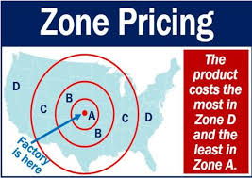
Zone Pricing
Dividing the overall market into different zones and establishing a single price within each zone

Slide 21
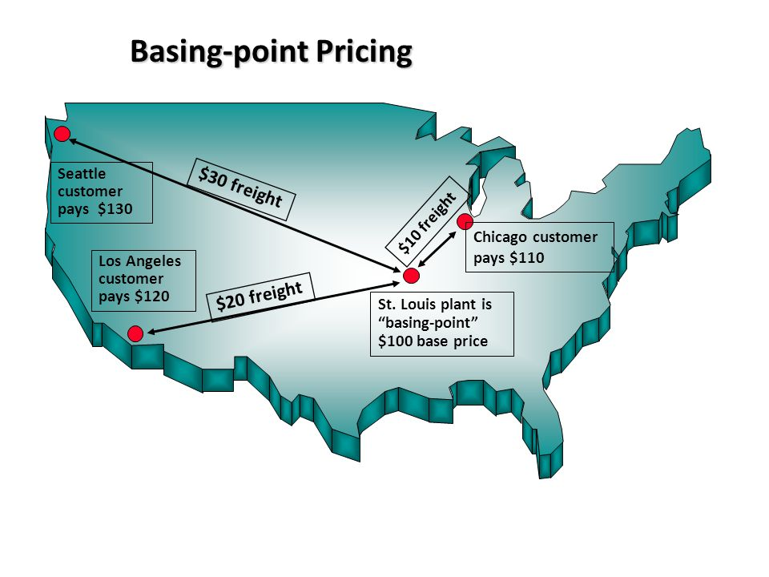
Basing-Point Pricing
- The buyer pays the factory price plus freight charges from the basing-point city nearest the buyer
- The basing point specifies a location from which freight charges are calculated

Slide 22
Psychological Pricing
Belief that certain price ranges make a good or service more appealing than others to buyers. Includes prestige pricing
Odd pricing - Setting prices at odd numbers just under round numbers
Unit pricing - Prices stated in terms of some recognized unit of measurement or a standard numerical count

Slide 23
Price Flexibility
Pricing policy permitting variable prices for goods and services
One-price policies suit mass-selling marketing programs
Variable pricing is more likely to be applied in marketing programs based on individual bargaining

Slide 24
Product-Line Pricing
- Practice/applying of setting/fixing a limited number of prices for a selection of merchandise and marketing different product lines at each of these price levels
- Helps retailers differentiate product lines
Retailers may have difficulty making price changes on individual items as necessary

Slide 25
Promotional Pricing
Pricing policy in which a lower-than-normal price is used as a temporary ingredient/input in a firm’s marketing strategy

Slide 26
Loss Leaders and Leader Pricing
Loss leader - Product offered to consumers at less than cost to attract them to stores in the hope that they will buy other merchandise at regular prices
Leader pricing – Variant/form of loss-leader pricing in which marketers offer prices slightly above cost
To avoid violating minimum-markup regulations and earn a minimal return on promotional sales

Slide 27
Price-Quality Relationships
Price affects consumer perception of quality
Customers often associate prestige with high prices
Many consumers are willing to pay more for ecofriendly products
Consumers have maximum and minimum price limits

Slide 28
Competitive Bidding and Negotiated prices
Competitive bidding - Inviting potential suppliers to quote prices on proposed purchases or contracts
Negotiating prices online
Online auctions are the purest form of online bidding

Slide 29
The Transfer Pricing Dilemma
Transfer price - The price for moving goods between profit centers (headoffice-affiliates).
Profit centers - Any part of the organization to which revenue and controllable costs can be assigned/allocated
Governments monitor transfer pricing because it can be used by companies to avoid paying taxes on profits

Slide 30
Figure 19.4 – Transfer Pricing to Escape/avoid Taxation

Slide 31
Traditional Global Pricing Strategies
Standard worldwide pricing - Can succeed if foreign marketing costs remain low or if their prices reflect average unit costs

Slide 32
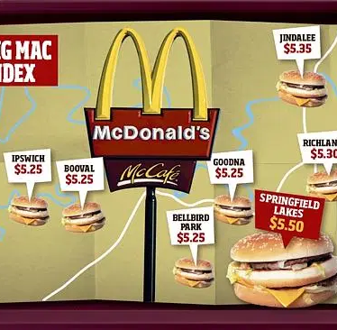
Traditional Global Pricing Strategies
Dual pricing - Distinguishes prices for domestic and export sales (be aware of dumping claims !)
Market-differentiated pricing - Setting prices according to local market conditions

Slide 33
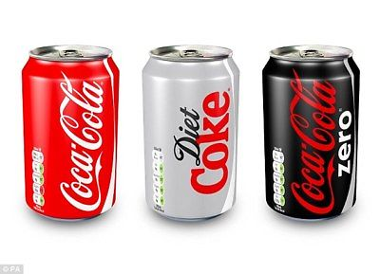
The Cannibalization Dilemma
Cannibalization - Loss of sales of an existing product due to competition from a new product in the same line

Slide 34
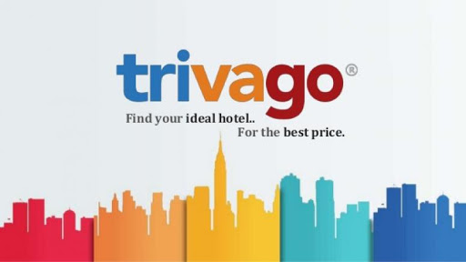
Use of Shopbots
Search programs that act as comparison shopping agents
Also called bots
Force online marketers to keep the prices low
cimri.com

Slide 35
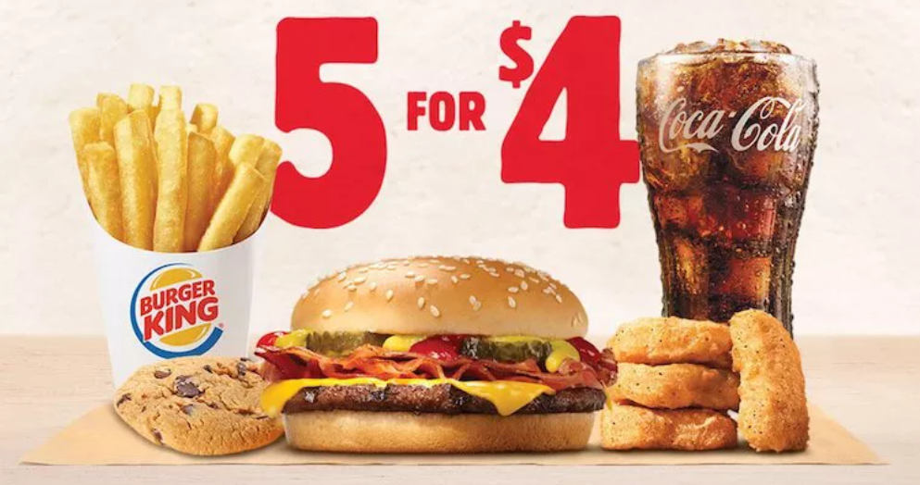
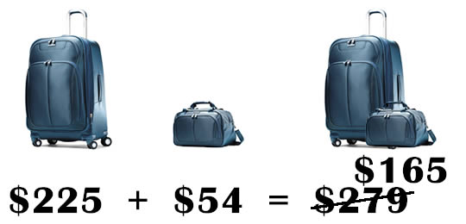
Bundle Pricing
Offering two or more complementary/supplementary products and selling them for a single price
Prevalent/common in the telecommunications industry
Consumers may resist/oppose the practice of bundling claiming they are being forced to pay for products they don’t want

Slide 36
BoltBus Video
http://www.cengage.com/marketing/book_content/boone_9781133628460/videos/ch19.html
Scripps Networks Interactive & Food Network Video
http://www.cengage.com/marketing/book_content/boone_9781133628460/videos/part7.html

