Slide 1
HAVE TO / HAS TO

Slide 3
Positive Form
I have to do something = It’s necessary to do it.
You have to wear uniform in this school. (because of the school rules)
Gary starts work at 5 a.m. He has to get up at four.
I have to wear glasses for reading.
She has to go work on time.
In Britain, you have to drive on the left.(because of the traffic laws)

Slide 4
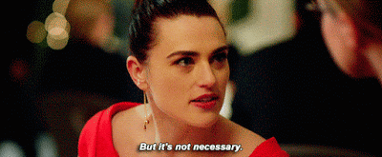
Negative Form
I don’t have to go work on time on Sunday.
The concert is for free, Jack doesn’t have to pay.
They don’t have to clean the house. (It’s not necessary)
The party is informal. We don’t have to wear a suit.
She doesn't have to read "War and Peace." It's optional reading for extra credit.

Slide 5
Question Form
Do they have to hand in their homework tomorrow?
+Yes, they do. /- No, they don’t.
Does he have to go?
+Yes, he does. /- No, he doesn’t.
Does she have to take this medicine?
+Yes, she does./ -No, she doesn’t.
Do you have to get up at 7 o’clock?
+Yes, I do. / -No, I don’t.

Slide 6
Warning!
Sometimes ‘you’ means everybody or people generally.
A: Do you have to wear suit for this party?
B: Yes, you do. (Yes, I do.WRONG!)
A: Do you have to get an account to read the article?
B: No you don’t.

Slide 7
MORE EXAMPLES!!

Slide 8
Examples:
1. In England, most schoolchildren have to wear a uniform.
2. John has to wear a tie at work.
3. I don’t have to take the bus to work, I can walk.
4. She has to read four books for this literature class.

Slide 9
Examples:
5. Jane has to finish the first book before the midterm.
6. Susan and Steve have to pay their rent every Friday.
7. Mike can’t come because he has to work tomorrow.
8. It’s Saturday night. Jason doesn’t have to go to bed early tonight.

Slide 10
THANK YOU!
Let’s do more practice☺
https://wordwall.net/tr/resource/24924400/have-to-dont-have-to

