Slide 1
Descriptive statistics Part 1
Or, how to throw away most of your data – but keep the message
Chapter 1

Slide 2
What is the relationship between employment status and education?
Are more highly educated people more likely to be employed?
Do you need a degree or just A-levels (school leaving certificate)?
How much more likely to be unemployed are you if you have no qualification?
Let’s look at some data and try to answer those questions

Slide 3
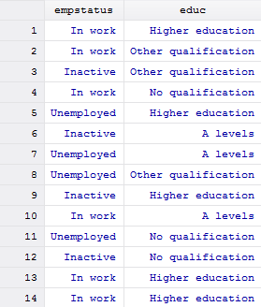
The raw data
For each person we record their employment status and educational attainment
37,789 observations in sample (75,578 cells!)
Big survey, lots of observations. Too many to digest, we cannot see anything with the data in this form
Start by a cross-tabulating the data…

Slide 4
Cross-tabulation
Table 1.1 Economic status and educational qualifications, 2009 (numbers in 000s)
Source: Adapted from Department for Children, Schools and Families, Education and Training Statistics for the UK 2009, http://dera.ioe.ac.uk/15353/, contains public sector information licensed under the Open Government Licence (OGL)v3.0. http://www.nationalarchives.gov.uk/doc/open-government-licence/open-government
Better:
About 72% in work (27,330/37,789)
Largest group of employed have ‘Other qualifications’
But still hard to see the patterns.
Draw a chart of the ‘In work’ category…

Slide 5
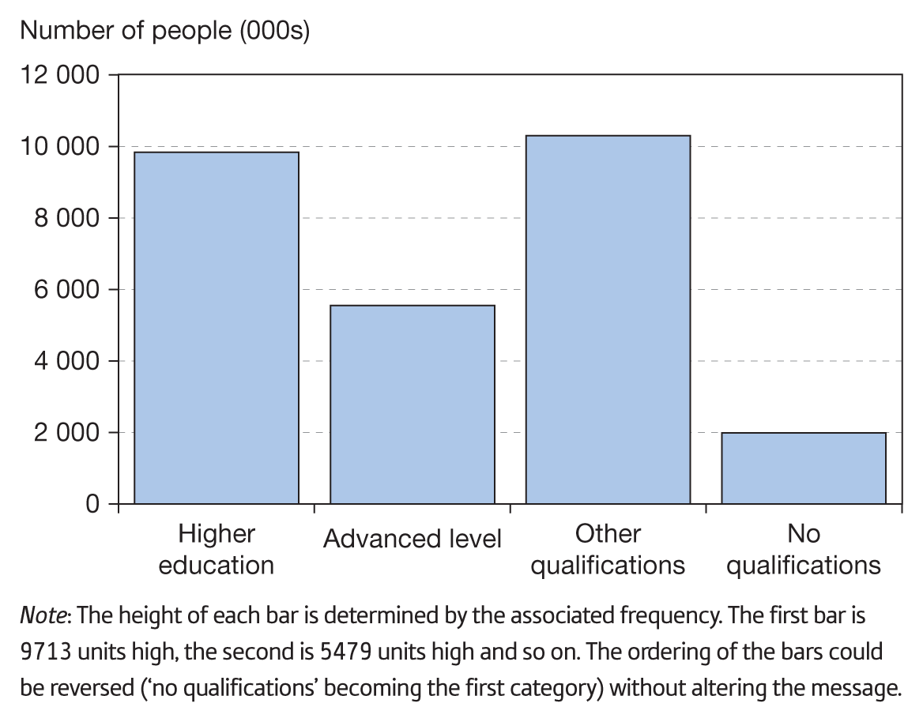
Bar chart of the ‘In work’ category
Figure 1.1 Educational qualifications of people in work in the United Kingdom, 2009
We begin to see patterns
Roughly equal numbers with higher education or other qualifications
Not many unemployed amongst this group
Yet we still do not see much…
What about those unemployed or inactive?
How do they compare to this group?
Can we draw all three groups (employment status) on the same chart?

Slide 6
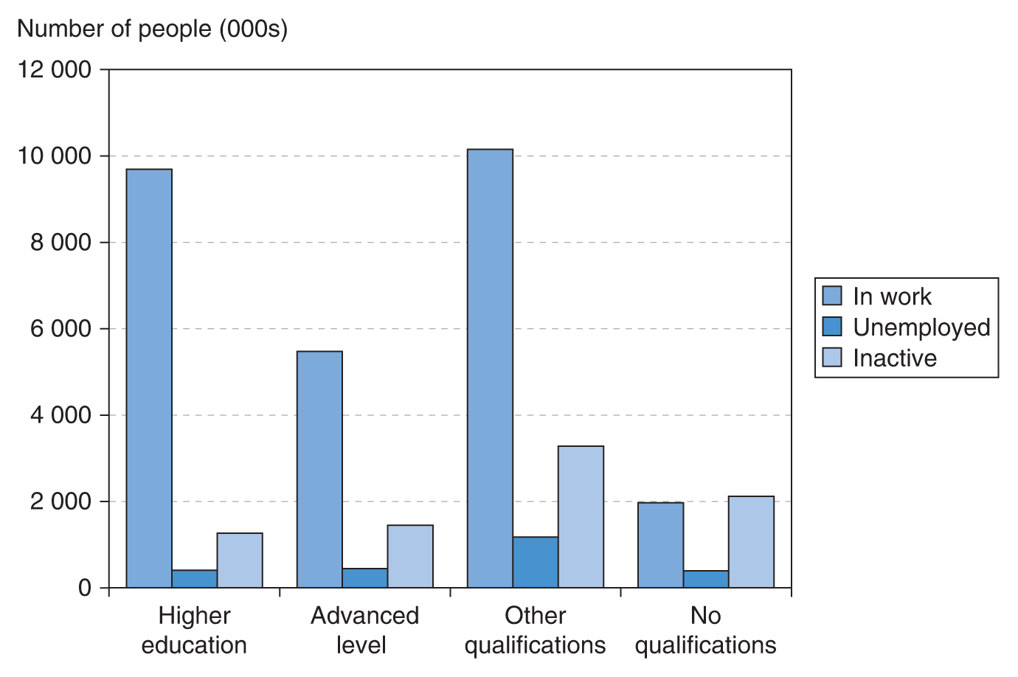
A multiple bar chart
Figure 1.2 Numbers employed, inactive
and unemployed, by educational qualification
Looking better
Notice how those with no qualifications have relatively many inactive persons
Also a lot of unemployed (in proportionate terms), though a little tricky to see
Difficult to compare across nine different bars though
What if we stack the bars?
Note: The bars for the unemployed and inactive categories are constructed in the same way as for those in work: the height of the bar is determined by the frequency.

Slide 7
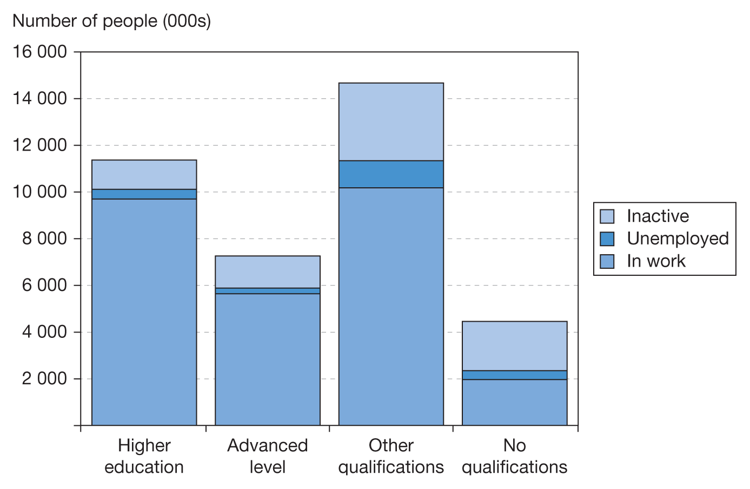
A stacked bar chart
Now starting to look more useful
Similar numbers of unemployed amongst those with higher education, A levels, or no qualifications. But relatively there are much fewer unemployed amongst the better educated
Still not perfect. Absolute numbers are difficult to compare. Better to use percentages…
Within each education category, calculate the percentage in work, unemployed, inactive
Figure 1.3 Stacked bar chart of educational
qualifications and employment status
Note: The overall height of each bar is determined by the sum of the frequencies of the category, given in the final row of Table 1.1. Hence, for higher education, the height of the bar is 11 362, with divisions at 9713 and 10 107 at (= 9713 + 394).

Slide 8
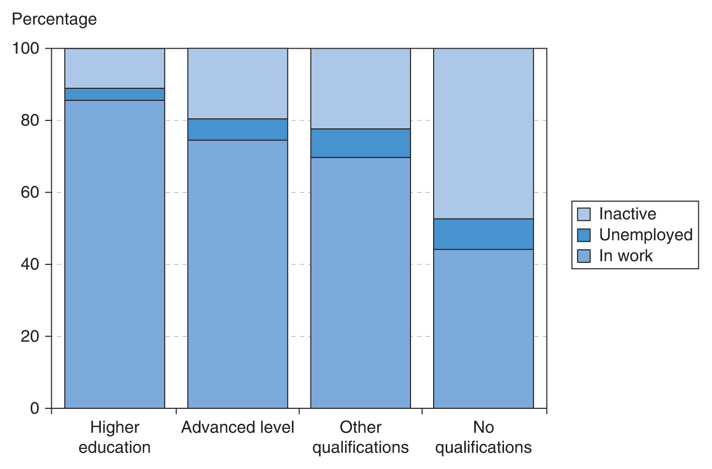
A stacked bar chart – percentages
Figure 1.4 Percentages in each employment category, by educational qualification
Yes!
The pattern is clear once we calculate the percentage figures. Now we easily see, e.g. that around 85% of the highly educated are employed, but only about 40% of those with no qualifications
Unemployment also varies with qualifications. Those with a degree are less likely to be unemployed

Slide 9
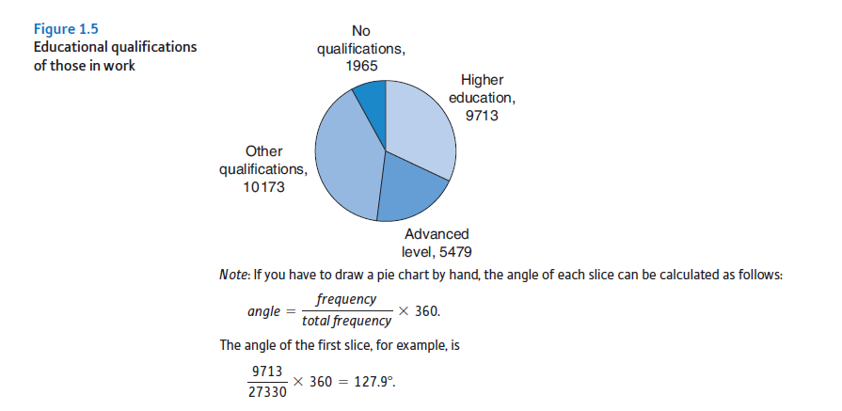
Pie Chart
It is not as good as stacked bar chart. But it gives some info as well.

Slide 10
Lessons so far
Raw data are hard to digest
Even a summary table is hard to read
Charts help, experiment with different types. Find the one that conveys the message(s) in the data clearly
And…
A degree is worth having! You’re less likely to be unemployed
(The graph does not show another advantage of education: your earnings will be higher – as long as you are employed)

Slide 11
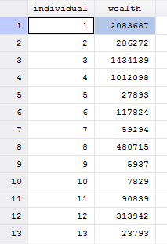
Now look at a different type of data – wealth
Data give the wealth of each taxpayer in the UK in 2005
Approximately 18.7 million observations (sample at left)
How to summarise?
First, draw up a frequency table

Slide 12
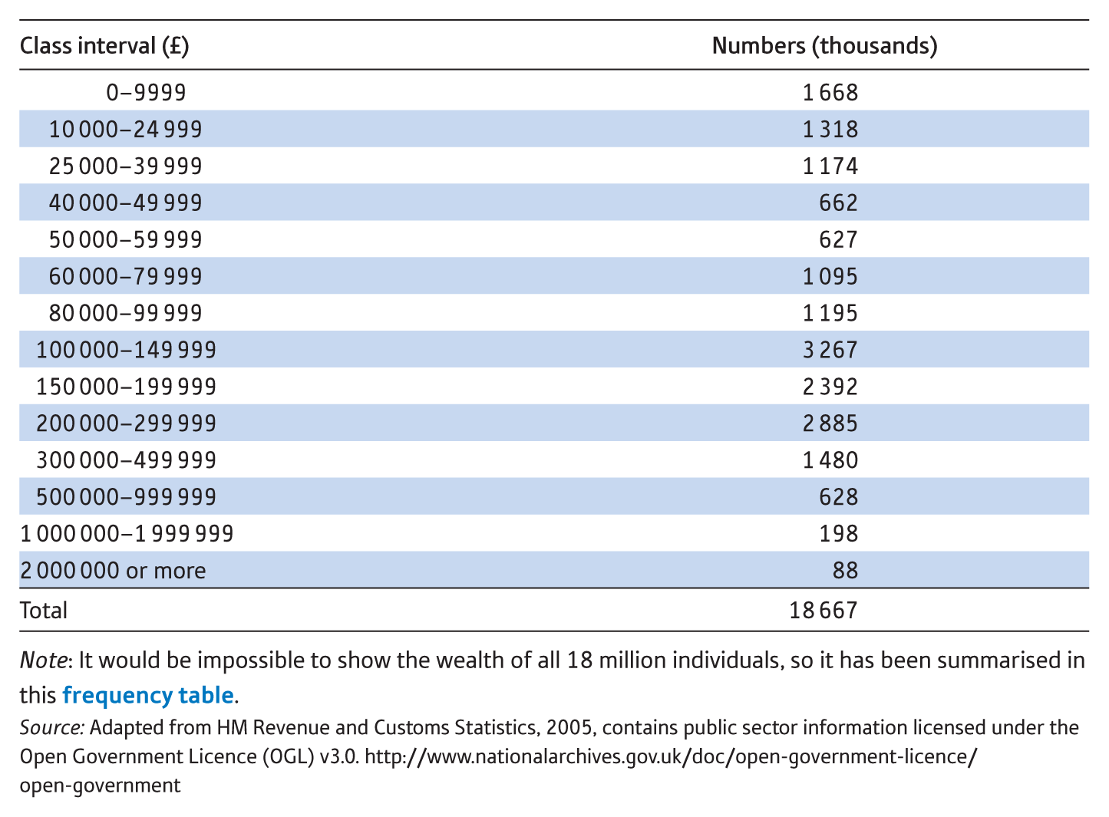
Frequency table of wealth
Table 1.3 The distribution of wealth, United Kingdom, 2005
We can begin to see things:
Largest group have £100-150,000 of wealth (but be careful!)
Only a very few have over £1 million
About 4 million people have less than £40,000 of wealth
However, we still don’t see the overall pattern
Draw a bar chart?

Slide 13
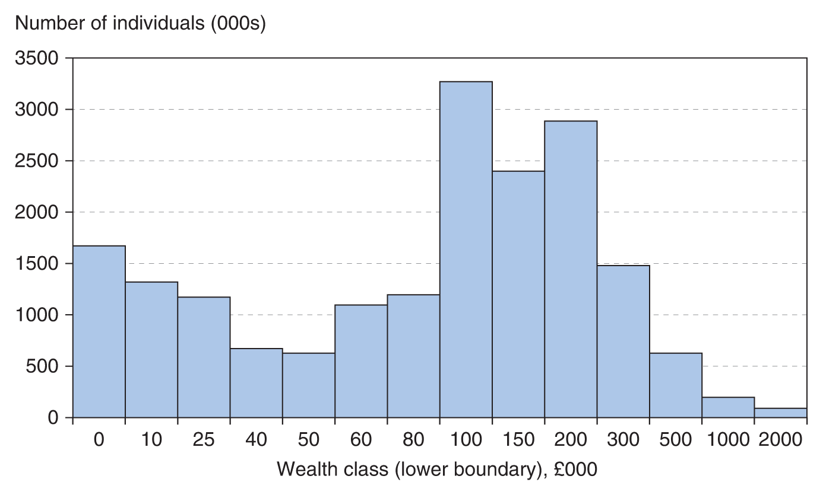
What’s wrong with this?
Figure 1.4 Bar chart of the distribution of wealth in the United Kingdom, 2005

Slide 14
What’s wrong with this?
Figure 1.4 Bar chart of the distribution of wealth in the United Kingdom, 2005
It looks completely wrong!
Each bar has the same width, yet they represent very different ranges of wealth, e.g.
10–25,000
50–60,000
200–300,000
What to do?

Slide 15
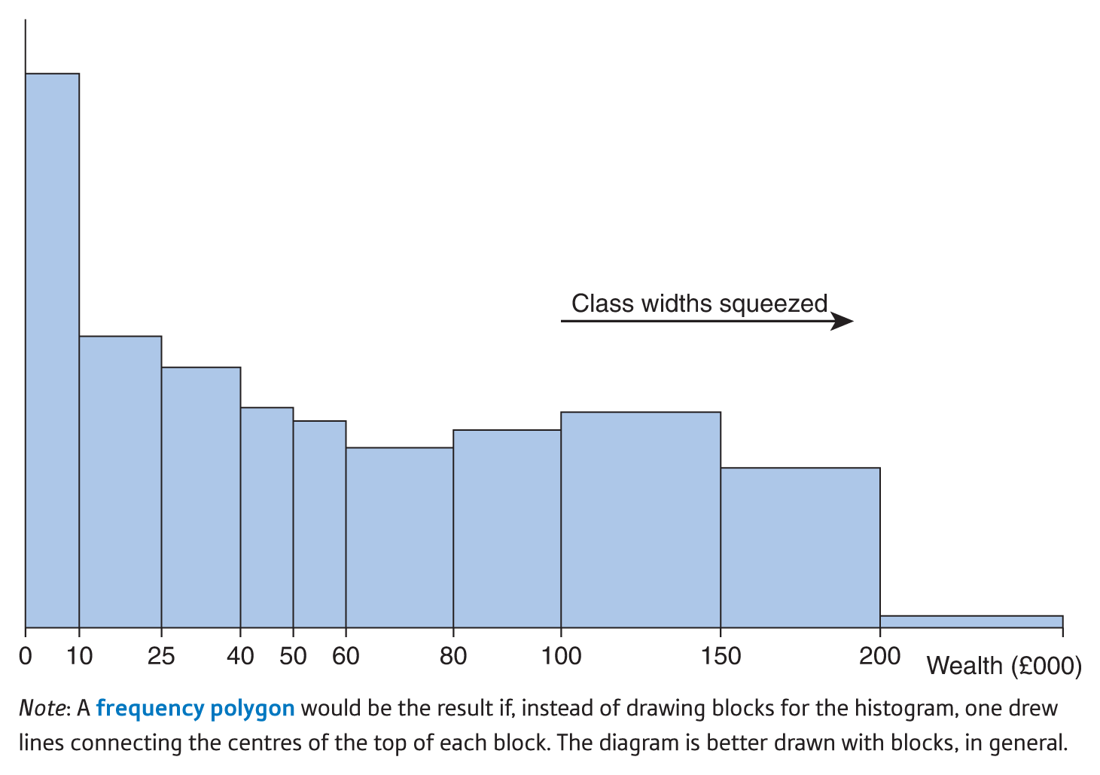
The histogram
Figure 1.9 Histogram of the distribution of wealth in the United Kingdom, 2005
Difficult to draw with software, have to do this ‘by hand’
x-axis is linear (until 100)
y-axis represents frequency density
Areas of the bars represent the frequencies
Most people have wealth below 100,000. A few are extremely wealthy

Slide 16
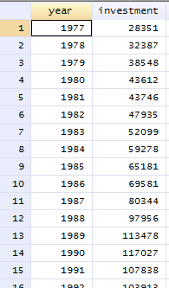
Graphs for time series data
Investment in the UK 1977–2009
Measured in £m, not adjusted for inflation
We can see investment is growing over time but not easy to see smaller fluctuations, how fast it is growing, etc.
Draw a time-series graph of the data

Slide 17
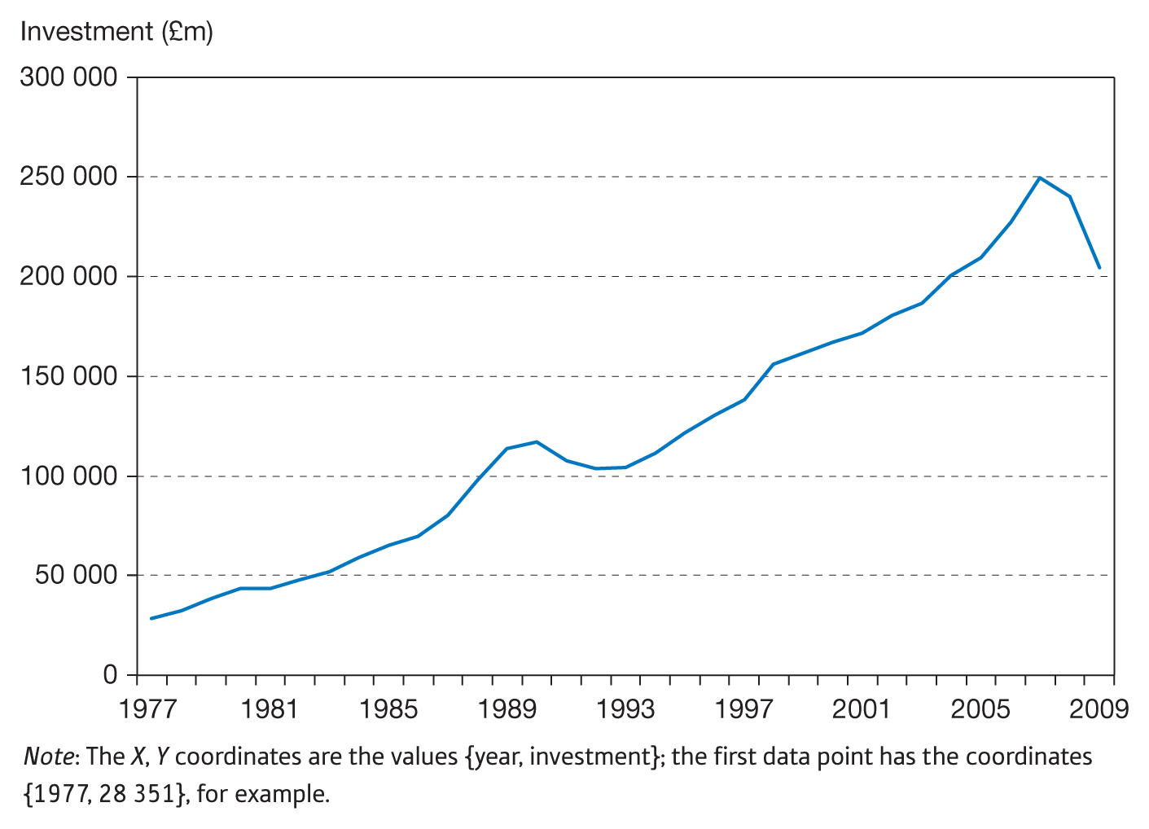
A time-series chart
Figure 1.16 Time-series graph of investment in the United
Kingdom, 1977–2009
Now we can see main features
* Mini-boom in late 1980s, followed by a slump
* Sudden fall after the financial crisis in 2007
* Trend: upwards and slighlty non-linear
Serial correlation: investment values are dependent on each other.
The series seems ‘smoother’ in some periods than others. There appear to be two particular periods of volatility, where investment varies more widely around its trend, (i.e. has a greater variance around the trend).
This is known as heteroscedasticity; a constant variance is termed homoscedasticity

Slide 18
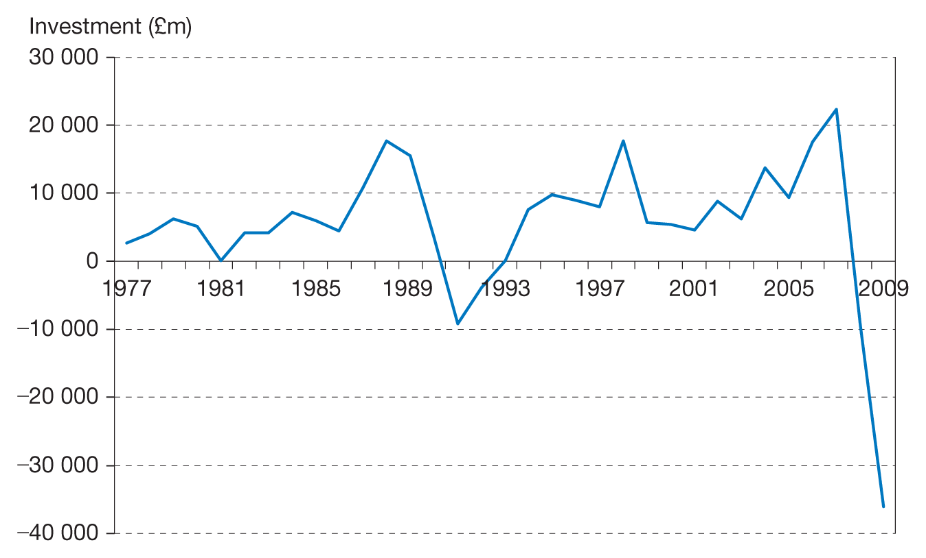
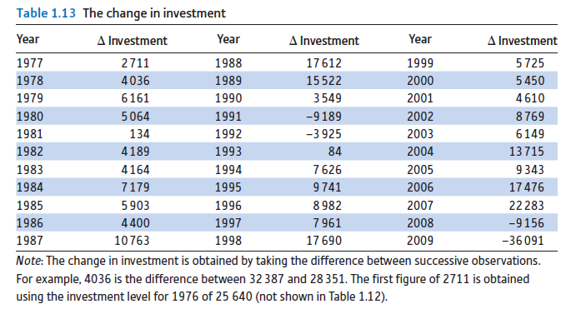
Alternative ways of illustrating the data
Figure 1.17 Time-series graph of the change in investment
The change in investment (between years) highlights the sudden downturns in 1989 and in 2007
In most years however, investment increases
This graph is not ideal though, it would be better to show things in proportionate terms rather than absolute ones

Slide 19
Outliers

Slide 20
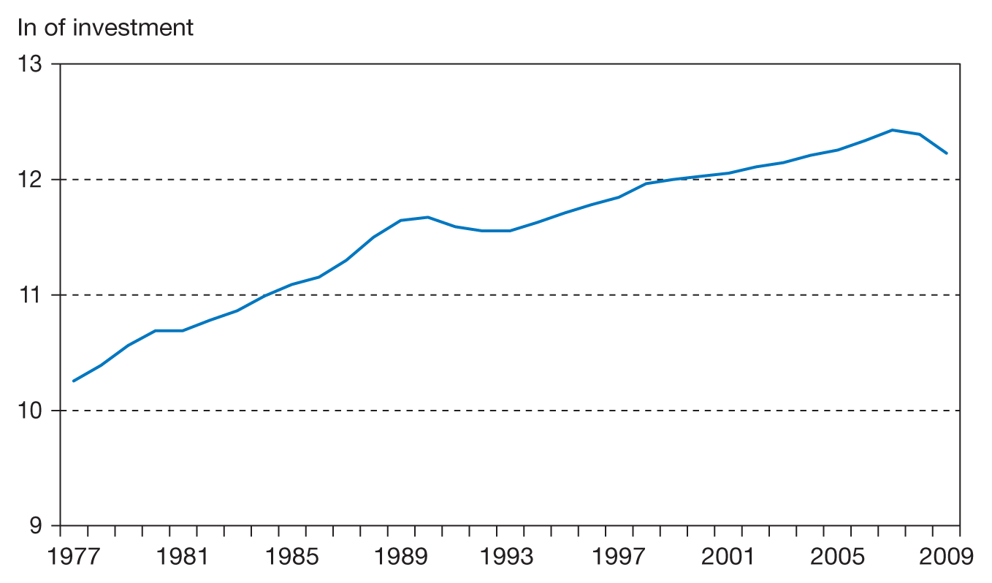
The logarithm of investment
Figure 1.18 Time-series graph of the logarithm of investment
expenditures
A graph of log investment smooths out the series, showing the general trend. The two downturns are still apparent
The slope of this graph gives the rate of change of investment. It rises from about 10.25 to 12.25 over 32 years. That is an increase of 2/32 = 0.0625 p.a. Hence the average growth rate is approximately 6.25% p.a.

Slide 21
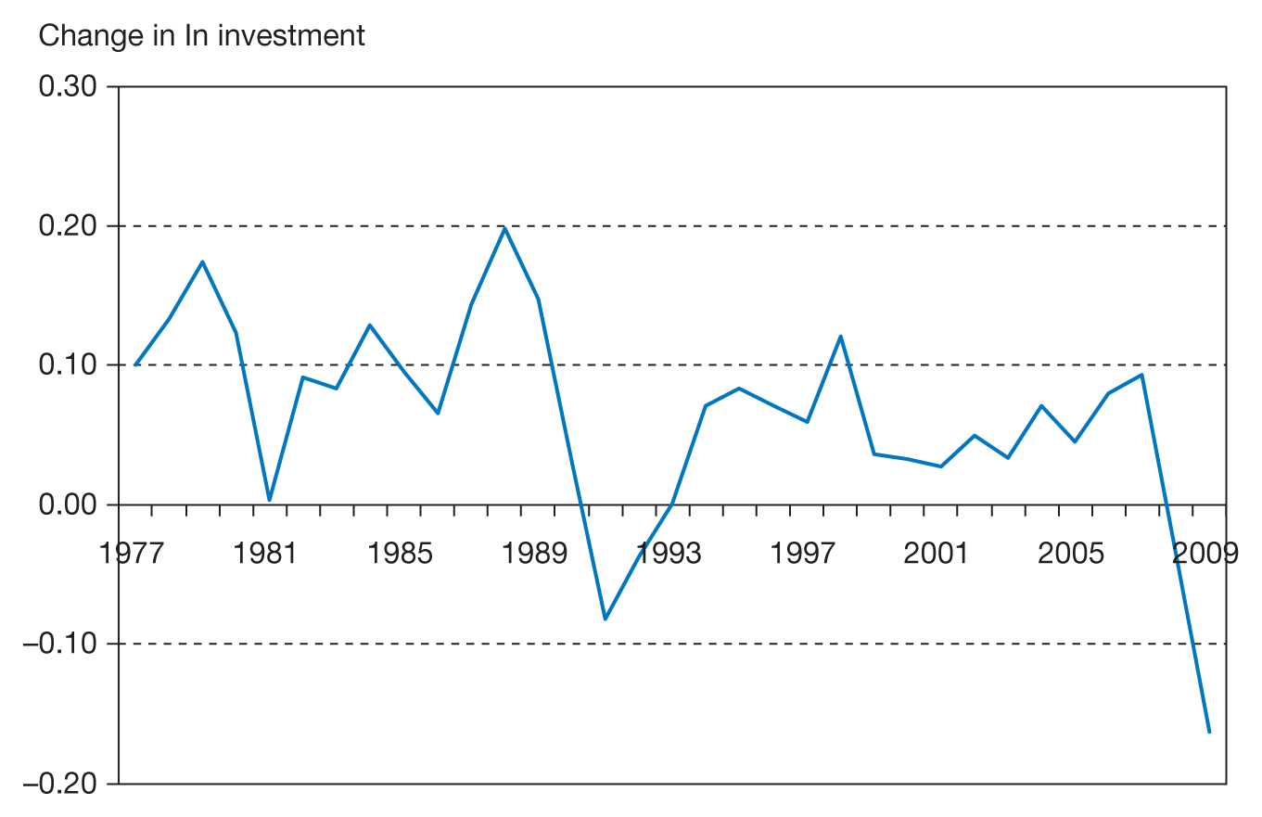
The change of the logarithm
Figure 1.19 Time-series graph of the difference of the logarithmic
series
The change in log investment looks similar to the change in investment level earlier
However, the vertical axis shows annual growth rate. The average rate of growth is around 6% as found before
Here get the average of numbers.

Slide 22
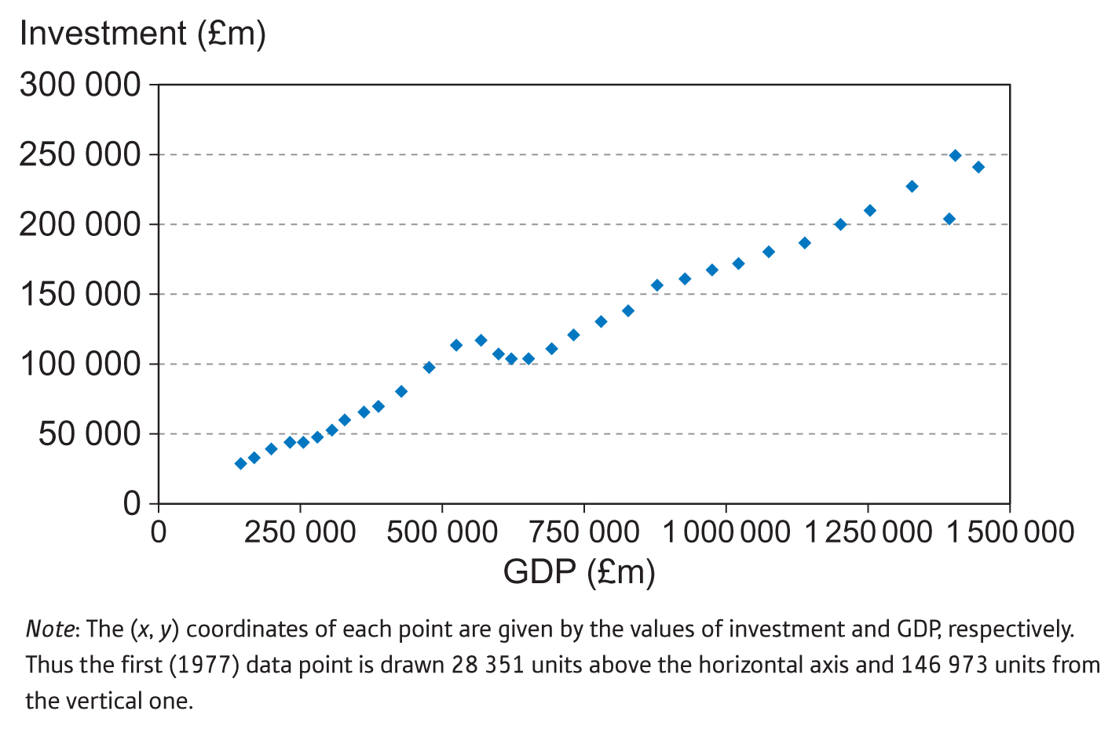
A scatter graph of two time series – investment and GDP
Figure 1.24 Scatter diagram of investment (vertical axis) against
GDP (horizontal axis) (nominal values)
Close linear relationship between investment and GDP
Some deviations from this relationship, e.g. around the GDP value of 500. Not clear from the graph what year this is but it is in fact around 1990
Graph includes the effects of inflation. Better to graph real investment and GDP.

Slide 23
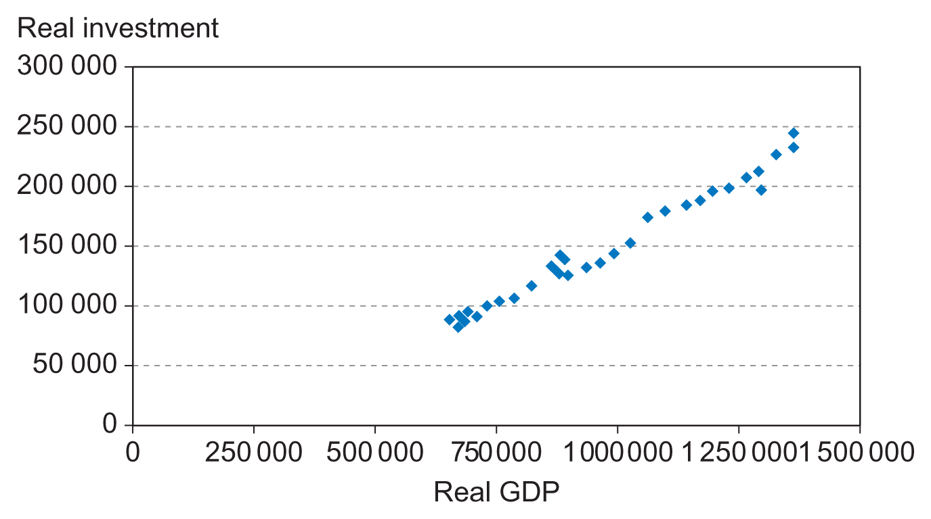
Real investment and real GDP
Figure 1.25 The relationship between real investment and
real output
Drawing the graph confirms the linear relationship between investment and GDP, it is not just due to inflation affecting measurement of both variables

Slide 24
Lessons
You can learn a lot by simply graphing your data
Trends
Relationships between variables
Distribution of a variable (location and spread)
Errors in the data, outliers
There are many different types of graph, choose the one most appropriate for your purpose
Start any analysis of data with a few graphs to get an overview of the data
Think what question you want to ask of the data, then design the graph to answer the question
More…

Slide 25
Graphs – good practice
Make each graph self-contained – include title, label axes, include units of measurement if appropriate. It should be able to stand alone and still tell the message
Keep all text horizontal – easier to read
Don’t put too much into a graph – stick to simple messages
Keep typeface and visual elements consistent
Think about colours, usually the fewer the better (remember that someone might print your graph in black and white too)
Keep it simple!
Example follows…

Slide 26
Compare and contrast!
Figure 1.24 Scatter diagram of investment (vertical axis) against
GDP (horizontal axis) (nominal values)

Slide 27
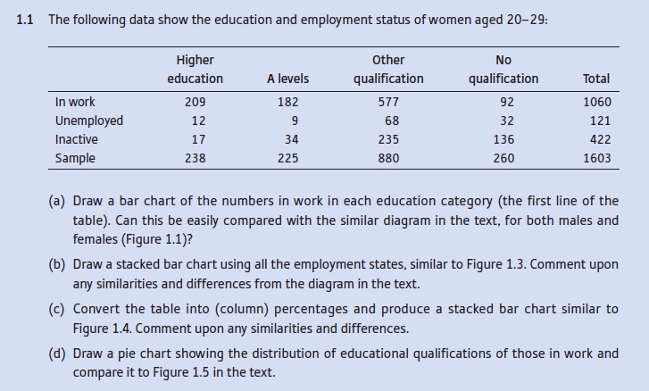
Problems

Slide 28
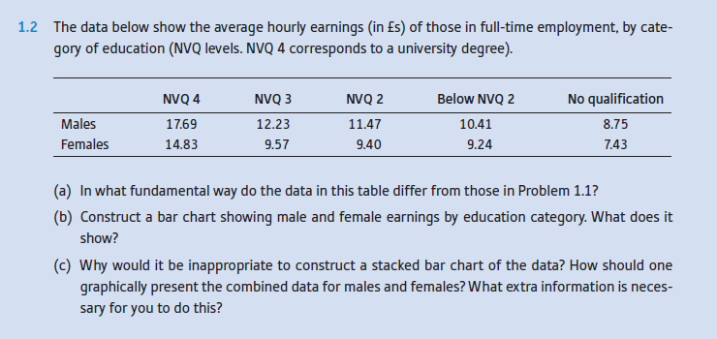
Problems

Slide 29
Problems

Slide 30
Problems

