Slide 1
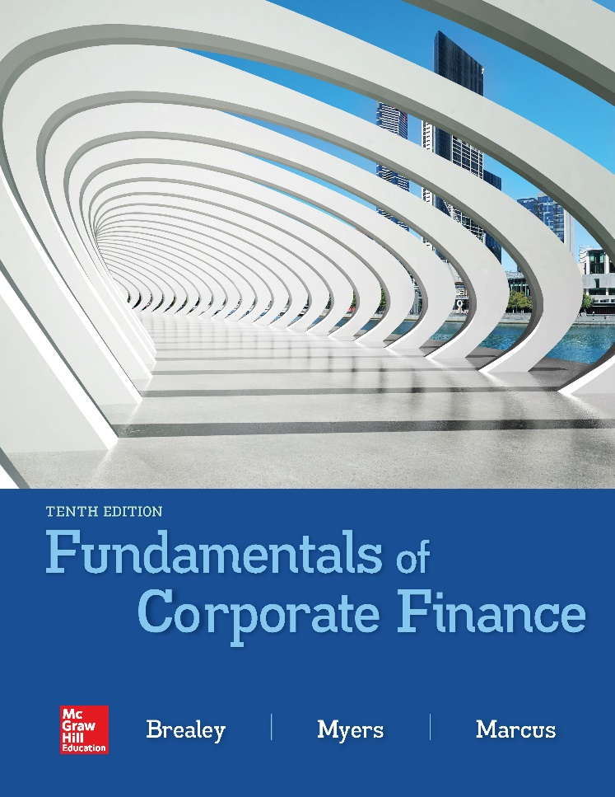

Slide 2
Topics Covered
6.1 The Bond Market
6.2 Interest Rates and Bond Prices
6.3 Yield to Maturity
6.4 Bond Rates of Returns
6.5 The Yield Curve
6.6 Corporate Bonds and the Risk of Default
Notes:
3
2
2
2
2
2

Slide 3
Bonds
Bond
Security that obligates the issuer to make specified payments to the bondholder
Face Value (Par Value or Principal Value)
Payment at the maturity of the bond
Coupon
The interest payments made to the bondholder
Coupon Rate
Annual interest payment, as a percentage of face value
Notes:
3

Slide 4
Interest Rates and Bond Prices (1 of 17)
WARNING
The coupon rate IS NOT the discount rate used in the Present Value calculations
The coupon rate merely tells us what cash flow the bond will produce
Since the coupon rate is listed as a %, this misconception is quite common
Notes:
5

Slide 5
Interest Rates and Bond Prices (2 of 17)
The price of a bond is the present value of all cash flows generated by the bond (i.e. coupons and face value) discounted at the required rate of return
cpn is commonly used as an abbreviation for coupon
Notes:
7

Slide 6
Interest Rates and Bond Prices (3 of 17)
Cash flows to an investor in the 2.25% coupon bond maturing in 2021

Slide 7
Interest Rates and Bond Prices (4 of 17)
Example
What is the price of a 2.25 % annual coupon bond, with a $1,000 face value, which matures in 3 years? Assume a required return of 2.391%.
$$PV=\frac{22.50}{{\left(1.02391\right)}^{1}}+\frac{22.50}{{\left(1.02391\right)}^{2}}+\frac{1,022.50}{{\left(1.02391\right)}^{3}}$$
$$PV=\$995.96$$
Notes:
9

Slide 8
Interest Rates and Bond Prices (5 of 17)
Example (continued)
What is the price of a 2.25 % annual coupon bond, with a $1,000 face value, which matures in 3 years? Assume a required return of 2.391 %.
Bond prices are quoted as a percentage of par
$$Par Value×Price \%=\$ Price$$
$\$1,000×Price \%=\$995.96$
$$Price \%=99.596 \%$$
Notes:
9

Slide 9
Interest Rates and Bond Prices (6 of 17)
The financial calculator functions used for the time value of money can be used for bond calculations as well
n
PMT
FV
i
PV
Maturity
*
$cpn
*
$Par
YTM
*
$Price
Notice how the keys map with the bond terminology
* These keys MUST reference the same time period (i.e. annual, semi-annual, quarterly, monthly, etc.)
Notes:
51

Slide 10
Interest Rates and Bond Prices (7 of 17)
Example
What is the price of a 2.25 % annual coupon bond, with $1,000 face value, which matures in 3 years? Assume a required return of 2.391 %.
n
PMT
FV
i
PV
3
22.50
1,000
2.391
PV
To get the final answer, push PV and you will get -$995.96. Ignore the minus sign and that is the answer
Notes:
51

Slide 11
Interest Rates and Bond Prices (8 of 17)
Example
Q: How did the calculation change, given semi-annual coupons versus annual coupon payments?
Twice as many payments, cut in half, over the same time period.
$$$$
$$$$
$$$$
$$$$
$$
$$
$$
$$
$$
$$
$$
$$
Notes:
14

Slide 12
Interest Rates and Bond Prices (9 of 17)
Cash flows to an investor in the 2.25% coupon bond maturing in 2021. The bond pays semiannual coupons, so there are two payments of $11.25 each year.

Slide 13
Interest Rates and Bond Prices (10 of 17)
Example (continued)
What is the price of the bond if the required rate of return is 1.1955% AND the coupons are paid semi-annually?
Price % = 99.594%
Notes:
13

Slide 14
Interest Rates and Bond Prices (11 of 17)
Example
What is the price of the bond if the required rate of return is 1.1955% AND the coupons are paid semi-annually?
n
PMT
FV
i
PV
6
11.25
1,000
1.1955
PV
To get the final answer, push PV and you will get -$995.94. Ignore the minus sign and that is the answer
Notes:
51

Slide 15
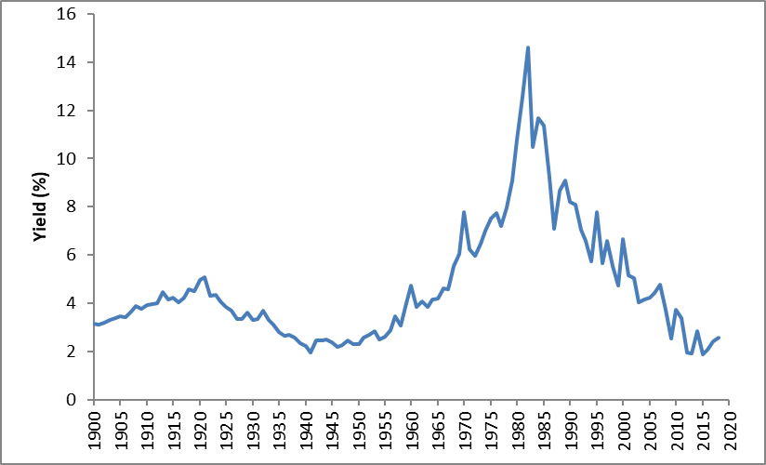
Interest Rates and Bond Prices (12 of 17)
The interest rate on 10-year U.S. Treasury bonds, 1900–2018

Slide 16
Interest Rates and Bond Prices (13 of 17)
Example (continued)
What is the price of the bond if the required rate of return is 2.25%?
Price % = 100%
Notes:
11

Slide 17
Interest Rates and Bond Prices (14 of 17)
Example (continued)
What is the price of the bond if the required rate of return is 10%?
Price % = 80.727%
Notes:
11

Slide 18
Interest Rates and Bond Prices (15 of 17)
Example (continued)
Q: How did the calculation change, given semi-annual coupons versus annual coupon payments?
Time Periods
Paying coupons twice a year, instead of once, doubles the total number of cash flows to be discounted in the PV formula.
Discount Rate
Since the time periods are now half years, the discount rate is also changed from the annual rate to the half year rate.
Notes:
16

Slide 19
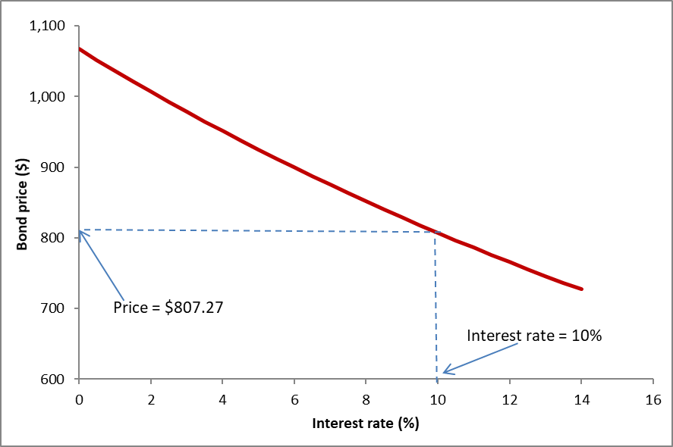
Interest Rates and Bond Prices (16 of 17)
The value of the 2.25% bond falls as interest rates rise

Slide 20
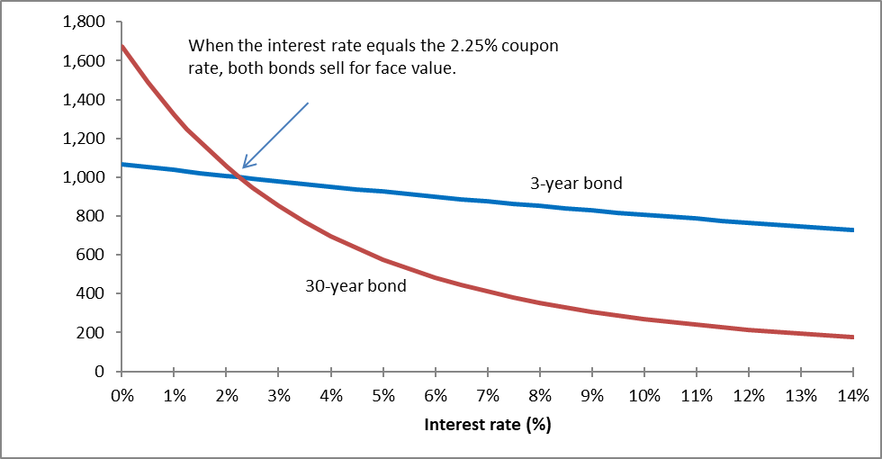
Interest Rates and Bond Prices (17 of 17)
Different maturity bonds have different interest rate risk

Slide 21
Bond Yields (1 of 6)
Current Yield
Annual coupon payments divided by bond price
Yield To Maturity
Discount rate for which the present value of the bond’s payments equals the price
Notes:
17

Slide 22
Bond Yields (2 of 6)
Calculating Yield to Maturity (YTM = r)
If you are given the price of a bond (PV) and the coupon rate, the yield to maturity can be found by solving for r
Notes:
19

Slide 23
Bond Yields (3 of 6)
Example
What is the YTM of a 10.0% annual coupon bond, with a $1,000 face value, which matures in 3 years? The market price of the bond is $1,200.
r = YTM = 2.94%
Notes:
21

Slide 24
Bond Yields (4 of 6)
Example (continued)
What is the YTM of a 10.0 % annual coupon bond, with a $1,000 face value, which matures in 3 years? The market price of the bond is $1,200.
n
PMT
FV
i
PV
3
100
1,000
i
-1,200
To get the final answer, push i and you will get 2.94%
NOTE: You must enter the price as a negative or your calculator when generate an error.
Notes:
51

Slide 25
Bond Yields (5 of 6)
Example (continued)
What is the current yield of a 10.0 % annual coupon bond, with a $1,000 face value, which matures in 3 years? The market price of the bond is $1,200.
Notes:
21

Slide 26
Bond Yields (6 of 6)
WARNING
Calculating YTM by hand can be very tedious
It is highly recommended that you learn to use the “IRR,” “YTM,” or “i” functions on a financial calculator
Notes:
22

Slide 27
Bond Rates of Return (1 of 5)
Rate of Return
Total income per period per dollar invested
Notes:
24

Slide 28
Bond Rates of Return (2 of 5)
Example
A bond increases in price from $963.80 to $1,380.50 and pays a coupon of $21.875 during the same period. What is the rate of return?
ROR = 45.5%
Notes:
21

Slide 29
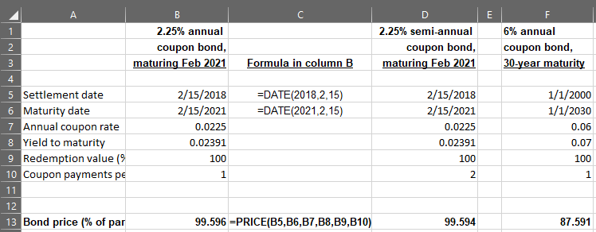
Bond Rates of Return (3 of 5)
Bond valuation spreadsheet

Slide 30
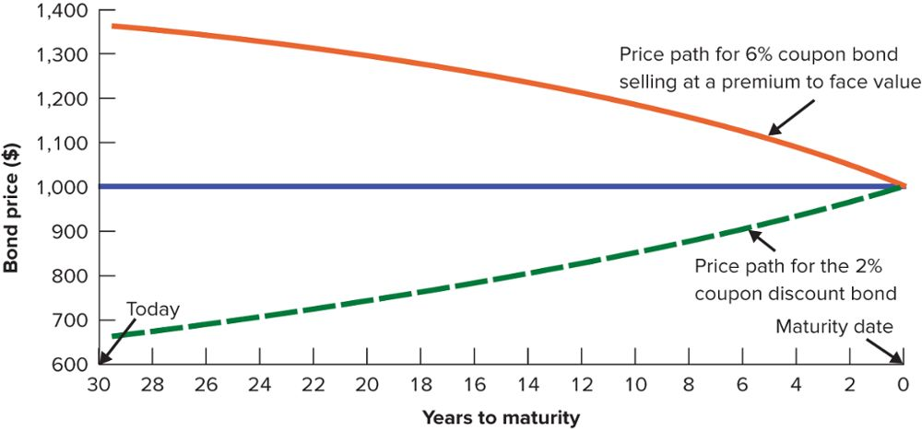
Bond Rates of Return (4 of 5)

Slide 31
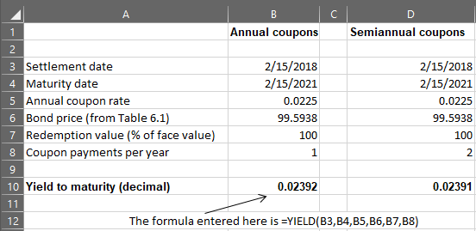
Bond Rates of Return (5 of 5)
Bond yield spreadsheet

Slide 32
The Yield Curve (1 of 2)
Term Structure of Interest Rates
A listing of bond maturity dates and the interest rates that correspond with each date
Yield Curve
Plot of relationship between bond yields to maturity and time to maturity
Notes:
26

Slide 33
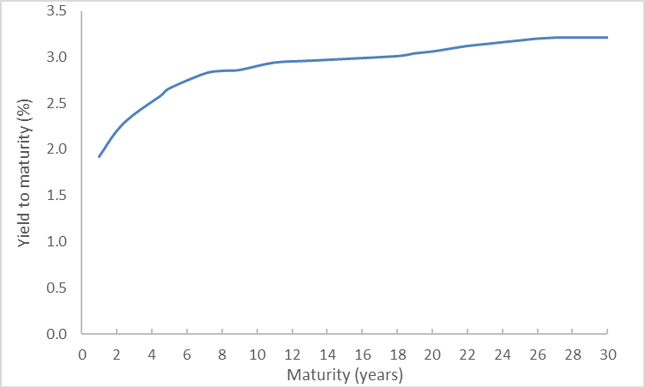
The Yield Curve (2 of 2)
Treasury strips are bonds that make a single payment. The yields on Treasury strips in December 2017 show that investors received a higher yield on longer term bonds.

Slide 34
Nominal and Real Rates of Interest (1 of 4)
In the presence of inflation, an investor’s real interest rate is always less than the nominal interest rate
$$1+real rate=\frac{1+nominal rate}{1+inflation rate}$$

Slide 35
Nominal and Real Rates of Interest (2 of 4)
Example
If you invest in a security that pays 8% interest annually and inflation is 4%, what is your real interest rate?
$$1+real rate=\frac{1.08}{1.04}$$
Real interest rate = .0385 or 3.85%

Slide 36
Nominal and Real Rates of Interest (3 of 4)
Treasury Inflation-Protected Securities (TIPS)
Example
If you invest in 3% coupon, 2 year TIPS and inflation is 5% in year 1 and 4% in year 2r, what are your real annual cash flows?
Year | 1 | 2
Real cash flows | $31.50 | 1,124.76
Notes:
TIPS: U.S. Treasury issued debt with fixed real flows, but with nominal cash flows (interest and principal) that are increased as the consumer price index increases.
Note: What are the nominal cash flows for the example above?

Slide 37
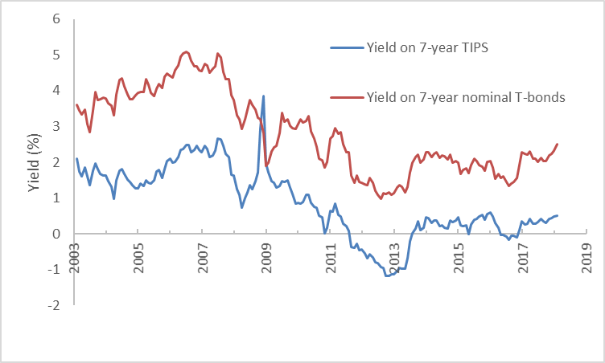
Nominal and Real Rates of Interest (4 of 4)

Slide 38
Default Risk (1 of 3)
Default or Credit Risk
The risk that a bond issuer may default on its bonds
Default premium
The additional yield on a bond that investors require for bearing credit risk
Investment grade
Bonds rated Baa or above by Moody’s or BBB or above by Standard & Poor’s
Junk bonds
Bond with a rating below Baa or BBB

Slide 39
Default Risk (2 of 3)
Moody' s | Standard & Poor's | Safety
Aaa | AAA | The strongest rating; ability to repay interest and principal is very strong
Aa | AA | Very strong likelihood that interest and principal will be repaid
A | A | Strong ability to repay, but some vulnerability to changes in circumstances
Baa | BBB | Adequate capacity to repay; more vulnerability to changes in economic circumstances
Ba | BB | Considerable uncertainty about ability to repay
B | B | Likelihood of interest and principal payments over sustained periods is questionable
Caa | CCC | Bonds in the Caa/CCC and Ca/CC classes may already be in default or in danger of imminent default
Ca | CC
C | C | C-rated bonds offer little prospect for interest or principal on the debt ever to be repaid

Slide 40
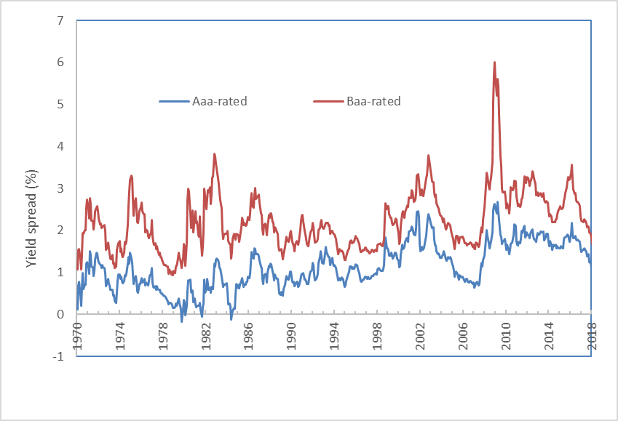
Default Risk (3 of 3)
Yield spreads between corporate Baa and Aaa bonds

Slide 41
Corporate Bonds
Zero-coupon bonds
Floating-rate bonds
Convertible bonds

