Slide 1
Tables and Interpretation of Tables: Descriptive Statistics

Slide 2
Sample Table

Slide 3
Sample Table

Slide 4
Sample Table

Slide 5
Sample Table

Slide 6
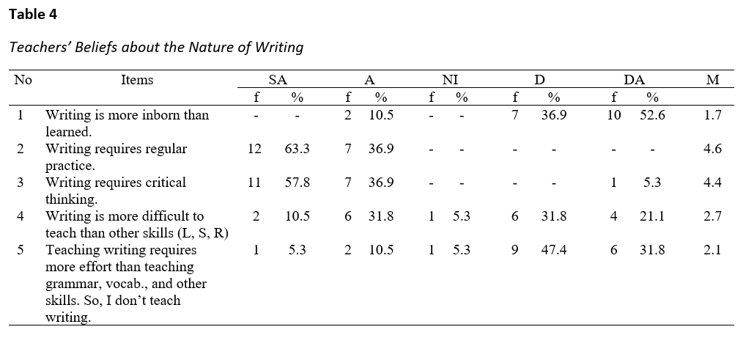
Interpretation of Descriptive Tables: Example 1
The main objective of the teachers’ questionnaire was to gather data about the teachers’ beliefs on writing and teaching writing, and their practice of teaching the skill. Table 1 presents the analysis of teachers’ responses.

Slide 10
Table 1 indicates that 7(36.9%) and 10(52.6%) of the respondents disagreed or strongly disagreed respectively with Item 1; these teachers believe that students can develop their writing skills if they get the chance to learn. Similarly, 12(63.3%) and 7(36.9%) of the teachers strongly agreed or agreed respectively that writing requires regular practice. Besides, 18 (94.7%) of the respondents strongly agreed and agreed that writing requires critical thinking. In short, the teachers in focus do not seem to have problems in relation to the belief they hold about writing.
Another way but not recommended a lot because the number (18/94.7%) is not present in the table

