Slide 1
TRANSPORTATION IN SUPPLY CHAIN

Slide 2
Introduction of Transportation
Transportation refers to the movement of product from one location to another as it makes its way from the beginning of supply chain to the customer.
Transportation is an important supply chain driver because products are rarely produced and consumed in the same location.

Slide 3
Role of Transportation in SCM

Slide 4
Key Drivers
Shipper:
The party who wants to transport the product from one place to another place.
Carrier:
Carrier is company that moves the goods from one place to another place.

Slide 5
Owners and operators of transportation infrastructure
- It is very important that infrastructure be managed in such a way that monies are available for maintenance and investment in further capacity as needed.
- Roads, ports, canals, and airports and the bodies that set transportation policy worldwide.

Slide 6
Modes of Transportation
Supply chains use a combination of the following modes of transportation:
Air
Package carriers
Road
Rail
Water
Pipeline
Intermodal

Slide 7
1. Road Transportation

Slide 8
Advantages
Flexible Service
Disadvantages
Accidents and breakdowns
Door-to-door assistance
Service in Rural areas
Vulnerable to season and weather conditions
Not best for heavy cargo and long distances
Notes:
Flexible Service: For road transportation, timings and routes can be tuned and changed to suit individual requirements easily; this gives road Transportation a great advantage over all different vehicles.
Door-to-door assistance: The best benefit of road transportation that makes it the salvation of the transport industry is its character to offer door-to-door services from destination to destination or warehouse to warehouse.
Service in Rural areas: It is most adaptable and flexible with a reach into the most remote areas that are not accessible by rail, air, or water.
-
Accidents and breakdowns: There is a high risk of breakdowns and accidents in the instance of road transport, due to which it is not a safe or predictable option.
Vulnerable to season and weather conditions: It is very susceptible to weather conditions and seasonal changes or, in the case of natural calamities such as floods or heavy rains.
Not best for heavy cargo and long distances: It is not very appropriate for transporting heavy cargo over long distances, which is a considerable drawback.
-
Exp: Horoz, Borusan

Slide 9
2. Rail Transportation

Slide 10
Advantages
High speed covering huge ranges
Disadvantages
Huge capital outlay
Suitable for heavy and bulky goods
Dependable
No rural service
Centrally administrated
Notes:
High speed covering huge ranges: Its speed over long ranges is higher than any distinct modes of transport (aside from airways). Therefore it is the best choice for long-distance traffics.
Dependable: It is the most reliable mode of transport as it is least affected by weather conditions compared to other methods.
Suitable for heavy and bulky goods: It is economical, and faster, and best suited for bulky and heavy goods transportation over huge distances.
-
Huge capital outlay: Rail transportation needs a considerable investment of capital. The funds for building, sustaining, and hanging expenses are enormous compared to other modes of Transportation.
Centrally administrated: Being the public utility service, rail transportation has a monopoly, and there is centralized administration, so the authorities fail to meet the personal needs of the people as compared to roadways.
No rural service: It cannot be operated economically in rural areas due to substantial capital needs and traffic, which causes much inconvenienced to the people living in rural areas.

Slide 11
3. Water Transportation

Slide 12
Advantages
Helpful in Defence
Disadvantages
Riskier
Essential for Foreign Trade
Slow speed
Notes:
Helpful in Defence: For the vigorous defense of the country, the development of shipping is vital as it is known as the second line of defense.
Essential for Foreign Trade: Water transportation plays a critical role in foreign trade as many countries depend mainly on water transportation for foreign trading, such as India.
-
Riskier: It is more dangerous than other modes of transport as there is always the danger of sinking boats or ships.
Slow speed: It is a quiet mode of transport. Failure of monsoon might result in the fall of rivers’ water level, making navigating the ship or boat difficult.
-
Exp: Arkas, Turkon Line Konteyner Taşımacılık, DSL,

Slide 13
4. Air Transportation

Slide 14
Advantages
Disadvantages
Rapid speed
Can operate for emergency services
Unbroken Journey
Very expensive
Specialized skills needed
Unreliable and uncertain
Notes:
Rapid speed: Among all the modes of transportation, air transportation is the fastest.
Unbroken Journey: Air transportation offers an unbroken journey over sea and land, due to which it can take you from one distinct destination to another quickest.
Can operate for emergency services: It can operate even when every other means of transport can’t due to floods or other natural calamities. So at that time, it is the only mode of Transportation that can be employed to do the relief work and offer the essential commodities of life.
-
Very expensive: It is the most costly mode of Transportation. The fare of transport is very high, which is difficult to afford for the ordinary person.
Unreliable and uncertain: Air transport is not very reliable and is unsure as it is controlled mainly by weather conditions. Fog, snow, or other unfavorable weather conditions might cause suspension of air service or cancellation of scheduled flights.
Specialized skills needed: Air transportation requires a specialized skill and a high degree of training for its operation.

Slide 15
5. Pipeline

Slide 16
Advantages
Disadvantages
Leakage
Low maintenance cost
Less rate of delays
Less energy requirement
Security
High initial cost
Notes:
Low maintenance cost: Both the maintenance and operation cost is meager.
Less energy requirement: The consumption of energy is deficient.
Less rate of delays: The losses of carrying mineral oil and natural gas and delays are minimized with a pipeline system.
-
Leakage: If there is a leakage, the repairing has to be done as soon as possible, so you can’t desert leakage.
High initial cost: The cost of construction and laying of pipelines is high.
Security: The security of pipeline transportation is complex.

Slide 17
6. Package Carrier

Slide 18
Package carriers are transportation companies which carry small packages.
Package carrier uses air, truck and rail to transport the goods. Package carriers also provide other value added services that allow shippers to inventory flow and track order status, shipper can proactively inform the customer about their packages.
Package carrier is suited for e-business.
Notes:
Exp FedEx, UPS, DHL

Slide 19
7. Intermodal Transportation

Slide 20
Intermodal transportation is use of more than one mode of transport for the movement of shipment from origin to its destination.
Intermodal operation is used two or more mode of transport to take the advantage of inherent economies of each and thus provide the integrated service at lower cost.
Notes:
Exp: Mars, Ekol

Slide 21
Design Options for Transportation Network
Three basic questions need to be considered when designing a transportation network between two stages of a supply chain:
Should transportation be direct or through an intermediate site?
Should the intermediate site stock product or only serve as a cross-docking location?
Should each delivery route supply a single destination or multiple destinations (milk run)?
Notes:
The design of a transportation network affects the performance of a supply chain by establishing the infrastructure within which operational transportation decisions regarding scheduling and routing are made. A well-designed transportation network allows a supply chain to achieve the desired degree of responsiveness at a low cost.
-

Slide 22
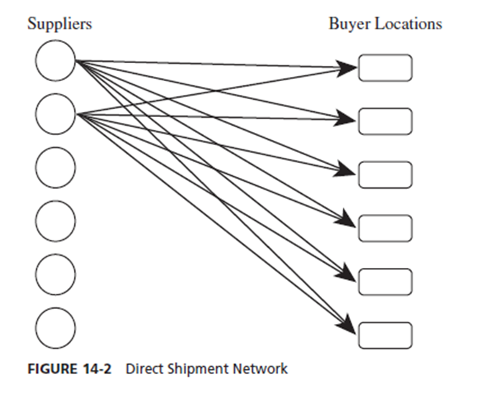
Direct Shipment Network
Notes:
All shipments come directly from each supplier to each buyer location.
Route is specified and SC manager only decides on quantity and mode of transportation.
Decision involves trade-off between transportation and inventory costs
Advantage is the elimination of intermediate warehouses and its simplicity of operation and coordination.

Slide 23
Direct Shipping With Milk Runs
Notes:
Milk run is a route on which a truck either delivers product from a single supplier to multiple retailers or goes from multiple suppliers to a single buyer location.

Slide 24
Shipments via Intermediate Distribution Center
Notes:
Suppliers send their shipments to DC and DC forwards appropriate shipments to each buyer
DC can play two different roles : to store inventory and to serve as transfer location
DC reduces SC costs if suppliers are far from buyer and transportation costs are high.

Slide 25
Shipping via DC Using Milk Runs
Notes:
Milk runs can be used from a DC if lot sizes to be delivered to each buyer location are small.
Milk runs reduce outbound transportation costs by consolidating small shipments.

