Slide 1
Chapter 4 Understanding research philosophies and approaches

Slide 2
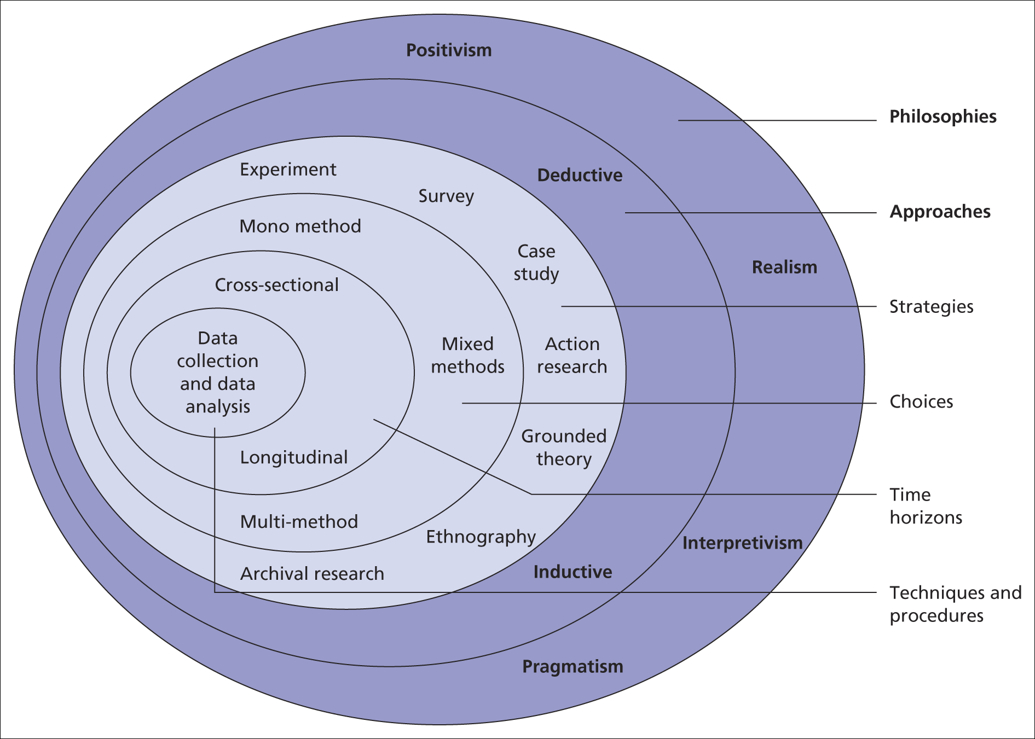
Underlying issues of data collection and analysis
The research ‘onion’
Saunders et al, (2008)
Figure 4.1 The research ‘onion’

Slide 3
Aspects of philosophy
Positivism - the stance of the natural scientist
Realism - direct and critical realism
Interpretivism – researchers as ‘social actors’
Axiology – studies judgements about value

Slide 4
Aspects of approaches
The two main research approaches are
Deduction - theory and hypothesis are developed and tested
Induction – data are collected and a theory developed from the data analysis

Slide 5
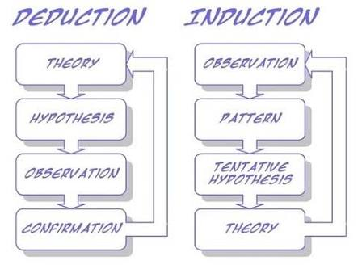

Slide 6
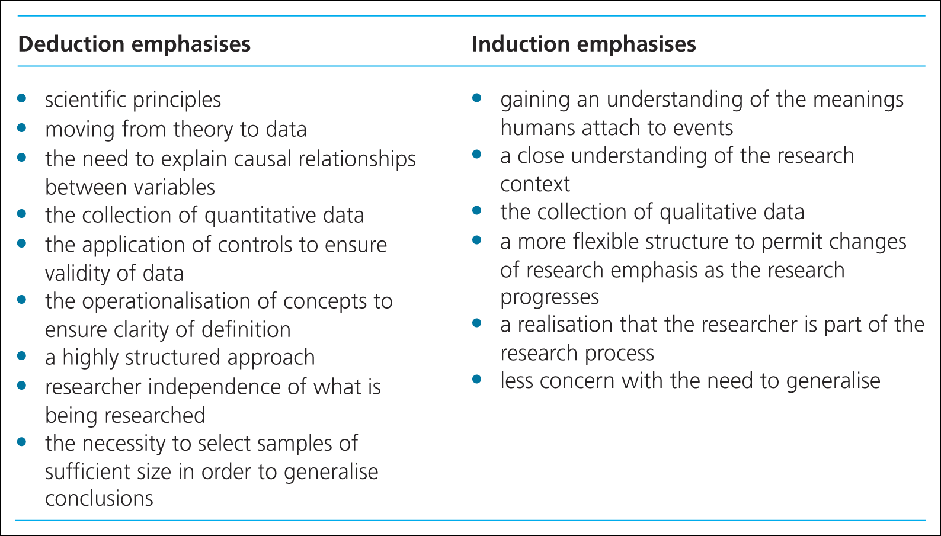
Deductive and Inductive research
Major differences between these approaches
Saunders et al, (2009)
Table 4.2 Major differences between deductive and inductive approaches to research

Slide 7
Thinking about research philosophy
Ontology: nature of reality
Epistemology: what is acceptable knowledge in a particular field of study.
Axiology: value research

Slide 8
Aspects of ontology
Objectivism:the position that social entities exist in reality external to social actors concerned with their existence.
Subjectivism: social phenomena are created from the perceptions and consequent actions

Slide 9
Research paradigms
Paradigsm: is a term frequently used in the soical sciences, but one can lead to confusion because it tends to have multiple meanings.
is a way of examining social phenomena from which particular understandings of these phenomena can be gained and explanations attemped.

Slide 10
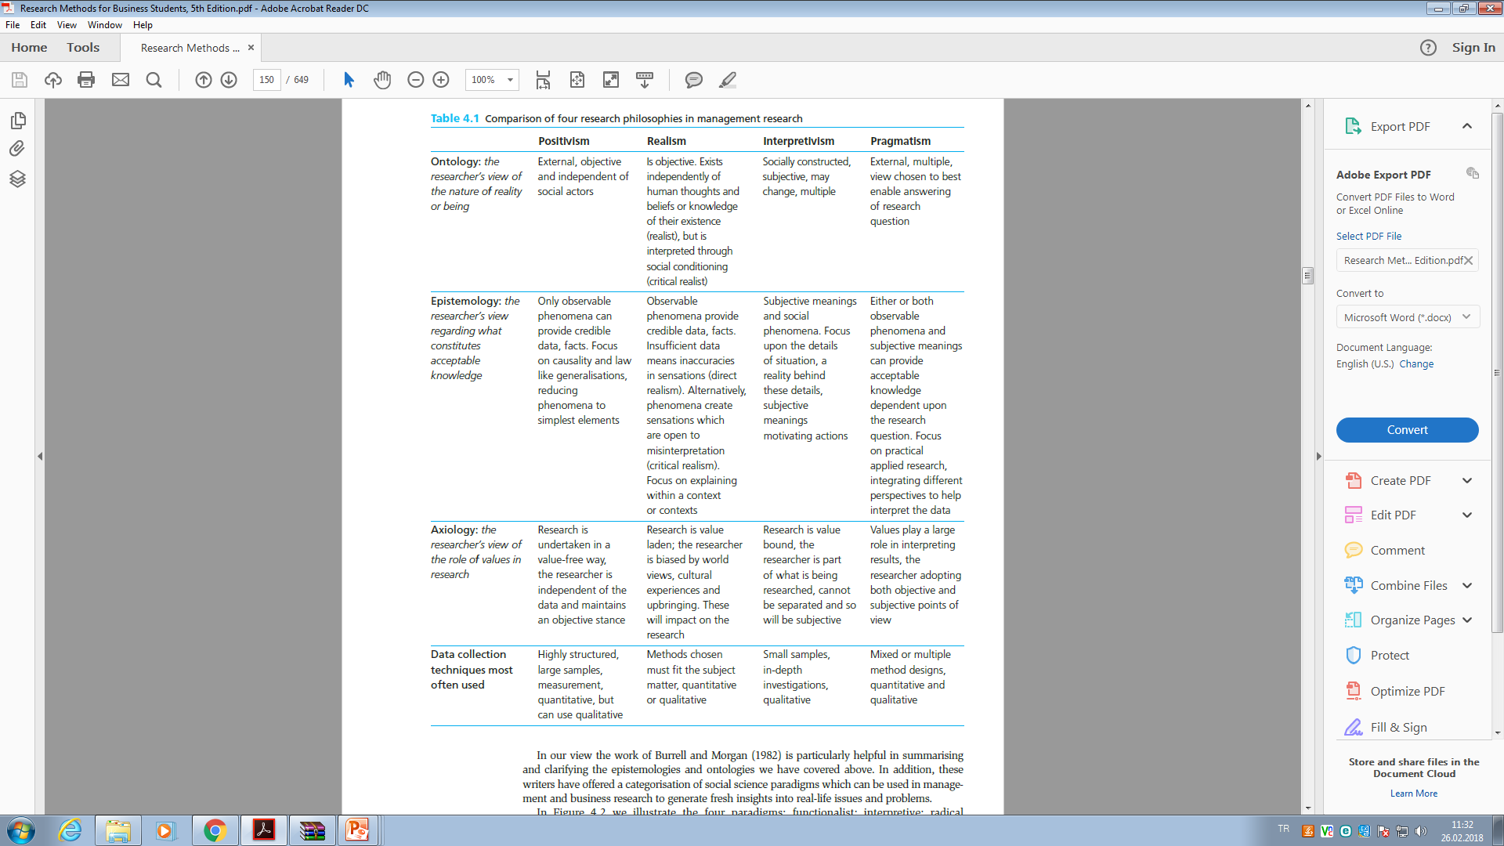

Slide 11
Social science paradigms can generate fresh insights into real-life issues and problems
Four of the paradigms are:
Functionalist Radical humanist
Interpretive Radical structuralist

Slide 12
Choosing your research approach
The right choice of approach helps you to
Make a more informed decision about the research design
Think about which strategies will work for your research topic
Adapt your design to cater for any constraints
Adapted from Easterby-Smith et al. (2008)

Slide 13
Combining research approaches
Things worth considering
The nature of the research topic
The time available
The extent of risk
The research audience – managers and markers

Slide 14
Sosyal bilimlerde akıl yürütme mantığı
Deduction:Tümdengelim (kuram test etme): doğa bilimlerinde temel araştırma yaklaşımıdır. Hipotezler yoluyla bir kuramın geçerliliği test edilir.
«Her canlı bir ölümlüdür, insan da bir canlıdır, o zaman insanda ölümlüdür»
Induction-Tümevarım (Kuram oluşturma): verilerden hareketle kuram geliştirilir.
Bitkiler ölümlüdür,hayvanlar ölümlüdür, doalyısıyla bir canlı olan insan da ölümlüdür önermesi.

Slide 15
Bilim felsefesi
Sosyal bilimlerde 3 araştırma fesefesi esas alınır:
Ontoloji (Varlık bilimsel)
Gerçekliğin ya da varlığın doğası nedir? Olgular arası ne tür ilişki vardır? İnsanın ve toplumun doğası nedir? Sorularıyla ilgilenir. Ontolojik felsefe; varlığın doğasına ilişkin nesnellik, öznellik ile geçerli bilgi üretimine katkı sağlar.
2. Epistomoloji (Bilgi bilimsel) kabul gören bilgiye nasıl ulaşılır? Bilgiye ulaşmanın iki yolu, rasyonellik (maddeden çok mana onemlidir, Sokrates, Plato,aristo Farabi vb.) ve görgülcülük (İbni-Sina, Bacon, vb.)dür.
3. Aksiyoloji (Değer bilimsel)
Araştırmada değerlerin rolü nedir? Araştırmacı, yürüttüğü araştırmada değerleri göz ardı etmeli mi etmemeli midir? Değerler ve bunların araştırma sürecine etkisi güvenilir araştırma sonuçları açısından önemlidir.

Slide 16
Paradigma
Olaylara ve dünyaya bakış açımız, gözlüğümüzdür, çevremizi algılama biçimimizdir.
« Bir bilimin uygulayıcılarının dünyayı nasıl yorumladıkları ve mesleklerini nasıl yaptıklarını ifade eden ve bir araştırma topluluğunu birbirine bağlayan düşünceler topluluğudur.»
Thomas Kuhn ile populerlik kazanmış bir kavramdır. Kuhn ‘a göre paradigma, bir problemin çözümüne ilişkin bilimsel topluluğun kabul ettiği ve belirli bir zaman dilimi için geçerli olan varsayımlardır.»

Slide 17
Sosyal Bilim (S.B.) anlayışları
Sosyal bilimlerde tek bir paradigma yoktur.
S. B’de tercih edilen paradigmalar arasında, yorumsamacı,eleştirel,feminist,pozitivist,post pozitivist realizm, post modern, pragmatizm gibi anlayışlar mevcuttur.

Slide 18
Pozitivist bilim
15.yy.’a kadar dayanır. (Fransız Sosyolog Comte)
Amacı, metafiziği insan bilgisinden dışlamak ve deneysel bilginin gücünü arttırmaktır.
Pozitivizme göre bizim dışımızda sosyal bir dünya vardır ve buna ait özellikler nesnel yöntemlerle ölçülmelidir.
Bilgi dışsal gerçekliğin gözlemlerine dayalıysa gerçek bilgidir.
Bilimin amacı neden-sonuç ilişkilerini açığa çıkarmak ve düzenlilikleri açıklayan kanunlar ortaya koymaktır.

Slide 19
Poztivizm ötesi (Yorumlayıcı) bilim
Bilimsel aşamaların hiçbir aşaması değer yargılarından bağımsız değildir.
Tek doğru yöntem söz konusu değildir.
Bilimsel kuramın temel varsayımları ampirik olarak test edilebilir nitelikte olmayabilir. (metafizik temelli olabilir)
(Max Weber)

Slide 20
Bilim feslefesi ve araştırmanın çerçevesi
Yöntem (ölçme-örnekleme-veri toplama analiz
Yöntembilim(deneysel,tarama,etnografik,olgubilim araştırması)
Bilim paradigmaları ( pozitivist,yorumsamacı vb.
Epistomoloji (bilgi)-Aksiyoloji (değer) (akılcılık-görgülcülük)
Ontoloji (varlık) nesnellik-öznellik

Slide 21
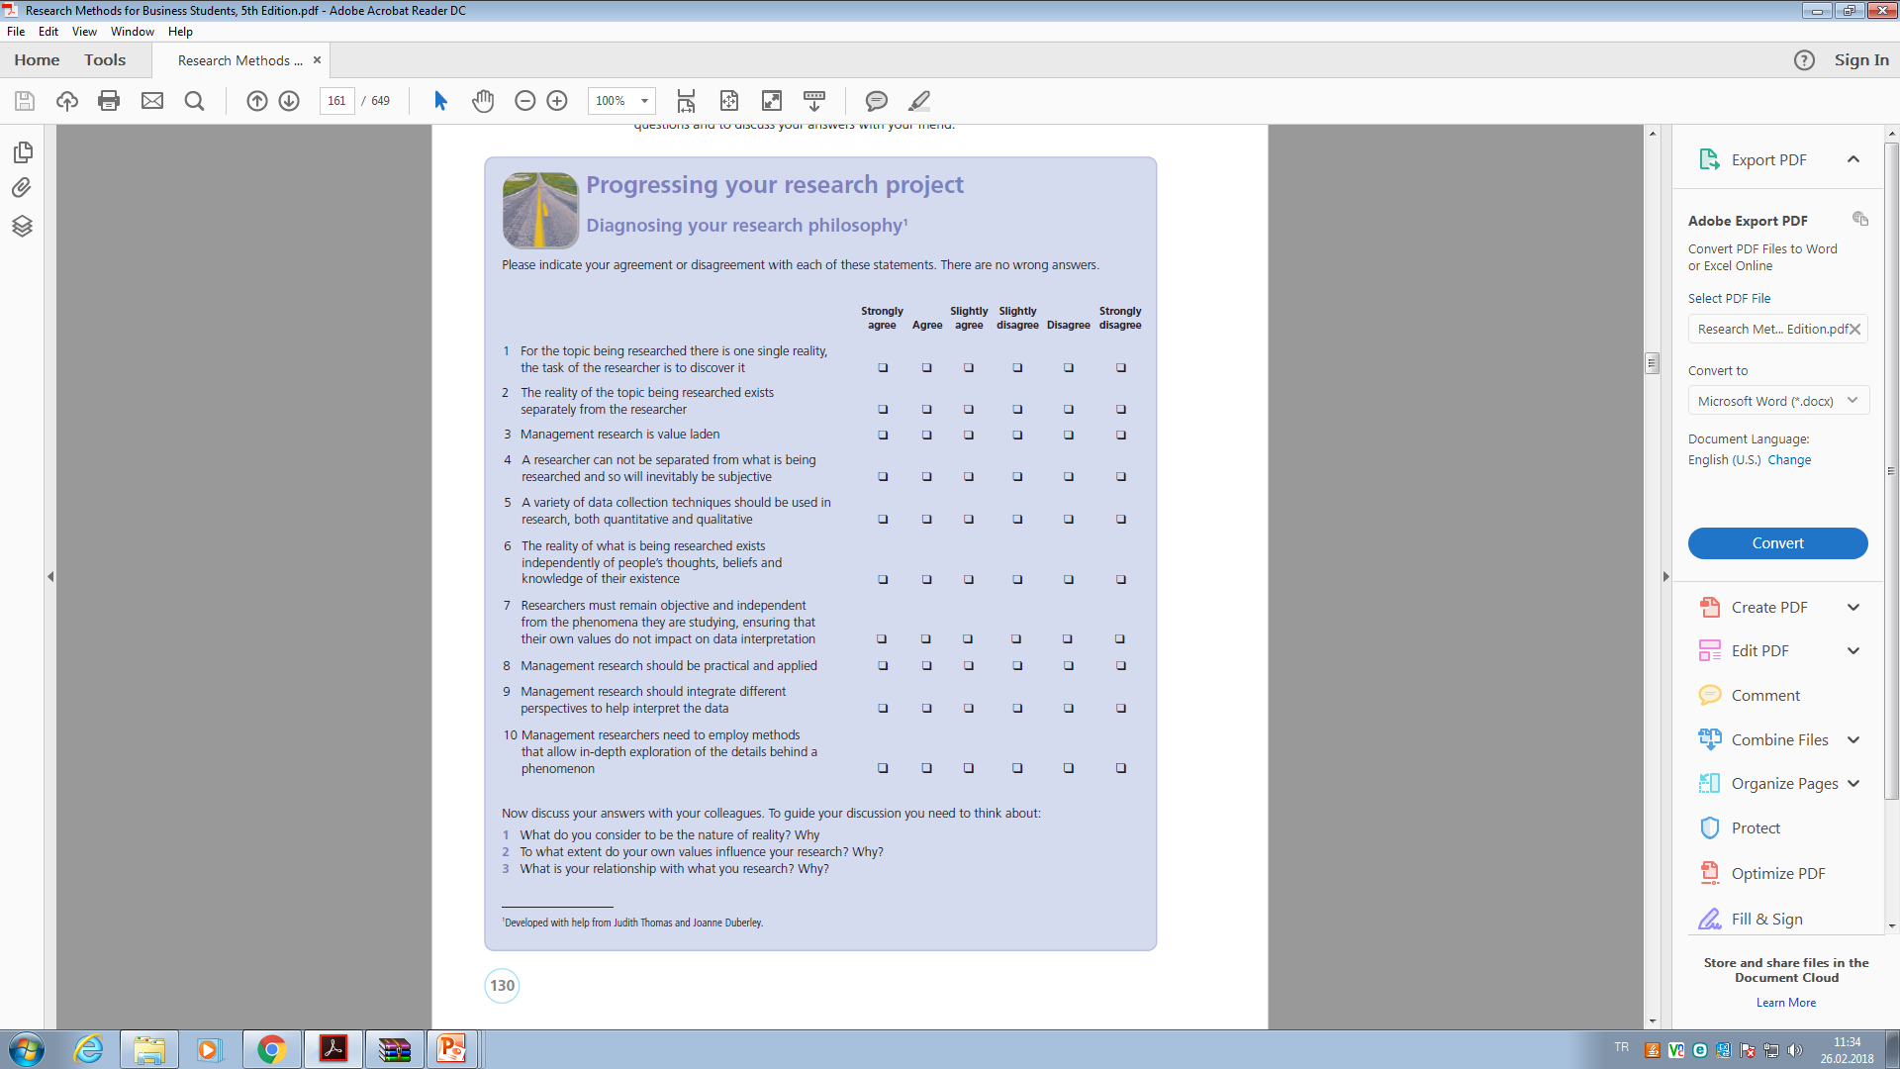

Slide 22
Hw quesiton...
Visit an online database or your university library and obtain a copy of a research-based refereed journal article that you think will be of use to an assignment you are currently working on. Read this article carefully. What research philosophy do you think the author has adopted? Use Section 4.2 to help you develop a clear justification for your answer.

Slide 23
Case 4
Read and sum up,then reply questions...

Slide 24
Chapter 5: formulating the research design
understand the importance of having thought carefully about your
research design;
• identify the main research strategies and explain why these should not
be thought of as mutually exclusive;
• explain the differences between quantitative and qualitative data
collection techniques and analysis procedures;
• explain the reasons for adopting multiple methods in the conduct of
research;
• consider the implications of adopting different time horizons for your
research design;
• explain the concepts of validity and reliability and identify the main
threats to validity and reliability;
• understand some of the main ethical issues implied by the choice of
research strategy

Slide 25
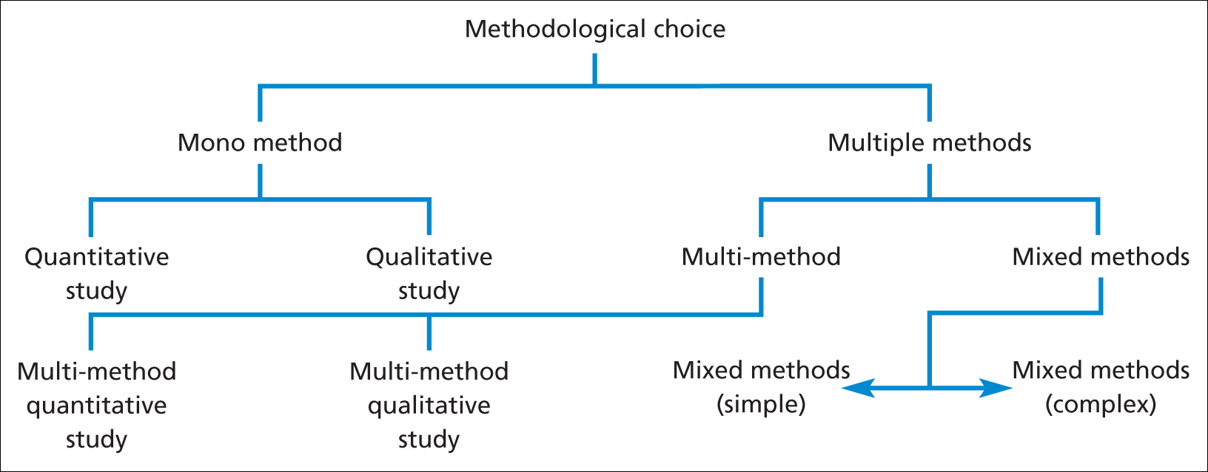
Figure 5.2 Methodological choice

Slide 26
Types of research
The classification of research purpose most often used in the research methods’ literature
is the threefold one of exploratory,
descriptive and explanatory

Slide 27
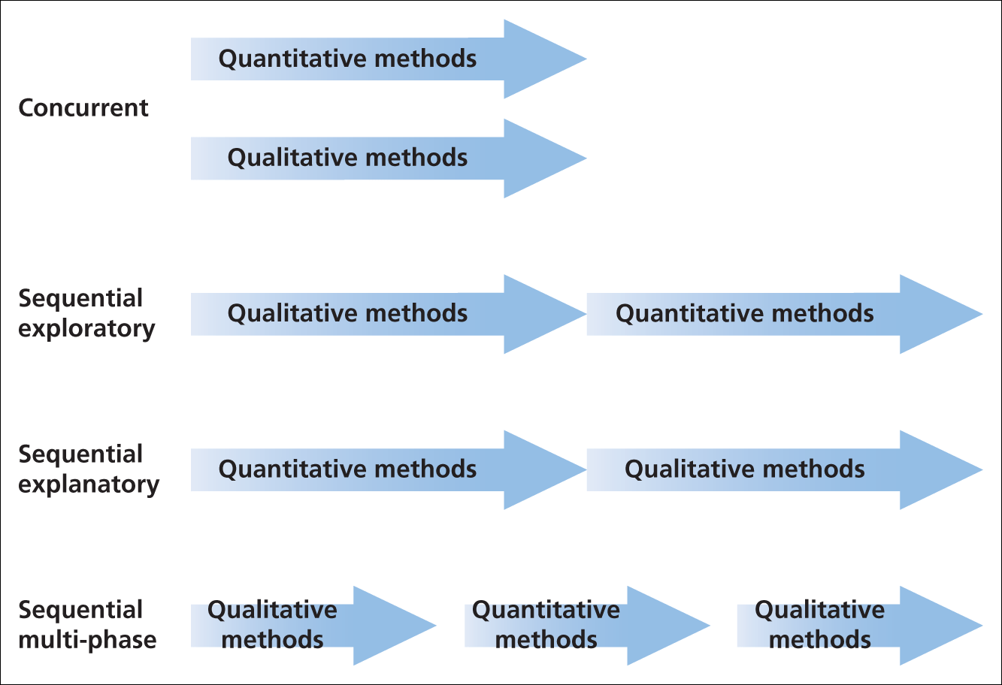
Figure 5.3 Mixed methods research designs

Slide 28
Exploratory study
An exploratory study is a valuable means of finding out ‘what is happening; to seek new
insights; to ask questions and to assess phenomena in a new light’.
It is particularly useful if you wish to clarify your understanding of a problem, such as if you are unsure of the precise nature of the problem (Box 5.1).
It may well be that time is well spent on exploratory research, as it may show that the research is not worth pursuing!

Slide 29
three principal ways of conducting exploratory research:
a search of the literature;
interviewing ‘experts’ in the subject;
conducting focus group interviews.
Exploratory research can be likened to the activities of the traveler or explorer.
Its great advantage is that it is flexible and adaptable to change.

Slide 30
Descriptive studies
The object of descriptive research is ‘to portray an accurate profile of persons, events or situations. It is necessary to have a clear picture of the phenomena on which you wish to collect data prior to the collection of the data.
One of the earliest well-known examples of a descriptive survey is the Domesday Book, which described the population of England in 1085.

Slide 31
Explanatory studies
is on studying a situation or a problem in order to explain the relationships between variables.
You could go ahead and subject the data to statistical tests such as correlation in order to get a clearer view of the relationship.

Slide 32
The need for a clear research strategy
The different research strategies:
experiment;
survey;
case study;
action research;
grounded theory;
ethnography;
archival research.

Slide 33
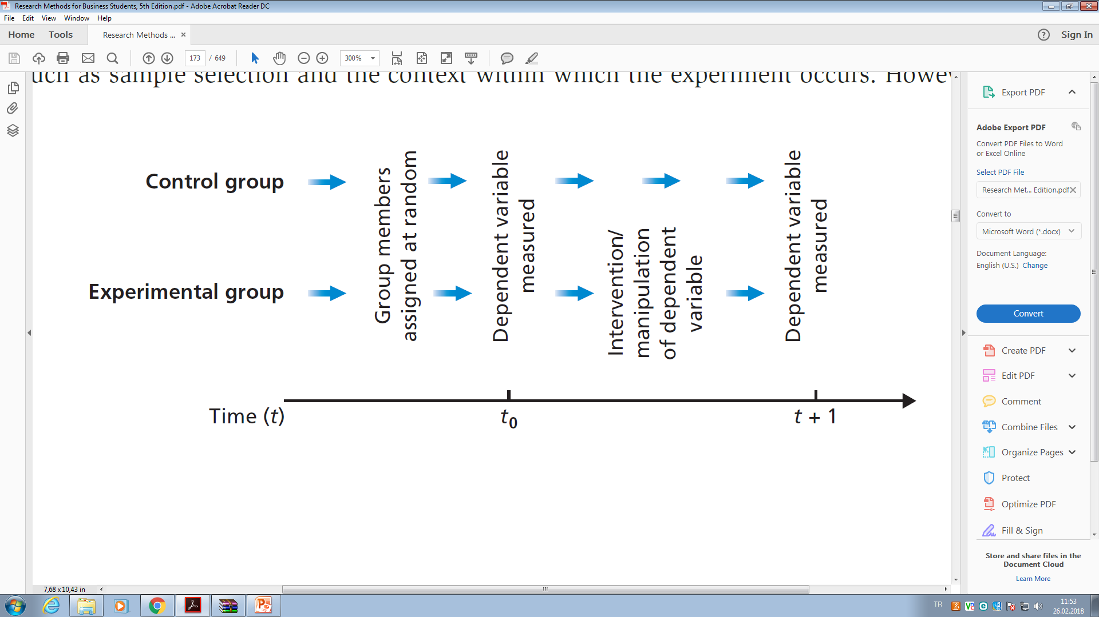
Experiment is a form of research that owes much to the natural sciences, although it features strongly in much social science research, particularly psychology. The purpose of an experiment is to study causal links; whether a change in one independent variable produces a change in another dependent variable

Slide 34
an experiment will involve typically
definition of a theoretical hypothesis (the introduction of a promotion will result in a change in the number of sales);
selection of samples of individuals from known populations;
random allocation of samples to different experimental conditions, the experimental group and the control group;
iintroduction of planned intervention or manipulation to one or more of the variables
measurement on a small number of dependent variables ( purchasing behaviour);
control of all other variables.

Slide 35
Survey
The survey strategy is usually associated with the deductive approach.
It is a popular and common strategy in business and management research and is most frequently used to answer who, what, where, how much and how many questions.
therefore tends to be used for exploratory and descriptive research.
Surveys are popular as they allow the collection of a large amount of data from a sizeable population in a highly economical way.
Often obtained by using a questionnaire administered to a sample, these data are standardized, allowing easy comparison.

Slide 36
Freeonlinesurvey
google docs
Paper-based

Slide 37
Case study
‘a strategy for doing research which involves an empirical investigation of a particular contemporary phenomenon within its real life context using multiple sources of evidence’.
Yin (2003) also highlights the importance of context, adding that, within a case study, the boundaries between the phenomenon being studied and the context within which it is being studied are not clearly evident.

Slide 38
The case study strategy
also has considerable ability to generate answers to the question ‘why?’ as well as the ‘what?’ and ‘how?’ questions, although ‘what?’ and ‘how?’ questions tend to be more the concern of the survey strategy. For this reason the case study strategy is most often used in explanatory and exploratory research.
The data collection techniques employed may be various: for example, interviews, observation, documentary analysis and questionnaires.
Consequently, if you are using a case study strategy you are likely to need to use and triangulate multiple sources of data.
Triangulation refers to the use of different data collection techniques within one study in order to ensure that the data are telling you what you think they are telling you. For example, qualitative data collected using semi-structured group interviews may be a valuable way of triangulating quantitative data collected by other means such as a questionnaire.

Slide 39
Action research
Lewin first used the term action research in 1946. It has been interpreted subsequently by management researchers in a variety of ways.

Slide 40
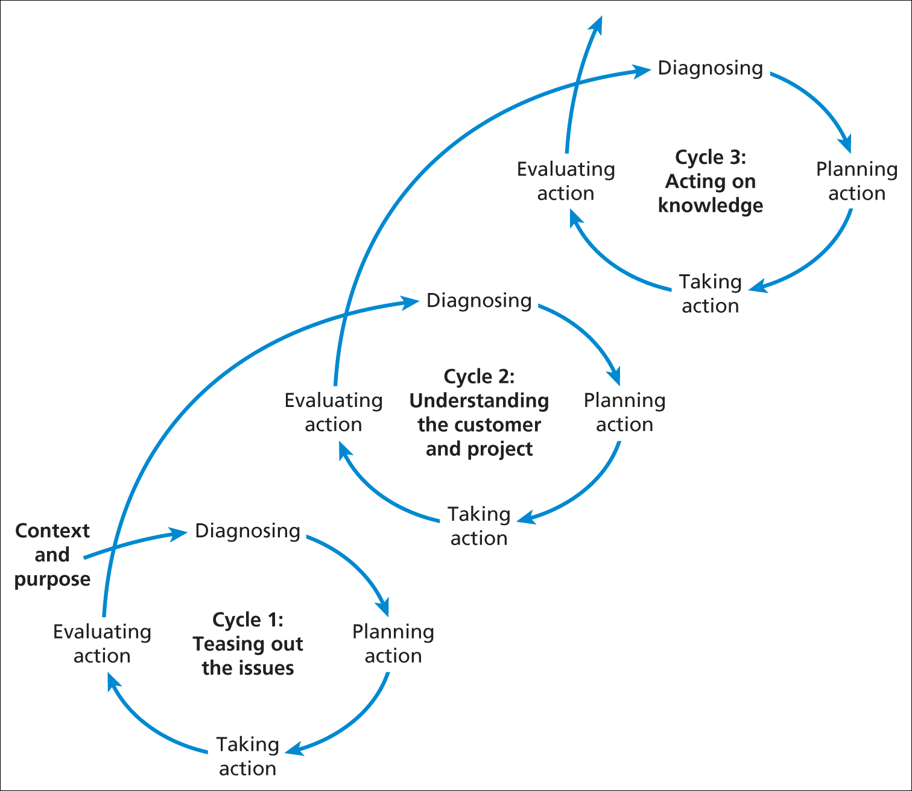
Figure 5.5 The three cycles of the Action Research spiral

Slide 41
Grounded theory
Classic grounded theory (Glaser and Strauss 1967) is often thought of as the best example of the inductive approach, although this conclusion would be too simplistic.
Grounded theory strategy is, according to Goulding (2002), particularly helpful for research to predict and explain behavior, the emphasis being upon developing and building theory.
As much of business and management is about people’s behaviors, for example consumers’ or employees’, a grounded theory strategy can be used to explore a wide range of business and management issues.

Slide 42
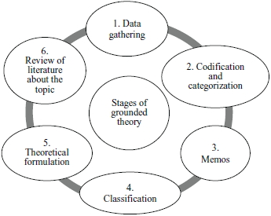

Slide 43
y
Ethno (people)graphy (writing): is rooted firmly in the inductive approach. It emanates from the field of anthropology.
The purpose is to describe and explain the social world the research subjects inhabit in the way in which they would describe and explain it.
This is obviously a research strategy that is very time consuming and takes place over an extended time period as the researcher needs to immerse herself or himself in the social world being researched as completely as possible.
The research process needs to be flexible and responsive to change since the researcher will constantly be developing new patterns of thought about what is being observed.

Slide 45
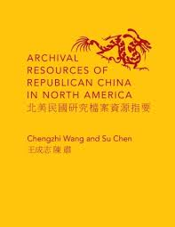
Archival research
makes use of administrative records and documents as the principal source of data. Although the term archival has historical connotations, it can refer to recent as well as historical documents

Slide 46
Quantitative vs. Qualitative
Quantitative is predominantly used as a synonym for any data collection technique (such as a questionnaire) or data analysis procedure (such as graphs or statistics) that generates or uses numerical data.
In contrast, qualitative is used predominantly as a synonym for any data collection technique (such as an interview) or data analysis procedure (such as categorising data) that generates or use non-numerical data. Qualitative therefore can refer to data other than words, such as pictures and video clips.

Slide 47
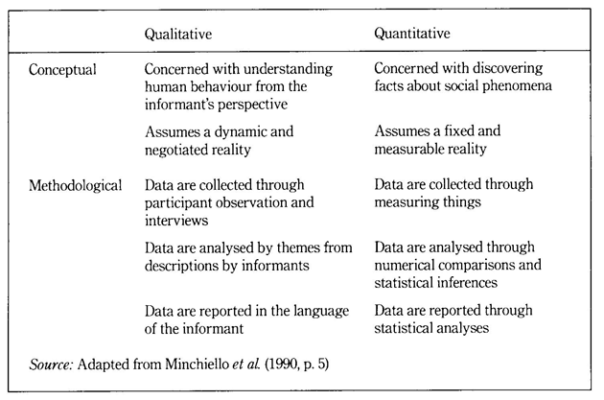

Slide 48
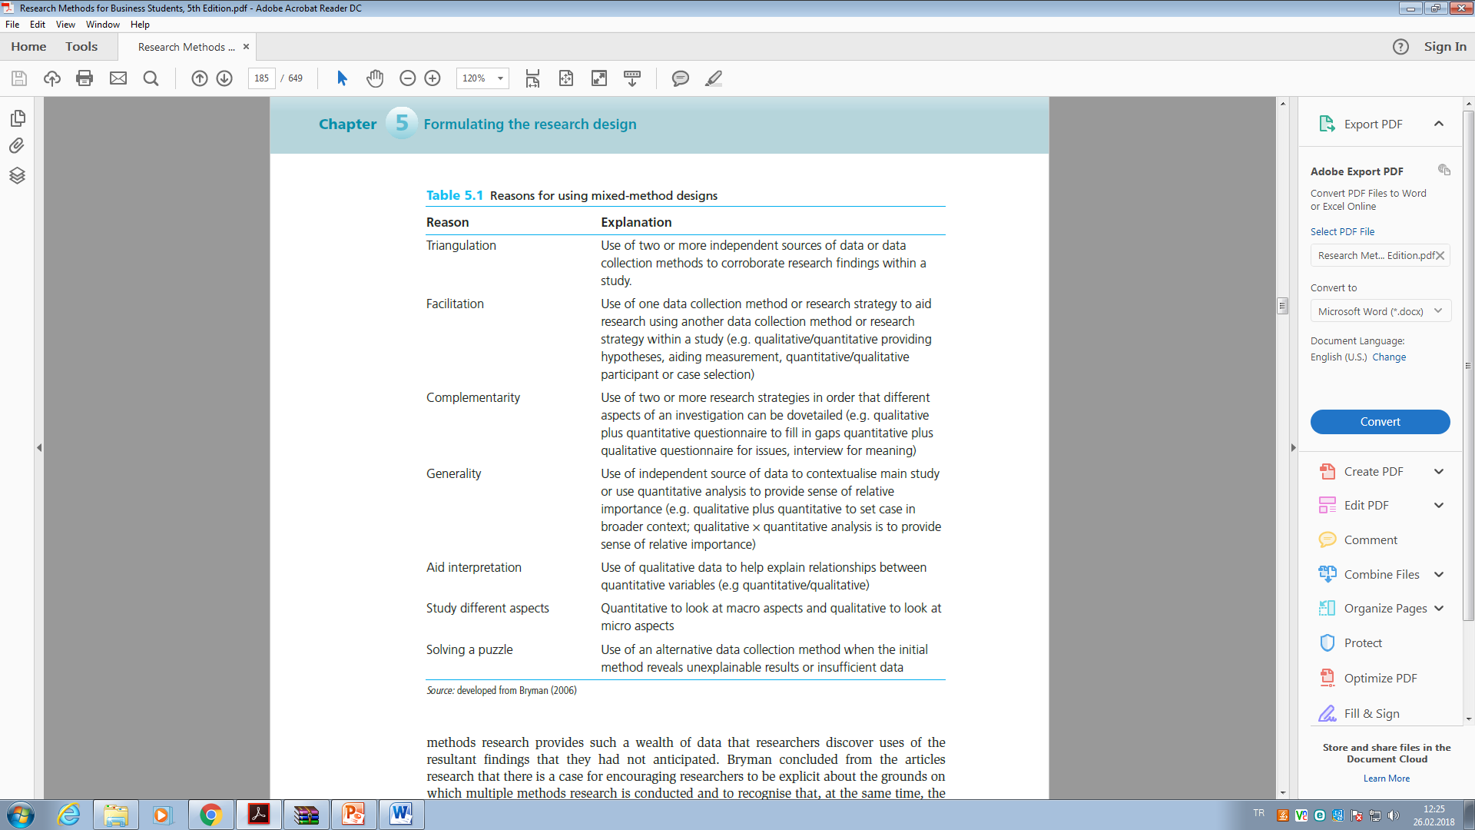

Slide 49
Reliability
Reliability refers to the extent to which your data collection techniques or analysis procedures will yield consistent findings. It can be assessed by posing the following three questions:
1 Will the measures yield the same results on other occasions?
2 Will similar observations be reached by other observers?
3 Is there transparency in how sense was made from the raw data?

Slide 50
Validity
is concerned with whether the findings are really about what they appear to be about. Is the relationship between two variables a causal relationship? For example, in a study of an electronics factory we found that employees’ failure to look at new product displays was caused not by employee apathy but by lack of opportunity.

