Slide 1
APA 7

Slide 2
APA Style - 7th edition: In-text Citations
An in-text citation is a reference within your paper to the source that informed your writing.
APA format generally utilizes the author-year model, for example (Johnson, 2020).

Slide 3
Paraphrasing or Summarizing Sources
If you are paraphrasing or summarizing a main idea from a source, only the author and the publication year need to be referenced. There are several different ways to do this.
Example 1: Smith (2020) believes that individuals can write well if they take the time to plan out their proposal.
Example 2: In 2020, Smith's research indicated that individuals that spend more time writing proposals are more likely to do well on their assignments.
Example 3: Good grades can be achieved through creating proposals (Smith, 2020).

Slide 4
Quoting Sources
If you quote directly from a source, make sure to use quotation marks and include the author’s last name, year of publication, and the specific page number for the reference, if available.
Example 1: He wrote, “It is important to cite sources” (Smith, 2012, p. 12).
If you introduce the author in the sentence, make sure that the year of publication proceeds the author's last name.
Example 2: Smith (2012) notes, "It is important to cite sources" (p. 12).

Slide 5
Multiple Authors
Two Authors
When referring to the work in a sentence, reference the authors by last name connected by 'and'.
Example : Lockhart and Carter (2014) believed that…
For in-text citations, list both author's names connected by an ampersand (&).
Example 1: Students retain more information through active learning (Lockhart & Carter, 2014).
Example 2: "Active learning serves as an effective means of aiding memory retention" (Lockhart & Carter, 2014, p. 145).

Slide 6
Multiple Authors
Three or More Authors
When quoting, summarizing or paraphrasing from works with three or more authors, list only the first author’s last name in all citations followed by “et al.”
Example 1: Mangum et al. (2018) described the process as….
Example 2: The findings suggested a correlation between the two variables (Mangum et al., 2018).
Example 3: "This study suggests a strong correlation between the two variables proposed by the author's prior research" (Mangum et al., 2018, p. 201).

Slide 7
Longer Quotes
If a quote is 40 or more words, use a free-standing block, as shown below:
Human society is located between these two; a society of persons who are material individuals, hence isolated each within itself but nonetheless requiring communication with one another as far as possible here below in anticipation of that perfect communion with one another and God in life eternal. The terrestrial common good of such a society is…superior the proper good of each member but flows back upon each. (Martain, 1966, p. 59)

Slide 8
You do not need to add quotations around block quotes.
Block quotes require you to start the quote on a new line, which should be indented 1/2 inch or 5 spaces from the left margin.
Double space the entire block quotation, and do not put extra spaces above or below it.
Unlike shorter quotes where you place a period after the page number, longer quotes require a period at the end of the quote but not after the page number in the parenthetical citation.

Slide 9
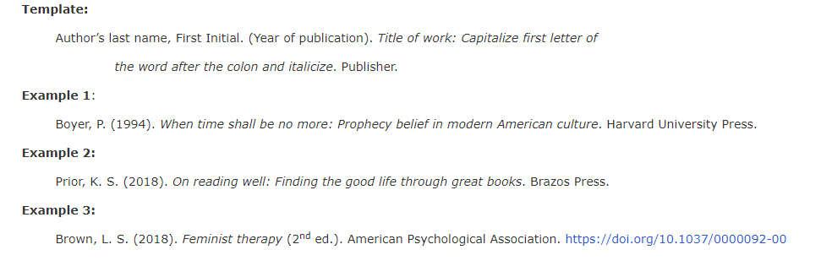
REFERENCE PAGE Print and Electronic Books
Physical books and e-books are cited exactly the same except when a DOI is provided.

Slide 10
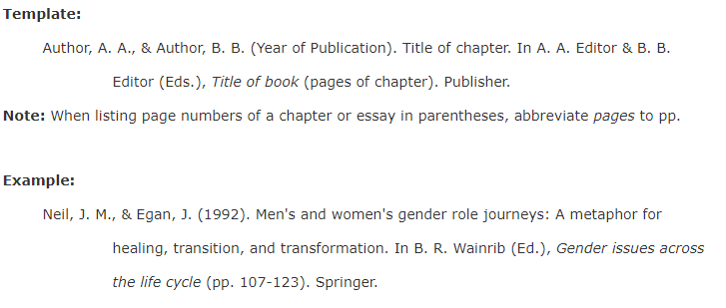
Chapter from an Edited Book

Slide 11
Book with an Edition or Volume Number

Slide 12
Journal Articles
DOI and URL Usage:
Use a DOI (digital object identifier) whenever it is provided.

Slide 13
Use a URL for open-access, online resources with no DOI. Instead, include the URL for the journal article.

Slide 14
Present DOIs and URLs as hyperlinks:
https://doi.org.10.1037/0000092-001 or https://www.website.com.
Do not use “Retrieved from” or “Accessed from” before the DOI or URL in the citation.
You can use a shortened doi link such as https://doi.org/fg6rf9.

Slide 15
It is acceptable to include the DOI in blue font and underlined, as hyperlinked text.
The DOI can also be listed as plain text and not hyperlinked.
However if preparing a paper for publication or if the paper will be read online, it is expected that the reader be able to select the link and be taken to the referenced article.

Slide 16
Multiple Authors
List all authors, up to 20.
When there are 21 or more authors, include the first 19 authors’ names, insert an ellipsis (but no ampersand), and then add the final author’s name.

Slide 17
Journal Articles & Periodicals
When citing journal articles, database journals are cited exactly as print journals. No distinction is made in the citation if the article is in print or in a database.
Article with a DOI:

Slide 19
Book Reviews

Slide 20
Presentation Slides
Follow the example below when citing class presentations or lectures for discussion boards or written assignments.

Slide 21
Blogs, Websites and Videos
When citing an internet source, locate as much information about the item as possible and use the below template as a guide when creating the citation:

Slide 22
Dissertations/Thesis

Slide 23
Newspaper Article

Slide 24
Published conference papers
If a conference paper has been published (for example, in a proceedings), the published form is usually either a chapter of an edited book or an article in a journal.

Slide 26
Conference papers, sessions and presentations
Paper or session presented at conference, not formally published in proceedings (also used for Poster Presentations):

Slide 27
Secondary Source (Indirect citation)
A secondary source (also known as an indirect citation) is when the ideas of one author are published in another author’s text but you have not read or accessed the primary author’s work.
Generally, it is best to access the original source for the information and cite that, but if you are unable to do so, include the following:
Include both the original author, publication year, and the original (primary) author and year of the work where quote/idea was found in the in-text reference.
Add "as cited in" before the author in the in-text reference.
For example, (Smith, 2015, as cited in Jonson, 2019).

Slide 28
In the reference list, provide the details of the work in which you found the quotation or idea.

Slide 29
https://library.csp.edu/c.php?g=982644&p=8146056

