Slide 1
SamplIng for QualItatIve Research

Slide 2
Sampling
A sampling plan: the design for how to specifically choose sources for your data.
Sampling: choosing people to collect data and also choosing specific locations, times of days, various events, and activities to observe in fieldwork.
Good qualitative researchers prefer purposeful sampling (they purposefully choose data that fit the parameters of the project’s research questions, goals, and purposes)

Slide 3
Sample Size
What is an appropriate sample size for qualitative research?
It depends: the size that adequately answers the research question
  For single questions or detailed studies: single sample
  For complex questions: larger samples

Slide 4
Samplıng strategıes
For Qualitative Research

Slide 5
Sample Strategies to be used in qualitative research
Three broad approaches:
  Theoretical sampling
  Convenience/Oppoorunistic sampling
  Purposive sampling

Slide 6
Theoretical Sampling
The process of data collection for generating theory
The researcher jointly collects, codes, and analyzes data and decides what data to collect next and where to find them, in order to develop his/her theory as it emerges.
i.e., it is an ongoing process rather than a distinct and single stage

Slide 7
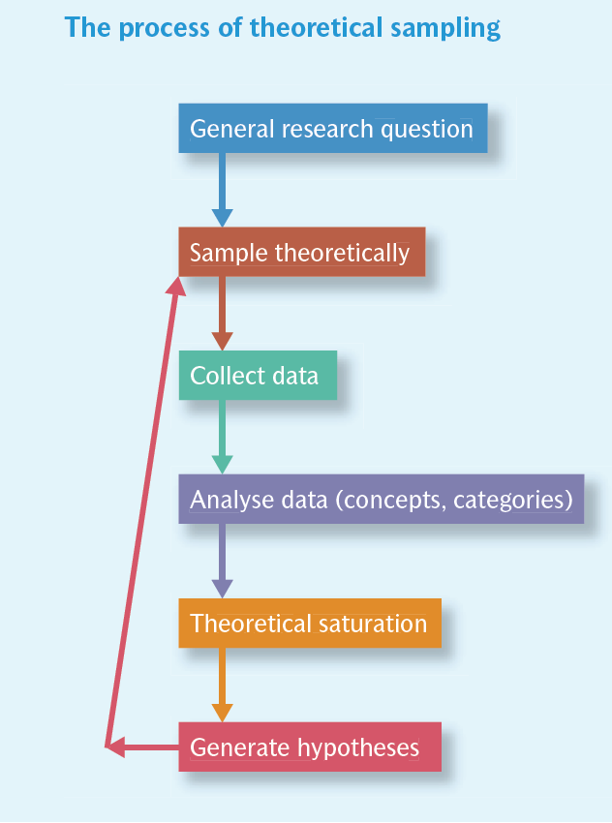

Slide 8
Convenience/Opportunistic Sampling
Selecting the most accessible subjects
The least costy to the researcher
May result in poor quality data and lacks intellectual credibility
Try to avoid; the least desirable method. If you have to, give explicit reasons why you are using this sampling method

Slide 9
Purposive Sampling
The most common in qualitative studies
Selection of units (people, organizations, documents, departments, etc) is done with direct reference to the research questions.
Research questions provide guidelines as to what categories of people (or whatever the unit of analysis is) need to be the focus of attention and therefore sampled.
Researcher selects the most productive sample to answer the research question
Sampling of context and sampling of participants/cases are to be considered

Slide 10
Different Strategies in Purposive Sampling
Extreme or deviant case sampling (outliers): Sampling cases that are unusual or that are unusually at the far end(s) of a particular dimension of interest.
  Generally used to develop a richer, more in-depth understanding of a phenomenon and to lend credibility to one's research account by showing extreme cases
Typical case sampling: Sampling a case because it exemplifies a dimension of interest.
Select the ones who are “average” (meeting your selected criteria); not the ones above or below average
  Generally used to develop a profile about what is normal or average for a particular phenomenon.

Slide 11
Critical case sampling: careful selection of cases to maximize the information you can get from a handful of samples--They are particularly important cases or ones that highlight vital information.
  For example, a case might be chosen precisely because it is anticipated that it might allow a theory to be tested.
Maximum variation sample: accessing a range of participants who will represent wide variations of the phenomena under study.
when you want to include extremes
to ensure as wide a variation as possible in terms of the dimension of interest.
  Used when
    you want to understand how different groups of people view a specific topic.
    You know little about the population (and so find it difficult or impossible to get a random sample).
    Random sampling is otherwise not practical (because of logistics or a small population).
    You want your sample to be as representative as possible; by sampling the extremes, together they may represent an “average” respondent.

Slide 12
Criterion sampling: Selecting cases that meet some predetermined criterion of importance
  Can be used
    for identifying and understanding cases that are information rich.
    to provide an important qualitative component to quantitative data.
    for identifying cases from a standardized questionnaire that might be useful for follow-up.
Snowball sampling: Asking participants to find more participants
  Researchers begin by identifying several participants who fit the study’s criteria
  Then they ask these people to suggest a colleague, a friend, or a family member.
It is used where potential participants are hard to find.

Slide 13
Stratified purposive (quota) sampling: Sampling of usually typical cases or individuals within subgroups of interest—sampling each subgroup independently
  Generally used in mixed methods
Key informant sampling: Selecting people who know about a population of interest (as a result of their personal skills, or position within a society).
  To get more information and a deeper insight into what is going on around them

Slide 14
Confirming/Disconfirming sampling: Identifying confirming and disconfirming cases after some portion of data collection and analysis.
sampling to verify the accuracy of preliminary findings.
  To get additional examples that lend further support, richness and depth to patterns emerging from data analysis (confirming cases)
  To get examples that do not fit emergent patterns and allow the research team to evaluate rival explanations (disconfirming cases). This can help the research team understand and define the limitations of research findings

