Slide 1
The Marketing Environment, Ethics, and Social Responsibility

Slide 2
Objectives
Identify the five components/ingredients of the marketing environment.
Explain the types of competition marketers face and the steps necessary for developing a competitive strategy.
Describe how marketing activities are regulated/ruled and how marketers can influence the political-legal environment.
Outline the economic factors that affect marketing decisions and consumer buying power.

Slide 3
Environmental Scanning/Observing
Collecting external marketing environment information to identify and interpret potential trends
Trends represent significant opportunities or threats to the company
Example: Consumer Product Safety Commission issued a recall/call back of children’s books due to choking/get drowned and laceration/wounding hazards.
What opportunities and threads Covid19 pandemic offers?

Slide 4
Environmental Management
Attainment/achievement of organizational objectives by predicting/forecast and influencing the competitive, political-legal, economic, technological, and social- cultural environments
Strategic alliance - Partnership in which two or more companies combine resources and capital to create competitive advantages in a new market

Slide 5
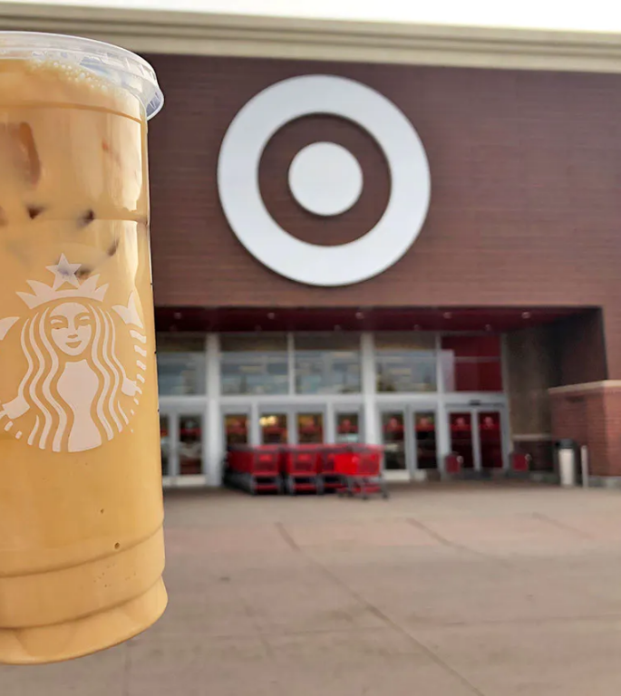
Strategic Alliances
Starbucks and Target
You’ve probably seen this strategic alliance several times – as soon as you walk into Target, there’s a Starbucks waiting to blend your favorite drink. Target and Starbucks knew both their brands had similar audiences (busy shoppers looking for affordable “luxuries” and a quick escape from the everyday).
This strategic alliance was formed all the way back in 1999 and is still going strong – we see thousands of Target stores hosting Starbucks cafes to fuel people’s Target runs. Target customers know if they get hungry or thirsty during a shopping trip, Starbucks has them covered right in store.

Slide 6
Strategic Alliances
The Turkish aerospace and defence industry giant, Turkish Aerospace Industries (TAI) - manufacturer of fighter planes, attack helicopters and military drones - and the Argentine company INVAP, dedicated to the development and construction of nuclear power plants, industrial technologies for defence, security and space, as well as medical and scientific equipment, have formed a joint venture in equal parts for the design, manufacture and marketing of new generation communication satellites.

Slide 7
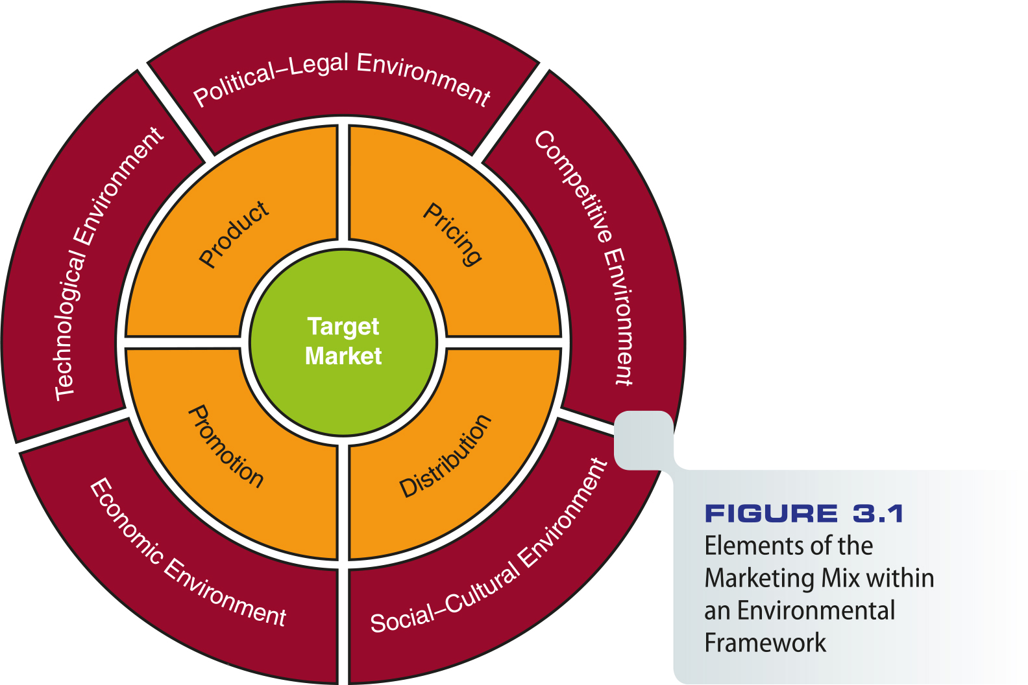
Figure 3.1 - Elements of the Marketing Mix within an Environmental Framework

Slide 8
The Competitive Environment
Interactive process that occurs in the marketplace among:
Marketers of directly competitive products
Marketers of products that can be substituted /replaced for one another
Marketers competing for the consumer’s purchasing power

Slide 9
The Competitive Environment
Marketing decisions by individual firms influence:
Consumer responses in the marketplace
Marketing strategies of competitors
Few organizations have monopoly positions
Monopoly - Market structure in which a single seller dominates trade/deal in a good or service for which buyers can find no close substitutes (and rivals).

Slide 10
The Competitive Environment
Antitrust/antimonopoly laws – Designed/ organised to prevent restraints/limits on trade such as business monopolies
Oligopoly* - Few number of sellers in an industry with high start-up costs which keep out new competitors
*An oligopoly is an industry dominated by a few large firms. For example, an industry with a five-firm concentration ratio of greater than 50% is considered a monopoly (https://www.economicshelp.org/microessays/markets/oligopoly/ Accessed: 10/18/2020).
- Turkey: Cement and automotive industry.
- Europe: The major airlines like British Airways (BA) and Air France often operate their routes with only a few close competitors, but there are also many small airlines catering for the holidaymaker or offering specialist services.

Slide 11
Types of Competition
Direct
Among marketers of similar products
Example: Alternative suppliers in the cell phone market such as Verizon, AT&T, and T-Mobile
ETİ vs ÜLKER in Turkey.
Indirect
Involves products that are easily substituted
Example: In the fast-food industry, pizza competes with chicken, hamburgers, and tacos
Simit (bagel), dürüm (kebap, döner) vs hamburger, pizza etc.

Slide 12
Types of Competition
Competition among all firms that compete for consumers’ purchases
All firms compete for a limited number of dollars that consumers can or will spend
Example: The purchase of a Honda Accord might compete with a Norwegian Cruise Line cruise (direct or indirect competiton?)

Slide 13
Developing a Competitive Strategy
Competitive strategy - Methods through which a firm deals with its competitive environment
Should we compete?
Depends on firm’s resources, objectives, and expected profit potential (worth?)
In what markets should we compete?
Requires marketers to acknowledge/admit their firm’s limited resources

Slide 14
Developing a Competitive Strategy
How should we compete?
Requires marketers to make product, distribution, promotion, and pricing decisions that give the firm a competitive advantage
Time-based competition - Strategy of developing and distributing goods more quickly than competitors.
Honda vs Yamaha Motorbike case (https://hbr.org/1988/07/time-the-next-source-of-competitive-advantage , Accessed: 10/18/2020).

Slide 15
The Political-Legal Environment
Consists of laws and their interpretations that require firms to operate under competitive conditions and to protect consumer rights
All marketers should be aware of the major regulations that affect their activities

Slide 16
Government Regulation (USA)
Falls into four historical phases:
Antimonopoly period of the late 19th and early 20th centuries
Protecting competitors during the Great Depression of the 1930s
The third phase focused on consumer protection
Industry deregulation (removing restrictions and regulations) began in the late 1970s and continues to the present

Slide 17
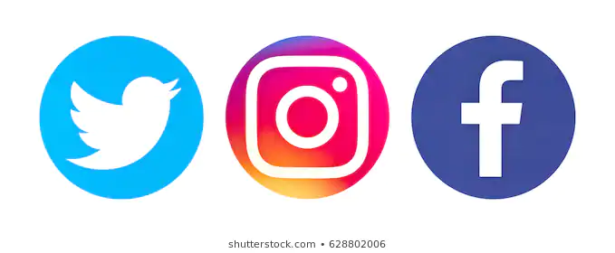
Government Regulation
Newest regulatory frontier/borderline is cyberspace/internet
Federal and state regulators are investigating ways to police the Internet and online services
Privacy and child protection issues are difficult enforcement challenge

Slide 18
Government Regulatory Agencies
The Federal Trade Commission (FTC) has the broadest regulatory powers over marketing
Enforces laws regulating unfair business practices and stops false and deceptive advertising.

Slide 19
Government Regulatory Agencies
Other federal regulatory agencies are:
Consumer Product Safety Commission
Federal Power Commission
Environmental Protection Agency
Food and Drug Administration
National Highway Traffic Safety Administration
To enforce laws, the FTC uses
Consent order
Cease-and-desist orders

Slide 20
Other Regulatory Forces (USA)
Consumer interest groups and self-regulatory organizations
Other groups attempt to advance the rights of minorities, senior citizens, and other causes
Self-regulatory groups represent industries’ attempts to set guidelines for responsible business conduct

Slide 21
The Economic Environment
Gross domestic product (GDP) - Sum of all goods and services produced by a nation in a year
Economic environment - Factors that influence consumer buying power and marketing strategies
Business cycle - Pattern of stages in the level of economic activity
Business cycles are the "ups and downs" in economic activity, defined in terms of periods of expansion or recession. During expansions, the economy, measured by indicators like jobs, production, and sales, is growing -in real terms, after excluding the effects of inflation. Recessions are periods when the economy is shrinking or contracting (https://www.frbsf.org/education/publications/doctorecon/2002/may/business-cycles-economy/, Accessed:10/18/2020).

Slide 22
Stages in the Business cycle
Prosperity/welfare - Consumer spending is brisk/vivid; growth in services sector
Recession/slowness - Consumers focus on basic, functional products
Depression/crisis - Consumer spending sinks/decreases to its lowest level
Recovery/upturn - Consumer purchasing power increases

Slide 23
The Global Economic Crisis
Business cycles take a severe/stringent turn and affect consumers and businesses across the globe
Marketers must reevaluate/reconsider their strategies and concentrate/focus on their most promising products

Slide 24
Inflation and Deflation
Inflation devalues/downrates money by reducing/lowering the products it can buy through persistent price increases
Deflation can cause:
A freefall/collapse in business profits
Lower returns on most investments
Widespread/extensive job layoffs/disemployments/dismissals

Slide 25
Inflation and Deflation
Unemployment - Proportion of people in the economy actively seeking work but do not have jobs
Rises during recession and declines during recovery and prosperity
Income - Influences consumer buying power
Marketers focus on discretionary income; the amount of money people must spend after buying necessities.
Discretionary income is a disposable income (after-tax income), minus all payments that are necessary to meet current bills. It is total personal income after subtracting taxes and minimal survival expenses (such as food, medicine, rent or mortgage, utilities, insurance, transportation, property maintenance, child support, etc.) to maintain a certain standard of living. It is the amount of an individual's income available for spending after the essentials have been taken care of:
Discretionary income = gross income – taxes – all compelled payments (bills). (Linden, Fabian; And Others https://files.eric.ed.gov/fulltext/ED310997.pdf , Accessed. 10/18/2020).

Slide 26
Resource Availability
Resources are not unlimited
Shortages/scarcities result from several conditions, including political instability and lack of raw materials, component parts, or labor
Demarketing - Reducing consumer demand for a good or service to a level that the firm can supply (mostly by increasing the price).

Slide 27
The International Economic Environment
Marketers must monitor/view the economic environment of other nations
Politics in other countries affects the international economic environment as well
How?

Slide 28
The Technological Environment
Represents/refers application/practises of knowledge based on discoveries in science, inventions, and innovations to marketing
Technology leads/results to:
New products
Improvements in existing products
Better customer service
Reduced prices

Slide 29
The Technological Environment
Technology addresses/studies social concerns
Sources of technology:
Industry
Educational institutions
Not-for-profit institutions
Federal government

Slide 30
Applying Technology
Marketers monitor new technology to gain a competitive edge/advantage and to enhance/emphasize customer service
VoIP (voice over Internet protocol) - A phone connection through a personal computer with any type of broadband Internet connection
Internet Protocol Multimedia Subsystem (IMS) will offer new opportunities to marketers

Slide 31
The Social-Cultural Environment
The relationship between the marketer, society, and culture
Marketers must be sensitive to demographic shifts/moves and changing values
Increasing importance of cultural diversity
Example: Univision and Telemundo face growing competition in Spanish-language television programming
Syrian population in Turkey!

Slide 32
Consumerism
Social force within the environment
Aids and protects the consumer
Exerts/employes legal, moral, and economic pressures on business and government
Consumerism is a social and economic order that encourages the acquisition of goods and services in ever-increasing amounts. With the industrial revolution, but particularly in the 20th century, mass production led to overproduction—the supply of goods would grow beyond consumer demand, and so manufacturers turned/invert to planned obsolescence/aging and advertising to manipulate consumer spending (https://en.wikipedia.org/wiki/Consumerism, Accessed. 10/18/2020).

Slide 33
Consumerism
Consumer rights:
The right to choose freely
The right to be informed
The right to be heard
The right to be safe

Slide 34
Ethical Issues in Marketing
Marketing ethics - Marketers’ standards of conduct/behavior and moral/ethical values
Some industries are required by law to maintain corporate-level positions responsible for ethics and legal compliance/obedience
Workplace may generate serious conflicts when individuals discover that their ethical beliefs don’t match those of their employer
While ethics can refer broadly to moral principles, one often sees it applied to questions of correct behavior within a relatively narrow area of activity: Our class had a debate over the ethics of genetic testing.
Morals often describes one’s particular values concerning what is right and what is wrong: It would go against my morals to help you cheat on the test.
In addition, morals usually connotes/indicates an element of subjective preference, while ethics tends to suggest aspects of universal fairness and the question of whether or not an action is responsible: Crossing the red light when there is no traffic on a secluded road (https://www.merriam-webster.com/dictionary/ethic#note-1, Accessed. 10/18/2020).

Slide 35
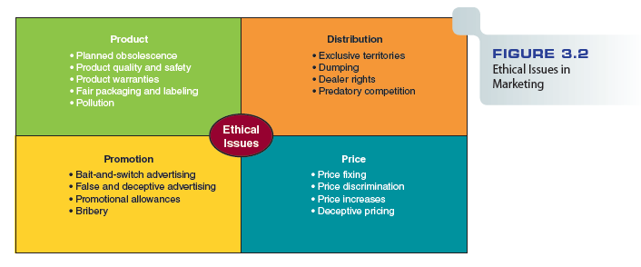
Figure 3.2 - Ethical Issues in Marketing

Slide 36
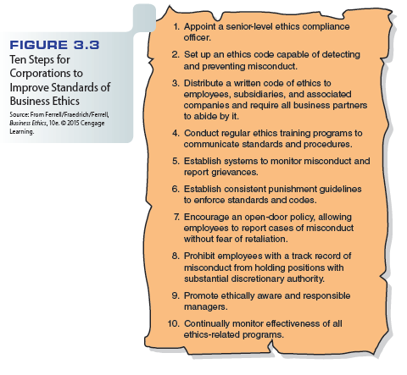
Figure 3.3 - Ten Steps for Corporations to Improve Standards of Business Ethics

Slide 37
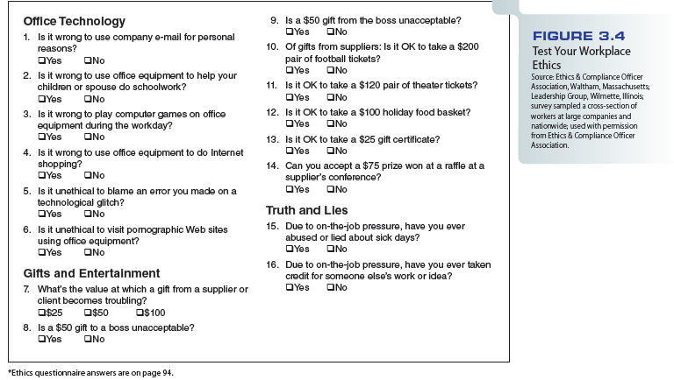
Figure 3.4 - Test Your Workplace Ethics

Slide 38
Ethics in Marketing Research
Consumers are concerned about privacy
Proliferation of databases
Selling of address lists
Ease with which consumer information can be gathered
Several agencies offer assistance
The U.S. government maintains a Do Not Call registry to prevent unwanted telemarketing

Slide 39
Ethics in Product Strategy
Product quality, planned obsolescence, brand similarity, and packaging raise ethical issues
Example: Packaging strategy
Larger packages are more noticeable on the shelf
Oddly/weirdly sized packages make price comparison difficult
Bottles with concave bottoms appear/seem to have more liquid in them than they do
PO: https://durabilitymatters.com/planned-obsolescence/

Slide 40
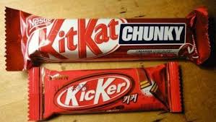
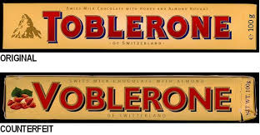
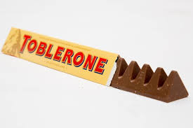
Brand & Logo Similarity

Slide 41
Ethics in Distribution
What is the appropriate degree of control over the distribution channel?
Should a company distribute its products in marginally profitable outlets that have no alternative source of supply?
Influenza vaccine: Community Clinic/Public Hospital vs Private Hospital/Pharmacy

Slide 42
Ethics in Promotion
Truth/reality in advertising is the bedrock/basis of ethics in promotion
Marketing to children has come under increased scrutiny/inspection
Promoting specific products to college students can raise ethical questions

Slide 43
Ethics in Pricing
Most regulated aspect of a firm’s marketing activities
Example: Credit-card companies target consumers with poor credit ratings
Offer them what industry observers call “subprime (high interest rate)” or “fee-harvesting” credit cards
Fee-harvesting credit cards are those whose purpose is to generate fee income for the issuer. The cards tend to have low credit limits, much of which can be eaten up by the various fees imposed, from processing fees to monthly and annual fees. Because the worst of these cards were unfair to consumers, the Credit CARD Act of 2009 included caps on fees. The act says no more than one-quarter of a card’s credit limit can be consumed by fees in the first year the account is opened. Thus, fees on a card with a $400 limit are capped at $100.

Slide 44
Social Responsibility in Marketing
Marketing philosophies, policies, procedures, and actions that have the enhancement of society’s welfare as a primary objective
Four dimensions of social responsibility:
Economic
Legal
Ethical
Philanthropic/Humanitarian

Slide 45
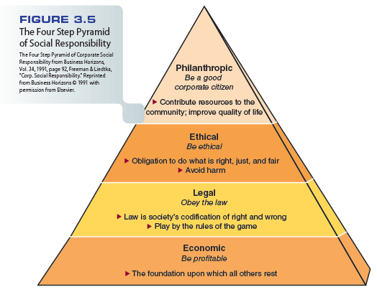
Figure 3.5 - The Four Step Pyramid of Social Responsibility

Slide 46
Marketing’s Responsibilities
Corporate responsibility covers the entire framework of society
Marketers must consider:
The global effects of their decisions
The long-term effects of their decisions
The well-being of future generations
For example fast-food and ready-to-eat-packed food industry: Lowering salt, saturated fat, preservatives and additives etc.
Entire communities can benefit through socially responsible investing

Slide 47
Marketing and the Environment
Environmental issues influence all areas of marketing decision making
Green marketing - Production, promotion, and reclamation/reformation of environmentally sensitive products.

Slide 48
Strategic Implications of Marketing in the 21st Century
With the Internet and rapid changes in technology, competition is even more intense than before
Marketers face new regulations as the political and legal environment responds to changes in the United States and abroad
Ethics and social responsibility must underlie/support everything that marketers do in the 21st century

Slide 49
Zappos Video
http://www.cengage.com/marketing/book_content/boone_9781133628460/videos/ch03.html

