Slide 1
Strategic Planning in Contemporary Marketing

Slide 2
Objectives
Distinguish/differentiate between strategic planning and tactical planning.
Explain how marketing plans differ at various levels in an organization.
Identify the six steps in the marketing planning process.

Slide 3
Objectives
Describe successful planning tools and techniques, including Porter’s Five Forces model, first and second mover strategies, SWOT analysis, and the strategic window.
Identify the two basic elements of a marketing strategy.
Describe the environmental characteristics that influence/affect strategic decisions.

Slide 4
Objectives
Describe the methods for marketing planning, including business portfolio analysis and the BCG matrix.

Slide 5
Marketing Planning: The Basis for Strategy and Tactics
Planning – Anticipating/expecting future events and conditions and determining the best way to achieve organizational objectives
Continuous process that includes:
Identifying objectives
Determining the actions through which a firm can attain/achieve those objectives
Creates a blueprint/road map for everyone in the organization

Slide 6
Marketing Planning: The Basis for Strategy and Tactics
Marketing planning – Implementing/applying planning activities devoted/allocated to achieving marketing objectives
Many planning activities take place over/happen the Internet with virtual conferences

Slide 7
Marketing Planning: The Basis for Strategy and Tactics
An important trend in marketing planning centers on/concentrates on relationship marketing
A firm’s effort to develop long-term, cost-effective links with individual customers and suppliers for mutual benefit.
Briefly, relationship marketing is about forming/ building long-term relationships with customers…

Slide 8
Relationship Marketing: Some Good Practises
- Conduct regular polls and surveys to solicit feedback from customers.
- Respect that feedback and incorporate it into the company's business practices.
- Use all social media outlets to connect with customers.
- Have effective customer monitoring technologies in place.
- Use clear policies to dictate how all company employees should interact with customers in both positive and negative situations.
- Leverage the value of warm leads – customers who have already expressed an interest in the company.
- Have a comprehensive customer relationship management strategy.
- Conduct regular training sessions for all members of staff.
- Stay on the cutting edge/prominent of product offerings.
- Do not sacrifice quality for innovativeness.
- Maintain a high customer satisfaction rate in all areas of the company.
- Try to inform customers how much they are appreciated (https://www.marketing-schools.org/types-of-marketing/relationship-marketing.html, accessed. 10.11.2020).

Slide 9
Strategic Planning Versus Tactical Planning
Strategic Planning
Determining an organization’s primary objectives
Adopting courses of action/ways that will achieve these objectives
Provides long-term direction for its decision makers
Tactical Planning
Guides the implementation of activities specified in the strategic plan
Addresses shorter-term actions

Slide 10
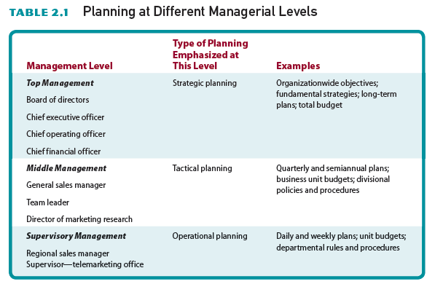
Table 2.1 - Planning at Different Managerial Levels

Slide 11
Steps in the Marketing Planning Process
Defining the organization’s mission and objectives
Mission - Essential purpose that differentiates one company from another
Walmart: “Save money. Live better.”
Infiniti: “Inspired performance.”
Amazon.com: "To continually raise the bar of the customer experience by using the internet and technology to help consumers find, discover and buy anything, and empower businesses and content creators to maximize their success. We aim to be Earth's most customer centric company."

Slide 12
The Mission
-Google: "To organize the world's information and make it universally accessible and useful. That's why Search makes it easy to discover a broad range of information from a wide variety of sources."
- Apple: “To bring the best personal computing products and support to students, educators, designers, scientists, engineers, businesspersons and consumers in over 140 countries around the world.”
Mission vs Vision?

Slide 13
Steps in the Marketing Planning Process
Objectives/Goals - Guide the development of marketing objectives and plans
For example:
Generate a 15 percent profit over the next 24 months
Add 25 new outlets within the next year
Objective or Goal?

Slide 14
Assessing Organizational Resources and Evaluating Environmental Risks and Opportunities
Resources include:
Production
Marketing
Finance
Technology
Employees
Strengths help planners:
Set objectives
Develop plans
Take advantage of marketing opportunities
What marketing opportunities does Covid19-pandemic offer?

Slide 15
Formulating, Implementing, and Monitoring a Marketing Strategy
Marketing strategy - Selecting and satisfying target consumers through the marketing mix elements
The final steps of the planning process:
Marketers put the marketing strategy into action
Marketers monitor/follow performance to ensure that objectives are achieved

Slide 16
Successful Strategies: Tools and Techniques
Porter’s Five Forces model
The potential of new entrants
The bargaining power of buyers
The bargaining power of suppliers
The threat/risk of substitute products
Rivalry/competition among competitors

Slide 17
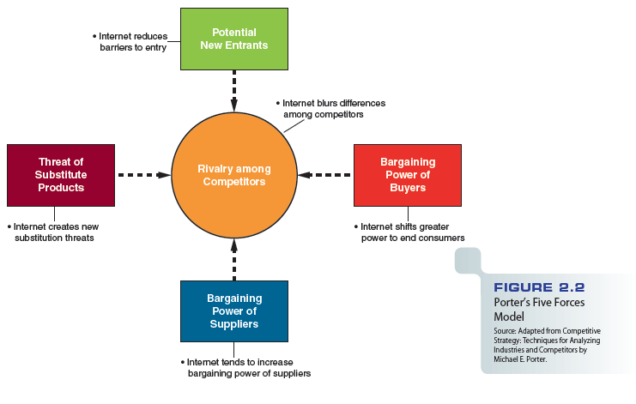
Figure 2.2 - Porter’s Five Forces Model

Slide 18
First Mover and Second Mover Strategies
First mover strategy - The company first to offer a product in a marketplace will be the long-term market winner. Sana-soft ghee, Selpak-tissue, Coca Cola-coke, I-phone (1997) etc.
Second mover strategy - Observing the innovations of first movers and then improving on them to gain advantage in the Marketplace. Avis (#1 Hertz), Pepsi Cola, Airbus (#1 Boeing), Samsung (2009) etc.

Slide 19
SWOT Analysis
Helps planners compare internal organizational strengths and weaknesses with external opportunities and threats
Provides managers with a critical view of the organization’s internal and external environments
Helps them evaluate the firm’s fulfillment of its basic mission

Slide 20
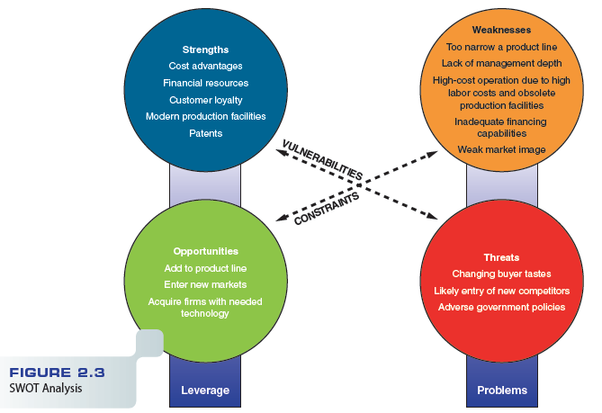
Figure 2.3 - SWOT Analysis

Slide 21
The Strategic Window
Limited periods when key requirements of a market and a firm’s particular competencies best fit together
Requires a thorough analysis of:
Current and projected external environmental conditions
Current and projected internal company capabilities
How, whether, and when the firm can reconcile/conform environmental conditions and company capabilities

Slide 22
Elements of a Marketing Strategy
The target market
Marketing mix (E. Jerome McCarthy-1960) variables
4Ps and 1 C of New Age Spiritually: A Hollistic Marketing Review ( Emre Başçı,
https://pdfs.semanticscholar.org/8f3d/34a798ca22fd1707793270a031afd40d4abf.pdf, accessed.11.10.2020).
Extended Marketing Mix (7Ps) in 1981 by Booms & Bitner
- People: Refer to the staff and salespeople who work for your business, including yourself.
- Process: Refers to the processes involved in delivering your products and services to the customer.
- Physical evidence: Refers to everything your customers see when interacting with your business ( https://www.business.qld.gov.au/running-business/ marketing-sales/marketing-promotion/marketing-basics/seven-ps-marketing,
accessed. 11.10.2020).

Slide 23
Other Considerations
The 4Cs marketing model was developed by Robert F. Lauterborn in 1990. It is a modification of the 4Ps model.
It is not a basic part of the marketing mix definition, but rather an extension.

Slide 24
The Target Market
The group of people toward whom the firm directs its marketing efforts and merchandise
Example: Boeing markets most of their products to business buyers such as Delta Airlines
Diversity/multiplicity plays a critical role
Example: Growing Hispanic population in United States. Increasing number of Syrians in Turkey.
Targeting consumers in specific global markets represents a challenge/difficulty and an opportunity

Slide 25
Marketing Mix Variables
Marketing mix – Blending/combining four strategy elements to fit the needs and preferences of a specific target market
Product
Distribution
Promotion
Pricing

Slide 26
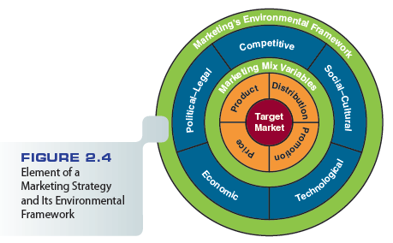
Figure 2.4 - Element of a Marketing Strategy and Its Environmental Framework*

Slide 27
Target Market
* Marketing Environmental Framework
A marketing environmental framework refers to the external forces that can affect it. The environment, or external forces, are often factors that a business cannot control, yet it is important to be aware of environmental concerns when preparing a marketing plan or introducing a new product to the market. The most common method for preparing a marketing environmental analysis is to conduct a PESTLE analysis, which stands for Political, Economic, Social, Technological, Legal and Environmental, all areas affecting a business.
PESTEL-E-Analysis: Political, Economic, Social, Technological, Environmental, Legal, Ethical (new)
It is a tool used to analyse and monitor the macro-environmental factors that may have a profound/deep/intense impact on an organization's performance. This tool is especially useful when starting a new business or entering a foreign market. It is often used in collaboration with other analytical business tools such as the SWOT analysis and Porter’s Five Forces to give a clear understanding of a situation and related internal and external factors.

Slide 28
Product Strategy
Deciding what goods or services the firm should offer to a group of consumers
Customer service
Package design
Brand names, trademarks, patents, and warranties
Lifecycle of a product
Product positioning
New-product development

Slide 29
Distribution Strategy
Consumers find their products in the proper/sufficient quantities at the right times and places
Involves modes/type of transportation, warehousing, inventory control, order processing, and selection of marketing channels
Technology has opened new channels of distribution in many industries

Slide 30
Promotion Strategy
Communication link between sellers and buyers
Firms may communicate messages:
Directly through salespeople (advantage?)
Indirectly through advertisements and promotions (disadvantage?)
Many companies use integrated marketing communications (IMC)

Slide 31
Pricing Strategy (why most important?)
Deals with methods of setting profitable and justifiable prices
Subject to regulation and public scrutiny
A good pricing strategy:
Creates value for customers
Builds and strengthens customer relationships with a firm and its products

Slide 32
The Marketing Environment
Five external dimensions that affect the marketing mix variables:
Competitive
Political-legal
Economic
Technological
Social-cultural

Slide 33
The Marketing Environment
Businesses increasingly looking to foreign shores for new growth markets
Technology continues changing the marketing environment
Rule of three (The rule of three: Surviving and thriving in competitive markets by Jagdish Sheth&Rajendra Sisodia) - In any industry, the three strongest, most efficient companies dominate 70 and 90 percent of a market (Gordon, R. M. Marketing Management; Chicago Vol. 10, Iss. 4, (Nov/Dec 2001): 53-54.)
Example: Cereal manufacturers - General Mills, Kellogg’s, and Post

Slide 34
Methods for Marketing Planning
Business portfolio analysis
An evaluation of a company’s products and divisions to determine the strongest and weakest

Slide 35
Strategic Business Units
Key business units within diversified firms
Each strategic business unit (SBU):
Has its own managers, resources, objectives, and competitors
Pursues its own distinct mission and develops its own plans independently
Help focus the attention of company managers.
Companies may have to redefine/reconsider their SBUs as market conditions dictate

Slide 36
The BCG Matrix
Developed by the Boston Consulting Group
A market share/market growth matrix that plots market share against market growth potential

Slide 37
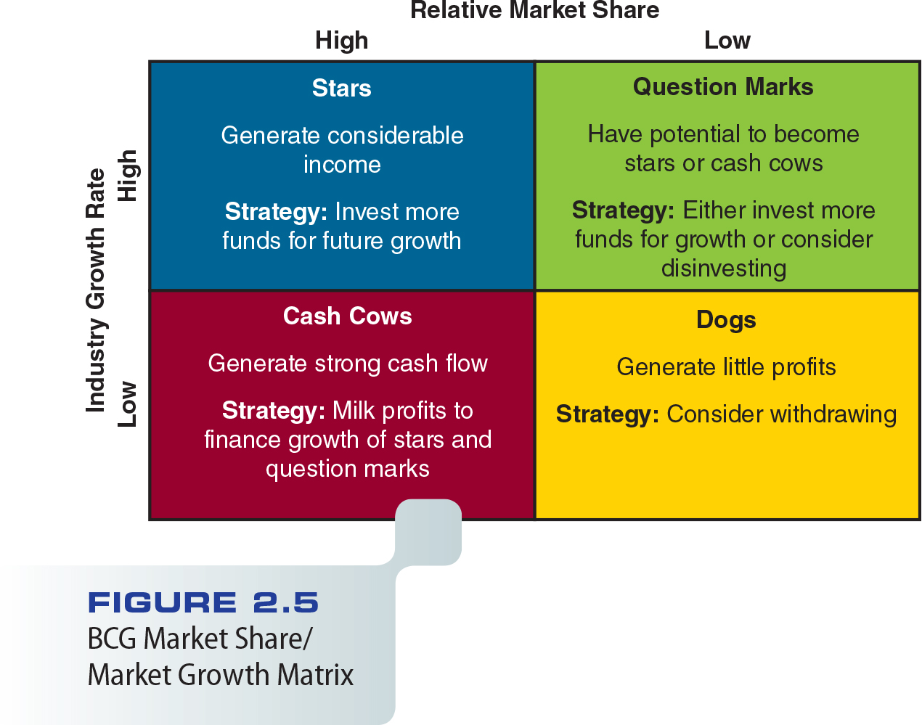
Figure 2.5 - BCG Market Share/Market Growth Matrix

Slide 38
Apple – Coca Cola

Slide 39
Samsung - Nestle

Slide 40
Strategic Implications of Marketing in the 21st Century
Planning becoming vital as technology advances
Marketers must consider:
A changing, diverse population
The boundaryless business environment created by the Internet
Planning reduces risk and worry of bringing new goods and services to the market

Slide 41
Nederlander Video
http://www.cengage.com/marketing/book_content/boone_9781133628460/videos/ch02.html

