Slide 1
SPSS FOR CHI-SQUARE

Slide 2
Chi-Square Test (X²) for Independence
-used if you want to EXPLORE the RELATIONSHIP between TWO categorical variables.
-COMPARES the observed frequencies or proportions of cases that occur in each category with the values that would be expected if there was no association between the two variables.
-based on a crosstabulation variable (female/male, smoker/non-smoker, married/single, etc.)

Slide 3
A sample crosstabulation
To see the significance here, we need chi-square test.

Slide 4
Example Research Questions
Is there an association between gender and fear of speaking in English?
Are males more likely to be afraid of speaking in English than females?
Is the proportion of males who are afraid of speaking in English the same as the proportion of females?

Slide 5
How to use SPSS for Chi-Square
Use chisquare data.sav
1. Click on Analyze, then Descriptive Statistics, and then Crosstabs.
2. Click on one of your variables (e.g. gender) to be your row variable and click on the arrow to move it into the box marked Row(s).
3. Click on the other variable to be your column variable (e.g. fearspeaking) and click on the arrow to move it into the box marked Column(s).
4. Click on the Statistics button. Tick Chi-square and Phi and Cramer’s V. Click on Continue.
5. Click on the Cells button.
• In the Counts box, make sure there is a tick for Observed.
• In the Percentage section, click on the Row box.
• In the Residuals section click on Adjusted standardized.
6. Click on Continue and then OK

Slide 6
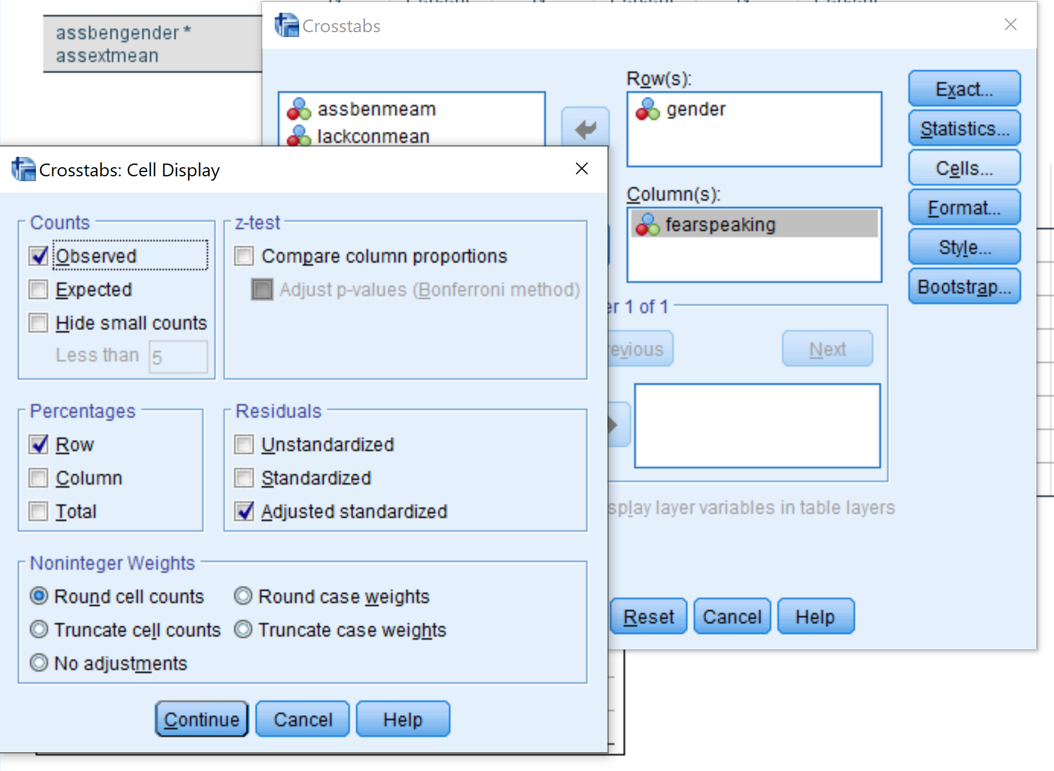

Slide 7
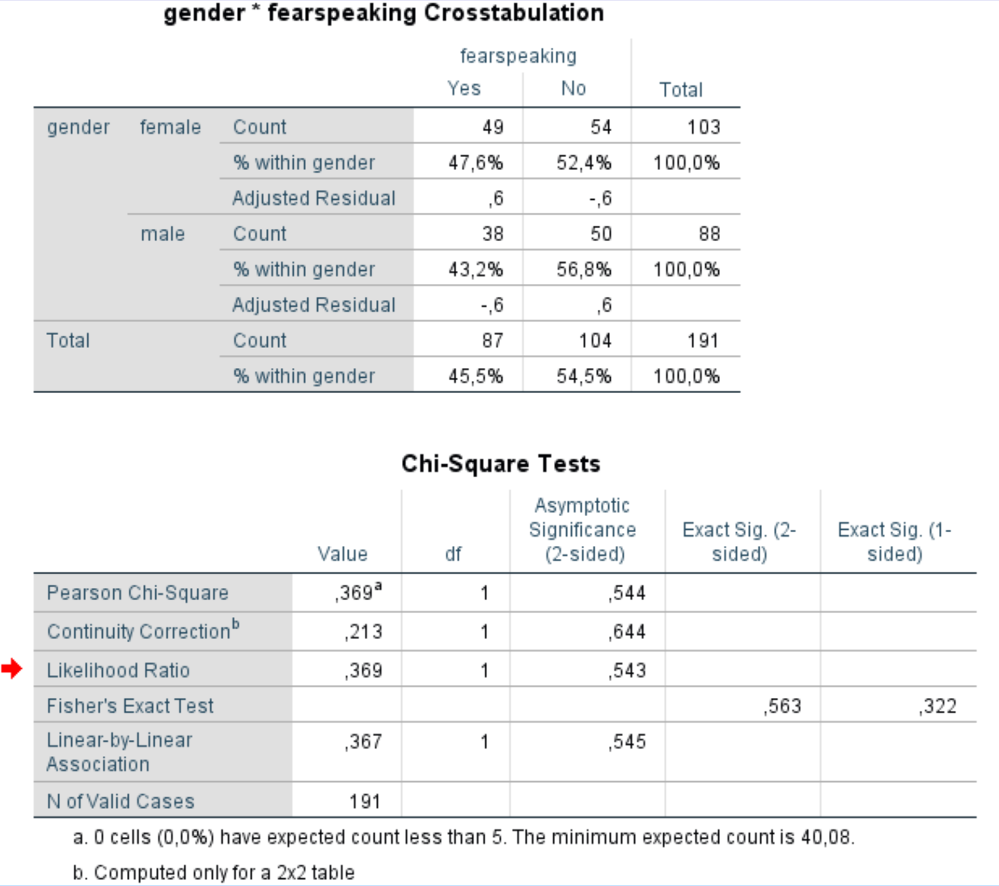

Slide 8
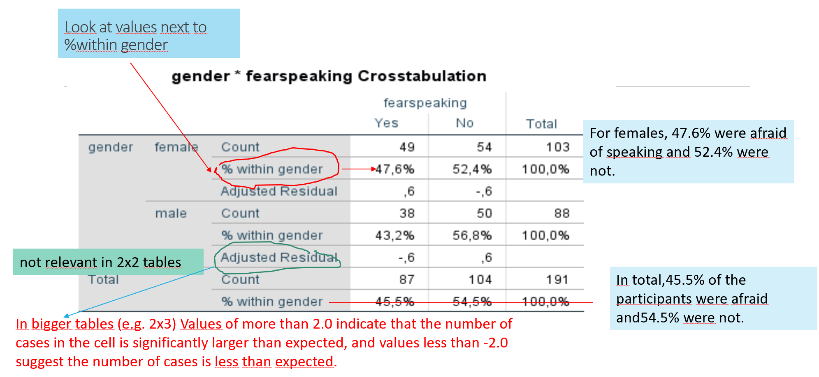

Slide 9
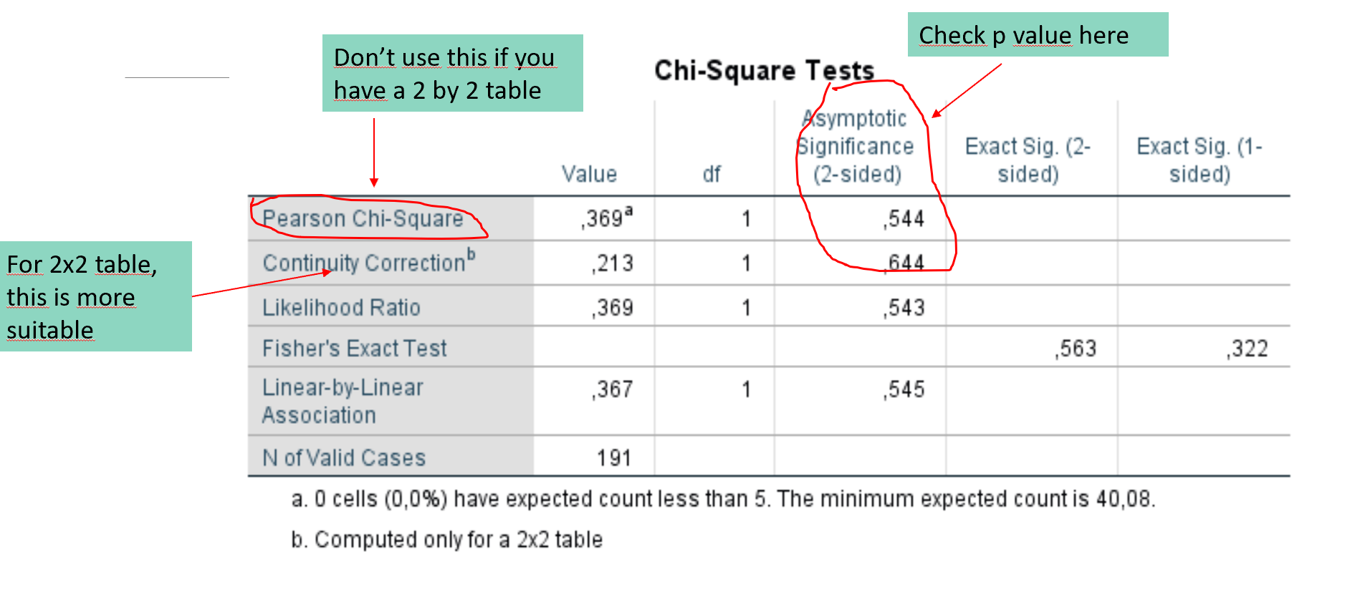
İmportant for violation

Slide 10
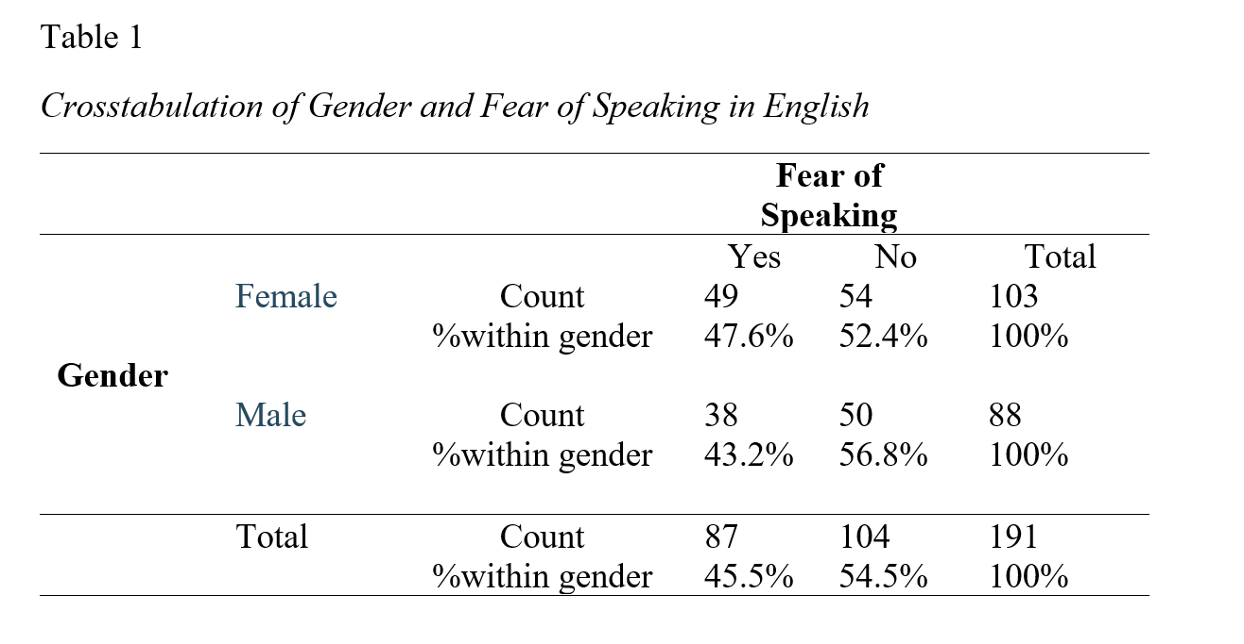
APA Table and Presenting the Results
A chi-square test (with Yates’ Continuity Correction) indicated no significant association between gender and fear of speking in English: χ2 (1, n = 191) = .21, p = .64.
(All the descriptive information in Table 1 should be written as well)

