Slide 1
Chapter 3:Equivalence and Equivalent Effect

Slide 2
INTRODUCTION
In order to avoid the age-old opposition between literal and free translation
theoreticians in the 1950s and 1960s began to attempt more systematic
analyses. The new debate revolved around certain key linguistic issues. The
most prominent were those of ‘meaning’ and ‘equivalence’, discussed in Roman
Jakobson’s 1959 paper .Over the following twenty years many
further attempts were made to define the nature of equivalence. In this chapter
we shall look at several major works of the time: Eugene Nida’s seminal concepts
of formal and dynamic equivalence and the principle of equivalent effect
Peter Newmark’s semantic and communicative translation
and Werner Koller’s Korrespondenz and Aquivalenz

Slide 3
Roman Jakobson

Slide 4
Roman Jakobson

Slide 5
Eugene Nida

Slide 6
Eugene Nida (THE SCIENCE OF TRANSLATING)

Slide 7
Noam Chomsky (THE INFLUENCE OF CHOMSKY)
Born: 7 December 1928
Born Place:Pensilvanya,Philidelphia
Linguist
Critic
Philosopher
Political Scientist
Logician
Author
Historian
He is still working at Massachusetts Technology Institute as a Linguist and Professor

Slide 8
The Influnce of Chomsky

Slide 10
THE NATURE OF MEANING:ADVANCES IN SEMANTICS AND PRAGMATICS
When it comes to analysing individual words, Nida describes
various ‘scientific approaches to meaning’ related to work that had been carried
out by theorists in semantics and pragmatics
Meaning is broken down into the following:
Linguistic meaning: the relationship between different linguistic structures,
borrowing elements of Chomsky’s model. Nida provides
examples to show how the meaning crucially differs even where similar
classes of words are used. For instance, the following three expressions
with the possessive pronoun his all have different meanings: his house
means ‘he possesses a house’, his journey equals ‘he performs a journey’
and his kindness is ‘kindness is a quality of him’.
Referential meaning: the denotative ‘dictionary’ meaning. Thus, son
denotes a male child.
Emotive or connotative meaning: the associations a word produces.
So, in the phrase ‘Don’t worry about that, son’, the word son is a term of
endearment or may in some contexts be patronizing.

Slide 11
Techniques to determine referential and emotive meaning focus on analysing the structure of
words and differentiating similar words in related lexical fields. These include
hierarchical structuring, which differentiates series of words according to
their level (for instance, the superordinate animal and its hyponyms goat, dog,
cow, etc.) and techniques of componential analysis

Slide 12
Another technique is semantic structure analysis in which Nida separates out visually the different meanings of spirit (‘demons’, ‘angels’,
‘gods’, ‘ghost’, ‘ethos’, ‘alcohol’, etc.) according to their characteristics (human vs. non-human, good vs. bad, etc.).
The central idea of this analysis is to encourage
the trainee translator to realize that the sense of a complex semantic term such as
spirit (or, to take another example, bachelor) varies and most particularly is ‘conditioned’
by its context.

Slide 13
Dynamic vs Formal Equivalance

Slide 14
Discussion of the importance of Nida’s Work

Slide 15
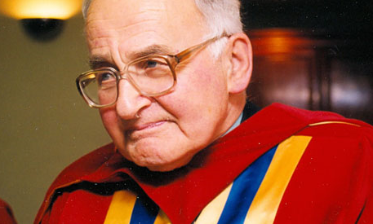
PETER NEWMARK

Slide 20
Koller:Equivalance Relations

