Slide 1
Fundamentals of Corporate Finance Tenth Edition
Chapter 3
Accounting and Finance
©2020 McGraw-Hill Education. All rights reserved. Authorized only for instructor use in the classroom. No reproduction or further distribution permitted without the prior written consent of McGraw-Hill Education.

Slide 2
Topics Covered
3.1 The Balance Sheet.
3.2 The Income Statement.
3.3 The Statement of Cash Flows.
3.4 Accounting Practice and Malpractice.
3.5 Taxes.

Slide 3
The Balance Sheet 1
Definition
Financial statement that shows the value of the firm’s assets and liabilities at a particular time (from an accounting perspective)

Slide 4
The Balance Sheet 2
The Main Balance Sheet Items
Current Assets
Cash & Securities
Receivables
Inventories
+
Fixed Assets
Tangible Assets
Intangible Assets
Current Liabilities
Payables
Short-term Debt
+
Long-term Liabilities
+
Shareholders’ Equity
=

Slide 5
The Balance Sheet 3
Home Depot’s Balance Sheet (December 31, 2017) $ Millions
End of fiscal
End of fiscal
Assets | 2017 | 2016 | Liabilities and shareholders’ equity | 2017 | 2016
Current assets |  |  | Current liabilities
Cash and marketable securities | 3,595 | 2,538 | Debt due for repayment | 2,761 | 1,252
Receivables | 1,952 | 2,029 | Accounts payable | 11,628 | 11,212
Inventories | 12,748 | 12,549 | Other current liabilities | 1,805 | 1,669
Other current assets | 638 | 608 | Total current liabilities | 16,194 | 14,133
Total current assets | 18,933 | 17,724
 |  |  | Long-term debt | 24,267 | 22,349
Fixed Assets |  |  | Other long-term liabilities | 2,614 | 2,151
Tangible fixed assets
Property, plant, and equipment | 41,413 | 40,426 | Total liabilities | 43,075 | 38,633
Less accumulated depreciation | 19,339 | 18,512
Net tangible fixed assets | 22,075 | 21,914 | Shareholders’ equity
 |  |  | Common stock and other paid-in capital | 9,715 | 9,010
Intangible asset (goodwill) | 2,275 | 2,093 | Retained earnings | 39,935 | 35,517
Other assets | 1,246 | 1,235 | Treasury stock | (48,196) | (40,194)
 |  |  | Total shareholders’ equity | 1,454 | 4,333
Total Assets | 44,529 | 42,966 | Total liabilities and shareholders’ equity | 44,529 | 42,966

Slide 6
The Balance Sheet 4
Common-Size Balance Sheet
All items in the balance sheet are expressed as a percentage of total assets.

Slide 7
The Balance Sheet 5
Home Depot Common Size Balance Sheet (December 31, 2017) $ Millions
End of fiscal
End of fiscal
Assets | 2017 | 2016 | Liabilities and shareholders’ equity | 2017 | 2016
Current assets |  |  | Current liabilities
Cash and marketable securities | 8.1% | 5.9% | Debt due for repayment | 6.2% | 2.9%
Receivables | 4.4% | 4.7% | Accounts payable | 26.1% | 26.1%
Inventories | 28.6% | 29.2% | Other current liabilities | 4.1% | 3.9%
Other current assets | 1.4% | 1.4% | Total current liabilities | 36.4% | 32.9%
Total current assets | 42.5% | 41.3%
 |  |  | Long-term debt | 54.5% | 52.0%
Fixed Assets |  |  | Other long-term liabilities | 5.9% | 5.0%
Tangible fixed assets
Property, plant, and equipment | 93.0% | 94.1% | Total liabilities | 96.7% | 89.9%
Less accumulated depreciation | 43.4% | 43.1%
Net tangible fixed assets | 49.6% | 51.0% | Shareholders’ equity
 | 0.0% | 0.0% | Common stock and other paid-in capital | 21.8% | 21.0%
Intangible asset (goodwill) | 5.1% | 4.9% | Retained earnings | 89.7% | 82.7%
Other assets | 2.8% | 2.9% | Treasury stock | −108.2% | −93.5%
 |  |  | Total shareholders’ equity | 3.3% | 10.1%
Total Assets | 100.0% | 100.0% | Total liabilities and shareholders’ equity | 100.0% | 100.0%

Slide 8
Book Values and Market Values 1
Book Values
Value of assets or liabilities according to the balance sheet
Market Values
The value of assets or liabilities were they to be resold in a market
Generally Accepted Accounting Principles (GAAP)
Procedures for preparing financial statements
Equity and asset “market values” are usually higher than their “book values.”

Slide 9
Book Values and Market Values 2
Example
According to GAAP, your firm has equity worth $6 billion, debt worth $4 billion, assets worth $10 billion. The market values your firm’s 100 million shares at $75 per share and the debt at $4 billion.
Q: What is the market value of your assets?
A: Since (Assets = liabilities + equity), your assets must have a market value of $11.5 billion

Slide 10
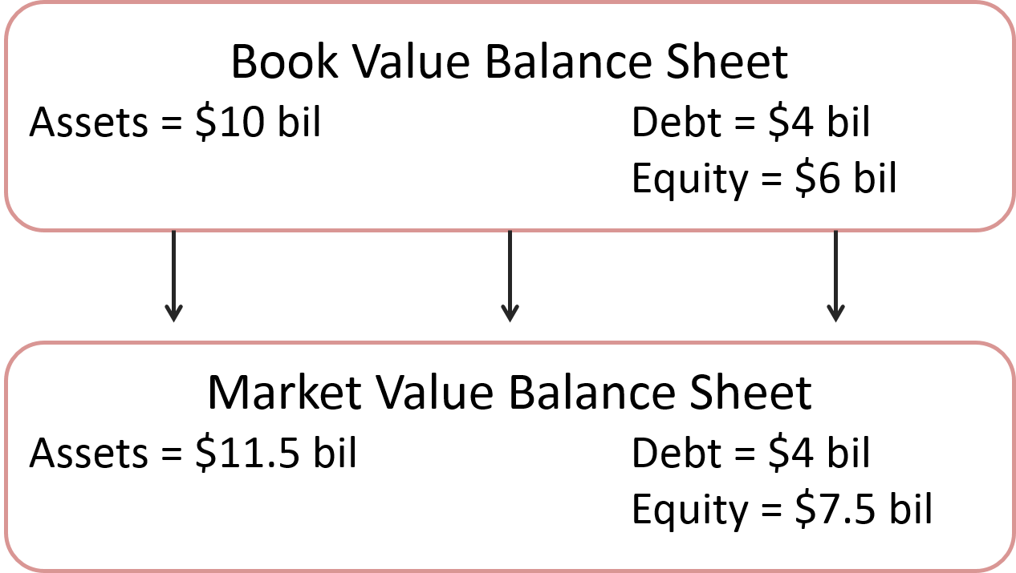
Book Values and Market Values 3
Example (continued)
Access the text alternative for these images

Slide 11
The Income Statement 1
Definition
Financial statement that shows the revenues, expenses, and net income of a firm over a period of time (from an accounting perspective)

Slide 12
The Income Statement 2
Home Depot’s Income Statement (December 31, 2017) $ Millions
 | $ Million | % of Sales
Net sales | 100,904 | 100.0%
Other Income | 325 | 0.3%
Cost of goods sold | 66,548 | 66.0%
Selling, general & administrative expenses | 17,864 | 17.7%
Depreciation | 2,062 | 2.0%
Earnings before interest and income taxes (EBIT) | 14,755 | 14.6%
Interest expense | 1,057 | 1.0%
Taxable income | 13,698 | 13.6%
Taxes | 5,068 | 5.0%
Net income | 8,630 | 8.6%
Allocation of net income
Dividends | 4,212 | 4.2%
Addition to retained earnings | 4,418 | 4.4%

Slide 13
The Income Statement 3
Earnings Before Interest and Taxes (EBIT)
EBIT = total revenues + other income − costs − depreciation
= 100,904 + 325 − (66,547 + 17,864) − 2,062
= $14,755 million
Home Depot’s Income Statement (December 31, 2017)

Slide 14
Profits versus Cash Flows
Differences
“Profits” subtract depreciation (a non-cash expense)
“Profits” ignore cash expenditures on new capital (the expense is capitalized)
“Profits” record income and expenses at the time of sales, not when the cash exchanges actually occur
“Profits” do not consider changes in working capital

Slide 15
The Statement of Cash Flows 1
Definition
Financial statement that shows the firm’s cash receipts and cash payments over a period of time

Slide 16
The Statement of Cash Flows 2
Home Depot Statement of Cash Flows (December 31, 2017) $ Millions
Cash provided by operations:
Net income | 8,630
Depreciation | 2,062
Changes in working capital items
Decrease (increase) in accounts receivable | 139
Decrease (increase) in inventories | (84)
Decrease (Increase) In other current assets | (10)
Increase (decrease) in accounts payable | 352
Increase (decrease) in other current liabilities | 669
Total decrease (increase) in working capital | 1,066
Cash provided by operations | 11,758

Slide 17
The Statement of Cash Flows 3
Home Depot Statement of Cash Flows (December 31, 2017) $ Millions (continued)
Cash flows from investments:
Capital expenditure | (1,897)
Sales (acquisitions) of long-term assets | 47
Other investing activities | (105)
Cash provided by (used for) investments | (1,955)
Cash provided for (used by) financing activities:
Increase (decrease) in short-term debt | 850
Increase (decrease) in long-term debt | 2,448
Dividends | (4,212)
Repurchases of stock | (7,745)
Other | (211)
Cash provided by (used for) financing activities | (8,870)
Net increase (decrease) in cash and cash equivalents | 933

Slide 18
The Statement of Cash Flows 4
Home Depot Statement of Cash Flows (December 31, 2017) $ Millions (continued)
Cash provided by operations | 11,758
Cash provided by (used for) investments | (1,955)
Cash provided by (used for) financing activities | (8,870)
Net increase (decrease) in cash and cash equivalents | 933

Slide 19
Free Cash Flow
Free Cash Flow (FCF)
Cash available for distribution to investors after firm pays for new investments or additions to working capital
FCF = Net Income
+ interest
+ depreciation
− additions to net working capital
− capital expenditures
Home Depot free cash flow =
$8,630 + $1,057 + $2,062 − $1,066 − $1,955 = $8,728

Slide 20
Accounting Practice
Revenue recognition
Cookie-jar reserves
Off-balance sheet assets and liabilities

Slide 21
Corporate Tax Rates (2018)
Companies pay tax on their income. The U.S. Tax Cuts and Jobs Act, passed in December 2017, reduced the corporate tax rate from 35% to 21%. Thus for every $100 that the company earns, it pays $21 in federal tax.

Slide 22
Taxes 1
Example
Taxes and cash flows can be changed by the use of debt. Firm A pays part of its profits as debt interest. Firm B does not.
 | Firm A | Firm B
EBIT | $100 | $100
Interest | 40 | 0
pretax income | 60 | 100
Tax (21% of pretax income) | 12.6 | 21
Net Income | 47.4 | 79

Slide 23
Taxes 2
FOOD FOR THOUGHT
If you were both the debt and equity holders of the firm, which would generate more cash flow to you?
 | Firm A | Firm B
EBIT | $100 | $100
Interest | 40 | 0
pretax income | 60 | 100
Tax (21% of pretax income) | 12.6 | 21
Net Income | 47.4 | 79
?

Slide 24
Taxes 3
FOOD FOR THOUGHT
If you were both the debt and equity holders of the firm, which would generate more cash flow to you?
 | Firm A | Firm B
Net income | 47.4 | 79
+ Interest | 40 | 0
Net cash flow | 87.4 | 79
?

Slide 25
Personal Tax Rates (2018)
Taxable Income (dollars)
Single Taxpayers | Married Taxpayers Filing Joint Returns | Tax Rate
0 to 9,525 | 0 to 19,050 | 10.0%
9,525 to 38,700 | 19,050 to 77,400 | 12.0%
38,700 to 82,500 | 77,400 to 165,000 | 22.0%
82,500 to 157,500 | 165,000 to 315,000 | 24.0%
157,500 to 200,000 | 315,000 to 400,000 | 32.0%
200,000 to 500,000 | 400,000 to 600,000 | 35.0%
500,000 and above | 600,000 and above | 37.0%

Slide 26
Taxes 4
Taxes have a major impact on financial decisions.
Marginal Tax Rate is the tax that the individual pays on each extra dollar of income.
Average Tax Rate is the total tax bill divided by total income.

Slide 27
Taxes 5
Example - Taxes paid by single person making $50,000

Slide 28
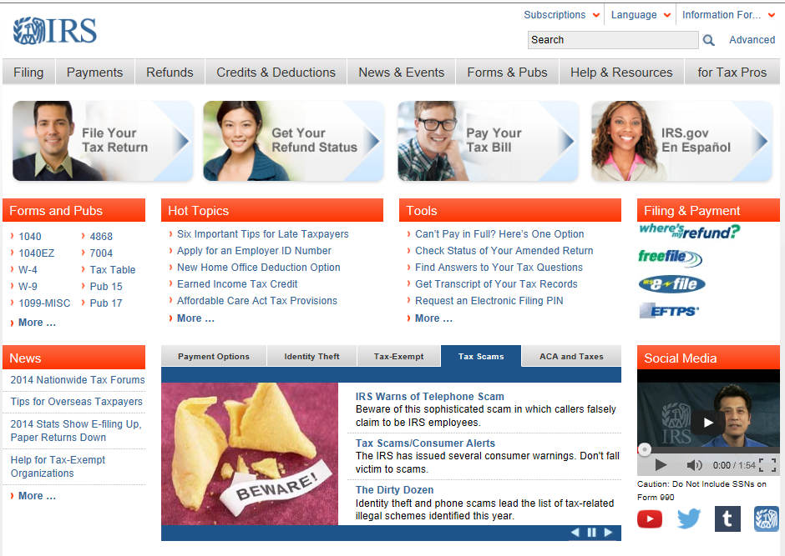
IRS Web Site
IRS Web Site (www.irs.gov)

Slide 29
Accessibility Content: Text Alternatives for Images

Slide 30
Book Values and Market Values 3 Text Alternative
A box at the top labeled book value balance sheet includes the following data: Assets equals $10 bil, debt equals $4 bil, equity equals $6 bil. This box leads to a box below labeled market value balance sheet that includes the following data: assets equals $11.5 bil, debt equals $4 bil, equity equals $7.5 bil.
Return to slide containing original image

