Slide 1
Irresolvable Conflicts: Arab Israel Conflict
Assist. Prof. Saffet Akkaya
Find course material at my page on IIBF https://www.cag.edu.tr/tr/akademik-kadro/429/hakkinda
E-mail: saffetakkaya@cag.edu.tr

Slide 2
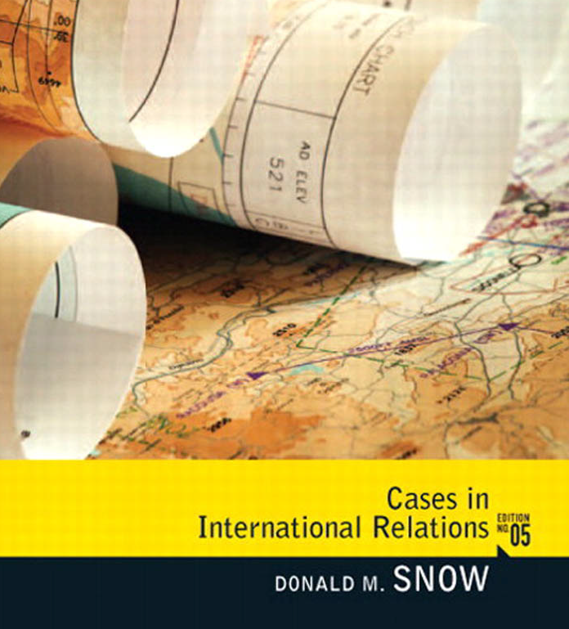
Main Source for the Course Pages: 62-84

Slide 3
Current Issues in World Politics
Syllabus weeks
1st : Sovereignty: The Violation and Restoration of Iraqi Authority
2nd: Resource Scarcity: The Changing Dynamics and Implications of Global Energy
3rd: War Crimes and International Criminal Court and Syria
4th: Irresolvable Conflicts: Arab Israeli conflict
5th: Irresolvable Conflicts: Israeli Palestinian Impasse
6th: Asymmetrical Warfare: New/Old Wars in the world
Midterm Exam
7th: The Proliferation Problem Applied: The Case of North Korea
8th: Pivotal States: Confronting and Accommodating Iran
9th: The Phenomenon of Fundamental Political Change: The Arab Spring
10th: Global Warming :Facing the Problem After Copenhagen
11th: International Immigration, Refugees & Syrian Refugees
12th: Failed and Failing States: Pakistan case
Final Exam

Slide 4
The Middle East

Slide 5
Crossroad between three continents Center of three big religions (Jewish, Christian, Muslim) Center of energy resources (oil-natural gas)

Slide 6
Issues with Colonialism
Religions: Judaism, Christianity, Islam
Languages: Turkish, Arabic, Persian, Hebrew, Kurdish, Armenian
Borders: Created by European nations after WWI without considering the ethnic makeup of the region
Colonial rule starting at the beginning of 19th Century (1800- Today)

Slide 7
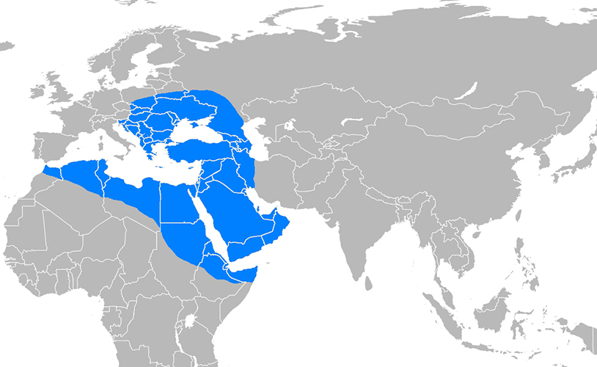
The Dominant Power OTTOMAN EMPIRE (1299-1918)

Slide 8
Sykes-Picot Agreement Partition of Middle East by Britain and France

Slide 9
British Mandate
Mesopotamia (Irak)
Puppet King
75 year term of oil consession
Trans-Jordan (İsrael, Jordan, Palestine)
Independence
Support the Jews on land purchase and migration

Slide 10
French Mandate
Lebanon
Support the Christian minorities
Syria
Expel of King Faisal from Syria

Slide 11
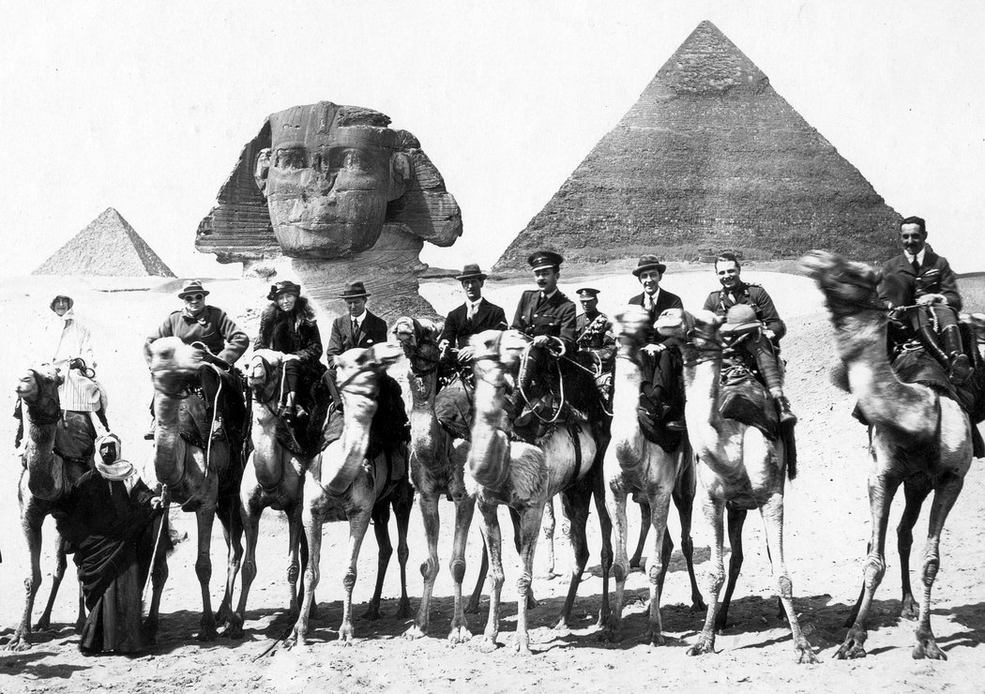
British Diplomacy and the Middle East

Slide 12
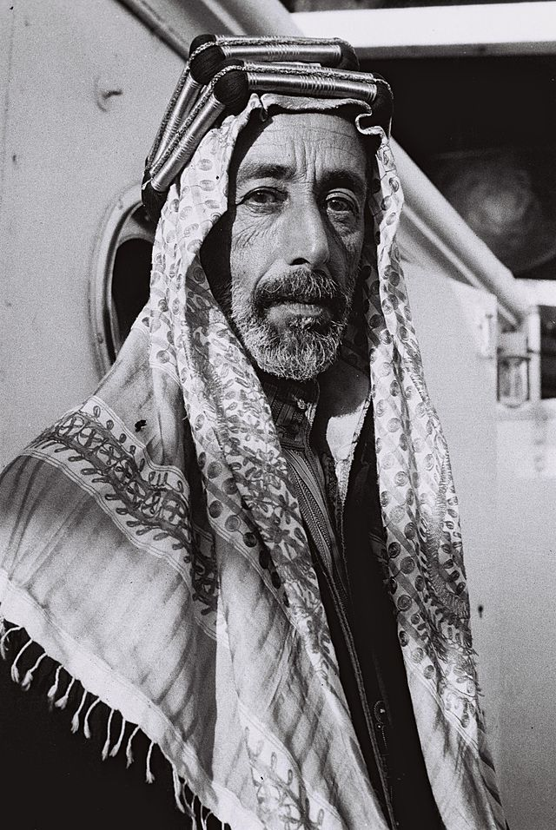
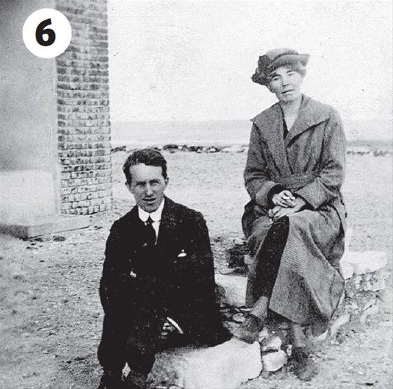
Leading Figures

Slide 13
League of Nations and Mandate Governments
In the wake of First World War
Weak states
A consequence of superiority of the West over the East

Slide 14
British Diplomacy
“We promise the Arabs freedom and independence.”
Lawrence of Arabia

Slide 15
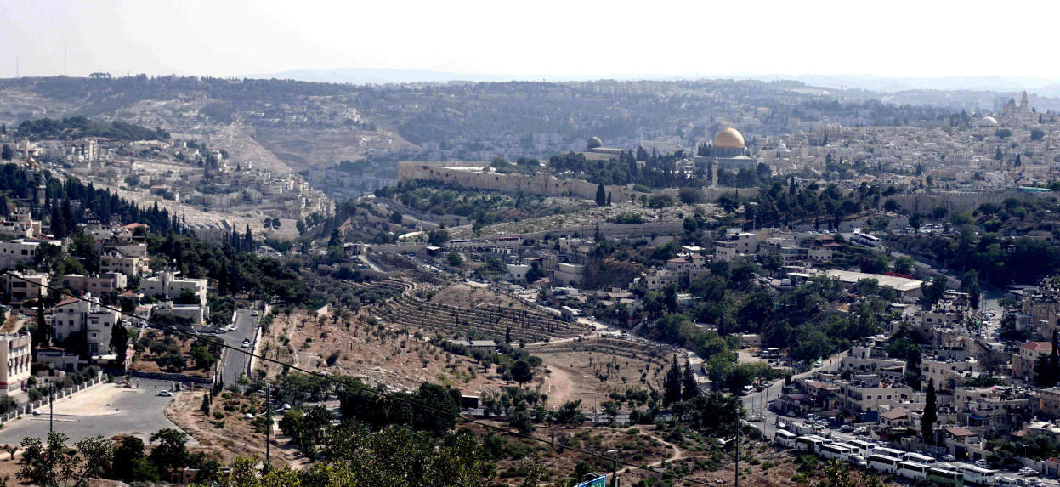
Sion Mountain in Jerusalem

Slide 16
Sionizm
The last independent Jewish state had been destroyed in 63 BC by Roman Empire.
Palestine was a part of Ottoman Empire between 16-20 Centuries.
The modern conflict between Jews and Arabs began in 1881.
At that time, about 565,000 Arabs and 24,000 Jews lived in Palestine.
About 90% of the Arabs were Muslim while most of the rest were Christian.
A few Zionist Jews from outside the Holy Land decided to emigrate to Palestine.
Zionism is one form of Jewish nationalism, called for the return of Jews to the Holy Land and the re-establishment of a Jewish homeland.

Slide 17
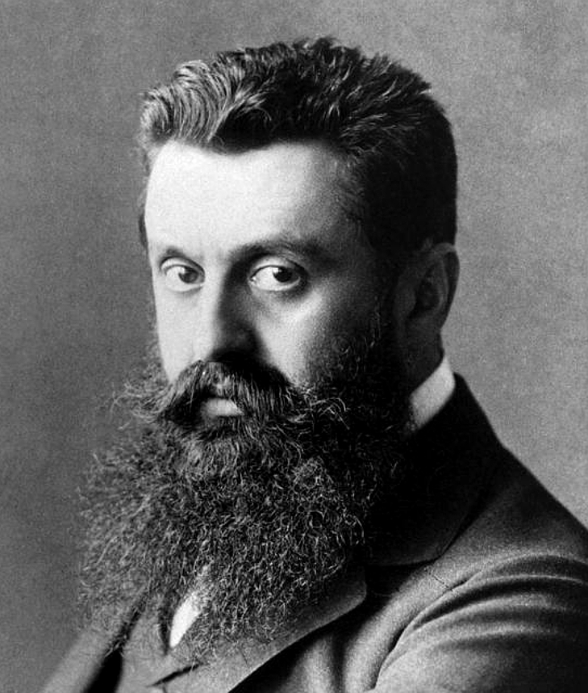
Sionizm/Theodor Herzl (1860-1904)
Until 1870s, the Jews lived all across the world including Africa and South America
The nationalist ideology and decline of Ottoman Empire grew the idea of returning homeland, Palestine amongst the Jewish people.
For Sionist ideology, a Hungarian Jew Theodor Herzl writes the book “Jewish State/Juden Staat”. (1896)

Slide 18
Sionizm/Theodor Herzl (1860-1904)
In 1897 first Jewish Congress was held by Theodor Herzl in Basel Switzerland.
In the Congress Herzl says; «Today I have established the Jewish State, this is a reality to prove itself in 5 years or in 50 years."
During the Congress the borders of the Jewish State has been also roughly plotted.
At the end of the Congress, Herzl was elected as the Chairman of World Sionist Organization.
Herzl himself worked to internationalize Zionism until he died in 1904

Slide 19
First Steps of Sionism in Palestine
Over the next few decades, Zionism moved on two fronts.
In Europe and other capitals, Zionist leaders sought statehood through diplomacy.
On the ground in the Holy Land, Zionists built new communities, bought land, welcomed new immigrants and emphasized Jewish labor and agriculture.
Chaim Weizmann later symbolized this international diplomatic route.
Over time, David Ben Gurion emerged as the leader of Jewish presence in Palestine.
He later became Israel’s first and longest-serving prime minister.

Slide 20
First Steps of Sionism in Palestine
The Zionist diplomats scored a major victory on November 2, 1917.
Lord Arthur J. Balfour, the British Foreign Secretary, wrote a letter to Lord Rothschild, a Jewish leader.
This statement, known as the Balfour Declaration, clearly privileged the Zionist cause over the rights of the Arab inhabitants of Palestine.

Slide 21
Balfour Declaration-1917
« Her Majestie’s Government will give full support to the Jews in Palestine for a national homeland. In this process, the civil rights and religious rights of non-Jewish people will be taken under guarrantie.»

Slide 22
Jewish Immigration to Palestine
Until 1917 World Zionist Organization/WZO has supported small scale immigrations into Palestine.
For this aim the WTO has established two funds;
Jewish National Fund (1901 – Purchase of Land for Jewish Settlements in Palestine)
British-Palestine Bank (1903 – Maintain credit to Jewish Agriculture Companies and Farmers in Palestine
Until 1942 “Israel State Formation” has not been put into Words.

Slide 23
Jewish Immigration to Palestine
Year | Muslims | Jews | Christians | Others
1922 | 486.177 | 83.790 | 71.464 | 7.617
1931 | 493.147 | 174.606 | 88.907 | 10.101
1941 | 906.551 | 474.102 | 125.413 | 12.881
1946 | 1.076.783 | 608.225 | 145.063 | 15.488

Slide 24
Arab Riots against Jewish Immigrations
From 1881-1948, the Jewish community, was much more effective than the Arab side at building state-like institutions.
For instance, the Jewish Agency functioned as a quasi-government.
The Jewish National Fund raised capital to purchase land, often from Arab landowners, for Jewish settlement.
Tel Aviv, established in 1909, rapidly became an urban center of Jewish life, and Jews established many agricultural collectives called kibbutzim.
The Arab side was less organized and more reactive.
Arab leadership was usually based on family and clan ties rather than on political and ideological factors as among the Zionist leaders.

Slide 25
Arab Riots against Jewish Immigrations
British mandate open the gate for the mass immigration of Jews to Palestine.
The Jews bought huge amounts of land from the Arab Land Lordss
This dramatic change in demografic structure fueled the unrest amongst poor, landless Palestinian people.
In 1920, 1921,1929 and 1939 blody riots emerged in Palestine to protest the Jews.
British mandate limited the immigration to 75.000 annually.

Slide 26
End of British Rule in Palestine
After World War II (1939-1945), the British soon realized that mandate in Palestine was not workable.
In February 1947, Britain asked the fledgling United Nations to address the question of Palestine.
United Nations Special Committee on Palestine (UNSCOP) favored a partition of Palestine into two states, a Jewish one and an Arab one.

Slide 27
UN Partition Plan
According to UNSCOP, the Arab state would be about 42% of Palestine and the Jewish one about 55%.
The remaining territory, including Jerusalem, would be an international zone.
The Jewish state would have about 500,000 Jews and 400,000 Arabs.
On November 29, 1947, UNSCOP’s majority report was approved by the United Nations General Assembly as resolution 181.
The Jews accepted partition, and the Arabs rejected it.

Slide 28
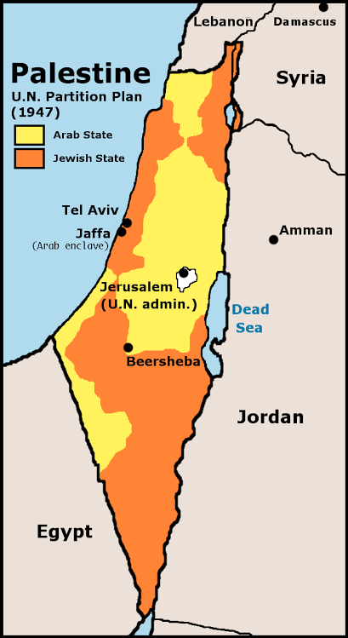
UN Partition Plan
Palestine and Israel States
Jerusalem Common Capital City

Slide 29
Arab Israeli Wars
Immediately, fighting started in Palestine between Jewish and Arab forces.
Until Israel declared its independence on May 14, 1948, most of the fighting was between local forces.
Once Israel declared independence, Arab states became directly involved.
By the time the fighting fully ended in early 1949, Israel controlled
about 78% of the territory in UNSCOP’s plan.
Jerusalem was not under international control. Israel controlled the west of the city while Jordan, held the east.
In 1949, Israel signed armistice agreements with Egypt, Jordan, Lebanon, and Syria.

Slide 30
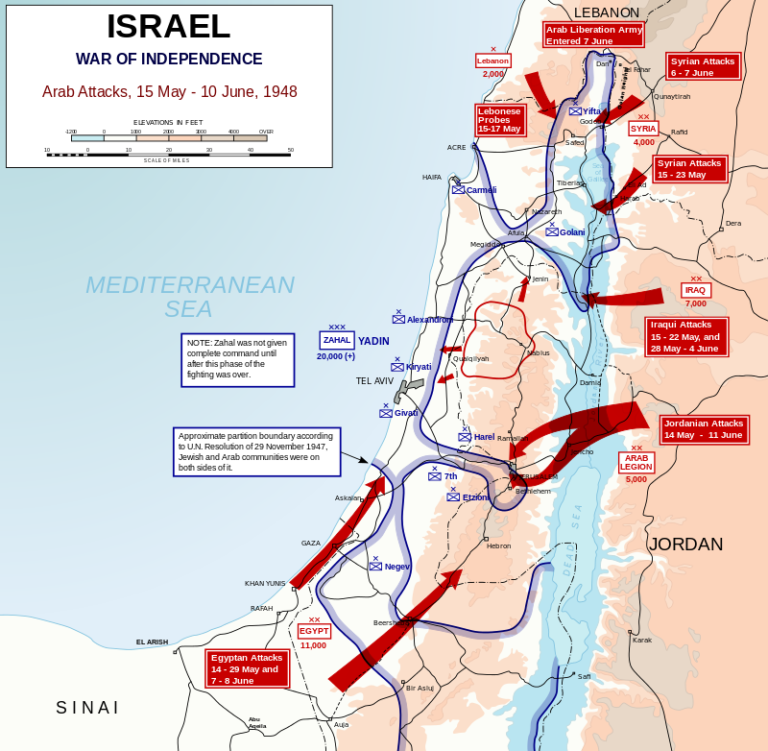
1948 Arap Israel War 15 May-10 June
Arab Armies
Eypt
Jordan
Lebanon
Syria
Iraq
Saudi Arabia

Slide 31
Arab Israeli Wars
Immediately, fighting started in Palestine between Jewish and Arab forces.
Until Israel declared its independence on May 14, 1948, most of the fighting was between local forces.
Once Israel declared independence, Arab states became directly involved.
By the time the fighting fully ended in early 1949, Israel controlled
about 78% of the territory in UNSCOP’s plan.
Jerusalem was not under international control. Israel controlled the west of the city while Jordan, held the east.
In 1949, Israel signed armistice agreements with Egypt, Jordan, Lebanon, and Syria.

Slide 32
Following Arab-İsrael Wars
1956 Suez Canal War
1967 6 Days War
1973 Yom Kippur War
1988 First Intifadah (Local Resistance).
2000’de Second Intifadah

Slide 33
Next Week
We will discuss the Wars Between the Arabs and Israel and focus on the reasons of Israeli Palestinian Impasse.
Palestine Conflict has direct implications on regional and global relations.
Following map proves how the picture is developing in disfavor of Palestinians.

Slide 34
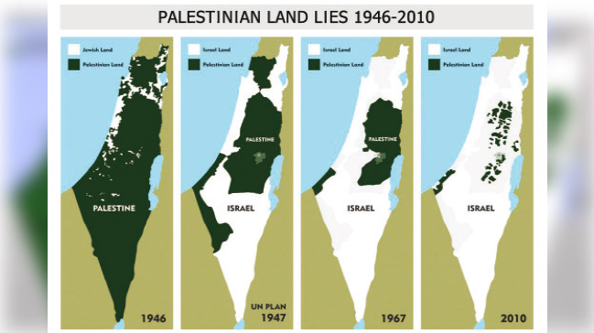
Palestine-Israel Conflict

Slide 35
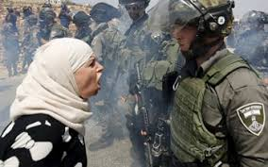
Questions?

