Slide 1
Chapter 4
Future Value, Present Value,
and Interest Rates

Slide 2
Learning Objectives
Compare the value of monetary payments using present value and future value.
Apply present value to a stream of payments using internal rate of return and bond valuation.
Explain the difference between real and nominal interest rates and how each is calculated.

Slide 3
Introduction
Credit is one of the critical mechanisms we have for allocating resources.
Although interest has historically been unpopular, this comes from the failure to appreciate the opportunity cost of lending.
Interest rates
Link the present to the future.
Tell the future reward for lending today.
Tell the cost of borrowing now and repaying later.

Slide 4
Valuing Monetary Payments Now and in the Future
We must learn how to calculate and compare rates on different financial instruments.
We need a set of tools:
Future value
Present value

Slide 5
Future Value and Compound Interest
Future value is the value on some future date of an investment made today.
$100 invested today at 5% interest gives $105 in a year. So, the future value of $100 today at 5% interest is $105 one year from now.
The $100 yields $5, which is why interest rates are sometimes called a yield.
This is the same as a simple loan of $100 for a year at 5% interest.

Slide 6
Future Value and Compound Interest
If the present value is $100 and the interest rate is 5%, then the future value one year from now is:
$100 + $100(0.05) = $105
This also shows that the higher the interest rate, the higher the future value.
In general:
FV = PV + PV(i) = PV(1 + i)

Slide 7
Future Value and Compound Interest
The higher the interest rate or the higher the amount invested, the higher the future value.
Most financial instruments are not this simple, so what happens when time to repayment varies.
When using one-year interest rates to compute the value repaid more than one year from now, we must consider compound interest.
Compound interest is the interest on the interest.

Slide 8
Future Value and Compound Interest
What if you leave your $100 in the bank for two years at 5% yearly interest rate?
The future value is:
$100 + $100(0.05) + $100(0.05) + $5(0.05) = $110.25
$100(1.05)(1.05) = $100(1.05)²
In general
FV_{n} = PV(1 + i)^{n}

Slide 9
Future Value and Compound Interest
Table 4.1: Computing the future value of $100 at 5% annual interest

Slide 10
Future Value and Compound Interest
Converting n from years to months is easy, but converting the interest rate is harder.
If the annual interest rate is 5%, what is the monthly rate?
Assume i^{m} is the one-month interest rate and n is the number of months, then a deposit made for one year will have a future value of
$100(1 + i^{m})¹².

Slide 11
Future Value and Compound Interest
We know that in one year the future value is $100(1.05) so we can solve for i^{m}
(1 + i^{m})¹² = (1.05)
(1 + i^{m}) = (1.05)^{1/12} = 1.0041
These fractions of percentage points are called basis points.
A basis point is one one-hundredth of a percentage point, 0.01 percent.

Slide 12
Invest $100 at 5% annual interest
How long until you have $200?
The Rule of 72:
Divide the annual interest rate into 72
So 72/5=14.4 years.
1.05^{14.4} = 2.02

Slide 13
Present Value
Financial instruments promise future cash payments, so we need to know how to value those payments.
Present value is the value today (in the present) of a payment that is promised to be made in the future.
Present value is the amount that must be invested today in order to realize a specific amount on a given future date.

Slide 14
Present Value
Solve the Future Value Formula for PV:
FV = PV × (1 + i), so
This is just the future value calculation inverted.
© McGraw Hill LLC. All Rights Reserved.

Slide 15
Present Value
We can generalize the process as we did for future value.
Present Value of payment received n years in the future:
© McGraw Hill LLC. All Rights Reserved.

Slide 16
Present Value
From the previous equation, we can see that present value is higher:
The higher future value of the payment, ${FV}_{n}$.
The shorter time period until payment, n.
The lower the interest rate, i.

Slide 17
Risk requires compensation, but securing proper compensation means understanding the risks of what is purchased.
If interest rates rise, losses on a long-term bond are greater than losses on a short-term bond.
Long term bonds are more sensitive to the risk that interest rates will change.

Slide 18
Investors might misjudge or underestimate risk.
The search for yield can bid up prices of risky securities and depress the market compensation for risk below a sustainable level.
When risk comes to fruition, like when defaults increase, the prices of riskier securities fall disproportionately, triggering financial losses.
During the 2007-2009 crisis, the plunge of corporate and mortgage security prices show how markets reprice risk when the search for yield has gone too far.

Slide 19
How Present Value Changes
Doubling the future value of the payment, without changing the time of the payment or the interest rate, doubles the present value.
The sooner a payment is to be made, the more it is worth.

Slide 20
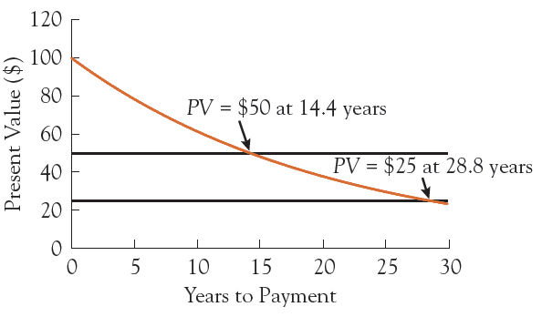
Figure 4.1: Present Value of $100 at 5% Interest

Slide 21
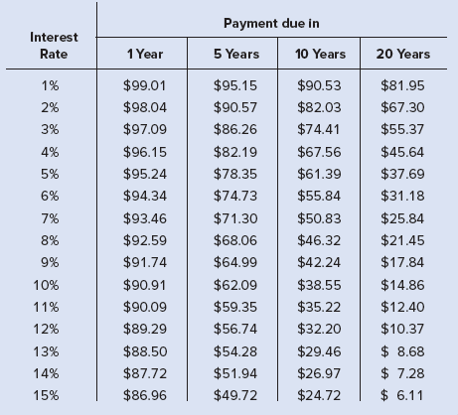
Table 4.2: Present Value of $100 Payment
Higher interest rates are associated with lower present values, no matter what the size or timing of the payment.
At any fixed interest rate, an increase in the time reduces its present value.
© McGraw Hill LLC. All Rights Reserved.

Slide 22
We can turn a monthly growth rate into a compound-annual rate using what we have learned in this chapter.
Investment grows 0.5% per month
What is the compound annual rate? FV_{n}= PV(1 + i)^{n} = 100×(1.005)¹² = 106.17
Compound annual rate = 6.17%
(Note: 6.17 > 12 × 0.05 = 6.0%)

Slide 23
We can also use this to compute the percentage change per year when we know how much an investment has grown over a number of years.
An investment has increased 20 percent over five years: from 100 to 120.
FV_{n} = PV(1 + i)^{n}
120 = 100(1 + i)⁵
i = 0.0371

Slide 24
Internal Rate of Return
Imagine that you run a tennis racket company and that you are considering purchasing a new machine.
Machine costs $1 million and can produce 3000 rackets per year.
You sell the rackets for $50, generating $150,000 in revenue per year.
Assume the machine is only input, have certainty about the revenue, no maintenance and a 10-year lifespan.

Slide 25
Internal Rate of Return
If you borrow $1 million, is the revenue enough to make the payments?
We need to compare the internal rate of return to the cost of buying the machine.
The interest rate that equates the present value of an investment with its cost.

Slide 26
Internal Rate of Return
Balance the cost of the machine against the revenue.
$1 million today versus $150,000 a year for ten years.
To find the internal rate of return, we take the cost of the machine and equate it to the sum of the present value of each of the yearly revenues.
Solve for i - the internal rate of return.

Slide 27
Internal Rate of Return: Example
Solving for i, i = 0.0814 or 8.14%
So long as your interest rate at which you borrow the money is less than 8.14%, then you should buy the machine.

Slide 28
What is the present value of the expected losses associated with a preventable future disaster?
Discount rates
Scale of future losses

Slide 29
Bond Basics
A bond is a promise to make a series of payments on specific future dates.
Bonds create obligations, and are therefore thought of as legal contracts that:
Require the borrower to make payments to the lender, and
Specify what happens if the borrower fails to do so.

Slide 30
Bond Basics
The most common type of bond is a coupon bond.
Issuer is required to make annual payments, called coupon payments.
The annual interest the borrower pays (i_{c}), is the coupon rate.
The date on which the payments stop and the loan is repaid (n), is the maturity date or term to maturity.
The final payment is the principal, face value, or par value of the bond.

Slide 31
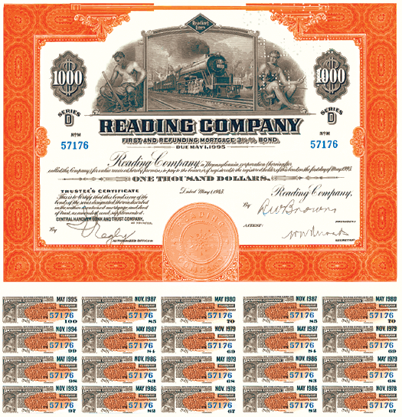
Coupon Bond
Called a coupon bond as buyer would receive a certificate with a number of dated coupons attached.
Coupons

Slide 32
Student debt across the United States is growing each year
Nearly 20% of adults have outstanding student loans, with outstanding balances ranging from $20,000 to $25,000.
Returns on investment are high
2010 study estimated PV of a college degree at $500,000 for men and $300,000 for women
Should we encourage people to borrow to go to college? Yes, but be careful.

Slide 33
Valuing the Principal
Assume a bond has a principle payment of $100 and its maturity date is n years in the future.
The present value of the bond principal is:
The higher the n, the lower the value of the payment.

Slide 34
Valuing the Coupon Payments
These resemble loan payments.
The longer the payments go, the higher their total value.
The higher the interest rate, the lower the present value.
The present value expression gives us a general formula for the string of yearly coupon payments made over n years.

Slide 35
Valuing the Coupon Payments Plus Principal
We can just combine the previous two equations to get:
The value of the coupon bond, P_{CB}, rises when
The yearly coupon payments, C, rise and
The interest rate, i, falls.

Slide 36
Bond Pricing
The relationship between the bond price and interest rates is very important.
Bonds promise fixed payments on future dates, so the higher the interest rate, the lower their present value.
The value of a bond varies inversely with the interest rate used to calculate the present value of the promised payment.

Slide 37
Pay down your debt
The opportunity cost of investing in a retirement fund is the interest rate you are paying on your mortgage, credit card, loan, etc.
No riskless investment is likely to match the rate you receive when you reduce the size of your debt

Slide 38
Real and Nominal Interest Rates
Borrowers care about the resources required to repay.
Lenders care about the purchasing power of the payments they received.
Neither cares solely about the number of dollars, they care about what the dollars buy.

Slide 39
Real and Nominal Interest Rates
Nominal Interest Rates (i)
The interest rate expressed in current-dollar terms.
Real Interest Rates (r)
The inflation adjusted interest rate.

Slide 40
Real and Nominal Interest Rates
The nominal interest rate you agree on (i) must be based on expected inflation (π^{e}) over the term of the loan plus the real interest rate you agree on (r).
i = r + π^{e}
This is called the Fisher Equation.
The higher expected inflation, the higher the nominal interest rate.

Slide 41
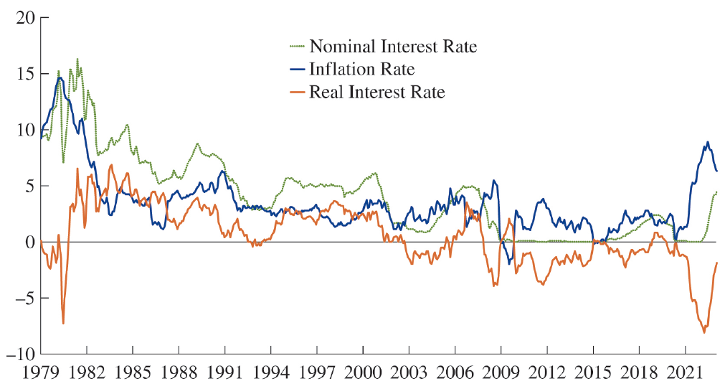
Figure 4.2: Nominal Interest Rate, Inflation Rate and Real Interest Rate

Slide 42
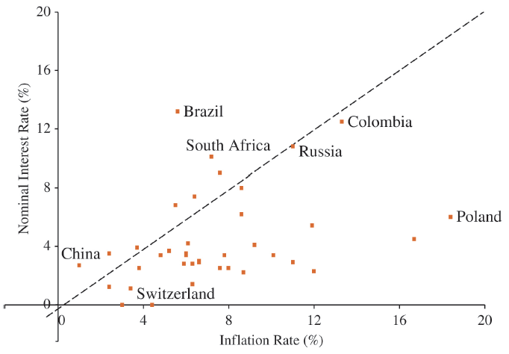
This figure shows the nominal interest rate and the inflation rate in 50 countries and the euro area in March 2023.
© McGraw Hill LLC. All Rights Reserved.

Slide 43
Real and Nominal Interest Rates
Financial markets quote nominal interest rates.
When people use the term interest rate, they are referring to the nominal rate.
We cannot directly observe the real interest rate; we have to estimate it.
r = i - π^{e}

