Slide 1
New Technologies for Business
Fatih Koç

Slide 2
“Machines will be able to do everything a human can do. In 20 years…”
Herbert A. Simon (said in 1965)
“After a generation, the problem of creating artificial intelligence will be largely resolved.”
Marvin Minsky (said in 1970)

Slide 3
Computer passes Turing Test if the human questioner can’t understand whether the computer is not human.

Slide 4
Jeopardy and AI
https://www.youtube.com/watch?v=P18EdAKuC1U

Slide 5
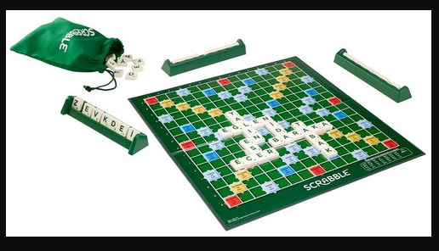
CHESS BACKGAMMON SCRABBLE GO

Slide 6
ALPHAGO

Slide 7
STARCRAFT

Slide 8
Some Definitons
Super Human: a machine reaches the highest level to beat human in a game
A path for a computer to become super human
Game theory: Do you know the game of rock, paper, scissors? There is no single strategy to win this game, right? StarCraft game is like that. Artificial intelligence needs to improve itself by constantly collecting strategic information.
Imprecise information: Games such as Chess and Go are based on certain information. Players see and know everything on the board. However, games like StarCraft also contain imprecise information. So it requires constant exploration.
Long-term planning: As in real life, the relationship between cause and effect is not instantaneous in this game. Long-term planning skills need to be developed.
Real-time: StarCraft is a real-time strategy game, unlike the sequential games on the board. Players need to make moves simultaneously and continuously.
Large space: There are 64 spatial points in chess and 361 in Go. In StarCraft, you have to control many different buildings and objects at the same time at hundreds of points. In addition, the actions taken are not as simple as moving a stone. You can perform hierarchical and non-uniform actions.

Slide 9
Types of A.I.
Narrow A.I
Makes basic tasks
General A.I
cognitive abilities such as language, memory and wayfinding
Artificial Super Intelligence
creativity, social skills and wisdom

Slide 10
For an AI product
1-) Expectation axis
2-) Time axis
Early
Middle
Late
3-) Stage of 5
Innovation Trigger
Peak of Inflated Expectations
Trough of Disillusionment
Slope pf Enligthment
Pleatau of Productivity
4-) Pleatau will be reached (time)

Slide 11
Generative AI
The innovations backed by Gen AI
AGI
Autonomous systems
Edge AI
The innovations that will accelerate Gen AI
Causal AI
Neurosymbolic AI
Responsible AI

Slide 12
Innovations that will be fueled by generative AI
Generative AI impacts business as it relates to content discovery, creation, authenticity and regulations. It also has the ability to automate human work, as well as customer and employee experiences.
The critical technologies that fall into this category include the following:
Artificial super (general) intelligence (ASI) is the (currently hypothetical) intelligence of a machine that can accomplish any intellectual task that a human can perform.
AI engineering is foundational for enterprise delivery of AI solutions at scale. The discipline creates coherent enterprise development, delivery, and operational AI-based systems.

Slide 13
Autonomic systems are self-managing physical or software systems performing domain-bounded tasks that exhibit three fundamental characteristics: autonomy, learning and agency.
Cloud AI services provide AI model building tools, APIs for prebuilt services and associated middleware that enable the building/training, deployment and consumption of machine learning (ML) models running on prebuilt infrastructure as cloud services.
Composite AI refers to the combined application (or fusion) of different AI techniques to improve the efficiency of learning to broaden the level of knowledge representations. It solves a wider range of business problems in a more effective manner.
Computer vision is a set of technologies that involves capturing, processing and analyzing real-world images and videos to extract meaningful, contextual information from the physical world.
Data-centric AI is an approach that focuses on enhancing and enriching training data to drive better AI outcomes. Data-centric AI also addresses data quality, privacy and scalability.

Slide 14
Edge AI refers to the use of AI techniques embedded in non-IT products, IoT endpoints, gateways and edge servers. It spans use cases for consumer, commercial and industrial applications, such as autonomous vehicles, enhanced capabilities of medical diagnostics and streaming video analytics.
Intelligent applications utilize learned adaptation to respond autonomously to people and machines.
Model operationalization (ModelOps) is primarily focused on the end-to-end governance and life cycle management of advanced analytics, AI and decision models.
Operational AI systems (OAISys) enable orchestration, automation and scaling of production-ready and enterprise-grade AI, comprising ML, DNNs and Generative AI.

Slide 15
Prompt engineering is the discipline of providing inputs, in the form of text or images, to generative AI models to specify and confine the set of responses the model can produce.
Smart robots are AI-powered, often mobile, machines designed to autonomously execute one or more physical tasks.
Synthetic data is a class of data that is artificially generated rather than obtained from direct observations of the real world.

Slide 16
Innovations that will fuel generative AI advancement
AI simulation is the combined application of AI and simulation technologies to jointly develop AI agents and the simulated environments in which they can be trained, tested and sometimes deployed.
AI trust, risk and security management (AI TRiSM) ensures AI model governance, trustworthiness, fairness, reliability, robustness, efficacy and data protection.
Causal AI identifies and utilizes cause-and-effect relationships to go beyond correlation-based predictive models and toward AI systems that can prescribe actions more effectively and act more autonomously.
Data labeling and annotation (DL&A) is a process where data assets are further classified, segmented, annotated and augmented to enrich data for better analytics and AI projects.
First-principles AI (FPAI) (aka physics-informed AI) incorporates physical and analog principles, governing laws and domain knowledge into AI models. FPAI extends AI engineering to complex system engineering and model-based systems

Slide 17
Foundation models are large-parameter models trained on a broad gamut of datasets in a self-supervised manner.
Knowledge graphs are machine-readable representations of the physical and digital worlds. They include entities (people, companies, digital assets) and their relationships, which adhere to a graph data model.
Multiagent systems (MAS) is a type of AI system composed of multiple, independent (but interactive) agents, each capable of perceiving their environment and taking actions. Agents can be AI models, software programs, robots and other computational entities.
Neurosymbolic AI is a form of composite AI that combines machine learning methods and symbolic systems to create more robust and trustworthy AI models. It provides a reasoning infrastructure for solving a wider range of business problems more effectively.
Responsible AI is an umbrella term for aspects of making appropriate business and ethical choices when adopting AI. It encompasses organizational responsibilities and practices that ensure positive, accountable, and ethical AI development and operation.

Slide 18
Backed by Gen AI
Artificial Super Intelligence (ASI): A type of intelligence (currently in the hypothesis stage) in which a machine can perform any mental task that a human can perform.️
Autonomous systems: Self-managing physical or software systems that fulfil their tasks within a limited space and exhibit three basic characteristics: automation, learning and efficiency: Autonomy, learning and agency.
Edge AI: Refers to the embedding of AI techniques in non-IT products, IoT endpoints, gateways and edge servers. This covers use cases for consumer, commercial and industrial applications such as automated vehicles, enhancing the capabilities of medical diagnostics and streaming video analytics.

Slide 19
Accelerate GEN AI
Causal artificial intelligence: Identifies and uses cause-and-effect relationships to move beyond correlation-based predictive models and towards AI systems that can prescribe actions more effectively and act more autonomously.
Neurosymbolic AI: A form of compound artificial intelligence that combines machine learning methods and symbolic systems to build more robust and reliable artificial intelligence models. It provides a reasoning infrastructure to solve a wider range of business problems more effectively.
Responsible AI: An umbrella term that encompasses the considerations of making appropriate business and ethical choices when adopting AI. It encompasses organisational responsibilities and practices that ensure the development and operation of positive, accountable and ethical AI.

Slide 20
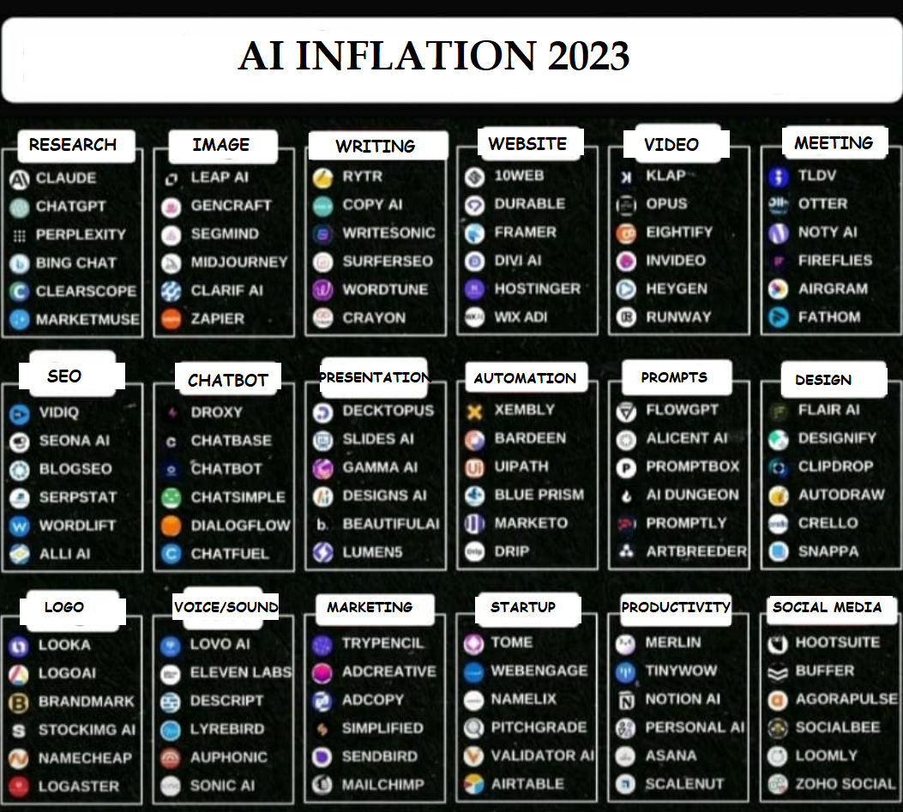

Slide 21
Difference between CHATGPT and SimSimi
Answer of ChatGPT:
Introduction: "I and SimSimi cannot be compared since we are different artificial intelligence systems. Both of us are designed for different purposes.
ChatGPT: I am a general-purpose language model and can converse with people on various topics.
Simsimi: SimSimi, on the other hand, is designed as an entertainment and chat application.
Conclusion: Therefore, which application is better depends on your personal preferences and needs."

Slide 22
Other samples
Yuzuncuyil.harikalar.com
(build your photo with Ataturk)
Buildmeacoverletter.com
(making cover letter)
Audiopen.ai
(record speech and change it to text in any language)
Brain Implant + AI: https://www.youtube.com/watch?app=desktop&v=iTZ2N-HJbwA&t
https://melihkarasu.com/yapay-zeka/

Slide 23
Four paradigms of science through four paradigm shifters;
Experience
Theory Hyptohesis / Law
H0 : -x :Birds cant fly
H1 : x : Birds can fly
Computer science (Quantum Computers)
Big data (Seeing the big picture / Thinking outside of the box)

Slide 24
Even as the Industrial Revolution forever changed the trajectory of human progress, leading voices of the 19th century remained divided on how it could affect workers.

Slide 26
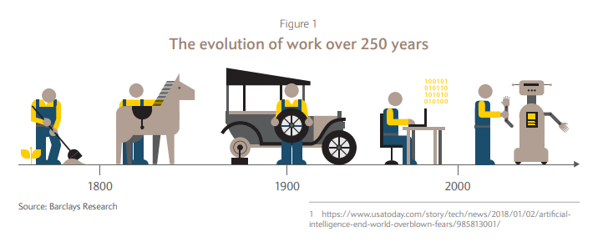

Slide 27
Sensori-motor skills:
Moravec’s paradox.
He points out the contradiction raised by the realization that for artificial intelligence, reasoning that normally requires
high-level brain activity requires very little computing power,
while low-level sensori-motor skills (such as moving arms and legs) require incredibly high computing power.

Slide 28
The issue that artificial intelligence has difficulty in putting into practice is not the subjects (for example, cooking) and skills (for example, playing chess) that an individual learns in his life, but the inherited sensori-motor skills that emerged in the evolutionary process (for example, jumping rope).
However, many people find it very difficult to solve a mathematical problem, play mind games, and understand engineering concepts. In fact, all these phenomena mentioned are temporary abilities learned in the last stages of the evolutionary process.

Slide 29
Actions that an average 4-year-old child can perform without difficulty (recognizing a face, recognizing voices, walking across the room…) actually meet the most complex engineering problems for artificial intelligence.

Slide 30
As the next generation of intelligent machines is developed, the jobs of those in professions such as stock analysts and petrochemical engineers will be threatened; The professions of gardeners, receptionists and cooks have been safe for decades.

Slide 31
Cognitive functionality:
Every social media site has added thousands of content moderators in recent years, including titans such as Facebook and Instagram. One would expect these technological leaders to use machines for this purpose, so why do they keep hiring human moderators?
Right or Wrong?
Racism

Slide 32
What is AI?
https://www.youtube.com/watch?v=2ePf9rue1Ao

Slide 33
A.I. is the study of how to make computers do things at which, at the moment, people are better.
Artificial Intelligence is a way of making a computer, a computer-controlled robot, or a software think intelligently, in the similar manner the intelligent humans think.

Slide 34
AI is accomplished by studying how human brain thinks, and how humans learn, decide, and work while trying to solve a problem, and then using the outcomes of this study as a basis of developing intelligent software and systems.

Slide 35
What if machines could learn on their own?
It would completely change what they can and cannot do, including in the field of work. Thanks to the confluence of several conditions, we may now be at this breakthrough point.

Slide 36
Polanyi’s Paradox:
Everyone knows more than they can tell. You may not be able to tell a machine how to ride a bike or feel the emotion, but you know how it is. An important paradox used in artificial intelligence development.

Slide 37
The automation process, which began in the 1900s, was replaced by digitalization. How the institutions that failed to adapt to this situation in the 1900s had to undergo transformation, today the institutions that cannot digitize their processes will not be sustainable.

Slide 38
Recommendations for Robotic Process Automation and AI Projects
Be sure to evaluate your processes before you get into robotic process automation, complete simple improvements that will be improved and simplified
Manage demand from business process owners. RPA should not be the default answer. Calculate current costs for solutions that are presently in use and consider which will be eliminated by the implementation of the RPA strategy.

Slide 39
Robotic process automation should be considered as a digital workforce that works 24/7. It is necessary to plan this period well in order to obtain continuous efficiency. Make and track the daily work plans of your digital employees.

Slide 40
Establish a central team to monitor your employees. This team should always follow the results of the study and plan the daily work schedule. Previous and new processes of problem management 1 Transformation of Business Model in Finance Sector with Artificial...
• Promote your RPA project well within the organization, ensuring that all units benefit from the benefits. Thus, the process of determining the processes carried out manually will be accelerated.

Slide 41
• Be prepared for the negative reactions of employees. The RPA can be seen as a threat to the employees. Establish your communication correctly. Ensure that the threat is not perceived as an opportunity. Inform your employees about how to use automation and how RPA tools work

Slide 42
Monitor new automation trends continuously. RPA projects will also disappear with new opportunities.
Find people who can see automation opportunities and contribute to the development of these skills.

