Slide 1
Comparative Adjectives

Slide 2
When do we use comparative adjectives?

Slide 3
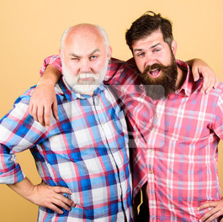
Use comparative adjectives + THAN to compare two or more things, people, etc.
Jack is older than Tom.
Tom is younger than Jack
Jack is funnier than Tom.
Tom is more handsome than Jack.
JACK
TOM

Slide 4
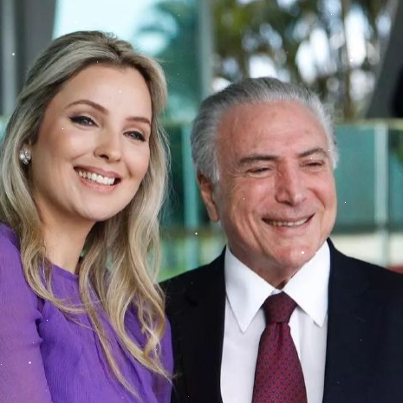
Some examples:
She’s much younger than her husband.
It’s a warmer day than yesterday.
This movie was longer than the last few I have seen.
GUESS WHAT!! ☺
How young do you think this woman is?

Slide 5
RULES FOR COMPARATIVE ADJECTIVES
RULE-1 :For adjectives with one syllable, add -er to the end.
Examples:
small-smaller
Old-older
loud-louder
warm-warmer
Strong-stronger

Slide 6
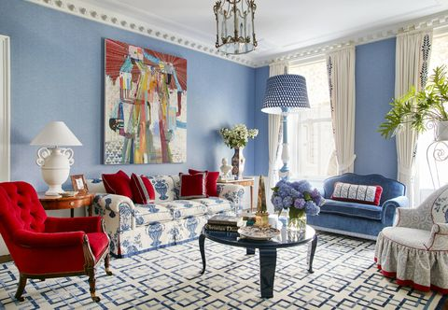
SOME EXAMPLES:
This red sofa is nice. But the blue one is nicer than the red one. It's also wider than the red one.

Slide 7
RULES FOR COMPARATIVE ADJECTIVES
RULE-2 :For adjectives end in -e, add -r
Examples:
Large-larger
Safe-safer
brave-braver
nice-nicer

Slide 8
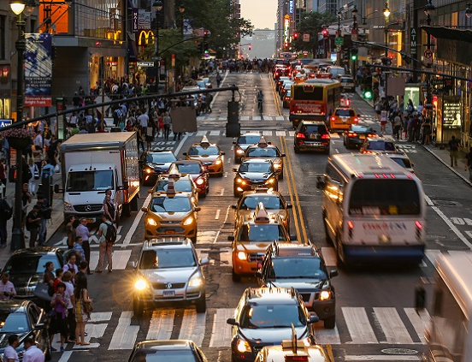
Some Examples:
The traffic is noisier than it was last year.
The new TV programme is funnier than the old one.
I am happy when I visit a friend, but I’m happier than when it’s her birthday.
You have a busier life than I have.

Slide 9
RULES FOR COMPARATIVE ADJECTIVES
Rule-3: For adjectives that end in -y, change the -y to -i and add -er.
Examples:
busy- busier
easy-easier
friendly-friendlier
happy-happier
lazy-lazier
early-earlier

Slide 10
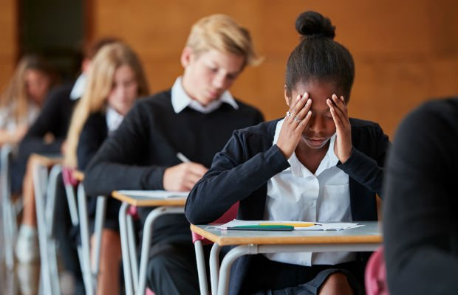
Some examples:
The exam today was more difficult than last year’s exam.
Her second book is more interesting thanher first one.
The students ask more intelligent questions than they did before.
Drivers in this country are more dangerous than drivers in my country.

Slide 11
RULES FOR COMPARATIVE ADJECTIVES
RULE-4:For adjectives with two or more syllables, add ‘’more’’
Examples:
more
handsome
more
important
more
beatiful
more difficult
more useful
more expensive

Slide 12
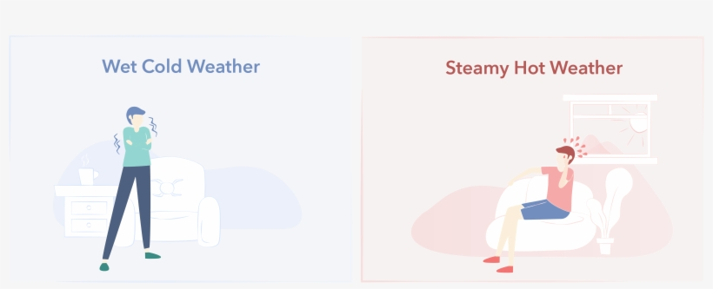
Some Examples:
The weather in May can be hot, but the weather in June is hotter than in May. October is a wet month, but November is wetter than October.

Slide 13
RULES FOR COMPARATIVE ADJECTIVES
RULE-5: Adjectives end in one vowel(a,e,i,o,u) and one consonant (g, n, t, etc.) double the consonant and add
-er
Examples:
Big-bigger
fat-fatter
thin-thinner
Hot-hotter

Slide 14
Common exceptions !!
They are irregular adjectives:
Examples:
bad worse
good better
little less

Slide 15
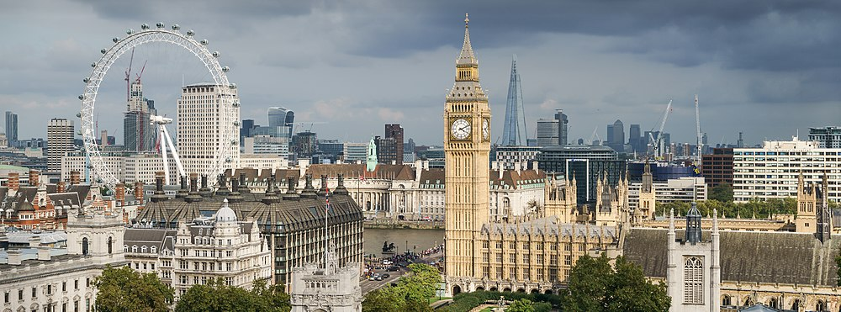
Some Examples:
The traffic in London is bad, but the traffic in Rome is worse.The traffic in London is better than the traffic in Rome.

Slide 16
Let’s see the whole frame☺

Slide 17
Common Comparative Adjectives are here!!

Slide 18
Let’s have a look more examples☺

Slide 19
Dark chocolate is healthier than the White chocolate.
London is older than New York.
Travelling by bus is worse than travelling by car.
Chilli peppers are spicier than bell peppers.
William’s car is bigger than mine.
All bacteria are larger than viruses.

