Slide 1
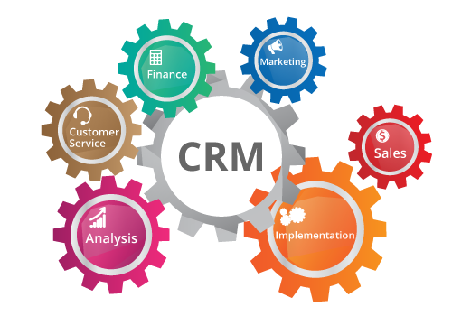
RELATIONSHIP MARKETING John EGAN - Fourt Edition PEARSON
https://results-software.com/tag/crm-for-small-business/

Slide 2
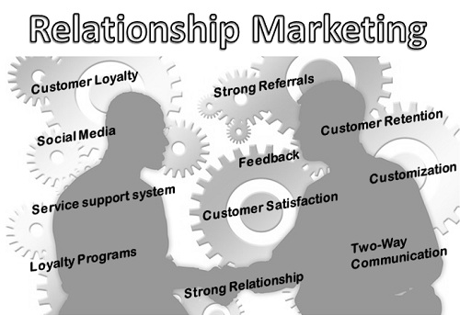
Chapter 3
Relationships & Relationship marketing

Slide 3
RM theory
suggests that relationships add quality to marketing transactions.
In consumer markets, the premise is that building strong relationships will have a positive influence on exchange outcomes (Palmatier et al., 2006, p. 140).
Barnes and Howlett (1998, p. 16) express the view that two characteristics must be present for an exchange situation to be described as a relationship:
The relationship is mutually perceived to exist and is acknowledged as such by both parties.
The relationship goes beyond occasional contact and is recognized as having some special status.
« true relationships» are not exist if these factors are absent!

Slide 4
Relationship Marketing: Why Marketing To Customers Not Strangers Is The Future of Marketing

Slide 5
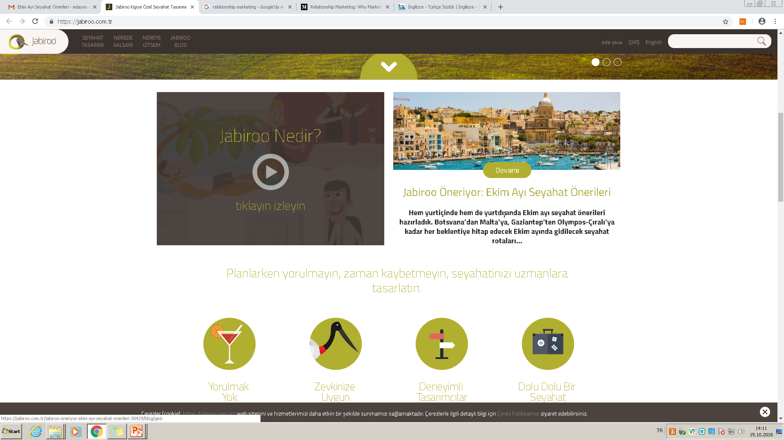

Slide 6
Use a relationship is a metaphor!
two key questions must, therefore, be asked regarding relationships:
1. Can customer-supplier interactios ever be called relationships’?
2. Can customer ever develop relationships with companies and/or brands or must relationships always be interpersonal?
There is no straightforward answer!.

Slide 7
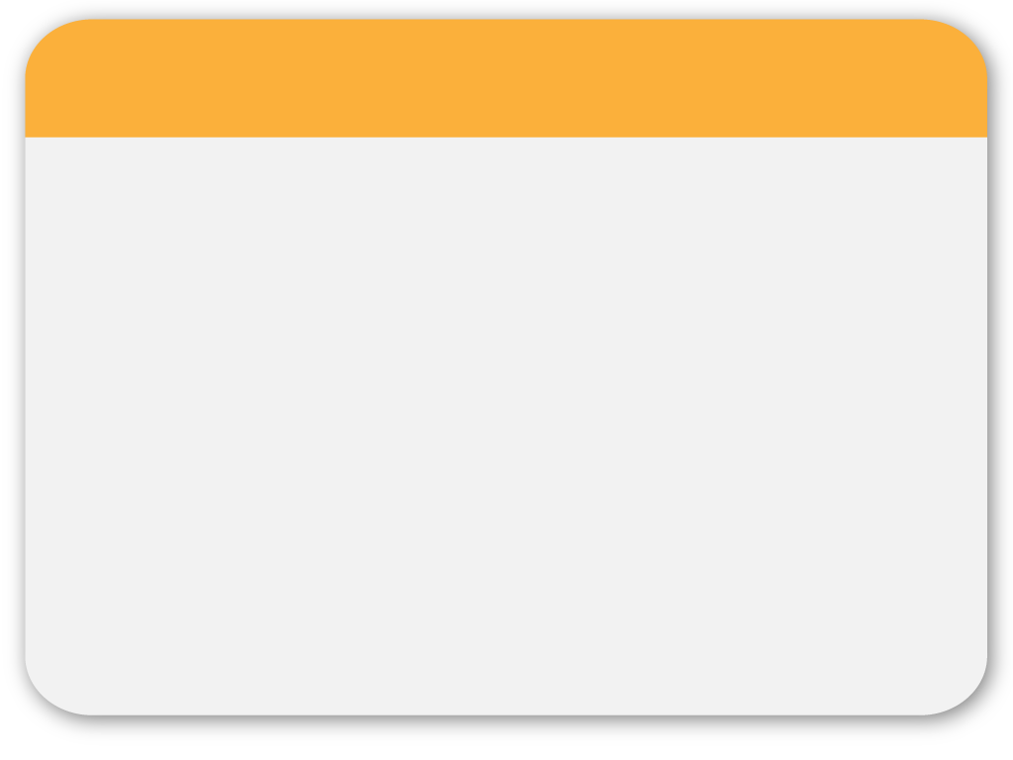
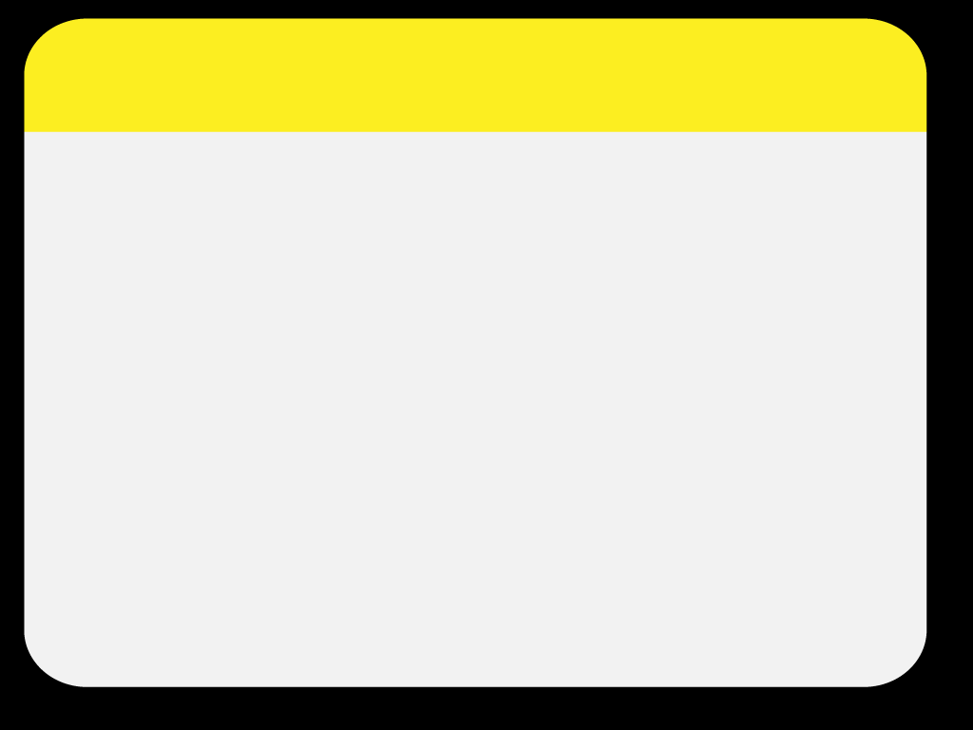
03
PowerPoint picture page
Notes:
7

Slide 8
Some rules:
Get the right people to spread the message…
A successful word of mouth campaign depens not just on how many people get the message, but on who is spreading and receiving it.
The richest interactions between customer and product often take place during the purchase process.
Effective communication is important…
Today’s customers appear to have lower expectations for a one and done transactions!

Slide 9
A Communication process

Slide 10
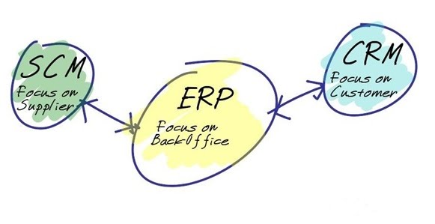
Treacy AND Wiersema (1996)
Company want to amaze its customers!, push the limits
Companies that apply this.

Slide 11
Categorising relationship

Slide 12
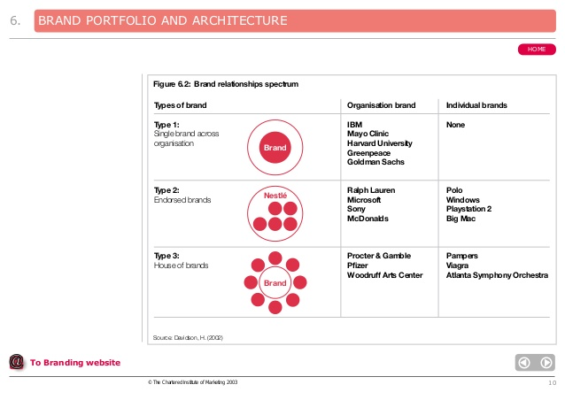
Organisational/Brand relationships
As Gummesson (ibid.) notes, ‘the more successful a company [is in tying] relationships to its structure, the less dependent it is on individual employees and the higher the value of its structural capital’.
Clubs or charities may be particularly clear examples of where organizational loyalty is not necessarily directly associated with the personnel who work for it.

Slide 13
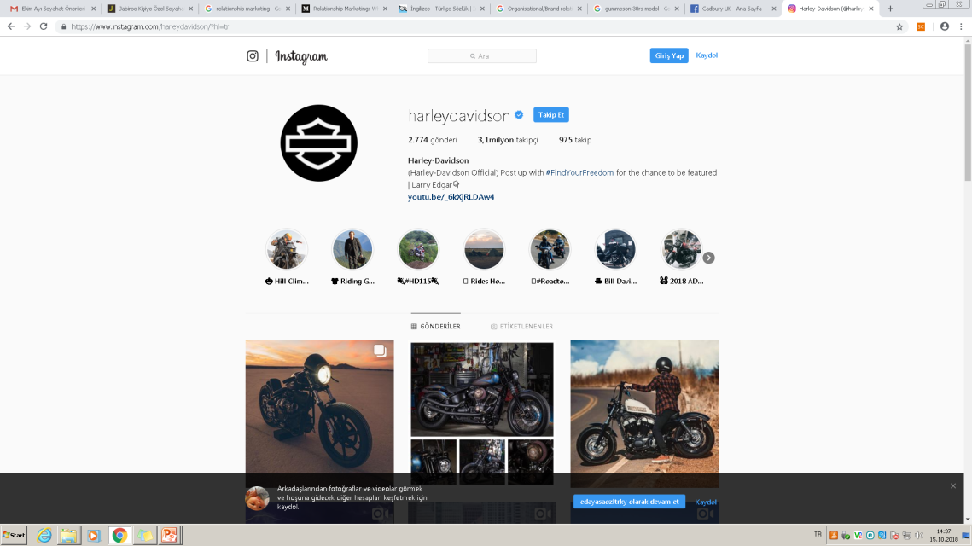
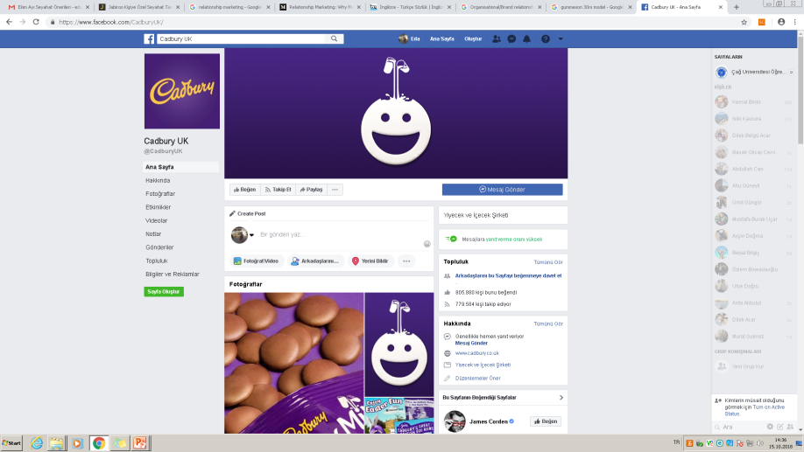
Brand communities
According to some researchers brands can indeed be conceptualized entities with personality characteristics similar to human characteristics (Fournier and Lee, 2009).
Variously called brand communities, brand tribes or brand sub-cultures they relate to communities who join together in allegiance (commitment) to a particular brand.
The widespread development of the world-wide web has led to considerable growth in stand-alone and social media hosted sites. Examples include Apple, Ford, Lego, Mini-Cooper, Jaguar andet al.

Slide 14
Learning relationships
Peppers and Rogers (2000, p. 244) have suggested that relationships are built on knowledge and propose that, when customers tell a company something about themselves, then it is the responsibility of the company to customize its offering to that customer.
As customers interact more frequently with sellers they appear to gain more information which reduces uncertainty and improves trust (Palmatier et al., 2006, p. 149).
This learning relationship gets ‘smarter and smarter’ with every interaction.

Slide 15
Motivational investments
Dwyer et al. (1987, p. 14) suggest that the type of relationship that develops between a supplier and a customer is determined by the different amounts of motivational investment that buyers and sellers are prepared to commit to the relationship.
There are four types of active relationships in addition to ‘no exchange’ (see Figure 3.1):
Bilateral relationships;
Seller-maintained relationships;
Buyer-maintained relationships;
Discrete exchanges.

Slide 16
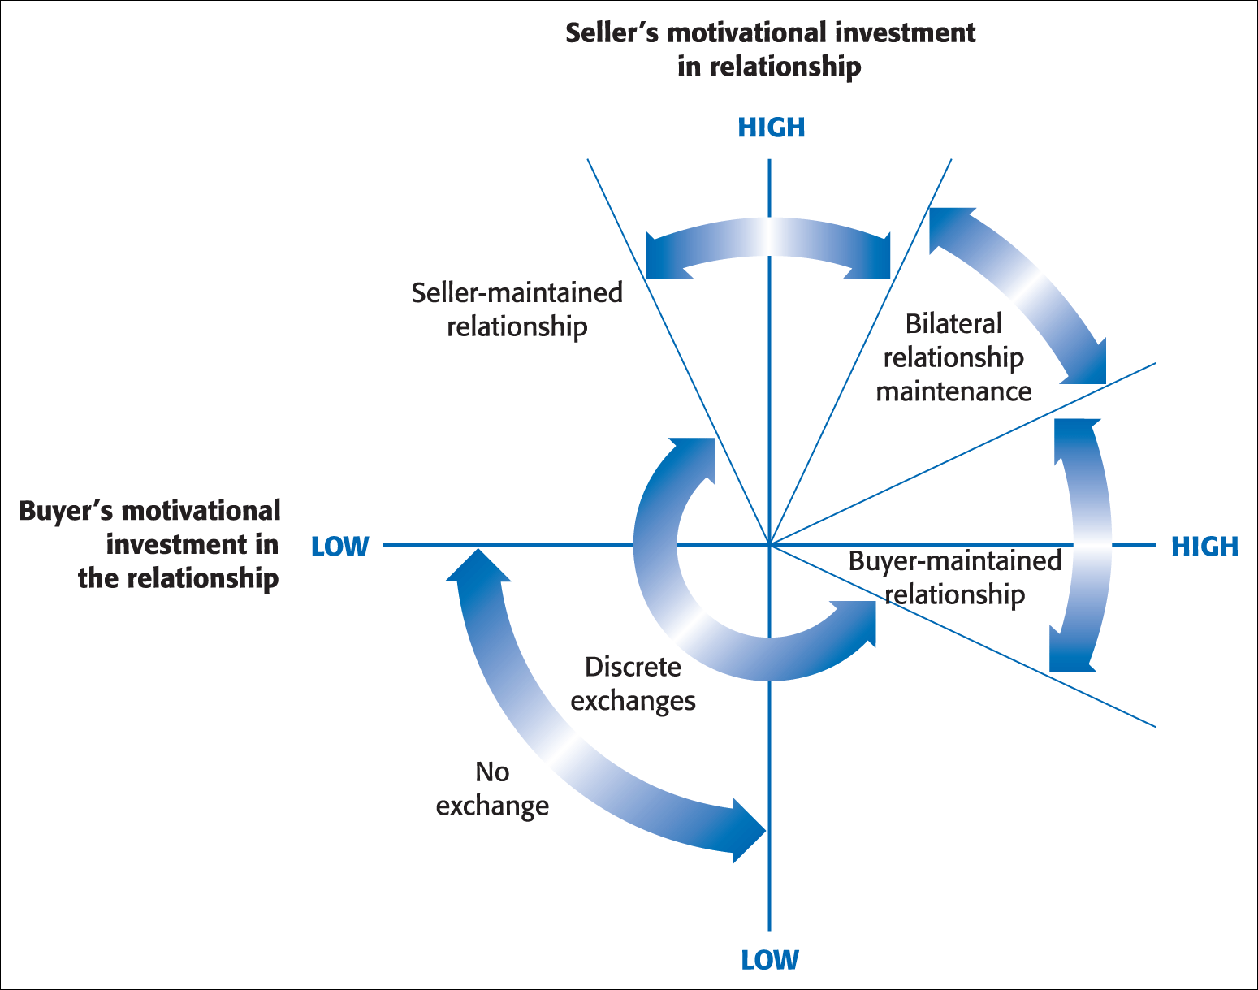
are those in which both parties are motivated highly enough to invest in a relationship
are those where it is in that company’s interest to foster longer-term bonds with the company
may be seen in the automobile market where Toyota, Ford and other manufacturers regularly share their production information with their suppliers.
are low involvement, purely transactional relationships.
Figure 3.1 Hypothesised realm of buyer–seller relationships
Source: Adapted from Dwyer et al., 1987, p. 14.

Slide 17
Relationship Loyalty is an unspecified number of repeat purchases from the same supplier over a specified period (Kendrick, 1998).
Loyalty in behavioural terms, usually based on the number of purchases and measured by monitoring the frequency of such purchases and any brand switching.
Loyalty in attitudinal terms, incorporating consumer preferences and disposition towards brands to determine levels of loyalty.

Slide 18
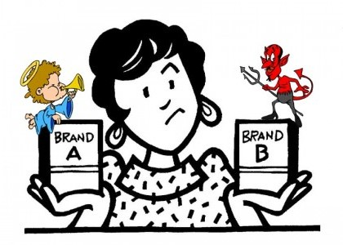
Loyalty
Is a deeply held commitment to rebuy or repatronise a preferred product-service consistently in the future, thereby causing repetitive same brand, or same brand- set purchasing, despite situational influences and marketing efforts having the potential to cause switching behaviour.

Slide 20
Co-creation
Homework
group 3-5 students together
Prepare a poster about any company’s co-creation facilities with its customers...

Slide 21
Antecedents to loyalty
There are two distinct viewpoints as to the antecedents to loyalty.
In Figure 3.2. loyalty is seen as more often built on ‘hard’ dimensions, such as value for money, convenience, reliability, safety and functionality, and that these are the prime drivers for product or service choice (Christopher, 1996, p. 60).

Slide 22
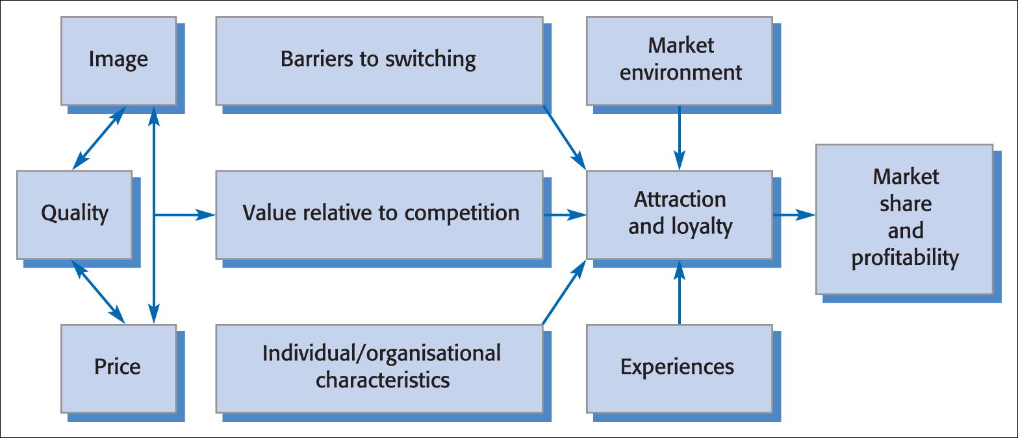
Figure 3.2 Customer loyalty: an integrated model
Source: Adapted from Fredericks and Salter, 1998, p. 64.

Slide 23
An alternative to this view is expressed by Dick and Basu (1994, p. 99). In this model, ‘softer’, more intangible factors such as emotion and satisfaction are seen to affect attitude in a decisive way.
This viewpoint suggests that customer loyalty is viewed principally as a result of the bond between an individual’s relative attitude and repeat patronage, again mediated by social norms and situational influences or experiences (Figure 3.3).

Slide 24
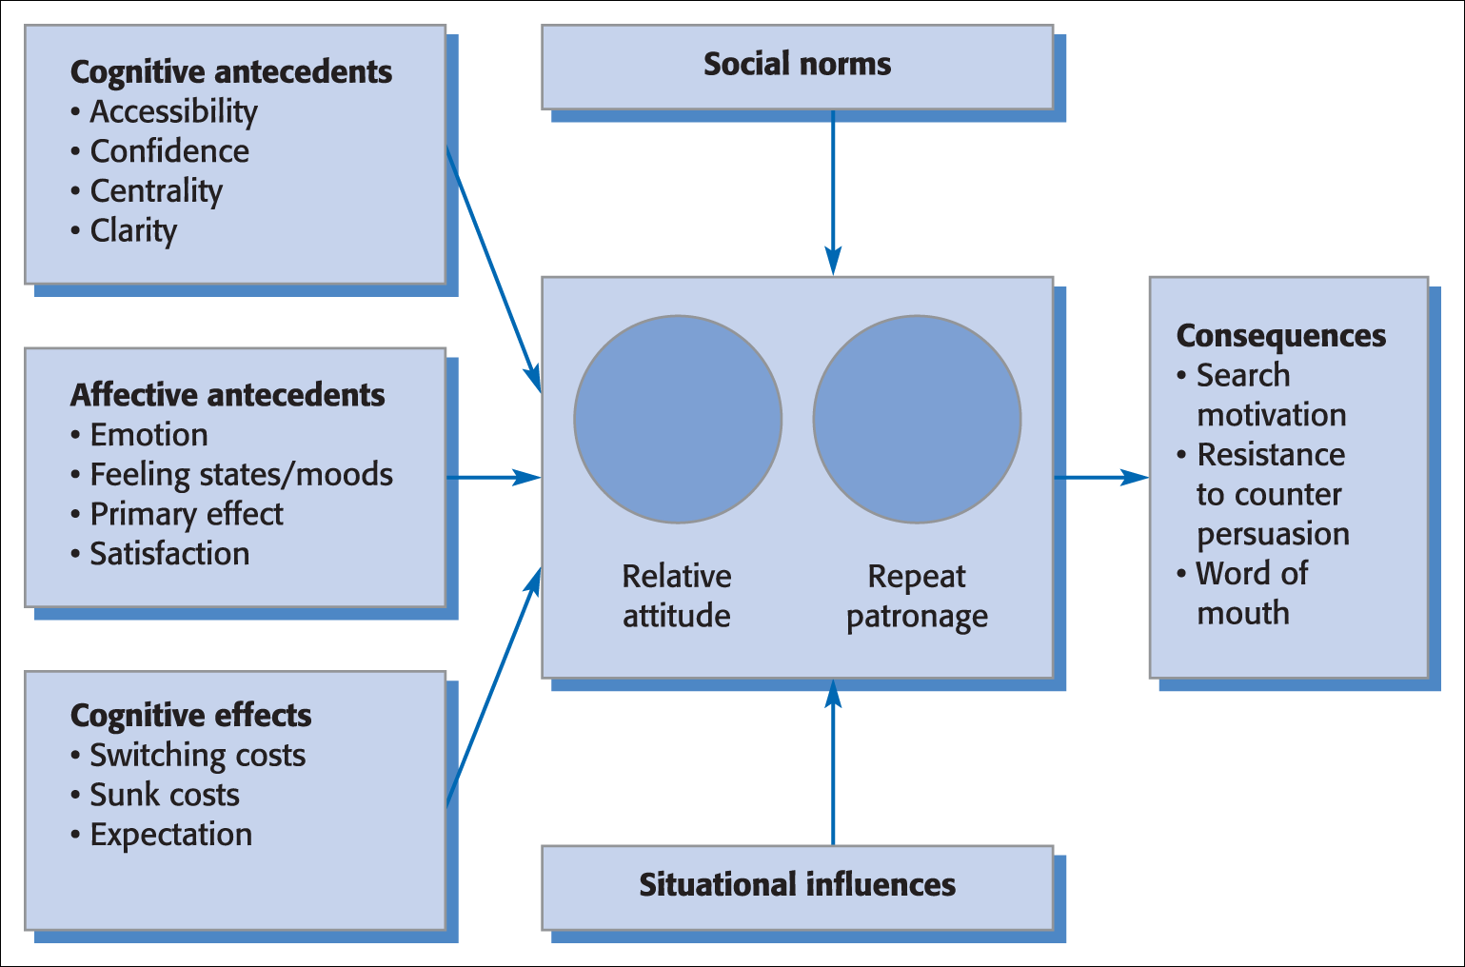
Figure 3.3 Framework for customer loyalty
Source: Adapted from Dick and Basu, 1994, p. 100.

Slide 25
What both models implicitly suggest is that customer satisfaction sustains loyalty.
The presumption is that loyalty is built upon satisfaction derived from a positive differentiation achieved by providing superior customer service ( Javalgi and Moberg, 1997, p. 165).

Slide 26
Customer loyalty
is not always based on positive attitude, and long term relationships do not necessarily require positive commitment from customers. The distinction is important because it challenges the idea that customer satisfaction leads to long lasting relationship.
Loyalty types:
Switching behavior: where purchasing is seen as an either/or decision- either the customer stays with you (loyalty) or turns against you.
Promiscuous (tentative) behavior: where customers are seen as making a «stream of purchases» but still within the context of an either or decision- either the customer is always with you or flits among an array of alternatives.
Polygamous (complicated)behavior: again, the customer makes a stream of purchases but their loyalty is divided among a number of products. They may be more or less loyal to your brand than any other.

Slide 27
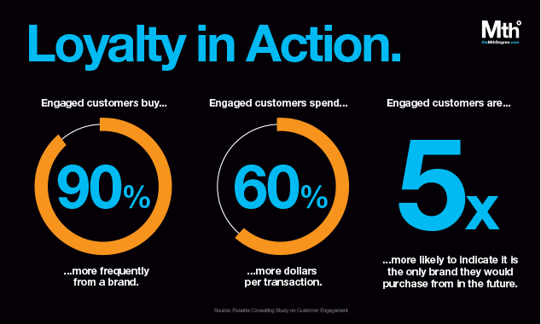
http://themthdegree.com/branding/building-brand-loyalty/

Slide 28
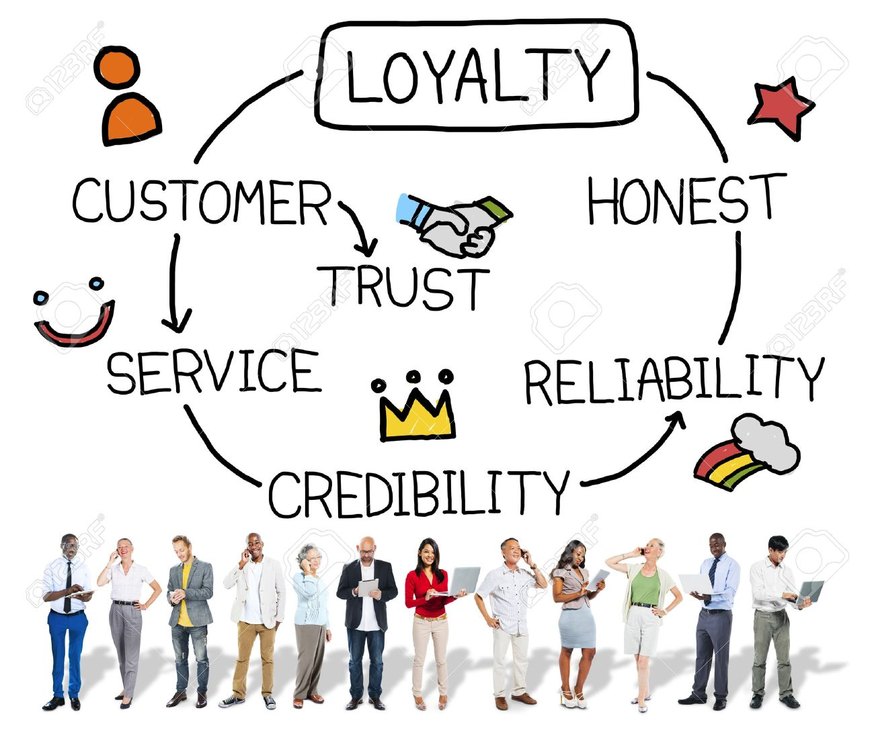

Slide 29
İt is important...
Not all relationships are close and enduring.
Relationships exist at many different levels. Depends on the type and the nature of the customer-supplier interactions

Slide 31
CRM
Customer relationship management (CRM) is a combination of people, processes and technology that seeks to understand a company’s customers.
It is an integrated approach to managing relationships by focusing on customer retention and relationship development.
A process that addresses all aspects of identfying customers, creating customer knowledge, building customer relationships and, shaping their perceptions of the organisation and its products (Payne & Frow,2005).

Slide 32
the walls between customer and company are torn down.
Regis McKenna, adopted the concept of «real-time marketing» CRM targets the buildings of infrastructure which may be used to develop long term customer-supplier relationships.

Slide 33
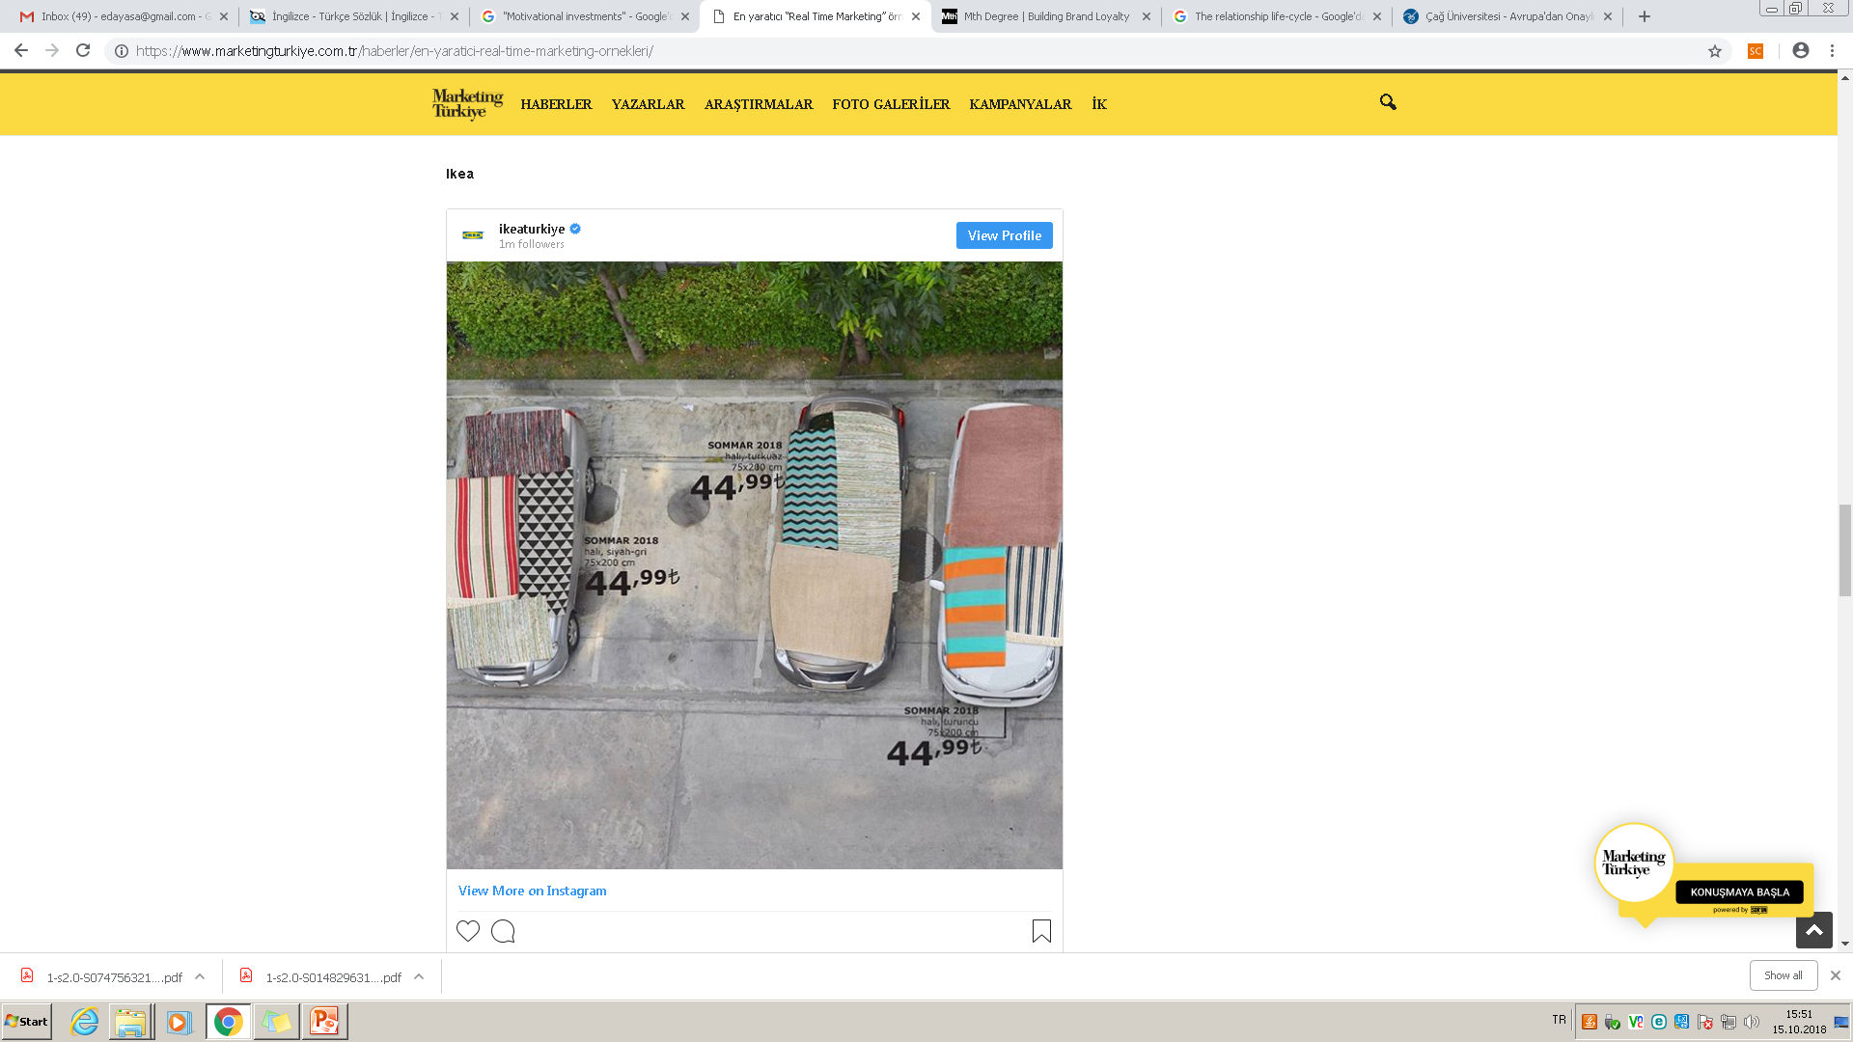

Slide 34
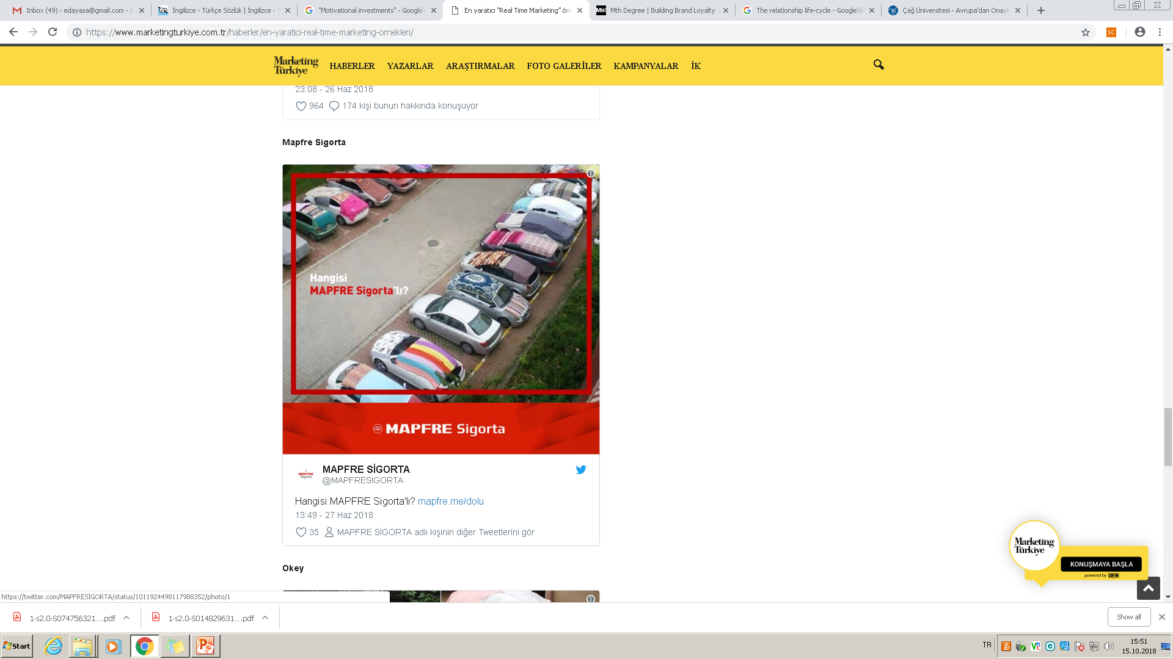

Slide 35
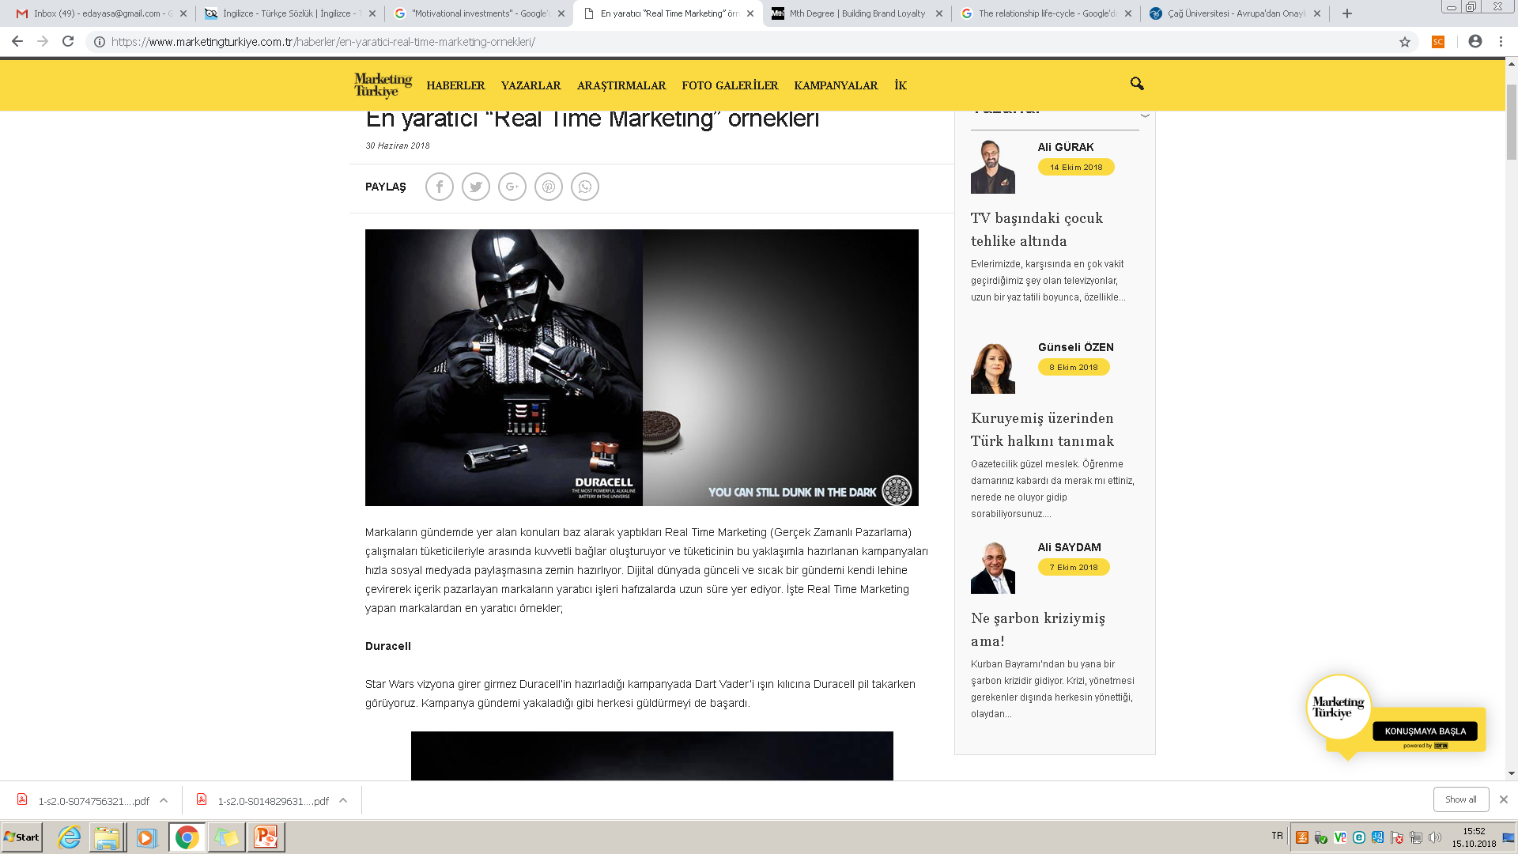

Slide 36
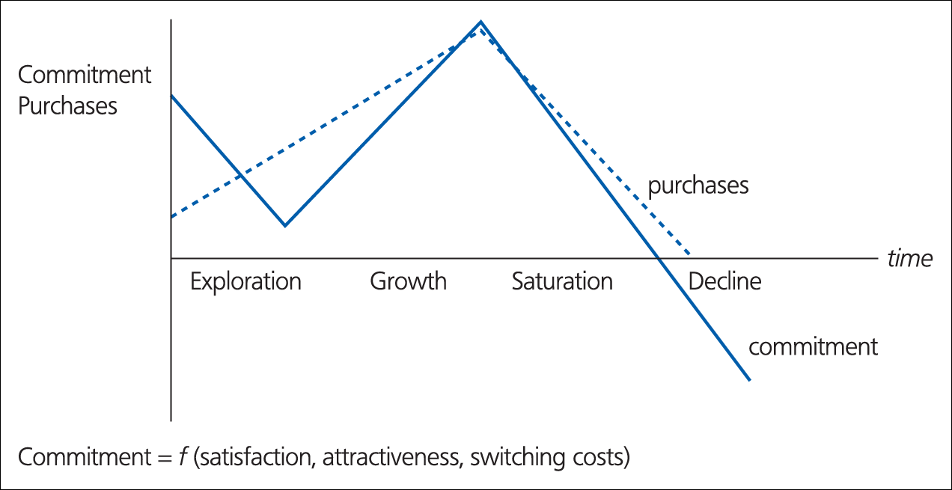
Figure 1.3 The relationship life-cycle
Source: Peelen et al. (1996).

Slide 37
The phases in relationship life cycle
Exploratory: the customer sees the promises made during communication fullfilled for the first time. The first impression make an important impression on the customer’s relations. The level of satisfaction is still relatively low the customers have little or no experience of the products or servicee supplier. The switching costs are still relativelly low.
The Growth: (3 months to 2 years): is charactarised by a sharp rise in the number of purchases. Customers would like to get to know the supplier’s products the satisfaction will be increased, the supplier is now examined more for its performance.
The Saturation (usually after more than two years) highest number of purchaes, from suppliers and and the highest commitment degree, not many changes are occuring in either, behavior of purchases, the goodwill has been built up with the customer. Trust grows, switching costs increase.
The Decline phase: number of transactions starts to decrease, at ant time in the phases customers may enter into decline phase. Type of customer and the reduction in the need for the products will be decreased. No longer they neey a product such this .

Slide 38
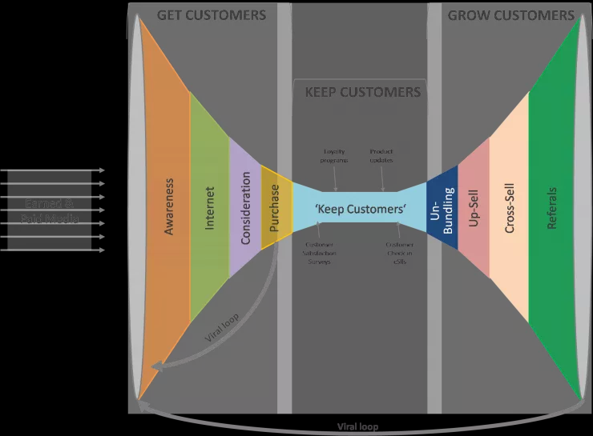
CRM

Slide 39
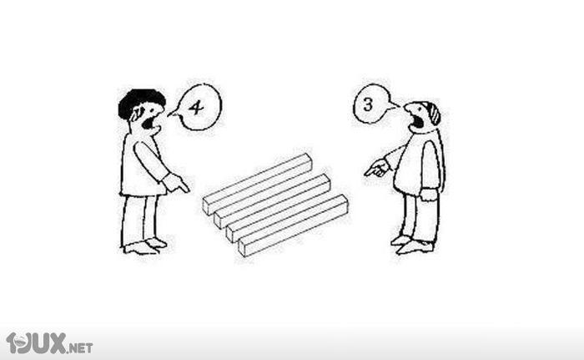
03
Notes:
39

