Slide 1
Chapter 10 Mechanics of Options Markets

Slide 2
Review of Option Types
A call is an option to buy
A put is an option to sell
A European option can be exercised only at the end of its life
An American option can be exercised at any time

Slide 3
Option Positions
Long call
Long put
Short call
Short put

Slide 4
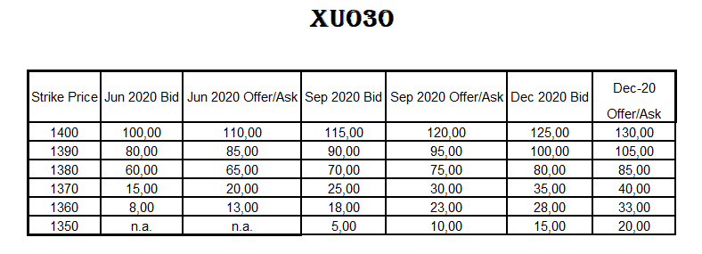
Q1: Today is 25 Dec 2019 Spot: 1.375, Long one call contract from 1.360 maturity: Dec 20 ;
(1 contract is 100 share)
What is the payoff and profit as of Dec 20? Dec’20 price of XU030 is 1.425
Profit / Loss =? Draw the Graph.

Slide 5
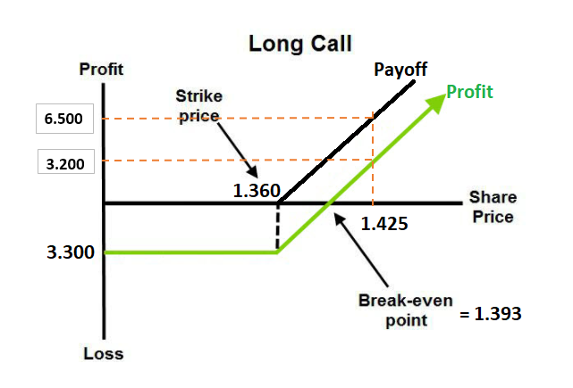
Answer Q1:
Ask Cost (1360)= : 33,00
1 option contract : 100 share
Total Cost (Premium): 33,00 x 100 = 3.300 TL
Break-even: 1.360 + 33 = 1.393
***PAYOFF OCCURS ABOVE 1.360
@dec 20 : 1.425
Payoff = 1.425 – 1.360 = 65 TL
Total Payoff = 65 x 100 = 6.500 TL
Profit = Payoff – Cost
= 6.500 – 3.300 = 3.200 TL

Slide 6
Q2: Today is 25 Dec 2019 Spot: 1.375, Long two call contracts from 1.350 maturity: Sep 20 ;
(1 contract is 100 share)
What is the payoff and profit as of Sep 20? Sep’20 Price of XU030 is 1.400
Profit / Loss =? Draw the Graph.

Slide 7
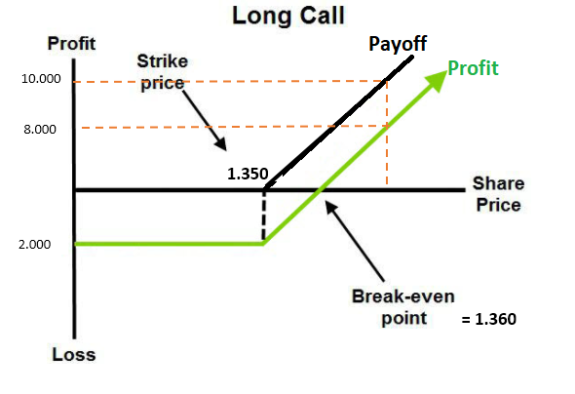
Answer Q2:
Ask Cost (1.350) : 10,00
2 option contracts: 200 share
Total Cost (Premium) : 10,00 x 200 = 2.000 TL
Break-even: 1350 + 10=1.360
***PAYOFF OCCURS ABOVE 1.350
@Sep 20 : 1.400
Payoff = 1.400 – 1.350 = 50 TL
Total Payoff = 50 x 200 = 10.000 TL
Profit = Payoff – Cost
Profit = 10.000 – 2.000 = 8.000 TL

Slide 8
Q3: Today is 25 Dec 2019 Spot: 1.375, Long three call contracts from 1.390 maturity: Jun 20 ;
(1 contract is 100 share)
What is the payoff and profit as of Jun 20?Jun’20 Price of XU030 is 1.420
Profit / Loss =? Draw the Graph.

Slide 9
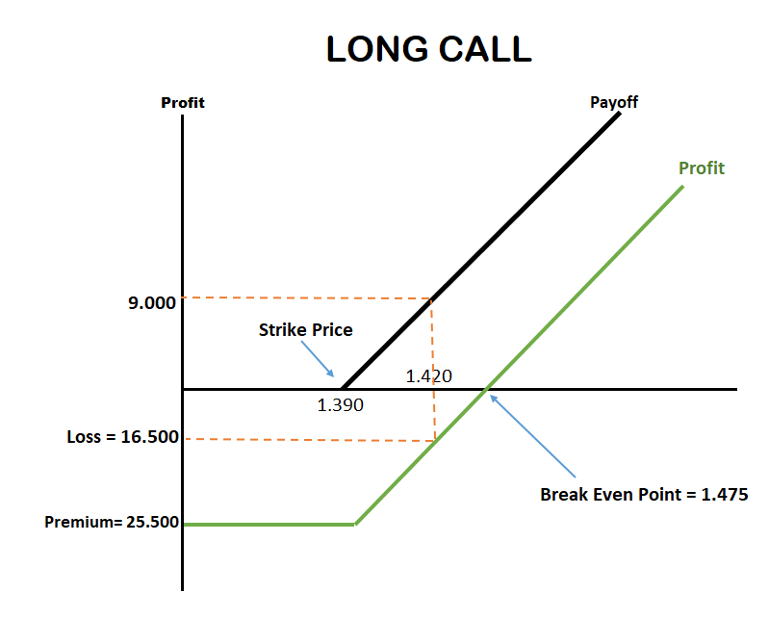
Answer Q3:
Ask Cost (1390) : 85,00
3 option contracts : 300 shares
Total Cost (Premium) = 85 x 300 = 25.500 TL
Break-even: 1.390+85 = 1.475
***PAYOFF OCCURS ABOVE 1.390
@ Jun 20: 1.420
Payoff = 1.420 – 1.390 = 30 TL
Total Payoff = 30 x 300 = 9.000 TL
Profit = Payoff – Cost
Profit = 9.000 – 25.500 = -16.500
Loss = 16.500 TL

Slide 10
Q4: Today is 25 Dec 2019 Spot: 1.375, Long one call contract from 1.370 maturity: Dec 20 ;
(1 contract is 100 share)
What is the payoff and profit as of Dec 20? Dec’20 Price of XU030 is 1.360
Profit / Loss =? Draw the Graph.

Slide 11
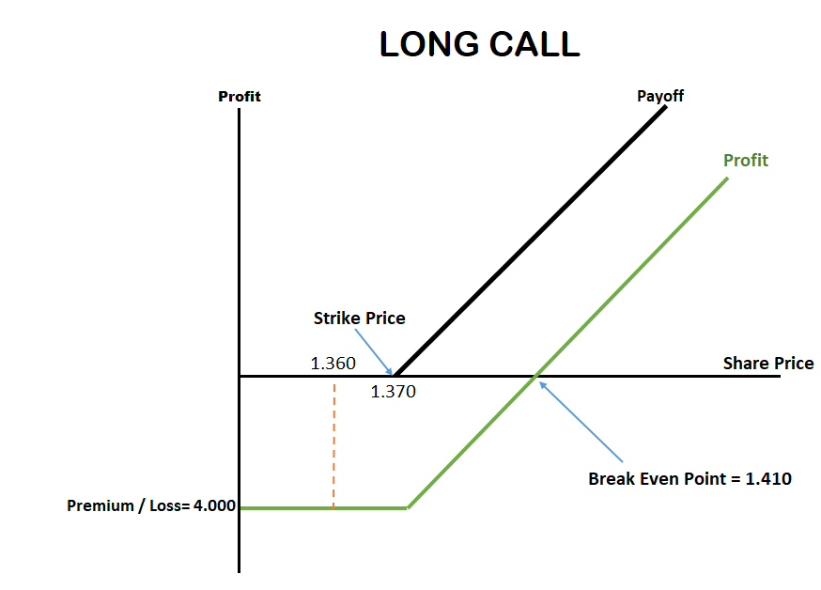
Answer Q4:
Ask Cost: (1.370 ) = 40,00 TL
1 option contract : 100 share
Total Cost = 40,00 x 100 = 4.000 TL
Break-even = 1.370+40 = 1.410
*** PAYOFF OCCURS ABOVE 1.370
Is Dec 20 Price above 1.370?
No it is not above 1.370 it is 1.360
So there is no payoff, Payoff = 0
Profit = Payoff – Cost
Profit = 0 – 4.000 = -4.000 TL
Loss = 4.000 TL

Slide 12
Option Sample
o_xu030e1220c1360.00
Type
of
derivative
Underlying asset
Maturity
(mm/yy)
Call / Put
Exercise (Strike) Price
European / American
Premium?
https://www.borsadirekt.com/canli-piyasa/opsiyon

