Slide 1
International Banking and Money Market
1
Notes:
This chapter serves to begin our discussion of world financial markets and institutions.

Slide 2
Chapter Outline
International Banking Services
The World’s Largest Banks
Reasons for International Banking
Types of International Banking Offices
Correspondent Bank
Representative Offices
Foreign Branches
Subsidiary and Affiliate Banks
Edge Act Banks
Offshore Banking centers
International Banking Facilities
Capital Adequacy Standards
11-2

Slide 3
Chapter Outline (continued)
International Money Market
Eurocurrency Markets
LIBOR
Eurocredits
Forward Rate Agreements
Euronotes
Eurocommercial Paper
Eurodollar Interest Rate Futures Contracts
International Debt Crisis
History
Debt-for-Equity Swaps
The Solution: Brady Bonds
The Asian Crisis
11-3

Slide 4
Chapter Outline (concluded)
Global Financial Crisis
The Credit Crunch
Impact of the Financial Crisis
Economic Stimulus
The Aftermath
Summary
11-4

Slide 5
International Banking Services
International banks do everything domestic banks do and:
Arrange trade financing.
Arrange foreign exchange.
Offer hedging services for foreign currency receivables and payables through forward and option contracts.
Offer investment banking services (where allowed).
11-5

Slide 6
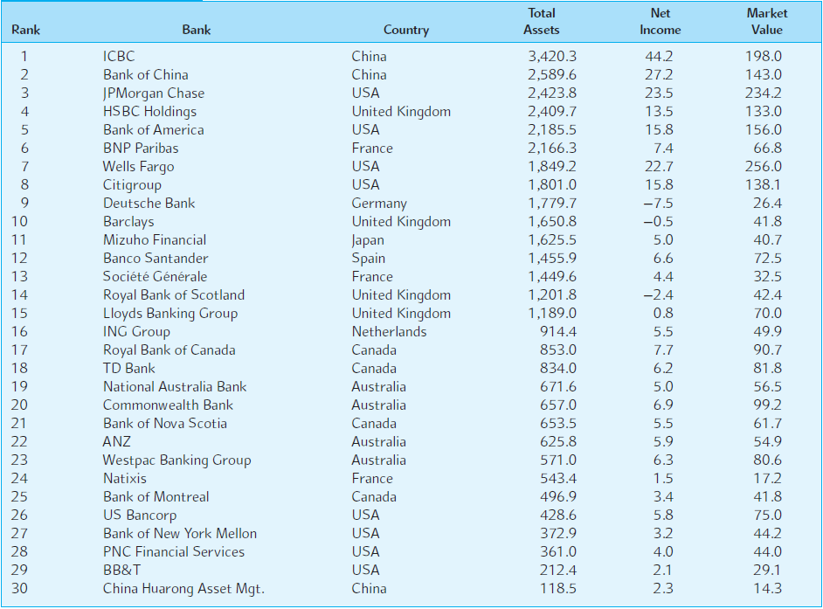
EXHIBIT 11.1 The World’s 30 Largest Banks
11-6

Slide 7
Reasons for International Banking
Low marginal costs
Managerial and marketing knowledge developed at home can be used abroad with low marginal costs.
Knowledge advantage
The foreign bank subsidiary can draw on the parent bank’s knowledge of personal contacts and credit investigations for use in that foreign market.
Home nation information services
Local firms in a foreign market may be able to obtain more complete information on trade and financial markets in the multinational bank’s home nation than is obtainable from foreign domestic banks.
Prestige
Very large multinational banks have high perceived prestige, which can be attractive to new clients.
Regulatory advantage
Multinational banks are often not subject to the same regulations as domestic banks.
11-7

Slide 8
Reasons for International Banking (continued)
Wholesale defensive strategy
Banks follow their multinational customers abroad to avoid losing their business at home and abroad.
Retail defensive strategy
Multinational banks also compete for retail services such as travelers checks and the tourist and foreign business market.
Transactions costs
Multinational banks may be able to circumvent government currency controls.
Growth
Foreign markets may offer opportunities for growth not found domestically.
Risk reduction
Greater stability of earnings with diversification.
11-8

Slide 9
Types of International Banking Offices
Correspondent bank
Representative offices
Foreign branches
Subsidiary and affiliate banks
Edge Act banks
Offshore banking centers
“Shell” branches
International banking facilities
11-9

Slide 10
Correspondent Bank
A correspondent banking relationship exists when two banks maintain deposits with each other.
Correspondent banking allows a bank’s MNC client to conduct business worldwide through his local bank or its correspondents.
11-10
Notes:
Recall the examples from Chapter 5.

Slide 11
Representative Offices
A representative office is a small service facility staffed by parent bank personnel that is designed to assist MNC clients of the parent bank in dealings with the bank’s correspondents.
Representative offices also assist with information about local business customs and credit evaluation of the MNC’s local customers.
11-11

Slide 12
Foreign Branches
A foreign branch bank operates like a local bank, but is legally part of the parent.
Subject to both the banking regulations of home country and foreign country.
Can provide a much fuller range of services than a representative office.
Branch banks are the most popular way for U.S. banks to expand overseas.
11-12

Slide 13
Subsidiary and Affiliate Banks
A subsidiary bank is a locally incorporated bank wholly or partly owned by a foreign parent.
An affiliate bank is one that is partly owned but not controlled by the parent.
U.S. parent banks like foreign subsidiaries because they allow U.S. banks to underwrite securities.
11-13

Slide 14
Edge Act Banks
Edge Act banks are federally chartered subsidiaries of U.S. banks that are physically located in the U.S. and are allowed to engage in a full range of international banking activities.
The Edge Act was a 1919 amendment to Section 25 of the 1914 Federal Reserve Act.
11-14

Slide 15
Offshore Banking Centers
An offshore banking center is a country whose banking system is organized to permit external accounts beyond the normal scope of local economic activity.
The host country usually grants complete freedom from host-country governmental banking regulations.
The IMF recognizes the following as major offshore banking centers:
The Bahamas, Bahrain, the Cayman Islands, Hong Kong, the Netherlands Antilles, Panama, and Singapore.
11-15

Slide 16
“Shell” Branches
Shell branches need to be nothing more than a post office box.
The actual business is done by the parent bank at the parent bank.
The purpose was to allow U.S. banks to compete internationally without the expense of setting up operations “for real.”
11-16

Slide 17
International Banking Facilities
An international banking facility is a separate set of accounts that are segregated on the parents books.
An international banking facility is not a unique physical or legal identity.
Any U.S. bank can have one.
International banking facilities have captured a lot of the Eurodollar business that was previously handled offshore.
11-17

Slide 18
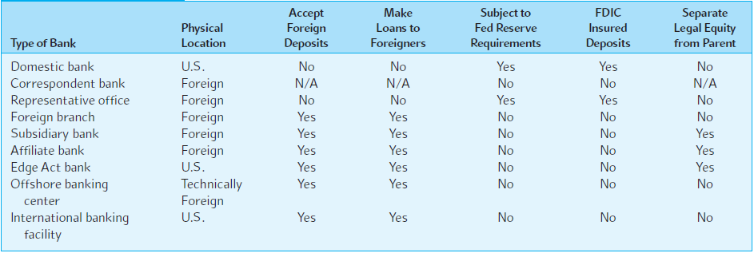
EXHIBIT 11.2 Organizational Structure of International Banking Offices from the U.S. Perspective
11-18

Slide 19
Capital Adequacy Standards
Bank capital adequacy refers to the amount of equity capital and other securities a bank holds as reserves.
Three pillars of capital adequacy:
Minimum capital requirements
Supervisory review process
Effective use of market discipline
While traditional bank capital standards protect depositors from traditional credit risk, they may not be sufficient protection from derivative risk.
Barings Bank, which collapsed in 1995 from derivative losses, looked good on paper relative to the capital adequacy standards of the day.
11-19

Slide 20
Capital Adequacy Standards (continued)
The Basel II Accord has been endorsed by central bank governors and bank supervisors in the G10 countries.
Sets out the details for adopting a more risk sensitive minimum capital requirements.
The key variables the bank must estimate are the probability of default and the loss given default for each asset on their books.
11-20

Slide 21
International Money Market
Eurocurrency is a time deposit in an international bank located in a country different than the country that issued the currency.
For example, Eurodollars are U.S. dollar-denominated time deposits in banks located abroad.
Euroyen are yen-denominated time deposits in banks located outside of Japan.
The foreign bank doesn’t have to be located in Europe.
11-21

Slide 22
Eurocurrency Market
Most Eurocurrency transactions are interbank transactions in the amount of $1,000,000 and up.
Common reference rates include:
LIBOR (London Interbank Offered Rate)
PIBOR (Paris Interbank Offered Rate)
SIBOR (Singapore Interbank Offered Rate)
A new reference rate for the new euro currency:
EURIBOR (the rate at which interbank time deposits of € are offered by one prime bank to another)
11-22

Slide 23
Eurocredits
Eurocredits are short- to medium-term loans of Eurocurrency.
The loans are denominated in currencies other than the home currency of the Eurobank.
Often the loans are too large for one bank to underwrite; a number of banks form a syndicate to share the risk of the loan.
Eurocredits feature an adjustable rate.
On Eurocredits originating in London the base rate is LIBOR.
11-23

Slide 24
Forward Rate Agreements
An interbank contract that involves two parties, a buyer and a seller.
The buyer agrees to pay the seller the increased interest cost on a notational amount if interest rates fall below an agreed rate.
The seller agrees to pay the buyer the increased interest cost if interest rates increase above the agreed rate.
11-24
Notes:
A forward rate agreement is basically a forward contract on a loan.

Slide 25
Forward Rate Agreements: Uses
Forward rate agreements can be used to:
Hedge assets that a bank currently owns against interest rate risk.
For example, a bank that has made a three-month Eurodollar loan against an offsetting six-month Eurodollar deposit could protect itself by selling a “three against six” FRA.
Speculate on the future course of interest rates.
11-25

Slide 26
Forward Rate Agreements: Example
A three against nine FRA is a 3-month forward contract on a six-month interest rate for a six-month period beginning three months from now.
0
1
2
3
4
5
6
7
8
9
Agreement period
FRA period (6 months)
(3 months)
Cash Settlement of FRA
11-26

Slide 27
Settling a Forward Rate Agreement
At the end of the agreement period, the loser pays the winner an amount equal to the present value of the difference between the settlement rate (SR) and the agreement rate (AR), sized according to the length of the agreement period and the notational amount.
days
Notational Amount × (SR – AR) ×
360
days
1 + SR ×
360
11-27

Slide 28
Settling a FRA
A €5,000,000, 4%, 3 against 9 FRA entered into January 1, 2018 has the following terms:
1/1/18
1
2
4
5
6
7
8
3/1/18
9/1/18
On 3/1/18 if the actual rate is 4% there is no payment.
184 days
Payment
184
€5,000,000 × (SR – 0.04) ×
360
If on 3/1/18 the SR = 5%
the seller pays the buyer €24,918.74.
184
1 + SR ×
360
If on 3/1/18 the SR = 3% the buyer pays the seller €25,169.62.
11-28
Notes:
€24,918.74 =[ €5,000,000 × (.05 – 0.04) × 184/360] / (1 + (.05 × 184/360))
A common mistake (for my American students at least) is
€47,619.05 =[ €5,000,000 × (.05 – 0.04) × 184/360] / ((1 + .05) × 184/360)
Or
€24,926.15 =[ €5,000,000 × (.05 – 0.04) × 184/360] / ((1 + .05) ^ (184/360)

Slide 29
Proof of FRA Utility as a Hedge
FRAs are designed so the buyer will have the same future value of interest expense (i.e., a perfect hedge at the agreed-up rate) for any value of LIBOR at maturity of the FRA.
Calculate the FV of interest expense
If LIBOR at expiration is 3 percent:
If LIBOR at expiration is 5 percent:
184
184
€5,025,169.62 x (1 + .03 x ) = €5m x ( 1 + .04 x )
360
360
€5,102,222.22 = €5,102,222.22
184
184
(€5m - €24,918.74)x(1 + .05 x ) = €5m x ( 1 + .04 x )
360
360
€5,102,222.22 =€5,102,222.22
11-29

Slide 30
Euronotes
Euronotes are short-term notes underwritten by a group of international investment banks or international commercial banks.
They are sold at a discount from face value and pay back the full face value at maturity.
Maturity is typically three to six months.
11-30

Slide 31
Eurocommercial Paper
Unsecured short-term promissory notes issued by corporations and banks.
Placed directly with the public through a dealer.
Maturities typically range from one month to six months.
Eurocommercial paper, while typically U.S. dollar denominated, is often of lower quality than U.S. commercial paper—as a result yields are higher.
11-31

Slide 32
Eurodollar Interest Rate Futures Contract
Widely used futures contract for hedging short-term U.S. dollar interest rate risk.
The underlying asset is a hypothetical $1,000,000 90-day Eurodollar deposit—the contract is cash settled.
Traded on the CME and the Singapore International Monetary Exchange.
The contract trades in the March, June, September, and December cycle.
11-32

Slide 33
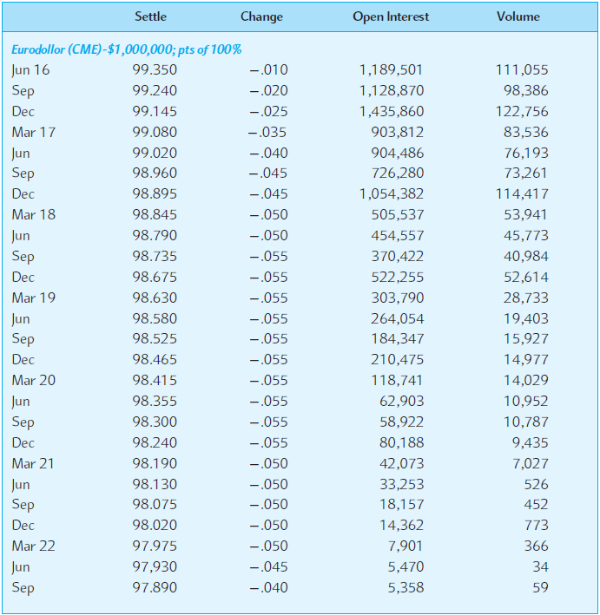
EXHIBIT 11.8 CME Group Eurodollar Futures Contract Quotations
11-33

Slide 34
LIBOR
London Interbank Offered Rate (LIBOR), the reference rate in London for Eurocurrency deposits.
There is a LIBOR for Eurodollars, Euro–Canadian dollars, Euroyen, and even euros.
In other financial centers, other reference rates are used.
For example, SIBOR is the Singapore Interbank Offered Rate, and TIBOR is the Tokyo Interbank Offered Rate.
Euro Interbank Offered Rate (EURIBOR) is the rate at which interbank deposits of the euro are offered by one prime bank to another in the euro zone.

Slide 35
International Debt Crisis
Some of the largest banks in the world were endangered when loans were made to sovereign governments of some less-developed countries.
At the height of the crisis, Third World countries owed $1.2 trillion.
Like many calamities, it is easy to see in retrospect that, it’s a bad idea to put too many eggs in one basket, especially if you don’t know much about that basket.
11-35

Slide 36
Debt-for-Equity Swaps
As part of debt rescheduling agreements among the bank lending syndicates and the debtor nations, creditor banks would sell their loans for U.S. dollars at discounts from face value to MNCs desiring to make equity investment in subsidiaries or local firms in the LDCs.
The LDC central bank would buy the bank debt from a MNC at a smaller discount than the MNC paid, but in local currency.
The MNC would use the local currency to make pre-approved new investment in the LDC that was economically or socially beneficial to the LDC.
11-36

Slide 37
Debt-for-Equity Swap Illustration
International Bank
Sell $100m LDC debt at 60% of face
$60m
$80m in local currency
LDC firm or MNC subsidiary
Equity Investor or MNC
Redeem LDC debt at 80% of face in local currency
$80m in local currency
LDC Central Bank
11-37

Slide 38
The Asian Crisis
This crisis followed a period of economic expansion in the region financed by record private capital inflows.
Bankers from the G-10 countries actively sought to finance the growth opportunities in Asia by providing businesses with a full range of products and services.
This led to domestic price bubbles in East Asia, particularly in real estate.
Additionally, the close interrelationships common among commercial firms and financial institutions in Asia resulted in poor investment decision making.
The Asian crisis is only the latest example of banks making a multitude of poor loans—spurred on by competition from other banks to make loans in the “hot” region.
11-38
Notes:
It is doubtful if the international debt crisis or the Asian crisis has taught banks a lasting lesson.

Slide 39
Global Financial Crisis
Officially began in the United States in December of 2007.
The origin of the credit crunch can be traced back to the low interest rate environment created by the Federal Reserve Bank in the early part of this century.
Many banks and mortgage lenders lowered their credit standards to attract new home buyers who could afford to make mortgage payments at the current low interest rates, or “teaser” rates that were temporarily set at a low level during the early years of an adjustable-rate mortgage, but would likely reset to a higher rate later on.
Many of these home buyers would not have qualified for mortgage financing under more stringent credit standards, nor could they afford the loan at the eventual higher rates of interest.
11-39

Slide 40
Global Financial Crisis: Subprime Primer
These so-called subprime mortgages were typically not held by the originating bank making the loan, but instead were resold for packaging into mortgage-backed securities (MBSs).
Between 2001 and 2006, the value of subprime mortgages increased from $190 billion to $600 billion.
Conceptually, mortgage-backed securities make sense. Each MBS represents a portfolio of mortgages, thus diversifying the credit risk that the investor holds.
11-40

Slide 41
Global Financial Crisis: SIVs
Structured Investment Vehicles (SIVs) have been one large investor in MBS. An SIV is a virtual bank, frequently operated by a commercial bank or an investment bank, but which operates off the balance sheet.
Typically, an SIV raises short-term funds in the commercial paper market to finance longer-term investment in MBSs and other asset-backed securities.
SIVs are frequently highly levered, with ratios of 10 to 15 times the amount of equity raised.
Since yield curves are typically upward sloping, the SIV might earn .25 percent by doing this. Obviously, SIVs are subject to the interest rate risk of the yield curve inverting (that is, short-term rates rising above long-term rates), thus necessitating the SIV to refinance the MBS investment at short-term rates in excess of the rate being earned on the MBS.
SIVs must contend with default risk. If the underlying mortgage borrowers default on their home loans, the SIV will lose investment value.
11-41

Slide 42
Global Financial Crisis: CDOs
Collateralized Debt Obligations (CDOs) have been another big investor in MBS.
A CDO is a corporate entity constructed to hold a portfolio of fixed-income assets as collateral. The portfolio of fixed-income assets is divided into different tranches, each representing a different risk class: AAA, AA-BB, or unrated.
CDOs serve as an important funding source for fixed-income securities. An investor in a CDO is taking a position in the cash flows of a particular tranche, not in the fixed-income securities directly.
The investment is dependent on the metrics used to define the risk and reward of the tranche. Investors include insurance companies, mutual funds, hedge funds, other CDOs, and even SIVs. MBSs and other asset-backed securities have served as collateral for many CDOs.
11-42
Notes:
Tranche is the French word for “slice.”

Slide 43
Global Financial Crisis: Fed Actions
To cool the growth of the economy, the Fed steadily increased the fed funds target rate at meetings of the Federal Open Market Committee, from a low of 1.00 percent on June 25, 2003, to 5.25 percent on June 29, 2006.
In turn, mortgage rates increased. Many subprime borrowers found it difficult, if not impossible, to make mortgage payments in a cooling economy, especially when their adjustable-rate mortgages were reset at higher rates.
11-43

Slide 44
Global Financial Crisis: Default Snowball
When subprime debtors began defaulting on their mortgages, commercial paper investors were unwilling to finance SIVs. Liquidity worldwide essentially dried up.
The spread between the three-month Eurodollar rate and three-month U.S. Treasury-bills (the TED spread), frequently used as a measure of credit risk, increased from about 30 basis points in March 2007 to 200 basis points in November 2007, as investors became fearful of placing funds in even the strongest international banks.
Additionally, many CDOs found themselves stuck with the highest risk tranches of MBS debt, which they had not yet placed or were unable to place as subprime foreclosure rates around the country escalated.
Commercial and investment banks have been forced to write down over $170 billion of subprime debt to date, with as much as $285 billion expected.
11-44

Slide 45
Global Financial Crisis: Lessons
At this point, the story of the global financial crisis is still ongoing. Many lessons should be learned from it:
Credit rating agencies need to refine their models for evaluating esoteric credit risk created in MBSs and CDOs.
Borrowers must be more wary of putting complete faith in credit ratings.
Bankers seem to scrutinize credit risk less closely when they serve only as mortgage originators rather than the paper holders themselves.
As things have turned out, when the subprime mortgage crisis hit, commercial and investment banks found themselves exposed, in one fashion or another, to more mortgage debt than they realized they held.
11-45

Slide 46
Summary
International banks facilitate imports and exports by arranging trade financing. They also arrange foreign currency exchange, assist in hedging exchange rate exposure, trade foreign exchange for their own account, and make a market in currency derivative products.
Various types of international banking offices include correspondent bank relationships, representative offices, foreign branches, subsidiaries and affiliates, Edge Act banks, offshore banking centers, and International Banking Facilities. The reasons for the various types of international banking offices and the services they provide vary considerably.
11-46

Slide 47
Summary (continued)
A Eurocurrency is a time deposit of money in an international bank located in a country different from the country that issued the currency. For example Eurodollars are deposits of U.S. dollars in banks outside of the United States. The Eurocurrency market is headquartered in London.
Other main international money market instruments include forward rate agreements, Euronotes, Eurocommercial paper, and Eurodollar interest rate futures.
11-47

Slide 48
Summary (continuing)
Capital adequacy refers to the amount of equity capital and other securities a bank holds as reserves to reduce the probability of a bank failure. The global financial crisis that began in mid-2007 illustrated how quickly and severely liquidity risks can crystallize and certain sources of funding can evaporate.
The international debt crisis was caused by international banks lending more to Third World sovereign governments than they should have.
The Asian crisis began in mid-1997. The crisis followed a period of economic expansion in the region financed by record private capital inflows.
11-48

Slide 49
Summary (concluded)
The global financial crisis began in the United States in the summer of 2007 as a credit crunch, or the inability of borrowers to easily obtain credit.
The origin of the credit crunch can be traced back to three key contributing factors: liberalization of banking and securities regulation, a global savings glut, and the low interest rate environment created by the Federal Reserve in the earlier part of the decade.
Low interest rates created the means for first-time homeowners to afford mortgage financing and for existing homeowners to trade up to more expensive homes.
11-49

