Slide 1
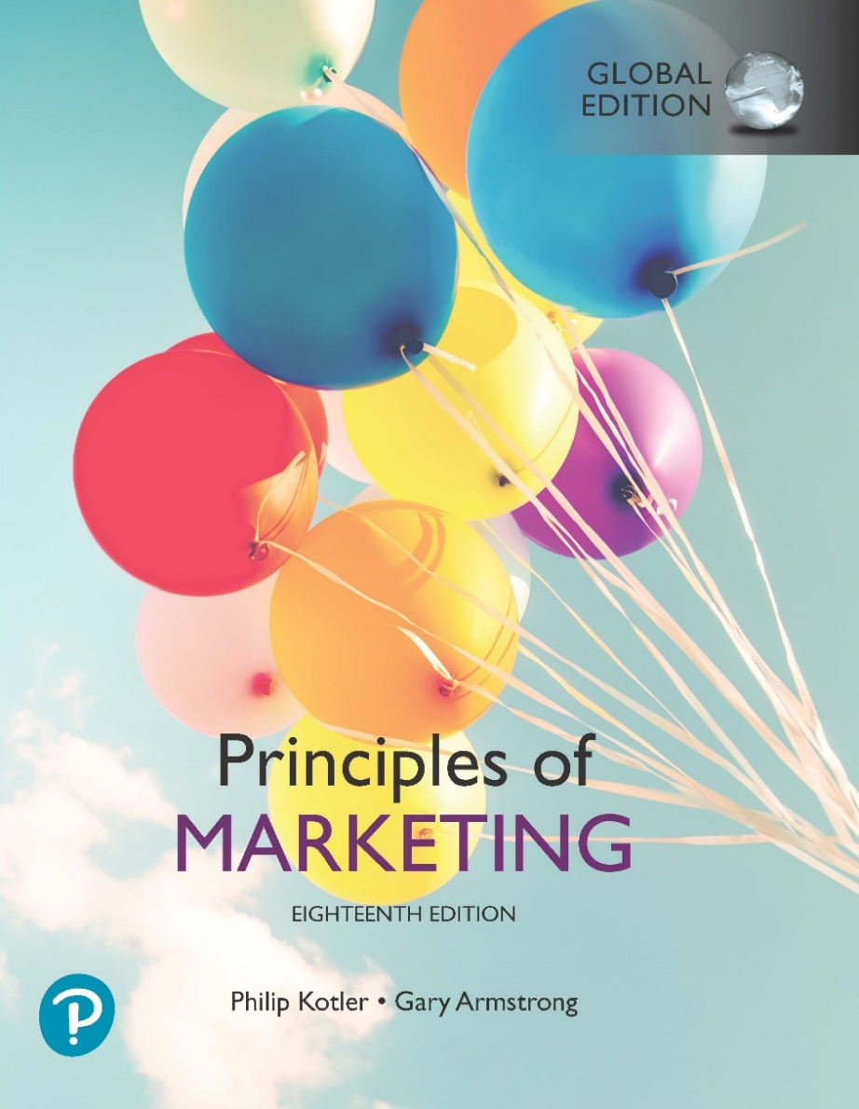
Principles of Marketing
Eighteenth Edition, Global Edition
Chapter 1
Marketing: Creating Customer Value and Engagement
Copyright © 2021 Pearson Education Ltd.

Slide 2
Learning Objectives
1.1 Define marketing and outline the steps in the marketing process.
1.2 Explain the importance of understanding the marketplace and customers and identify the five core marketplace concepts.
1.3 Identify the key elements of a customer value-driven marketing strategy and discuss the marketing management orientations that guide marketing strategy.
1.4 Discuss customer relationship management and identify strategies for creating value for customers and capturing value from customers in return.
1.5 Describe the major trends and forces that are changing the marketing landscape in this age of relationships.

Slide 3
Learning Objective 1
Define marketing and outline the steps in the marketing process.

Slide 4
What Is Marketing? (1 of 2)
Marketing is a process by which companies create value for customers and build strong customer relationships in order to capture value from customers in return.

Slide 5
What Is Marketing? (2 of 2)
Marketing is all around you, in good old traditional forms and in a host of new forms, from websites and mobile apps to online videos and social media.

Slide 6
Examples of Value-driven Marketing Approaches
Amazon dominates the online marketplace by creating a world-class on-line buying experience that helps customers to “find and discover anything they might want to buy online.”
Facebook has attracted more than 2 billion monthly active web and mobile users worldwide by helping them to “connect and share with the people in their lives.”
Starbucks dominates the U.S. out-of-home coffee market by “creating a culture of warmth and belonging, where everyone is welcome

Slide 7
Figure 1.1 The Marketing Process: Creating and Capturing Customer Value

Slide 8
Learning Objective 2
Explain the importance of understanding the marketplace and customers and identify the five core marketplace concepts.

Slide 9
We examine five core customer and marketplace concepts:
(1) needs, wants, and demands;
(2) market offerings (products, services, and experiences);
(3) value and satisfaction;
(4) exchanges and relationships; and
(5) markets.

Slide 10
Understanding the Marketplace and Customer Needs (1 of 5)
Needs..
are states of felt deprivation.
Wants..
are the form human needs take as they are shaped by culture and individual personality.
Demands..
are human wants that are backed by buying power.
Staying close to customers: Airbnb’s CEO Brian Chesky and co-founder Joe Gebbia regularly stay at the company’s host locations, helping them shape new customer solutions based on real user experiences.

Slide 11
Understanding the Marketplace and Customer Needs (2 of 5)
Customer needs and wants are fulfilled by market offerings. Market offerings are some combination of products,
services, information, or experiences offered to a market to satisfy a need or want.
Marketing myopia—paying more attention to the specific products than to the benefits and experiences produced
*Create brand experience

Slide 12
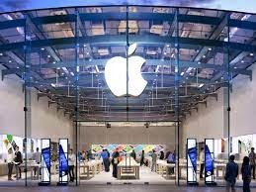
Smart marketers look beyond the atributes of the productst and services
Walt Disney World Resort doesn’t offer just amusement park rides, it uses its famed Disney magic to create carefull orchestrated guest experiences true.
Apple’s highly successful retail stores don’t just sell the company’s products. They create engaging Apple brand experience.

Slide 13
Understanding the Marketplace and Customer Needs (3 of 5)
Customers form expectations about the value and satisfaction of market offerings.
Satisfied customers buy again
Dissatisfied customers switch to competitors
Marketing occurs when people decide to satisfy their needs and wants through exchane relationships.
Exchange is the act of obtaining a desired object from someone by offering something in return.(political candidate wants votes ! )
Marketing actions try to create, maintain, and grow desirable exchange relationships.
Set the right level of expectation !

Slide 14
Understanding the Marketplace and Customer Needs (4 of 5)
Exchange and relationships lead to the concept of a market.
A market is the set of actual and potential buyers.
Traditionally marketing was carried out by sellers, the concept now also includes consumer engagement in marketing!
Consumers market when they:
search for products
interact with companies to obtain information
make purchases

Slide 15
Understanding the Marketplace and Customer Needs (5 of 5)
Figure 1.2 A Modern Marketing System

Slide 16
Learning Objective 3
Identify the key elements of a customer value-driven marketing strategy and discuss the marketing management orientations that guide marketing strategy.

Slide 17
Designing a Customer Value-Driven Marketing Strategy (1 of 6)
Marketing management is the art and science of choosing target markets and building profitable relationships with them.
What customers will we serve (target market)?
How can we best serve these customers (value proposition)?
Marketing manager’s aim is to find, attract, keep, and grow target customers by creating, delivering and communicating superior value.
Notes:
.

Slide 18
Selecting Customers to Serve
The company must first decide whom it will serve. It does this by dividing the market into segments of customers (market segmentation) and selecting which segments it will go after (target marketing).
It’s not finding as many customers as possible.
Marketing managers know that they cannot serve all customers in every way. By trying to serve all customers, they may not serve any customers well.
Instead, the company wants to select only customers that it can serve well and profitably
Marketing managers must decide which customers they want to target and the level, timing, and nature of their demand.
Simply put, marketing management is customer management and demand management.

Slide 19
Designing a Customer Value-Driven Marketing Strategy (2 of 6)
A brand’s value proposition is the set of benefits or values it promises to deliver to customers to satisfy their needs.
Some examples of value proposition:
What is Starbucks value proposition?
To inspire and nurture the human spirit - one person, one cup and one neighborhood at a time. With our partners, our coffee and our customers at our core, we live these values: Creating a culture of warmth and belonging, where everyone is welcome.
Jeff Bezos defines that Amazon's business model is based on three value propositions: low price, fast delivery, and a wide selection of product

Slide 20
Let’s discuss some value propositions…
BMW promises “the ultimate driving machine.”
YouTube “provides a place for people to connect, inform, and inspire others across the globe.”
Facebook helps you “connect and share with the people in your life.”
Nissan Leaf electric car is “100% electric. Zero gas. Zero tailpipe.”
New Balance’s Minimus shoes are “like barefoot only better.”

Slide 21
Designing a Customer Value-Driven Marketing Strategy (3 of 6)
Production concept
Product concept
Selling concept
Marketing concept
Societal Marketing concept

Slide 22
Five Eras of Marketing History
FIGURE 1.1
Henry Ford’s quotes for Model T car: (production concept)
"You can have it in any color you want, as long as it is black."
"If I had asked people what they wanted, they would have said faster horses."

Slide 23
The Production Era
Period before 1925
Production orientation - Stressing efficiency in producing a quality product, with the attitude toward marketing that “a good product will sell itself”
Business success was defined solely in terms of production successes
Characterized by production shortages and intense consumer demand

Slide 24
The Sales Era
Sales orientation - Customers will resist purchasing nonessential items
Only personal selling and creative advertising would persuade them to buy
With the sophistication/complication of production techniques, output grew from the 1920s into the early 1950s
Manufacturers began to increase their emphasis/ interest on effective sales forces

Slide 25
The Marketing Era
Emergence/occurence of the marketing concept
Shift from a seller’s market to a buyer’s market
A strong buyer’s market created the need for consumer orientation/focus
Marketing concept - A companywide consumer orientation/focus/cooperation to achieve long-run success
A strong market orientation improves market success and overall performance

Slide 26
The Relationship Era
Emerged during the 1990s and continues to grow in importance
Relationship marketing - Developing long-term, value-added relationships over time with customers and suppliers
Strategic alliances and partnerships benefit everyone

Slide 27
The Social Era
Characterized by the accessibility to the Internet and the creation of social media sites
Routine use of the Web and social networking sites by companies to connect to consumers

Slide 28
Designing a Customer Value-Driven Marketing Strategy (4 of 6)
Figure 1.3 Selling and Marketing Concepts Contrasted
«Transition from make and sell to sense and respond philosophy»

Slide 29
Designing a Customer Value-Driven Marketing Strategy (5 of 6)
Societal marketing:
The company’s marketing decisions should consider consumers’ wants, the company’s requirements, consumers’ long-run interests, and society’s long-run interests.
Figure 1.4 Three Considerations Underlying the Societal Marketing Concept
Evolution of Sustainable Marketing !
Balance these 3 considerations !

Slide 30
How does societal marketing concept influence your buying behavior ? What companies can you identify with social marketing ?

Slide 31
Designing a Customer Value-Driven Marketing Strategy (6 of 6)
After deciding which customers to serve and how to create value for these customers, its time to talk abouot an integrated marketing program. The marketing program consists of tools the firm uses to implement strategies !
The marketing mix is comprised of a set of tools known a the four Ps:
product
price
promotion
place
Integrated marketing program—a comprehensive plan that communicates and delivers intended value

Slide 32
Learning Objective 4
Discuss customer relationship management and identify strategies for creating value for customers and capturing value from customers in return.

Slide 33
Managing Customer Relationships and Capturing Customer Value (1 of 9)
Customer relationship management—the overall process of building and maintaining profitable customer relationships by delivering superior customer value and satisfaction.

Slide 34
Managing Customer Relationships and Capturing Customer Value (2 of 9)
Relationship Building Blocks
Create superior value and satisfaction !
Customer-perceived value
The difference between total customer perceived benefits and customer cost of a market offering relative to those of competing offers. Customers act on perceived value. Example: customer buying a luxurious watch gives a small fortune but when owning and wearing it feels its a great value.
Customer satisfaction
The extent to which perceived performance matches a buyer’s expectations
Customer satisfaction: Customer service champion L.L.Bean was founded on a philosophy of complete customer satisfaction. “If you are not 100% satisfied with one of our products, you may return it within one year of purchase for a refund.”

Slide 35
Managing Customer Relationships and Capturing Customer Value (3 of 9)
Customer-Engagement Marketing
Fosters direct and continuous customer involvement in shaping brand conversations, experiences, and community.
Engaging customers: Rather than using intrusive, hard-sell product pitches, Innocent Drinks interacts with customers in humorous ways, inspiring conversations and fostering relationships.

Slide 36
Managing Customer Relationships and Capturing Customer Value (4 of 9)
Consumer-Generated Marketing
Brand exchanges created by consumers themselves.
Consumers are playing an increasing role in shaping brand experiences.
Oreo recently ran a #MyOreoCreation contest asking fans to come up with new flavor ideas. Three finalist flavors hit the stores for two months before fans voted online for a winner, who received $500,000.
At the My Starbucks Idea site, Starbucks collects ideas from customers on new products, store changes, and just about anything else that might make their Starbucks experience better. “You know better than anyone else what you want from Starbucks,” says the company at the website. “So tell us. What’s your Starbucks idea? Revolutionary or simple—we want to hear it.” The site invites customers to share their ideas, vote on and discuss the ideas of others, and see which ideas Starbucks has implemented.
Notes:
A growing form of customer-engagement marketing is consumer-generated marketing.
This might happen through uninvited consumer-to-consumer exchanges in blogs, video-sharing sites, social media, and other digital forums. But increasingly, companies themselves are inviting consumers to play a more active role in shaping products and brand content. Some companies ask consumers for new product and service ideas.

Slide 37
Managing Customer Relationships and Capturing Customer Value (5 of 9)
Partner relationship management involves working closely with partners in other company departments and outside the company to jointly bring greater value to customers.
Marketers must also partner with suppliers, channel partners, and others outside the company.

Slide 38
Managing Customer Relationships and Capturing Customer Value (6 of 9)
Customer lifetime value is the value of the entire stream of purchases that the customer would make over a lifetime of patronage.
Customer lifetime value: To keep customers coming back, Stew Leonard’s has created the “Disneyland of dairy stores.” Rule #1—The customer is always right. Rule #2—If the customer is ever wrong, reread Rule #1.
Notes:
At Stew Leonard’s profitable four-store supermarket, the lifetime revenue of a customer is $50,000. Because his average customer spends about $100 a week, shops 50 weeks a year, and remains in the area for about 10 years, losing one customer can be a significant loss.
Discussion Question
Ask students if they know of other retailers that build this kind of customer loyalty and retention.
Good customer relationship management creates customer satisfaction. In turn, satisfied customers remain loyal and talk favorably to others about the company and its products.
Studies show big differences in the loyalty of customers who are less satisfied, somewhat satisfied, and completely satisfied. Keeping customers loyal makes good economic sense. Loyal customers spend more and stay around longer. Research also shows that it’s five times cheaper to keep an old customer than acquire a new one. Conversely, customer defections can be costly. Losing a customer means losing more than a single sale. It means losing the entire stream of purchases that the customer would make over a lifetime of patronage.

Slide 39
Managing Customer Relationships and Capturing Customer Value (7 of 9)
Share of customer is the portion of the customer’s purchasing that a company gets in its product categories.
To increase share of customer, firms can offer greater variety to current customers. Or they can create programs to cross-sell and up-sell to market more products and services to existing customers.
For example, Amazon is highly skilled at leveraging relationships with its more than 310 million customers worldwide to increase its share of each customer’s spending budget

Slide 40
Managing Customer Relationships and Capturing Customer Value (8 of 9)
The ultimate aim of customer relationship management is to produce high customer equity. Customer equity is the total combined customer lifetime values of all of the company’s customers.
It’s the potential profit company earns from all its customers, during customer-company relationship.
The more loyal the firm’s profitable customers, the higher its customer equity. Customer equity may be a better measure of a firm’s performance than current sales or market share.
Whereas sales and market share reflect the past, customer equity suggests the future.

Slide 41
Customer Equity Example
Managing customer equity: To increase customer equity, Cadillac is making the classic car cool again among younger buyers. For example, says GM, “Cadillac will lead the company to an all-electric future.”

Slide 42
How to measure customer equity?
Let’s say the average of loyal customer is 6 years. They purchase $100 per transaction. They make 3 transactions per year. Your customer lifetime value will be 6 times 100 times 3, which is $1800. If your profitiability is 20%, you know each customer generates $360.

Slide 43
Managing Customer Relationships and Capturing Customer Value (9 of 9)
Figure 1.5 Customer Relationship Groups
Different customers require different engagement and relationship management !

Slide 44
Learning Objective 5
Describe the major trends and forces that are changing the marketing landscape in this age of relationships.

Slide 45
The Changing Marketing Landscape (1 of 5)
Digital Age
Changing Economic Environment
Growth of Not-for-Profit Marketing
Rapid Globalization
Sustainable Marketing
Notes:
Every day, dramatic changes are occurring in the marketplace. Five major developments that are changing the marketing landscape and challenging marketing strategy include the digital age, changing economic environment, growth of not-for-profit marketing, rapid globalization, and the call for sustainable marketing practices.
We will examine these developments in more detail on the following slides.

Slide 46
The Changing Marketing Landscape (2 of 5)
We live in the age of Internet of Things, where everything is connected to everything else.
Digital and social media marketing involves using digital marketing tools such as websites, social media, mobile ads and apps, online videos, email, and blogs that engage consumers anywhere, at any time, via their digital devices.
Notes:
The explosive growth in digital technology has fundamentally changed the way we live—how we communicate, share information, access entertainment, and shop.
More than 4 billion people—55 percent of the world’s population—are now online; almost 80 percent of all American adults own smartphones. These numbers will only grow as digital technology rockets into the future.

Slide 47
The Changing Marketing Landscape (3 of 5)
Social media provide exciting opportunities to extend customer engagement and get people talking about a brand.
Mobile marketing: Using mobile channels to stimulate immediate buying, make shopping easier, and enrich the brand experience.
Big Data and AI: Brands can use big data to gain deep customer insights, personalize marketing offers, and improve customer engagements and service.
Notes:
Facebook has more than 2.3 billion active monthly users, Instagram more than 1 billion, Twitter more than 326 million, and Snapchat 186 million. Reddit, the online social news community, has 330 million users from 185 countries. But smaller, more focused social media sites are also thriving, such as CafeMom, an online community that reaches 75 million moms monthly who exchange advice, entertainment, and commiseration at the community’s online, Facebook, Twitter, Pinterest, YouTube, and mobile sites.
Mobile marketing is the fastest-growing digital marketing platform. Marketers use mobile channels to stimulate immediate buying, make shopping easier, enrich the brand experience, or all of these. For example, Starbucks customers can use their mobile devices for everything from finding the nearest Starbucks and learning about new products to placing and paying for orders.
Although online, social media, and mobile marketing offer huge potential, most marketers are still learning how to use them effectively. The key is to blend the new digital approaches with traditional marketing to create a smoothly integrated marketing strategy and mix.
Brands use big data to gain deep customer insights, personalize marketing offers, and improve customer engagements and service. To make sense of all this big data and use it to benefit their brands and customers, marketers are turning to ever-more-advanced marketing analytics.
Artificial intelligence (AI) involves machines that think and learn in a way that looks and feels human but with a lot more analytical capacity. Marketers can use AI to analyze data quickly and apply the insights to engage customers in real time and help them through the buying process.

Slide 48
The Changing Marketing Landscape (4 of 5)
Not-for-profit marketing is growing, as sound marketing can help organizations attract membership, funds, and support.
Notes:
Marketing has become a major part of the strategies of many not-for-profit organizations, such as colleges, hospitals, museums, zoos, symphony orchestras, foundations, and even churches. They face stiff competition for support and membership. Sound marketing can help them attract membership, funds, and support. For example, Alex’s Lemonade Stand Foundation is a not-for-profit organization with a special mission: “Fighting childhood cancer, one cup at a time.”
Government agencies have also shown an increased interest in marketing. For example, the U.S. military has a marketing plan to attract recruits to its different services.
Various government agencies are now designing social marketing campaigns to encourage energy conservation and concern for the environment or discourage smoking, illegal drug use, and obesity.

Slide 49
The Changing Marketing Landscape (5 of 5)
Rapid Globalization: Managers around the world are taking both local and global views of the company’s:
Industry
Competitors
Opportunities
Sustainable Marketing: Corporate ethics and social responsibility have become important for every business.
Notes:
Managers in countries around the world are increasingly taking a global, not just local, view of the company’s industry, competitors, and opportunities. They are asking: What is global marketing? How does it differ from domestic marketing? How do global competitors and forces affect our business? To what extent should we “go global”?
For example, a new internet retailer finds itself receiving orders from all over the world, while at the same time, an American consumer goods producer introduces new products into emerging markets abroad.
Marketers are reexamining their relationships with social values and responsibilities and with the very Earth that sustains us. Today’s marketers are being called on to develop sustainable marketing practices. Corporate ethics and social responsibility have gained in importance. They seek ways to profit by serving immediate needs and the best long-run interests of their customers and communities.

Slide 50
So, What Is Marketing? Pulling It All Together
Figure 1.6 An Expanded Model of the Marketing Process

Slide 51
Critical Thinking Exercies
Select an FTSE 100 company. How much did the company spend on marketing activities in the most recent year for which data are available? What percentage of sales does marketing expenditure represent for the company? Have these expenditures increased or decreased over the past five years?
Use the internet to search for salary information regarding jobs in marketing in your region. What is the national average salary for five different jobs in marketing? How do the averages compare in different areas of the region
Some believe that social marketing is primarily effective only for bigger companies with the time and capacity to manage and update their media content. Choose a local business
and evaluate its effectiveness in creating customer engagement. Is the content up-to-date and relevant? How does it manage its content?

