Slide 1
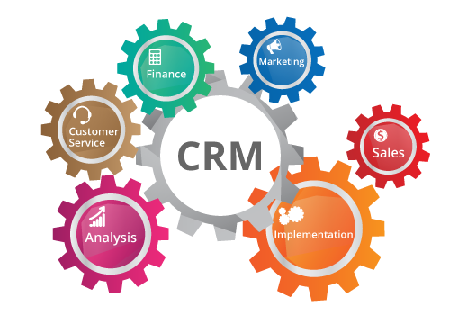
https://results-software.com/tag/crm-for-small-business/

Slide 2
Man 329: Customer Relationship Management
Reference textbooks:
Relationship Marketing; John Egan, Prentice Hall
Customer Relationship Management; Ed Peelen & Rob Beltman, Pearson
Connecting with your customers: Harvard Business School Press

Slide 3
MAN 329 Performance Criterias
Midterm exam (%25) (Essay & Multiple choice)
Term Project (%25)
Final exam (%50) (Essay & Multiple choice)

Slide 4
Cag University, Faculty of Economics and Administrative Sciences 2019-2020 Fall Semester CRM Term Paper (% 25)
Term Project: 1 - 3 students
Contents &Deadlines:
Submitted the group members names and company’s name till 18th October, 2019.
List your group members and specify the company’s name (please contact with the company before submitting their title)
Presentation weeks: All projects should be finished and submitted to the assigned students 6th December, 2019.
Please find a company with/without a CRM department, please identify all detailed information through CRM that you learn during the lectures.
Make an appointment to the company and examine their CRM approaches based on the chapters in the textbook. Otherwise, you may find a company without a CRM department. Please install CRM programs based on the chapters.
Presentation will be 20 minutes at most.
Don’t forget that, reading most of the slides will reduce your grades halfly.
Be ready and on time before the presentation with all group members.
Contact with your lecturer any of time you need by e mail: edayasa@cag.edu.tr
ayseluluguner@cag.edu.tr

Slide 5
Notes:
5

Slide 6
Notes:
6

Slide 7
Notes:
7

Slide 8
One of an Up-scale chain of hotels
Rrecords guest preferences gleaned from conversation with customers during their stay and uses them to tailor the services that customers receive on their next visit at any other Ritz-Carlton in the world.
Requests for items such as hypoallergenic pillows and additional towels are recorded for future use so that personalized goods and services can be added for repeat customers.

Slide 9
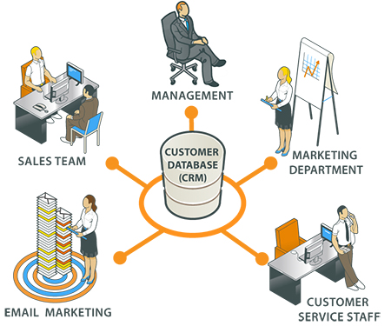
The rules:
Put your buyer first then make your number, every year.
Companies can develop relationships to customize the shopping experience,
Predict online buying patterns better,
Entice (attract) customers with special offers or services
Evaluate the economic advantage of each customer, and
Build long-term beneficial relationships.
Grow sales by building
trusted relationships.

Slide 10
For more sales;
Find out how to develop trusting relationships with your clients and customers.
Learn how to scope out and meet their needs
Discover how to be the person your buyer calls when they need someone.
Create a great value for your customers…

Slide 11
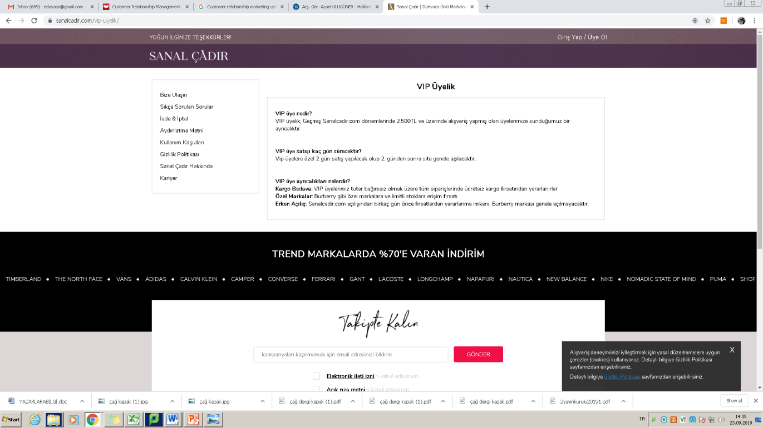
Identify most profitable customers.
Use powerful communication tactics to influence customer’s behavior.
Develop successful products and services with customer’s help ( Customer’s engagement, feedbacks, etc.)

Slide 12
Learn...
Value
Profitable
Communication
Trusted relationship
Discover the needs
Customer’s help

Slide 13
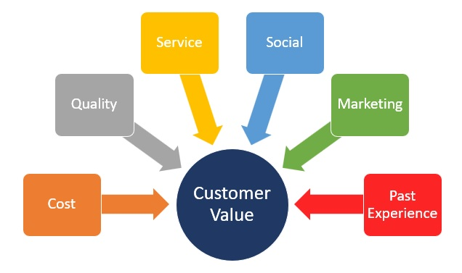
Customer value: the difference between what a customer gets from a product and what he/she has to give in order to get in.

Slide 14
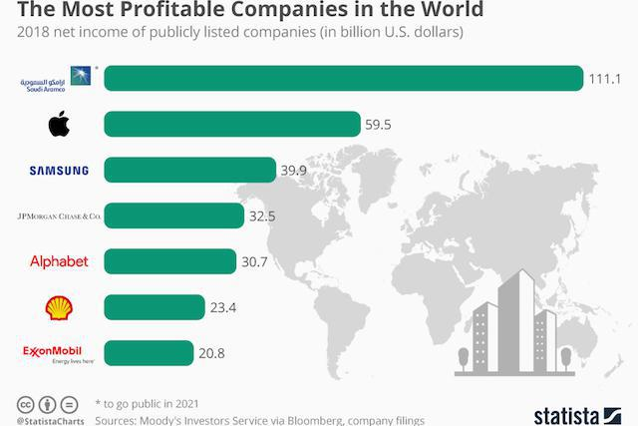
Saudi Aromco is the first ...

Slide 15
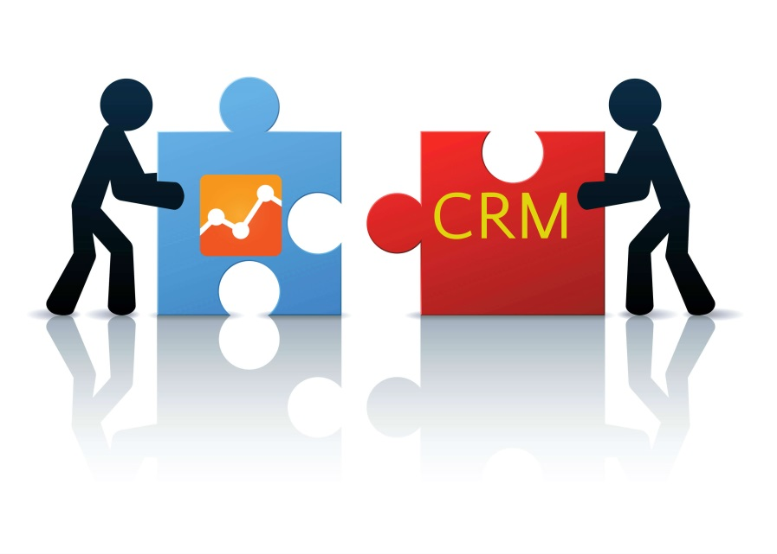
Relationship
Thoughts of the feelings that two people have for one another:
-mutual attraction and respect,
consideration,
dependency and the like.
Interactions must take place between at least two parties; characteristic of interactions can influence one another.
Relationships will also have to extend over a longer period of time.

Slide 16
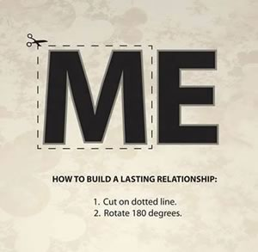

Slide 17
What is marketing ?
According to the definition of American Marketing Association marketing is the activity, set of institutions, and processes for creating, communicating, delivering, and exchanging offerings that have value for customers, clients, partners, and society at large (https://www.ama.org/AboutAMA/Pages/Definition-of-Marketing.aspx, 2013).
Shortly, marketing is a process by which companies create value for customers and build strong customer relationships to capture value from customers in return (Kotler, 2014 by Pearson Education).
Marketing must be understood in the new sense of satisfying customer needs.

Slide 18
Value theory was area of economic (and philosophical) thought built upon by early marketers. Value theorists investigated how people value things (positively or negatively), the reasons why they make such evaluations and use consumer choice as evidence of intrinsic value.
ÇAĞ STARBUCKS
ÇAĞ AMİGO CAFE

Slide 19
Discover the Marketplace and Customer Needs
Customer Needs, Wants, and Demands
Needs
Physical—food, clothing, warmth, safety
Social—belonging and affection
Individual—knowledge and self-expression
Wants
Demands
Form that needs take as they are shaped by culture and individual personality
Wants backed by buying power
States of deprivation
Copyright ©2014 by Pearson Education, Inc. All rights reserved
Notes:
Discussion Question:
Ask the students to
1) give an example of a product (good or service) they purchased recently
2) Tell how did that product satisfy a need, want or desire.
Marketing must be understood in the new sense of satisfying customer needs.
Human needs are states of felt deprivation. They include basic physical needs for food, clothing, warmth, and safety; social needs for belonging and affection; and individual needs for knowledge and self-expression.
Marketers did not create these needs; they are a basic part of the human makeup.
Wants are the form human needs take as they are shaped by culture and individual personality. An American needs food but wants a Big Mac, french fries, and a soft drink. A person in Papua, New Guinea, needs food but wants taro, rice, yams, and pork. Wants are shaped by one’s society and are described in terms of objects that will satisfy those needs. When backed by buying power, wants become demands. Given their wants and resources, people demand products with benefits that add up to the most value and satisfaction.
Outstanding marketing companies go to great lengths to learn about and understand their customers’ needs, wants, and demands. They conduct consumer research and analyze mountains of customer data.

Slide 20
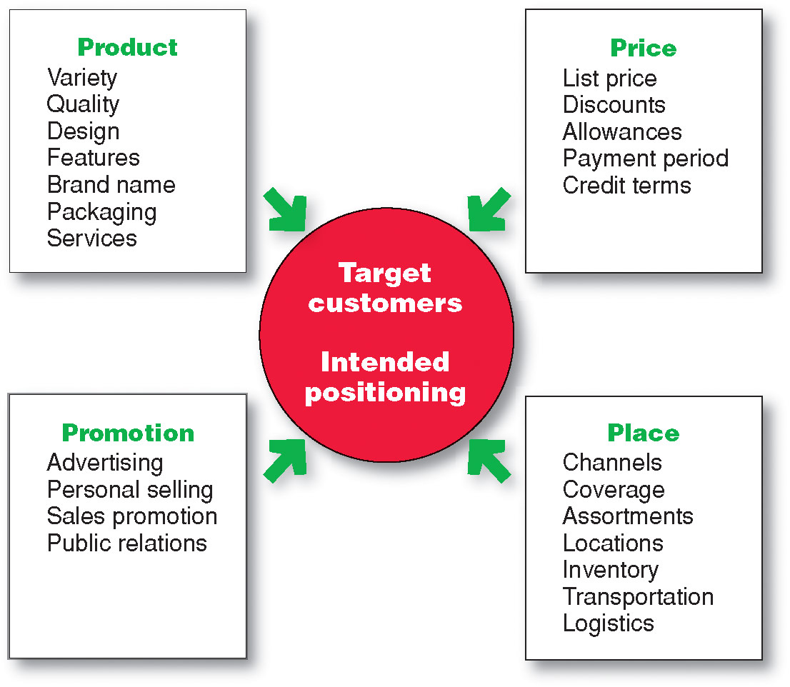
Marketing Mix
McCarthy (1960) presented the ‘marketing mix’, 4Ps model of marketing (product,price placement and promotion).
The goods-and-services combination the company offers to the target market.
is the amount of money customers must pay to obtain the product.
refers to activities that communicate the merits of the product and persuade target customers to buy it
includes company activities that make the product available to target consumers.
Copyright ©2014 by Pearson Education, Inc. All rights reserved
Notes:
The many possibilities can be collected into four groups of variables—the four Ps. Figure 2.5 shows the marketing tools under each P.
Product means the goods-and-services combination the company offers to the target market. Thus, a Ford Escape consists of nuts and bolts, spark plugs, pistons, headlights, and thousands of other parts. Ford offers several Escape models and dozens of optional features. The car comes fully serviced and with a comprehensive warranty that is as much a part of the product as the tailpipe.
Price is the amount of money customers must pay to obtain the product. For example, Ford calculates suggested retail prices that its dealers might charge for each Escape. But Ford dealers rarely charge the full sticker price. Instead, they negotiate the price with each customer, offering discounts, trade-in allowances, and credit terms. These actions adjust prices for the current competitive and economic situations and bring them into line with the buyer’s perception of the car’s value.
Place includes company activities that make the product available to target consumers. Ford partners with a large body of independently owned dealerships that sell the company’s many different models. Ford selects its dealers carefully and strongly supports them. The dealers keep an inventory of Ford automobiles, demonstrate them to potential buyers, negotiate prices, close sales, and service the cars after the sale.
Promotion refers to activities that communicate the merits of the product and persuade target customers to buy it. Ford spends more than $1.9 billion each year on U.S. advertising to tell consumers about the company and its many products. Dealership salespeople assist potential buyers and persuade them that Ford is the best car for them. Ford and its dealers offer special promotions—sales, cash rebates, and low financing rates—as added purchase incentives.
An effective marketing program blends the marketing mix elements into an integrated marketing program designed to achieve the company’s marketing objectives by delivering value to consumers. The marketing mix constitutes the company’s tactical tool kit for establishing strong positioning in target markets.
Some critics think that the four Ps may omit or underemphasize certain important activities. For example, they ask, “Where are services?” Just because they don’t start with a P doesn’t justify omitting them. The answer is that services, such as banking, airline, and retailing services, are products too. We might call them service products. “Where is packaging?” the critics might ask. Marketers would answer that they include packaging as one of many product decisions. All said, as Figure 2.5 suggests, many marketing activities that might appear to be left out of the marketing mix are included under one of the four Ps. The issue is not whether there should be four, six, or ten Ps so much as what framework is most helpful in designing integrated marketing programs.
It is interesting to ask how to make the 4Ps more customer centric. This leads to a redefining of the 4Ps to the 4Cs as follows:
Product—Customer solution
Price—Customer cost
Place—Convenience
Promotion—Communication

Slide 21
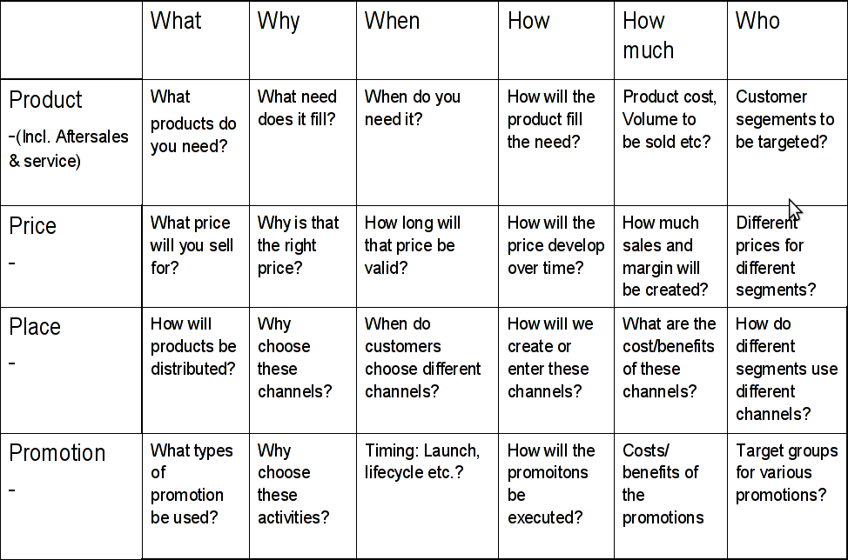

Slide 22
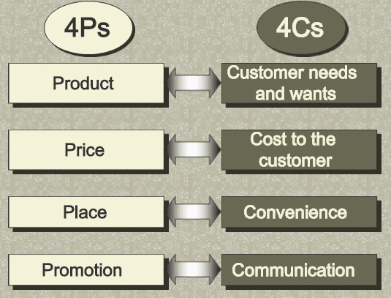
4Ps to 4Cs

Slide 23
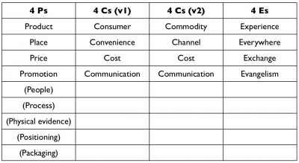
The journey of 4P...

Slide 24
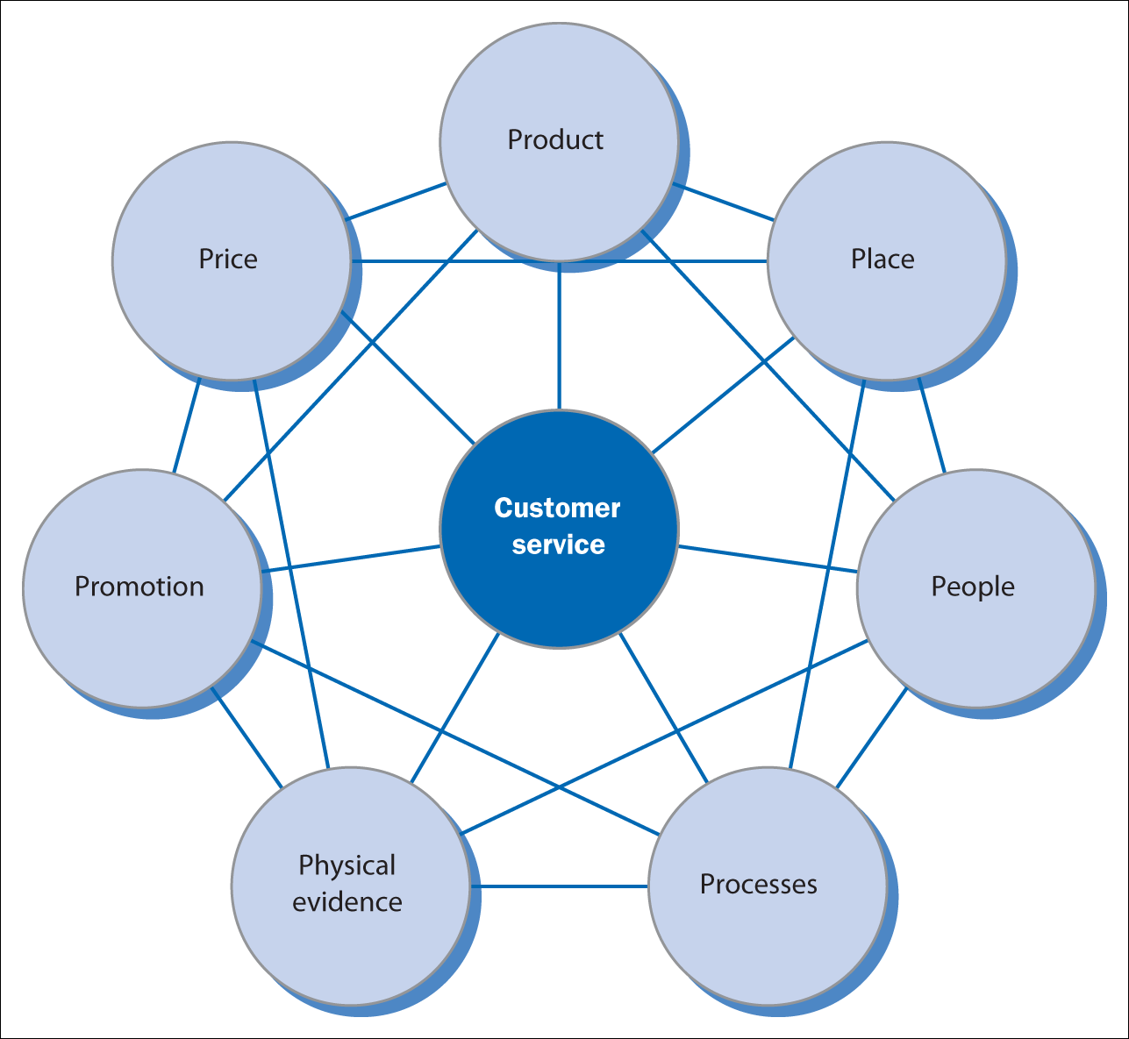
Figure 2.6 Customer service and the marketing mix
Source: Adapted from Christopher et al., 1991, p. 13.

Slide 25
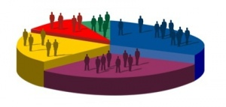
Designing a Customer-Driven Marketing Strategy
Selecting Customers to Serve
Market segmentation (Smith, 1956) refers to dividing the markets into segments of customers.
Target marketing refers to which segments to go after.
Marketing managers must decide which customers they want to target and on the level, timing, and nature of their demand.
Copyright ©2014 by Pearson Education, Inc. All rights reserved
Notes:
Discussion Question: Ask the students to describe a market segment they are a part of for a specific product such as, athletic or fitness equipment or clothing.
The company must first decide whom it will serve. It does this by dividing the market into segments of customers (market segmentation) and selecting which segments it will go after (target marketing). Some people think of marketing management as finding as many customers as possible and increasing demand. But marketing managers know that they cannot serve all customers in every way. By trying to serve all customers, they may not serve any customers well. Instead, the company wants to select only customers that it can serve well and profitably.
Marketing managers must decide which customers they want to target and on the level, timing, and nature of their demand. Simply put, marketing management is customer management and demand management.

Slide 26
Firstly decide whom the company will serve..
The rule:
marketing management is customer management and demand management.
Do not forget....

Slide 27
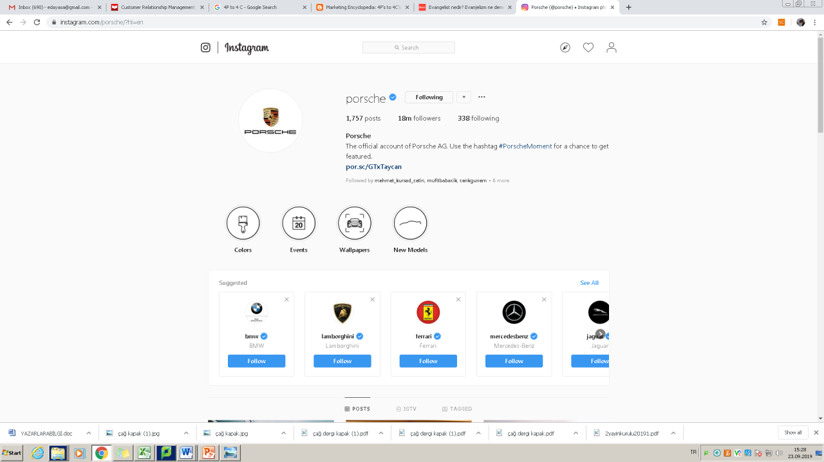
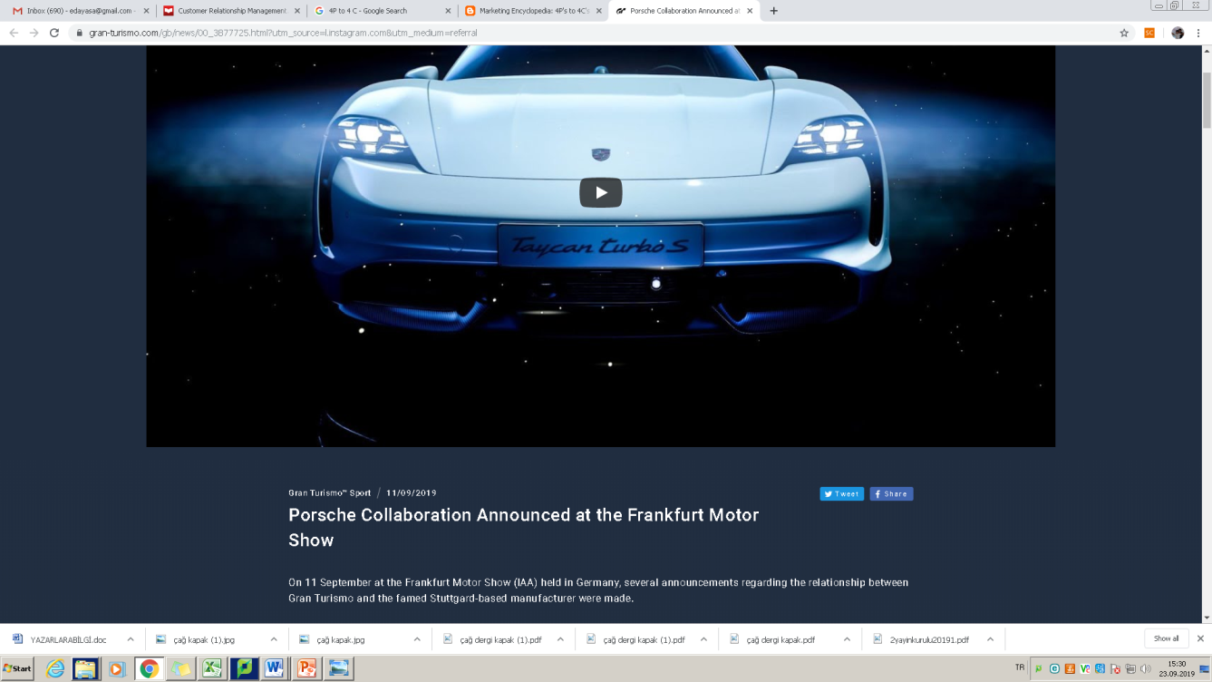
https://www.instagram.com/porsche/?hl=en
18 million followers...
Let us overview the Porsche Marketing Mix and Target Market

Slide 28
Product :
Porsche has always tried to come up with quality product. They follow the theory of high-priced-high-quality sport cars available for premium segments.
Price :
Porsche has been using price skimming in its marketing mix pricing strategy where you introduce your product with high price but with time, the price came down.
Place :
They follow a direct distribution channel system where there is licensee and customer can go directly to it.
Promotion :
Porsche uses media such as TV, social media to promote its products. They often do offline promotions such as through magazines. However, they don’t provide incentives such as offers and discounts as the people they are targeting are rich and wealthy.
It has been found that the cars built by Porsche out of which 70% are still on the roads. This shows that what quality products, this company comes up with.

Slide 29
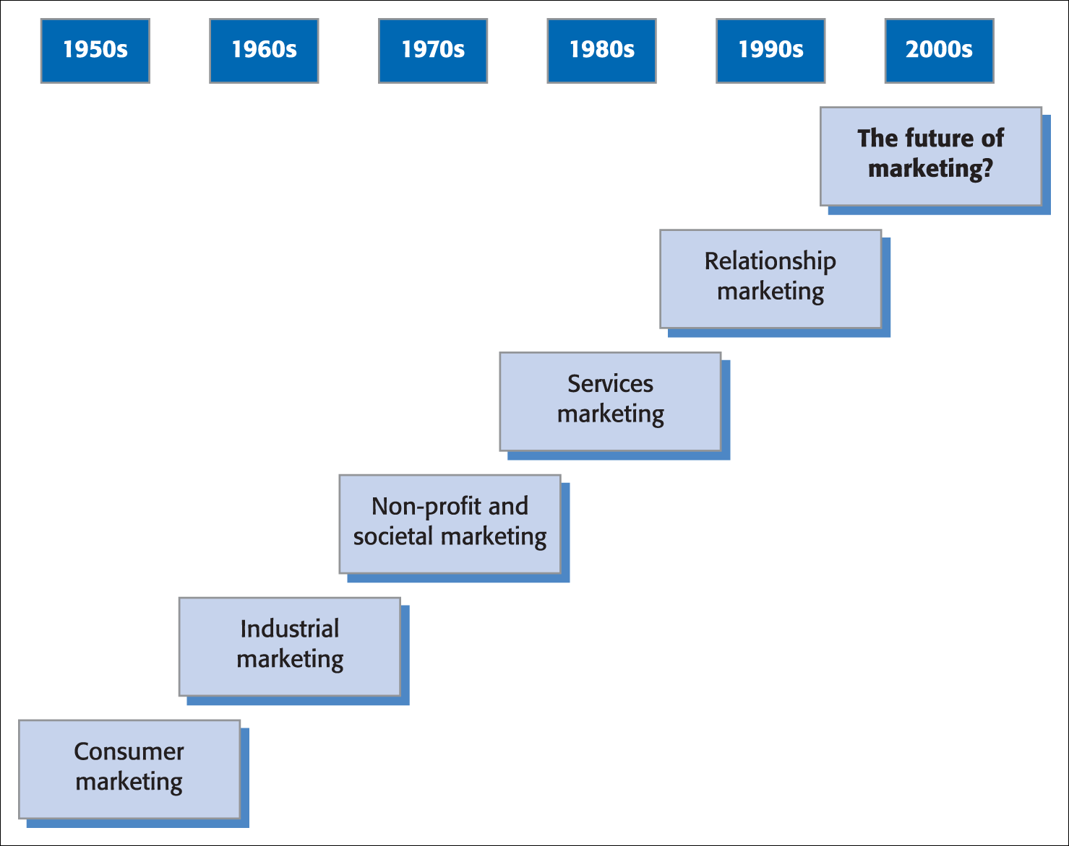
Figure 2.1 Development in marketing
Source: Adapted from Christopher et al., 1991.

Slide 30
Development in marketing
The 1950s, age of consumer marketing when corporate manufacturers and brand marketing concepts dominated the marketing agenda.
1960s, industrial marketing researches are essential.
1970s, non profit sector
1980s, service sector
1990s, and beyond relational researches become important, knowledge management, total quality concepts

Slide 31
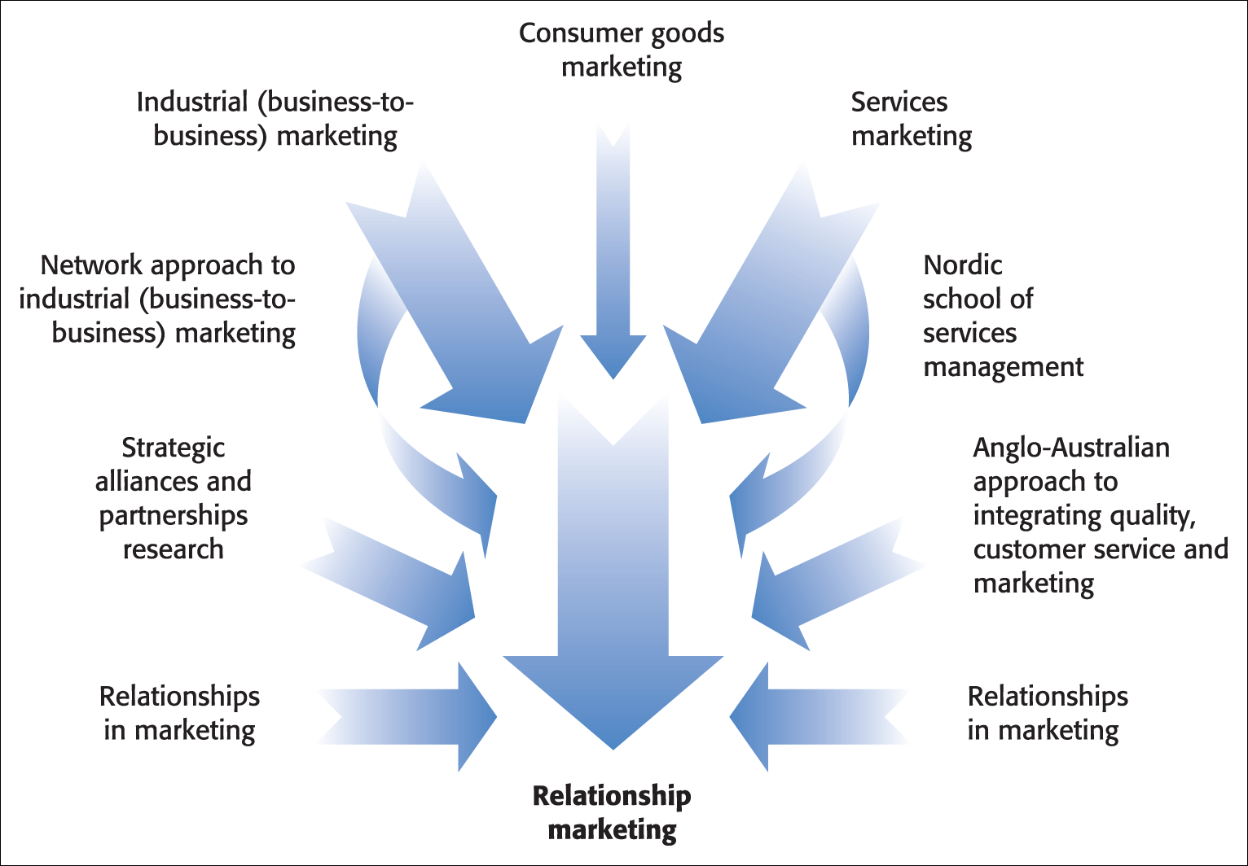
Figure 2.2 Influences on relationship marketing

Slide 32
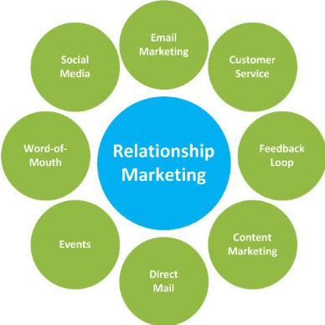
Relationship marketing ( RM)
RM seeks to create new value for customers and then share it with these customers.
RM represents continuous cooperative effort between buyers and sellers.

Slide 33
RM
Grönroos’ (1994) identfy and establish, maintain and enhance and, when necessary, terminate relationships with customers and other stakeholders, at a profit so that the objectives of all parties involved are met, and this is donew by mutual exchange and fullfillment of promises.

Slide 34
RM
recognises the key role that customers have both as purchasers and in defining the value they wish to achieve.
businesses are seen to design and align processes, communication, technology and people in support of customer value,
recognises the value of customers’ purchasing lifetimes
seeks to build a chain of relationships within the organisation and its main stakeholders including suppliers, distribution channels, intermediaries and shareholders.

Slide 35
TRANSACTIONAL MARKETING (TM)
highly focus on maximizing the profit for the company
by recruiting more and more customers
to purchase the firm’s product and
not building much of relationship with them!

Slide 36
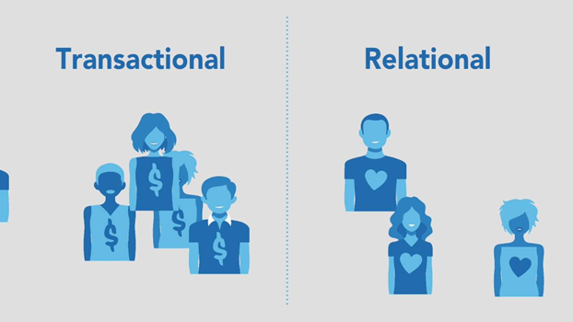
TM Versus RM

Slide 37
The next chapter includes the topics of...
Customer loyalty
Leaky Bucket theory
Relationship ladders or stages
Lifetime value

