Slide 1
Marketing Channels and Supply Chain Management

Slide 2
Objectives
Describe the four types of marketing channels and the roles they play in marketing strategy.
Outline the three major channel strategy decisions.
Describe the concepts of channel management, conflict/disagreement, and cooperation.

Slide 3
Objectives
Describe the three different vertical/ upended marketing systems.
Explain the roles of logistics and supply chain management in an overall distribution strategy.
Identify the six major components/ elements of a physical distribution system.

Slide 4
Objectives
Compare the five major modes/manners of transportation.
Discuss the role of transportation intermediaries, combined transportation modes, and warehousing in improving physical distribution.

Slide 5
Introduction
Distribution - Movement of goods and services from producers to customers
Marketing (distribution) channel - System of marketing institutions that enhances the:
Physical flow of goods and services
Ownership title/right, from producer to consumer or business user

Slide 6
Introduction
Logistics - Coordinating the flow of information, goods, and services among members of the distribution channel
Supply-chain management - Control of the activities of purchasing, processing, and delivery through which:
Raw materials are transformed into products and made available to final consumers

Slide 7
Introduction
Physical distribution - Broad range of activities aimed at:
Efficient movement of finished goods from the end of the production line to the consumer

Slide 8
The Role of Marketing Channels in Marketing Strategy
Four functions of marketing channels:
Facilitating/forwarding the exchange process by reducing the number of marketplace contacts necessary to make a sale
Adjusting for discrepancies/inconsistencies in the market’s assortment of goods and services via sorting/classifying.
Standardizing exchange transactions by setting expectations for products
Facilitating/simplifying searches by both buyers and sellers

Slide 9
Types of Marketing Channels
Marketing intermediary - Organization that operates between producers and consumers or business users
Wholesaler - Takes title/ownership to the goods it handles and then distributes these goods to:
Retailers
Other distributors
End consumers

Slide 10
Types of Marketing Channels
Service firms market through short channels because they sell intangible products and need to maintain personal relationships within their channels

Slide 11
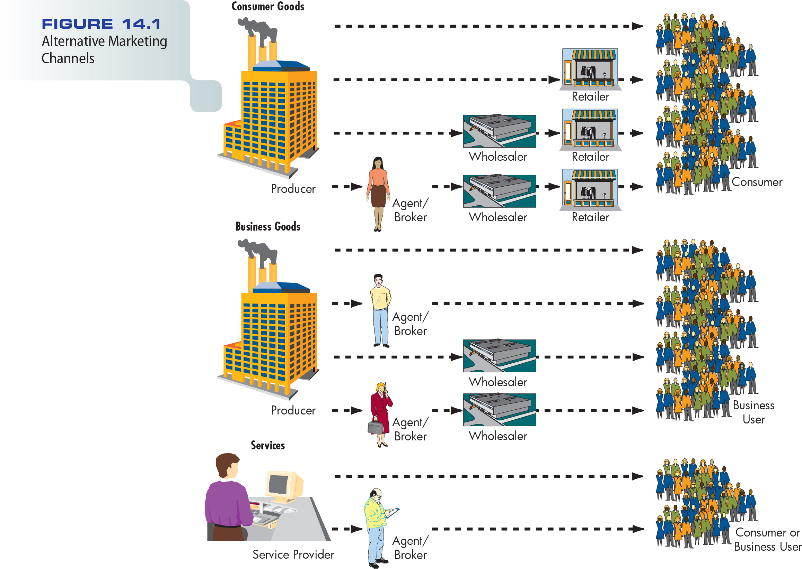
Figure 14.1 – Alternative Marketing Channels

Slide 12
Direct Selling
Direct channel - Moves goods directly from a producer to the business purchaser/buyer or ultimate/end user (example?)
Direct selling - Strategy designed to establish direct sales contact between producer and final user

Slide 13
Direct Selling
Important option for goods that require extensive demonstrations in persuading/ convincing customers to buy
Plays an important role in both B2B and B2C markets
The Internet and direct mail are important tools/means for direct selling

Slide 14
Channels Using Marketing Intermediaries
Producer to wholesaler to retailer to consumer
The traditional channel for consumer goods
Gives small producers access/reach to hundreds of retailers
Gives small retailers access to wholesaler’s specialized distribution skills
Producer to wholesaler to business user
Industrial distributor - Intermediaries in the business market that take title to goods

Slide 15
Channels Using Marketing Intermediaries
Producer to agent to wholesaler to retailer to consumer
Common in markets served by small companies
Agent performs the basic function of bringing buyer and seller together
Agent may or may not take possession/use of goods but does not take title

Slide 16
Channels Using Marketing Intermediaries
Producer to agent to wholesaler to business user
Manufacturers’ representative - Intermediary who represents manufacturers of related but noncompeting products and receives a commission on each sale
Provides an independent sales force to contact wholesale buyers

Slide 17
Channels Using Marketing Intermediaries
Manufacturers’ representative - Agent wholesaling intermediary that represents manufacturers of related but noncompeting products and receives a commission on each sale
Producer to agent to business user
Independently owned wholesaler takes title to the goods
Common in transactions with large unit sales in which transportation is a small percentage of the total cost

Slide 18
Dual/double Distribution
Movement of products through more than one channel to reach the firm’s target market
Used to maximize the firm’s coverage in the marketplace
To increase the cost-effectiveness of the firm’s marketing effort
Example: Nordstrom/Migros sells through stores, catalogs, and the Internet

Slide 19
Reverse/backward Channels
Channels designed to return goods to their producers
Gained increased importance with:
Rising prices for raw materials
Increasing availability of recycling facilities
The passage/entry into force of additional antipollution conservation/protection laws
Used for recalls/callbacks and repairs/mends

Slide 21
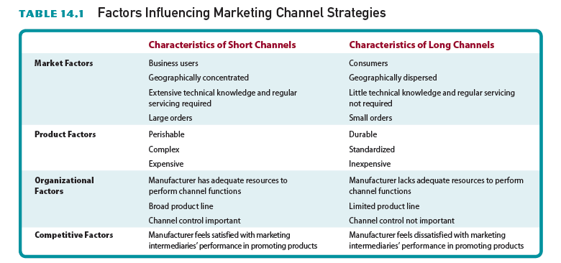
Table 14.1 – Factors Influencing Marketing Channel Strategies

Slide 22
Determining Distribution Intensity
Intensive/heavy distribution - Distribution of a product through all available channels
Selective/choosy distribution - Distribution of a product through a limited number of channels
Exclusive/proprietary/private Distribution - Distribution of a product through a single wholesaler or retailer in a specific geographic region

Slide 23
Legal Problems of Exclusive Distribution
Exclusive dealing agreement prohibits a marketing intermediary from handling competing products
Closed sales territories – Restrict/limits their distributors to certain geographic regions
Tying/binding agreements - Arrangement that requires a marketing intermediary to carry items other than those they want to sell

Slide 24
Who Should Perform Channel Functions?
A member of the channel must perform certain central marketing functions
Responsibilities of the different members may vary
An independent intermediary earns a profit in exchange for providing services to manufacturers and retailers

Slide 25
Who Should Perform Channel Functions?
An intermediary must provide better service at lower costs than manufacturers or retailers can provide for themselves

Slide 26
Channel Management and Leadership
Keys to successful management of channel relationships include the development of high levels of:
Coordination
Commitment/adherence
Trust between channel members

Slide 27
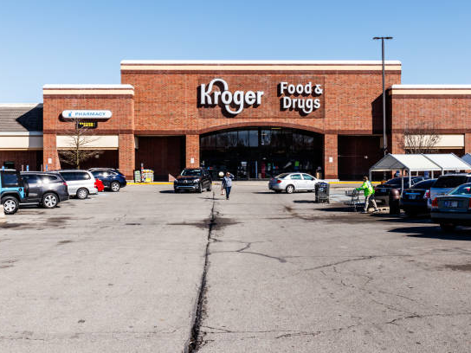
Channel Management and Leadership
Channel captain - Dominant and controlling member of a marketing channel
Example: Kroger is a channel captain in the grocery industry
Migros or BİM in Turkey.

Slide 28
Channel Conflict
Horizontal conflict
Disagreements among channel members at the same level
Vertical conflict
Occurs among members at different levels of the channel

Slide 29
Channel Conflict
The gray market
Gray goods - Products manufactured abroad under license from a U.S. firm and then sold in:
The U.S. market in competition with that firm’s own domestic output/production/goods

Slide 30
Achieving Channel Cooperation/Solidarity
Best achieved when all members of channel see themselves as equal components of the same organization
Channel captain should provide this leadership

Slide 31
Vertical Marketing Systems
Designed to improve distribution efficiency and cost-effectiveness by:
Integrating various functions throughout the distribution chain
Rely on forward or backward integration
Forward integration - Firm attempts to control downstream(marketing oriented) distribution
Backward integration - Manufacturer attempts to gain greater control over inputs to production process (upstream-production oriented)

Slide 32
Vertical Marketing Systems
Benefits
Improves chances for controlling and coordinating the steps in the distribution or production process
May lead to the development of economies of scale that ultimately saves money
May let a manufacturer expand into profitable new businesses

Slide 33
Vertical Marketing Systems
Disadvantages
Involves some costs
Marketers lose some flexibility
Marketers have developed three categories of VMSs
Corporate/institutional systems
Administered/governed systems
Contractual/chartered systems

Slide 34
Corporate and Administered Systems
Corporate marketing system - A single owner operates the entire marketing channel
Administered marketing system - Achieves channel coordination when a dominant channel member exercises/shows its power

Slide 35
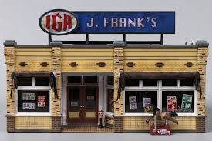
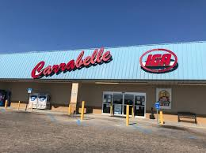
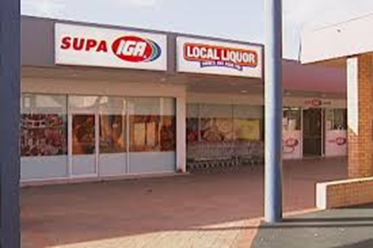
Contractual Marketing Systems
Coordinates channel activities through formal agreements among participants
Wholesaler-sponsored voluntary chain
A wholesaler has formal agreement with retailers to use a common name and to purchase the wholesaler’s goods
Example: IGA Food Stores

Slide 36
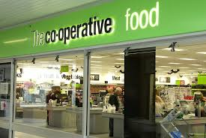
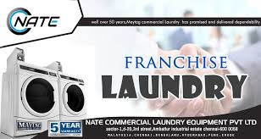
Contractual Systems
Retail cooperative
Retailers establish a shared wholesaling operation to help them compete with chains
Franchise
A wholesaler or retailer agrees to meet the operating requirements of a manufacturer or other franchiser

Slide 37
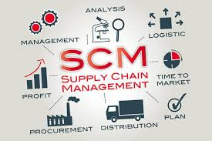
Logistics and Supply Chain Management
Effective logistics requires:
Proper supply chain management
Control of the activities of purchasing, processing, and delivery
Delivery through which raw materials are transformed into products and made available to final consumers

Slide 38
Logistics and Supply Chain Management
Supply chain - Complete sequence/ consecution of suppliers and activities that contribute to the creation and delivery of merchandise
Begins with raw-material inputs for production
Ends with the movement of final product to customers
Takes place in two directions: upstream and downstream

Slide 39
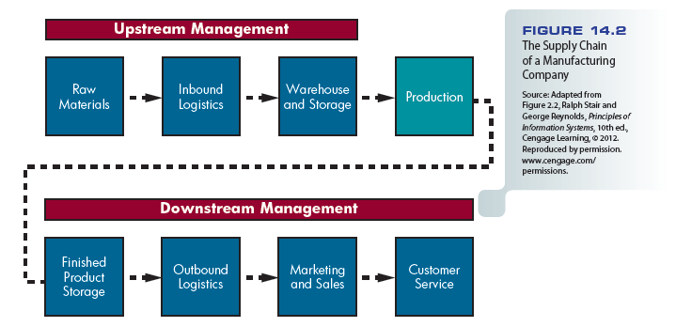
Figure 14.2 – The Supply Chain of a Manufacturing Company

Slide 40
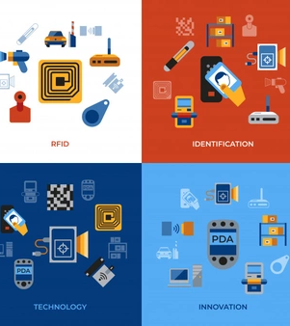
Radio Frequency Identification (RFID)
Technology that uses a tiny chip with identification information that can be read by a scanner using radio waves from a distance

Slide 41
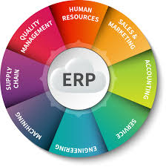
Enterprise Resource Planning
Software system that consolidates data from among a firm’s various business units
ERP and its related software aren’t always perfect

Slide 42
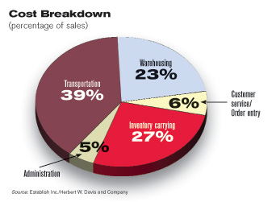
Logistical Cost Control
The distribution function accounts for half of a firm’s total marketing costs
Businesses are reexamining each link of their supply chains to identify activities that do not add value for customers
Third-party logistics firms - Specialize in handling logistical activity

Slide 43
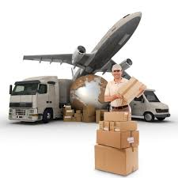
Physical Distribution
A physical distribution system contains these elements:
Customer service
Transportation
Inventory control
Protective packaging and materials handling
Order processing
Warehousing

Slide 44
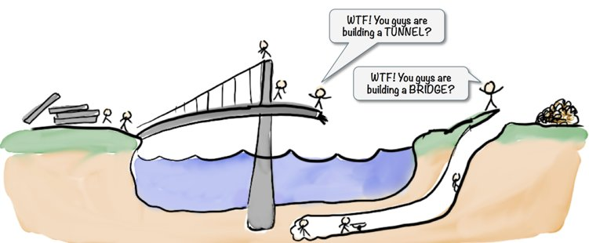
The Problem of Suboptimization/inadequate
Results when the managers of individual physical distribution functions attempt to:
Minimize costs, but the impact of one task on the others leads to less-than-optimal results
Occurs when a firm introduces a new product that:
May not fit easily into its current physical distribution system
Effective management of physical distribution requires cost trade-offs

Slide 45
Customer-Service Standards
State the goals and define acceptable performance for the quality of service a firm expects to deliver to its customers
After these standards are defined:
Designers assemble/piece together other physical distribution components to meet these standards at the lowest possible total cost

Slide 46
Customer-Service Standards
Components of overall/total cost:
Transportation
Warehousing
Inventory control
Customer service/order processing
Administrative costs

Slide 47
Transportation
Transportation and delivery expenses add approximately 10 percent to product costs
Key to cost control is often careful management of relationships with shipping firms
Freight carriers use two basic rates:
Class rate*
Commodity rate or special rate**
*The transportation rate for goods according to similar shipping characteristics so that it simplifying the process of pricing different kinds of freights. There are 18 different classes identified products’ value, range from a low of class 50 to a high of class 500. It means that the lower the class the lower the price.
**Commodity rate refers to a transportation rate published for specific commodities without regard to classification. Carriers commonly publish commodity rates when a large quantity of product moves between the two locations on a regular basis.

Slide 48
Classes of Carriers
Common carriers - Provide transportation services as for-hire carriers to the general public
Contract carriers - For-hire transporters that do not offer their services to the general public
Private carriers - Transporters that provide service solely for internally generated freight

Slide 49
Major Transportation Modes
Railroads
Most efficient way for moving bulky commodities over long distances; enjoying a resurgence/revival
Intermodal operations - Combination of transport modes, to improve customer service and achieve cost advantages

Slide 50
Major Transportation Modes
Motor carriers
Relatively fast and consistent service
Receives greater revenue per ton shipped
Technology (satellite communication system) has improved the efficiency of trucking

Slide 51
Major Transportation Modes
Water carriers
Inland or barge/scow lines and ocean-going, deepwater ships
Barge lines carry bulky, low-unit-value commodities such as grain, lumber, and steel
Freight rates are based on the:
Size of the vessel
Cost of fuel
Security requirements

Slide 52
Major Transportation Modes
Pipelines
Efficiently transports natural gas and oil
Advantages
Low maintenance
Dependable
Disadvantages
Few locations
Accommodate only a small number of products
Relatively slow

Slide 53
Major Transportation Modes
Air freight
Declining in certain market sectors
Firms are adapting
UPS is offering two less-expensive, nonguaranteed services:
UPS Air Freight Direct
UPS Air Freight Consolidated

Slide 54
Table 14.3 – Comparison of Transport Modes

Slide 55
Freight Forwarders/freight broker and Supplemental Carriers
Act as transportation intermediaries that consolidate shipments to gain lower rates for their customers
The customers gain advantages from the services
Lower costs on small shipments
Faster delivery service than they could achieve with their own LTL (less than a truck load) and LCL (less than a container load) shipments

Slide 56
Freight Forwarders and Supplemental Carriers*
Logistics manager can ship products via several auxiliary/subsidiary, or supplemental/nonscheduled, carriers that specialize in small shipments
*Supplemental air transport, loosely defined as "charter trips to supplement scheduled service," granted carriers the rights to carry passengers and cargo on a non-scheduled, or chartered, basis.

Slide 57
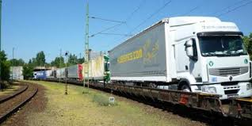
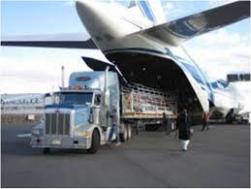
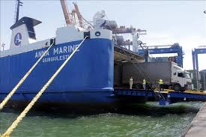
Intermodal Coordination
Piggyback - Most widely used form of intermodal coordination
Birdyback service - Sends motor carriers to pick up a shipment locally and deliver that shipment to local destinations
An air carrier takes it between airports near those locations
Fishyback service - Intermodal coordination system between motor carriers and water carriers

Slide 58
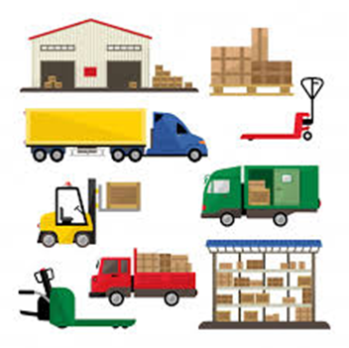
Warehousing
Storage warehouse - Holds goods for moderate to long periods to balance supply and demand for producers and purchasers
Distribution warehouse - Assembles and redistributes goods, keeping them moving as much as possible

Slide 59
Warehousing
Automated warehouse technology
Can cut distribution costs and improve customer service
Warehouse locations
Main influences on choice
Warehousing and materials handling costs
Delivery costs from warehouses to customers
Warehouse location affects customer service

Slide 60
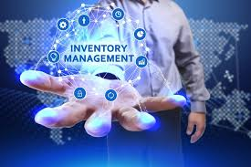
Inventory Control Systems
Companies must balance maintaining enough inventory to meet customer demand with:
Incurring unneeded costs for carrying excess inventory
To manage cost, firms use:
Just-in-time (JIT)
RFID technology
Vendor-managed inventory (VMI)

Slide 61
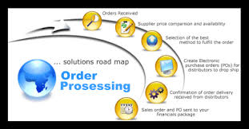
Order Processing
Directly affects firm’s ability to meet customer service standards
Includes four major activities:
Conducting a credit check
Keeping a record of the sale
Making appropriate accounting entries
Locating orders, shipping them, and adjusting inventory records

Slide 62
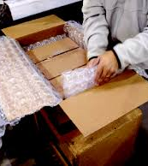
Protective Packaging and Materials Handling
Materials handling system - Activities for moving products within plants, warehouses, and transportation terminals
Unitizing - Combining as many packages as possible into each load that moves within or outside a facility
Containerization - Combining several unitized loads into a single, well protected load for shipment

Slide 63
Geoffrey B. Small Video
http://www.cengage.com/marketing/book_content/boone_9781133628460/videos/ch14.html

