Slide 1
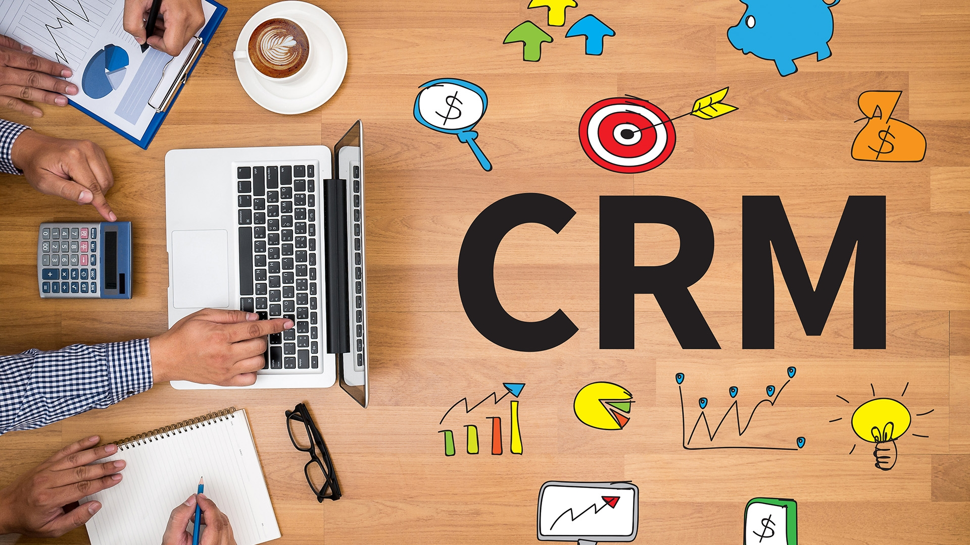

Slide 2
Code & name of course | MAN 329 Customer Relationship Management
Lecturer & email | Assoc.Prof.Dr. Eda Yaşa Özeltürkay, edayasa@cag.edu.tr
Asst. Of Lecture & email | Res.Ass. Deniz YALÇINTAŞ, denizyalcintas@cag.edu.tr
Course Day& hour | Tuesday, 13:30-15.45
Office hour | Tuesday 16:00-18:00

Slide 3
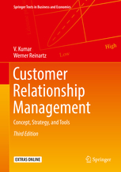
Reference textbooks:
V. Kumar, Werner Reinartz.
Customer Relationship Management
Concept, Strategy, and Tools
Third Edition

Slide 4
MAN 329 Performance Criterias
Activities | Number | Effect | Notes
Midterm Exam | 1 | 30% | Project
Case Discussion | 1 | 10% | Case will be given by the lecturers
Seminars | 2 | 10% | Guest speaker
Effect of The Activities |  | 50%
Effect of The Final Exam |  | 50%

Slide 5
Project
Project guideline %30 (% 20 document %10 presentation) - during the presentation the cameras should be on
Term Project: 1 - 4 students
Contents &Deadlines:
This course's CRM project will be a CRM marketing plan (that will contain a written CRM Brief and then a written CRM Plan) for a business that the student and the instructor have chosen and agreed upon. You will choose a business wherever you currently work, or you may choose a better choice. You must be able to examine the operations of the company you have chosen.
As you evaluate your business's CRM needs, you'll be acting as a marketing consultant. This will require conducting interviews with key stakeholders. As the supervisor, your instructor will explain the purpose of this project to the selected business and confirm approval for the participant to complete it.
The written CRM Brief will include the following categories:
• objective
• scenarios
• contact strategies
• communication tools

Slide 6
Objective 1. Introduction to company and industry involved. (Instructor approval and permission access granted by company.)
2. Description of CRM system objective (Where is the company now with CRM? and where does the company want to go with a new or up-dated CRM system to include current and future requirements and integration with existing organizational systems? What are we trying to achieve with a new CRM system or up-date to an existing CRM System? Why does the current CRM system need improving? How are the changes going to integrate with the existing organizational systems?) Tell the story and include a relevant background analysis of the company and the current situation. What are you trying to achieve (i.e., customer retention, customer win-back, customer acquisition, complaint processing or customer feedback)? How can this CRM system help customers/company/stakeholders? Relate the story to course topics included in the course module topic areas.. This means you should make observations about the current CRM system and management/leadership activities, the effects on customer/employee/stakeholder behavior/attitudes, and the relationship of the story to the overall organizational environment/competitive environment, etc. Critically analyze the company’s CRM actions in the story, and make suggestions of what, if anything, you would do differently. Think of yourselves as consultants making recommendations to top management based on the lessons learned from the course case studies, lecture materials, textbook and other readings and discussions
Scenarios 3. What kind of scenarios are involved and what are they designed to facilitate? What kind of scenarios are involved (i.e., customer feedback, suggestions, complaints, inquiries, sales – all can include online and offline contact points)? Is the system designed to facilitate (i.e., welcome letters, new member offers, up-selling, cross selling, reactivation on previous customers)?
Contact Strategies 4. What kind of contact strategies might the scenarios involve? Communication Tools 5. What kind of communication tools will generate the data (i.e., e-mail, snail mail, outbound telemarketing, inbound telemarketing, sales teams, website dialogues, etc.)?

Slide 7
The written CRM Plan; will include the following categories:
CRM Plan Part A
• Situation (Where are we now with CRM?) Summarize the Situation from your CRM Brief.
• Objectives (What do we want to achieve?) Summarize the Objectives from your CRM Brief. •Strategy (How will we get there?) Strategy includes analysis, evaluation, and implementation of the new or up-dated CRM system. This involves considerations of budget , CRM system creation, development, testing, maintenance of managing the database and maintenance of costs and timescales, and control issues.
CRM Plan Part B
• Summary (Briefly review key points and recommendations)
Submitted the group members names and the company’s name till 31th October, 2021.
please obey the rules of “academic ethics” and upload the document to the Turnitin class that will be assigned later in Moodle system.
Presentation weeks: All projects should be finished and submitted to system and informed to Res.Asst. Deniz Yalçıntaş, 24th December 2021
Note: Please use web 2.0 technologies in your presentation to make it more interactive.

Slide 8
Dear Students
Please introduce yourselves to your classmates and chat about your career interests. Tell us a little about YOU! For example, you might want to share the following:
• Your name
• Where you were born and grew up
• Your interests and hobbies
• If employed/trained where and your job title and responsibilities
• Do you like your uni.department why or why not?
• Future career aspirations. You are encouraged discuss career interests with other classmates.

Slide 9
Notes:
9

Slide 10
Notes:
10

Slide 11
Notes:
11

Slide 12
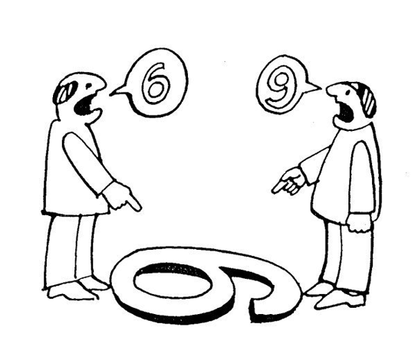

Slide 13
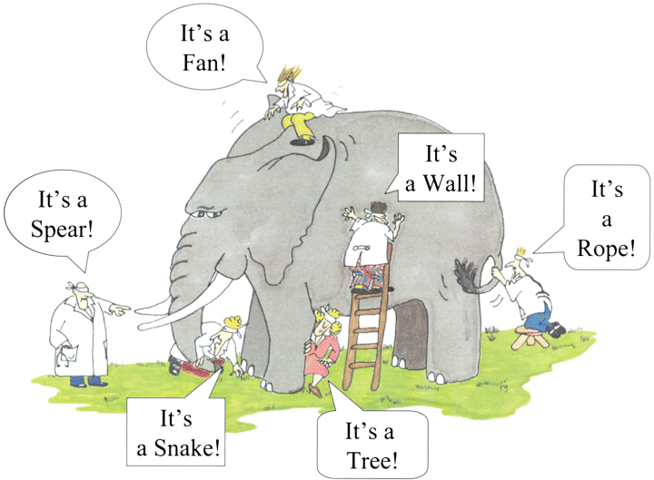
a story of…6 blind man and an elephant

Slide 14
Perceptions…

Slide 15
Chapter I CRM: Conceptual Foundation

Slide 16
1.1 Introduction to Strategic CRM
CRM is identifying the different types of customers and then developing specific strategies for interacting with each one.
Examples of such strategies;
developing better relationships with profitable customers,
locating and incenting new customers who will be profitable, and,
finding appropriate strategies for unprofitable customers, which could mean terminating those relationships that cause a company to lose money.

Slide 17
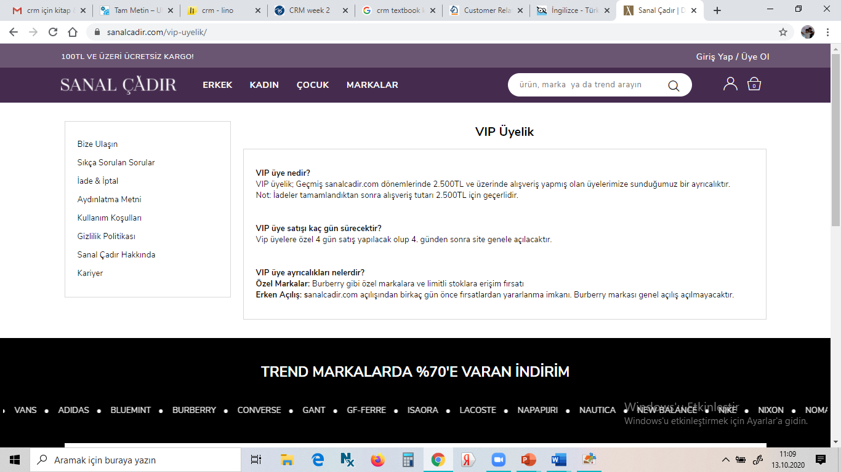
Profitable customers
occasion sanal cadir

Slide 18
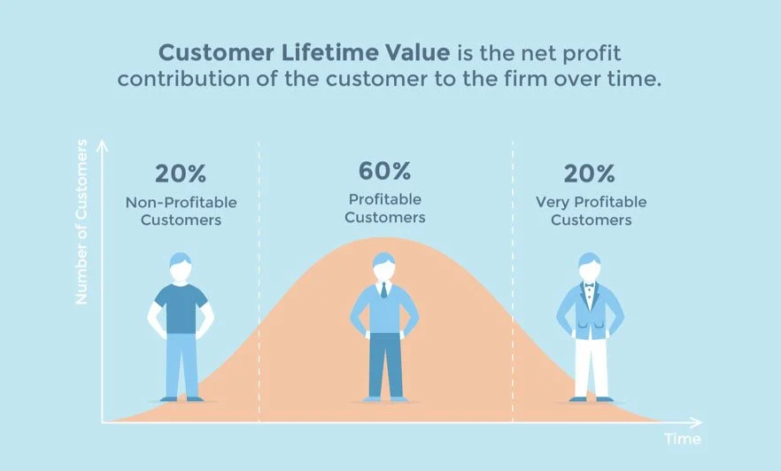

Slide 19
Focus on…

Slide 20
According to P. Kotler
"a profitable customer is a person, household or a company that overtime,
yields a revenue stream that exceeds by an acceptable amount the company's cost stream of attracting,
selling and servicing the customer.»

Slide 21
Profitable customers

Slide 22
Unprofitable customers

Slide 23
Do not forget!

Slide 24
CRM; as the practice of analyzing and using marketing databases and leveraging communication technologies to determine corporate practices and methods that maximize the lifetime value of each customer to the firm.

Slide 25
Customer life time value

Slide 26
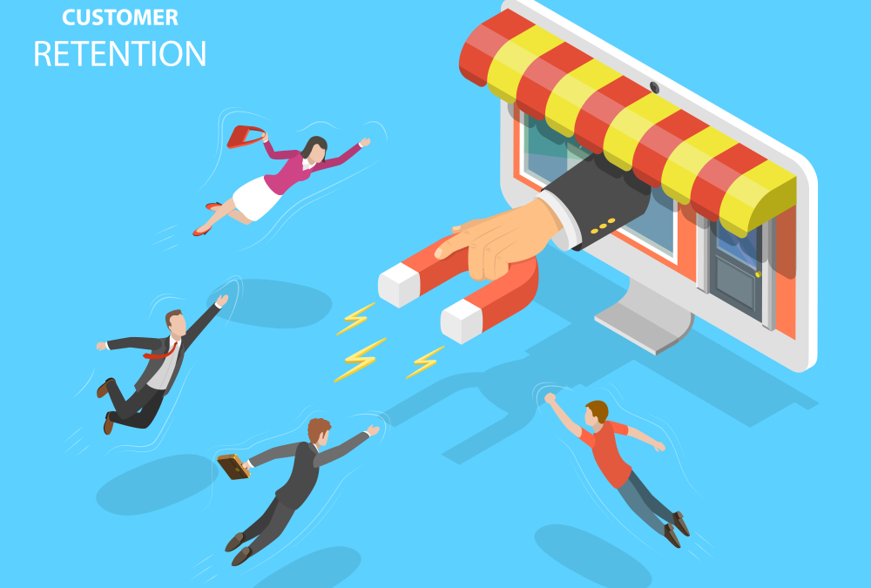
Customer Retention

Slide 27
Sikayetvar.com

Slide 28
We Love Customers…

Slide 29
Strategic customer relationship management
is a relationship management concept based on established marketing principles that recognizes the need to balance organizational and customer interests carefully.
CRM is not a result primarily of technological solutions but is rather supported by them.
With CRM, a company creates an environment and flexible support system that can deal readily with issues surrounding product innovation, increasing customer expectations, acquisitions, globalization, deregulation, the convergence of traditional markets, and emergence of new technologies, privacy issues, and new customer contact channels.

Slide 31
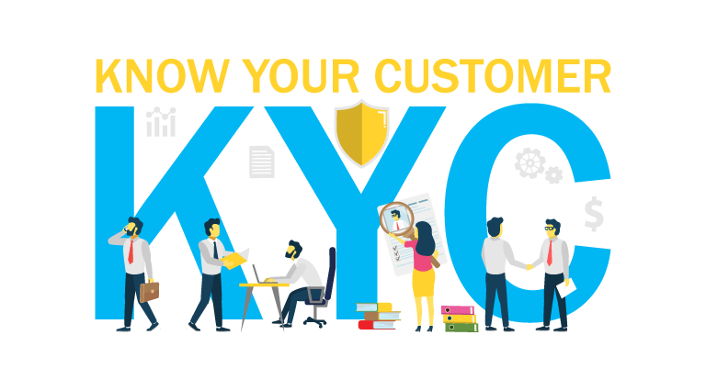
A long-term competitive advantage by optimally delivering value and satisfaction to the customer and extracting business value from the exchange.
Knowledge about customers and their preferences is of utmost importance for the entire organization.

Slide 32
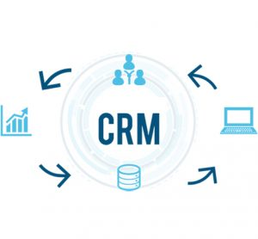
What is CRM? Why CRM?
Customer Relationship Management is the strategic process of selecting customers that a firm can most profitably serve and shaping interactions between a company and these customers. The ultimate goal is to optimize the current and future value of customers for the company.

Slide 33
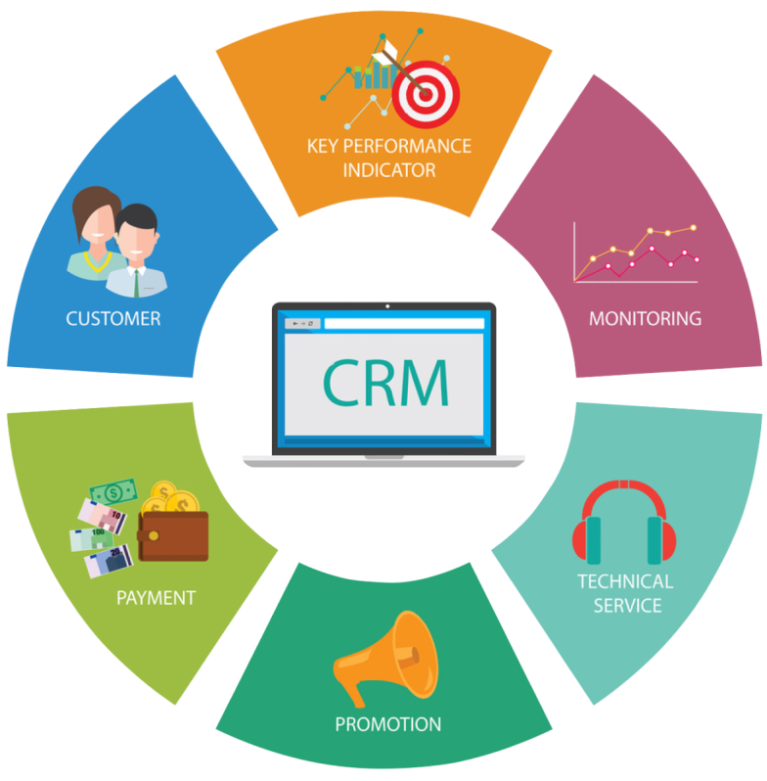
With CRM, a company creates an environment and flexible support system that can deal readily with issues surrounding product innovation, increasing customer expectations, acquisitions, globalization, deregulation, the convergence of traditional markets, and emergence of new technologies, privacy issues, and new customer contact channels.

Slide 34
Why Managing Customers Is More Critical Than Ever
The major factors that influence strategic CRM and have severe consequences for companies; it also introduces a customer- centric management approach and shows how the evolution of CRM points to a new understanding. Modern firms face gradual but still seismic changes with respect to three major forces: (1) consumers, (2) marketplaces, and (3) marketing functions.
It is important to understand those changes to function successfully in the marketplace.

Slide 35
Changes with Respect to Consumers
Major consumer trends that are essential to understand the growing importance of a strategic approach to CRM.
Demographic changes relate mostly to current developments in the growing diversity of customers; behavioral changes describe shifts in the way consumers act and react to market offers.

Slide 36
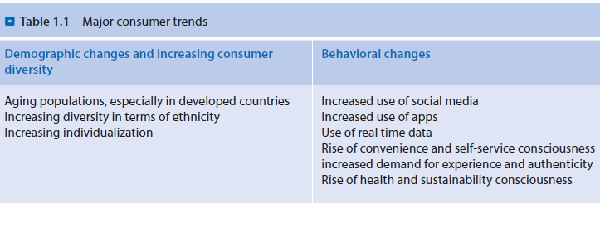

Slide 38
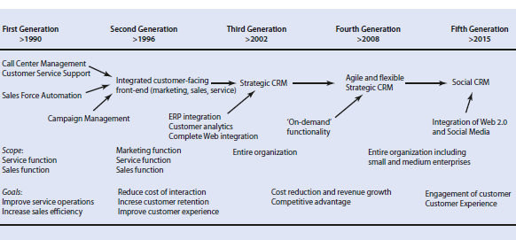
Evolution and Growth of CRM
The stages of development of CRM, from the 1990s until today. It has grown from a tactical marketing tool to a strategic element in all marketing decisions. The growth of the Internet also has increased the adoption rate of CRM in many industries. To provide a historical perspective, the figure depicts a timeline, and this section describes each of the phases in that timeline.

Slide 39
First Generation (Functional CRM)
The collection of activities that later took on the umbrella acronym CRM originally developed as two independent product offerings:
1. Sales force automation (SFA): These products addressed presales functions such as maintaining prospect and customer data, telemarketing, generating leads, creating sales quotes, and placing sales orders.
2. Customer service and support (CSS): This function addressed mainly after-sales activities, such as help desks, contact and call centers, and field service support. The CSS databases often worked with specific customer information, isolated from other systems.
Although fragmented and poorly integrated with the back office, early SFA/CSS applications delivered the promise of sales and service improvements, though their combined market niche remained small.

Slide 40
Second Generation (Customer- Facing Front-End Approach)
The market for enterprise resource planning (ERP)—a tool designed to integrate all company departments and functions within a single computer system that served every department’s needs—instead was growing.
Innovations in CRM during the 1990s matched those of ERP, including the integration of different independent subsystems into one package.
The goal was to create a single view of all interactions with customers, independent of the purpose of that contact (e.g., pre-sales, sales transaction, post-sales service) or its means (e.g., telephone, e-mail, Internet).
For the most part, this goal was not achieved during the 1990s, leading to increasing disillusionment with CRM technology and implementations. Customer expectations in this period far exceeded the realized benefits of CRM technology.

Slide 41
Third Generation (Strategic Approach)
By the end of 2002, the CRM market had started to pick up, and the gap between customers’ perceived value and value realized was closing.
Organizations learned from experience and their failure to implement prior versions of CRM. The best organizations began to focus on integrating customer-facing front-end systems with back-end systems, as well as with the systems used by partners and suppliers.
The integration of the Internet technology helped to boost CRM. Many organizations realized that they could benefit by adopting a strategic CRM approach rather than blindly implementing technology-based solutions. Companies recognized the eventual goal of CRM: to grow revenue, not just control costs.

Slide 43
Fourth Generation (Agile and Flexible Strategic CRM)
At the end of the first decade of the twenty-first century, we face the start of the fourth generation of CRM.
Strategic CRM is widely accepted and established as an essential element of the marketing strategy, and an ever increasing number of small and medium-sized companies adopt this management tool and its corresponding technologies to drive their business.
Agility, flexibility, and low fixed costs are key. The emergence of social media and increased self-service, as well as the growing prevalence of web-based services, mean that customer empowerment is an emerging topic. In particular, CRM technology on a pay-per-use basis can provide on-demand functionality.

Slide 44
Fifth Generation (Social CRM)
The development of the new technological advances and the unprecedented reach of social media gave rise to the fifth generation of CRM.
Social CRM is characterized by the engagement of the customer through the integration of the web 2.0 and social media and by the use of data driven insights to optimize the overall customer experience.
Companies encourage active customer participation online, while they use software applications to track real time social data. This information enables companies to offer relevant content and personalized messages to specific customers and to improve the customer experience at each touch point along the customer journey.

Slide 45
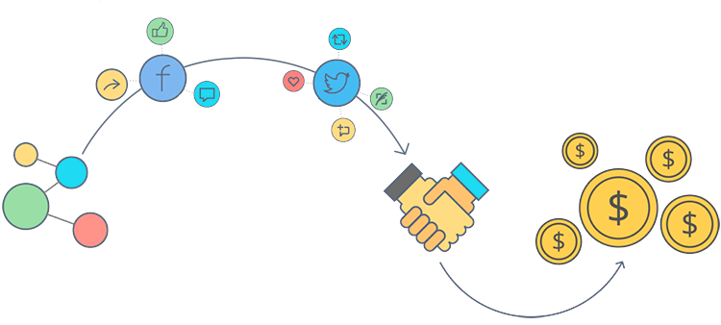
Additionally, the combination of data across different social media platforms allows companies to determine the customer value not only based on profitability but also based on their online behavior in terms of referrals, knowledge dispersion and influencing other members of the social media community.

Slide 46
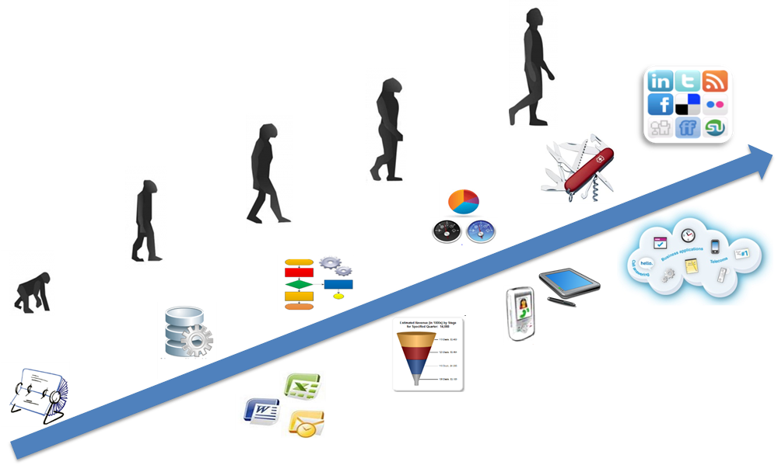

Slide 47
Thank you…

