Slide 1
SPSS

Slide 2
Descriptive Statistics with Categorical Data
1. From the menu click on Analyze, then click on Descriptive Statistics, then Frequencies.
2. Choose and highlight the categorical variables you are interested in. Move these into the Variables box.
3. Click on OK.

Slide 3
e.g. SPSS Output
mean
 |  | Frequency | Percent | Valid Percent | Cumulative Percent
Valid | 1 | 27 | 24,5 | 24,5 | 24,5
 | 2 | 81 | 73,6 | 73,6 | 98,2
 | 3 | 2 | 1,8 | 1,8 | 100,0
 | Total | 110 | 100,0 | 100,0
Statistics
mean
N | Valid | 110
 | Missing | 0

Slide 4
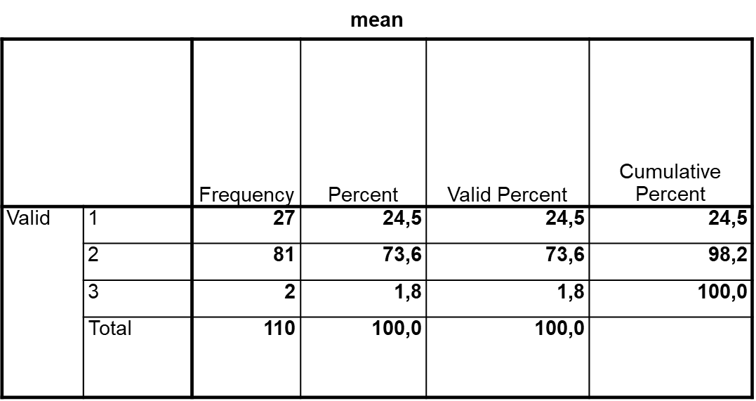
Interpreting the Data
Out of the 110 participants, 27 (24.5%) of them stated that they used such activities in their classes often, 81 (73.6%) once in a while, and only 2 (1.8%) never. This shows that most of the participants practice culture teaching activities once in a while.

Slide 5
Descriptive Statistics for Continuous Data
1. From the menu click on Analyze, then select Descriptive Statistics, then Descriptives.
2. Click on all the continuous variables that you wish to obtain descriptive statistics for. Click on the arrow button to move them into the Variables box.
3. Click on the Options button. Make sure mean, standard deviation, minimum, maximum are ticked and then click on skewness, kurtosis.
4. Click on Continue, and then OK

Slide 6
SPSS Output
Descriptive Statistics
 | N | Minimum | Maximum | Mean | Std. Deviation | Skewness |  | Kurtosis
 | Statistic | Statistic | Statistic | Statistic | Statistic | Statistic | Std. Error | Statistic | Std. Error
mean | 110 | 1 | 3 | 1,77 | ,463 | -,738 | ,230 | -,039 | ,457
Valid N (listwise) | 110

Slide 7
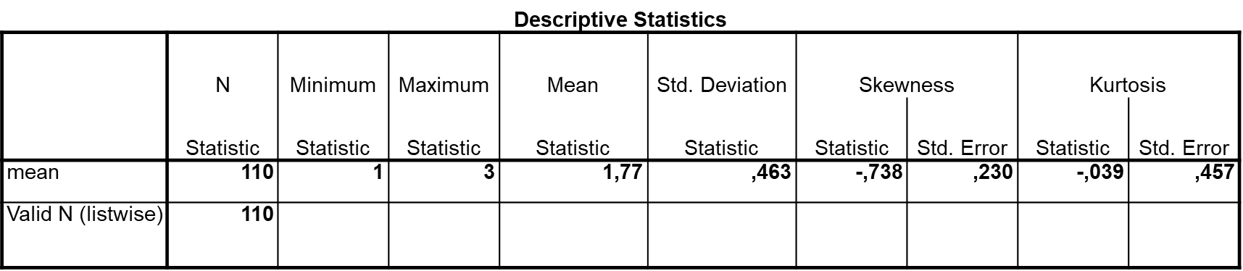
Interpreting the Data
For the variable culture teaching activities, we have information from 110 participants, who use the activities ranging from often to never with a mean of 1.77 and standard deviation of .46.

Slide 8
Assessing Normality
1. From the menu at the top of the screen click on Analyze, then select Descriptive Statistics, then Explore.
2. Click on the variable(s) you are interested in. Click on the arrow button to move them into the Dependent List box.
3. In the Display section, make sure that Both is selected.
4. Click on the Statistics button and click on Descriptives and Outliers. Click on Continue.
5. Click on the Plots button. Under Descriptive, click on Histogram to select it. Click on Stem-and-leaf to unselect it. Click on Continue.
6. Click on the Options button. In the Missing Values section, click on Exclude cases pairwise.
Click on Continue and then OK.

Slide 9
SPSS Output
Descriptives
 |  |  | Statistic | Std. Error
mean | Mean |  | 1,77 | ,044
 | 95% Confidence Interval for Mean | Lower Bound | 1,69
 |  | Upper Bound | 1,86
 | 5% Trimmed Mean |  | 1,78
 | Median |  | 2,00
 | Variance |  | ,214
 | Std. Deviation |  | ,463
 | Minimum |  | 1
 | Maximum |  | 3
 | Range |  | 2
 | Interquartile Range |  | 0
 | Skewness |  | -,738 | ,230
 | Kurtosis |  | -,039 | ,457

Slide 10
If you have skewed data, report non-parametric descriptive statistics
The mean (a parametric statistic)
The median (a non-parametric statistic).
Select Quartiles under the Statistics button of Frequencies
  Report a median value and an indication of the spread of your score: the Inter-Quartile Range, which represents the 25th percentile and the 75th percentile values.
E.g. Md=36 (IQR: 26, 47)

Slide 11
Activity 1 (Reverse Items)
Imagine Items 1, 5, 11, 13, 16(R) are related to activities that illustrate foreign culture to promote positive attitudes towards foreign cultures
1. Item 16 is a reverse item—Rescore this item on SPSS
From the menu at the top of the screen, click on Transform, then click on Recode Into Same Variables. -Select the items you want to reverse (Q16). Move this into the Variable box.
Click on the Old and New Values button. In the Old Value section, type 1 in the Value box. In the New Value section, type 3 in the Value box (this will change all scores that were originally scored as 1 to a 3).
Click on Add. This will place the instruction (1 → 3) in the box labelled Old > New.
Repeat the same procedure for the remaining scores. For example:
Old Value—type in 2 New Value—type in 2 Add
Old Value—type in 3 New Value—type in 1 Add
Click on Continue and then OK.

Slide 12
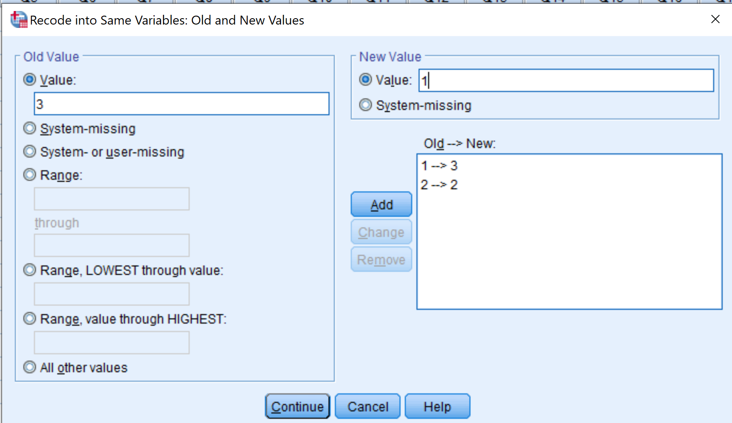
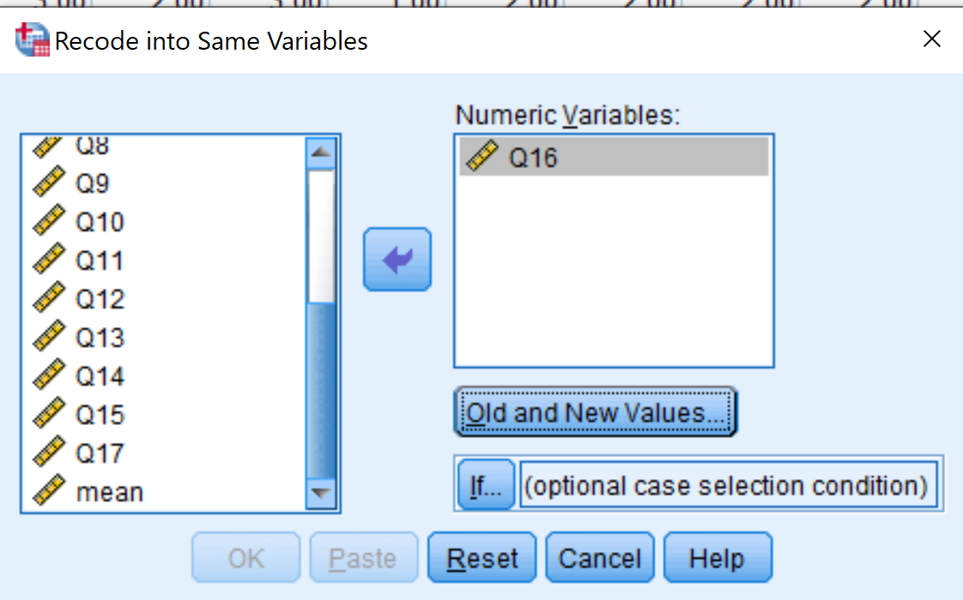

Slide 13
Activity 2
(Manipulating Data: Getting the Sum & Mean)
You want to get the SUM of the Sub-Scale «Activities to illustrate foreign culture» (Items 1, 5, 11, 13, 16)
From the menu at the top of the screen, click on Transform, then click on Compute Variable.
In the Target Variable box, type in the new name you wish to give to the total scale scores (IllustrateTOT).
Select Statistical under Function Group. Then select Sum under Functions and Special Variables.
From the list of variables on the left-hand side, double click on the items you want to add in the sub-scale (Q1, Q5, Q11, Q13, Q16). Make sure there is a comma between each item.
Click OK
This will create a new variable at the end of your data set called «IllustrateTOT».

Slide 14
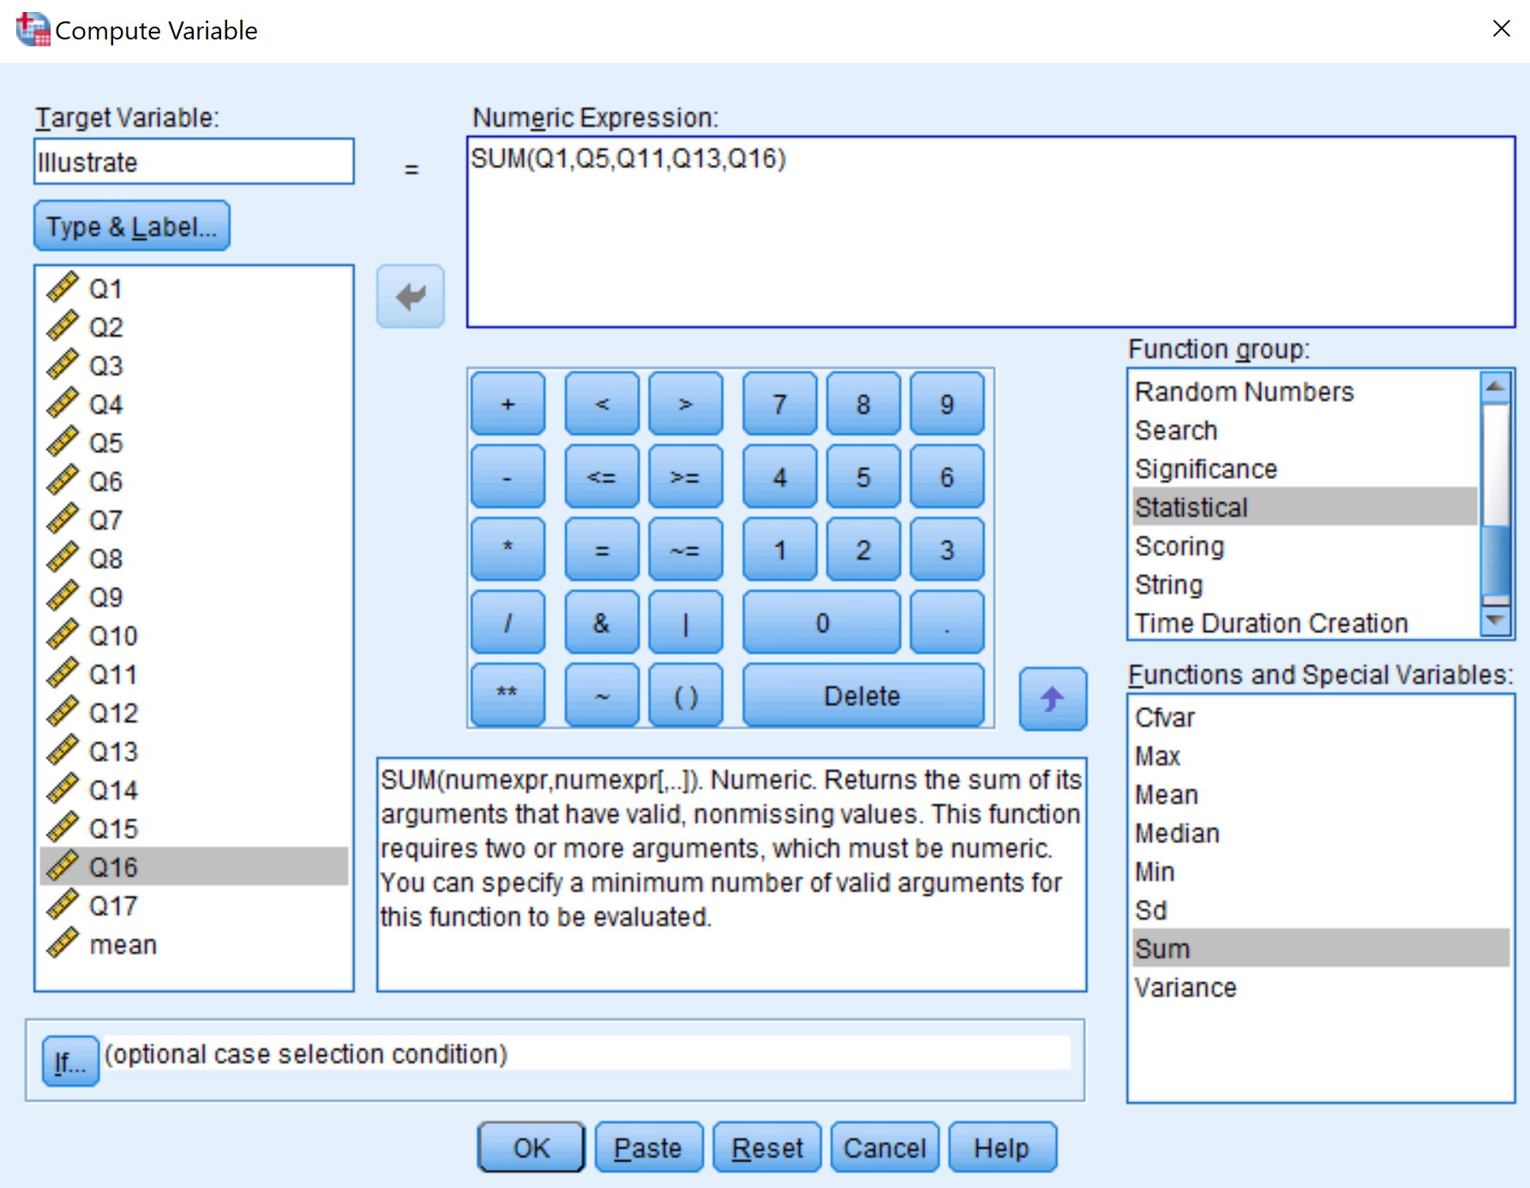
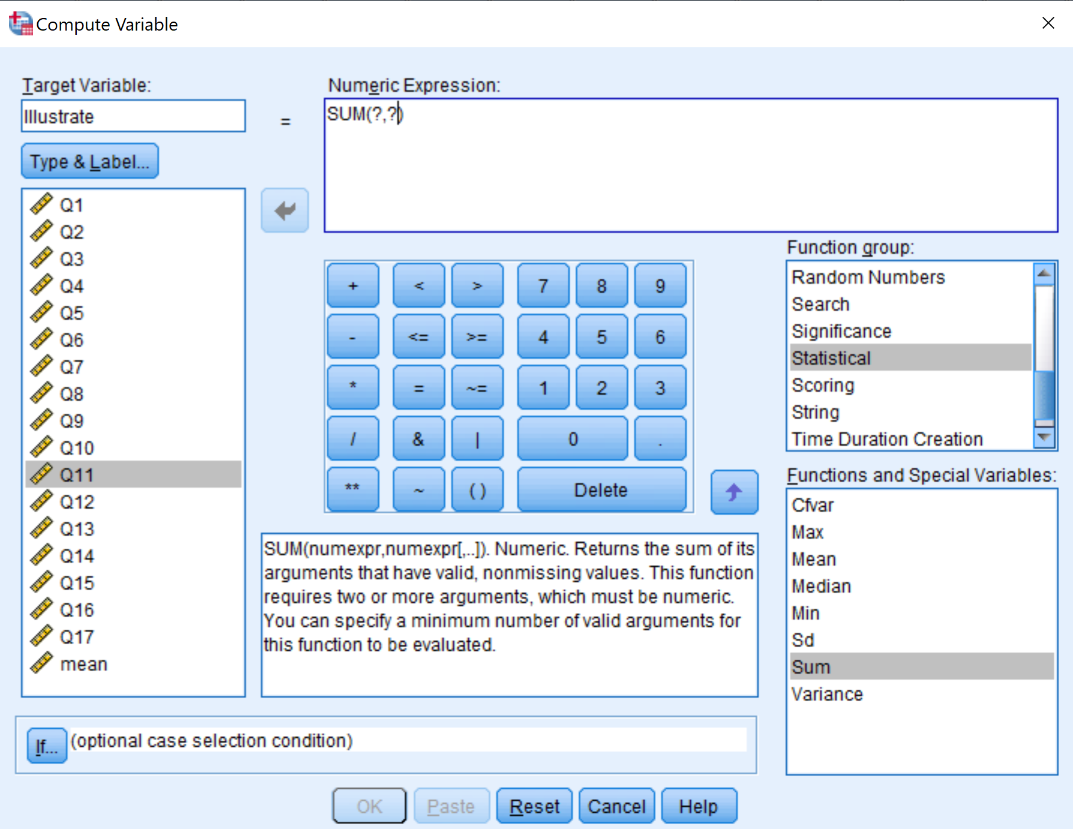

Slide 15
Activity 3
(Manipulating Data: Getting the Sum & Mean)
You want to get the MEAN of the Sub-Scale «Activities that illustrate foreign culture» (Items 1, 5, 11, 13, 16)
Follow the same procedure as you did for SUM. But select Mean under Functions and Special Variables.
In the Target Variable box, type in the new name you wish to give to the total scale scores (IllustrateMEAN).
BUT, this will not round the mean scores, so you will have fractional numbers. If you want to have rounded scores (no fractions), type in the following:
  rnd(MEAN(Q1, Q5, Q11, Q13, Q16),1)
This will create a new variable at the end of your data set called «IllustrateMEAN».

Slide 16
Activity 4
Descriptive Results of the Sub-Scale
Do the descriptive analysis of the sub-scale «Illustrate» and present the findings in a table. Following table presents only the first item. Do the rest of the sub-scale

Slide 18
Activity 5
Now do all the step for another sub-scale: «Sharing Experiences»
Select Q2, Q3, Q7, Q8, Q9, Q10, Q17
There is no reverse item
Create a new variable for this sub-scale; Use mean (not sum)
Develop a table to present the results
Interpret the results

Slide 19
Activity 6
Now do all the step for another sub-scale: «Helping Students Experience Foreign Culture»
Select Q4, Q6, Q12, Q14, Q15
There is no reverse item
Create a new variable for this sub-scale; Use mean (not sum)
Develop a table to present the results
Interpret the results

