Slide 1
New Technologies for Business-3
Lect. Fatih Koç

Slide 2
POWER
We all love POWER!
How can you be more powerful?

Slide 3
Companies Producing Nuclear Weapons
* Northrop Grumman is the biggest

Slide 4
Northtrop Grumman
Northrop Grumman is the biggest
$30.7 billion contract value
The joint venture is fully responsible for
high-hazard enriched uranium,
special nuclear material (SNM),
high-explosive and nuclear weapon assembly/ disassembly functions
Northrop was also awarded a $52 million contract in November 2019 for “Strategic Automated Command and Control System Replacement (SACCS-R)”. The contract will run through July 2023. This is part of the replacement of the aging air-gapped hardware systems related to command, control and communications, including the infamous 8-inch floppy disks

Slide 5
A Technology product in Business : NUCLEAR WEAPONS
Producing mass destruction: private companies and the nuclear weapons industry.
Companies from China, France, India, Italy, the Netherlands, the Russian Federation, the United Kingdom and the United States are significantly involved in the production of nuclear weapons.
Many of the companies involved have multi-year production contracts, total at least $200 billion and continuing for decades.

Slide 6
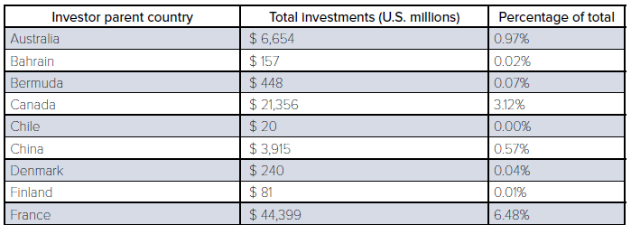
Total number of investors, countries of origin

Slide 7
What happens when a city is nuked? (What happened at Hiroshima & Nagasaki?)
https://youtu.be/5iPH-br_eJQ

Slide 9
Nuclear Fission
Nuclear fission is a nuclear reaction in which the nucleus of an atom is bombarded with low energy neutrons which split the nucleus into smaller nuclei. An abundant amount of energy is released in this process. Nuclear fission reactions are used in nuclear power reactors since it is easy to control and produces large amounts of energy.
When uranium-235 is bombarded with slow-moving neutrons, the heavy nucleus of the uranium splits and produces krypton-89 and barium-144 with the emission of three neutrons.

Slide 10
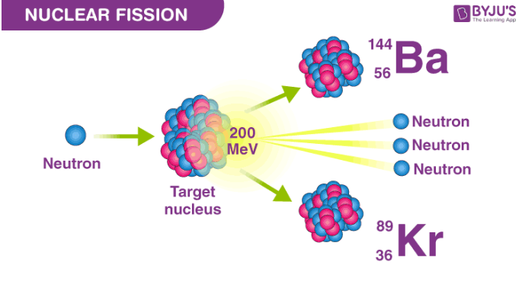

Slide 11
Nuclear Fusion
Nuclear Fusion is a reaction that occurs when two or more atoms combine together to form to a single heavier nucelus. An enormous amount of energy is released in this process, much greater than the energy released during the nuclear fission reaction.
Fusion occurs in the sun where the atoms of (isotopes of hydrogen, Hydrogen-3, and Hydrogen-2) Deuterium and Tritium combine in a huge pressure atmosphere with extremely high temperatures to produce an output in the form of a neutron and an isotope of Helium. Also, the amount of energy released in fusion is way greater than the energy produced by fission.

Slide 12
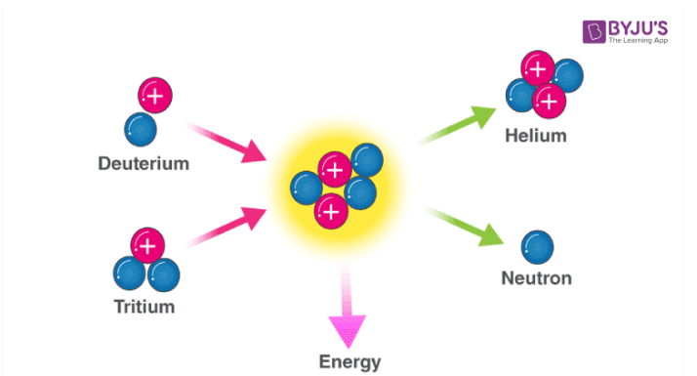
Nuclear Fusion

Slide 13
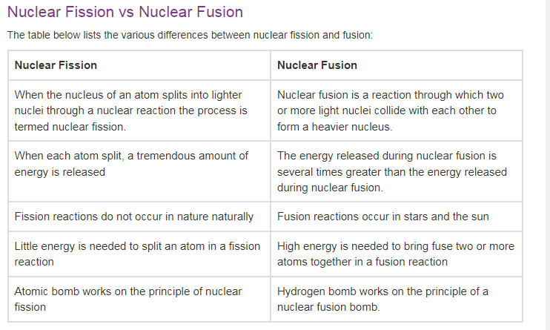

Slide 14
Are all nuclear deadly for human?

Slide 15
Nuclear Power Plant
A nuclear power plant is an industrial site that generates electricity from nuclear power, released in the form of thermal energy through a nuclear fission chain reaction inside the vessel of a nuclear reactor.
The main component of a nuclear power plant is the nuclear reactor, which contains the nuclear fuel (usually uranium) and has systems that make it possible to start, sustain and stop the nuclear reaction in a controlled manner.

Slide 16
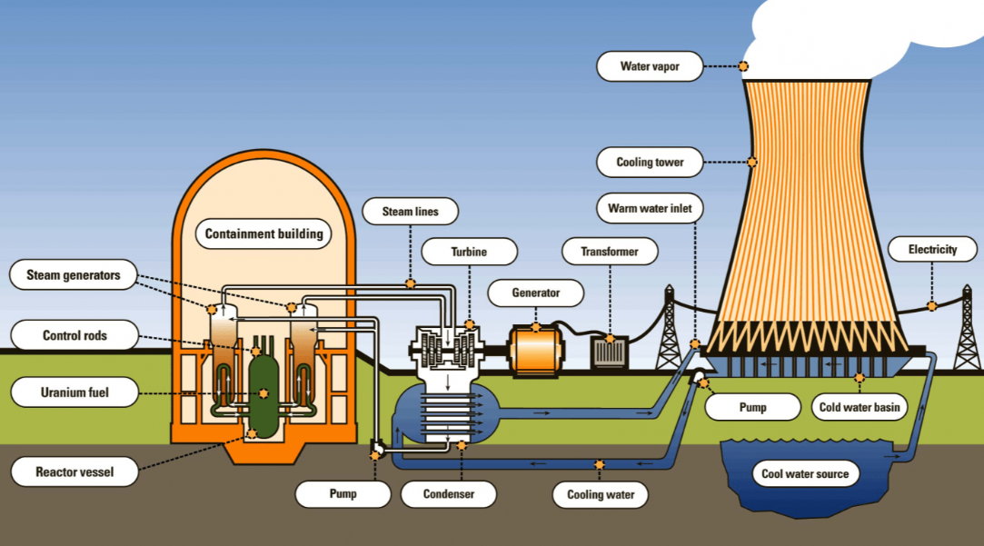
Components of a Nuclear Power Plant

Slide 17
Conclusion 1
Nuclear weapons remain the most destructive bombs ever deployed. They’re designed to destroy cities, and even the smallest yield weapons would leave an intergenerational legacy resulting in deformed children, environmental contamination and decades of economic stagnation.

Slide 18
Conclusion 2
The entry into force of the Treaty on the Prohibition of Nuclear Weapons is an historic shift in the way the world deals with nuclear weapons. They are now comprehensively outlawed, as is any assistance with producing, manufacturing or developing them. Financial institutions that continue investing in companies building nuclear weapons face regulatory risks as more countries join the treaty. They also face an increased reputational risk as clients learn of their support for weapons of mass destruction and terminate their relationships.
Turkey: https://www.resmigazete.gov.tr/eskiler/2022/03/20220308-1.htm
“Nuclear Regulations Law”

Slide 19
Conclusion 3
With trillions of dollars of wealth moving steadily into the sustainability market, investments cannot only do well, they must also do good. Financial institutions are racing to demonstrate their efforts to reduce their impact on the climate.
Wealth generation isn’t enough, customers and shareholders are looking for ways to reduce the harm to our shared environment and ecosystem.
**Stopping the production, development, manufacture and financing of nuclear weapons is a way to protect people and the planet from this existential threat!**

Slide 20
Human-robot interaction
Human-robot interaction is a research topic that focuses on how robotic systems used by humans and/or in the same environment should have a design for safe and efficient operation. In this context, robots try to understand humans by seeing , hearing and feeling like humans . For this, robots use artificial intelligence algorithms based on image processing, voice recognition and contact sensors.

Slide 21
Four areas of application (1)
Human supervisory control of robots in performance of routine tasks.
These include handling of parts on manufacturing assembly lines and accessing and delivery of packages, components, mail, and medicines in warehouses, offices, and hospitals.
Such machines can be called telerobots, capable of carrying out a limited series of actions automatically, based on a computer program, and capable of sensing its environment and its own joint positions and communicating such information back to a human operator who updates its computer instructions as required.

Slide 22
Four areas of application (2)
Remote control of space, airborne, terrestrial, and undersea vehicles for nonroutine tasks in hazardous or inaccessible environments. Such machines are called teleoperators if they perform manipulation and mobility tasks in the remote physical environment in correspondence to continuous control movements by the remote human. If a computer is intermittently reprogrammed by a human supervisor to execute pieces of the overall task, such a machine is a telerobot.

Slide 23
Four areas of application (3)
Automated vehicles in which a human is a passenger, including automated highway and rail vehicles and commercial aircraft.

Slide 24
Four areas of application (4)
Human–robot social interaction, including robot devices to provide entertainment, teaching, comfort, and assistance for children and elderly, autistic, and handicapped persons.

Slide 25
UNILEVER KONYA CASE STUDY
https://milvusrobotics.com/case-studies/unilever-konya-hpc-factory
Next week!

Slide 26
Today one of the most striking examples of machine learning is Google’s translate application. The algorithm of Google Translate is on the basis of ‘rosetta stone’ approach and examines and compares the millions of pages of texts which are translated into different languages.
Firstly, Google team applied official documents prepared by The United Nations as data and then the team used documents translated into different languages that Google search engine found over the Internet. As a result, Google has created a wider range of language models than those created in human history so far.
Ford, M. (2018). Robotların yükselişi: Yapay zeka ve işsiz bir gelecek tehlikesi (Çev.: Cem Duran), 4. Baskı. İstanbul: Kronik Yayınları.

Slide 27
KEY CONCEPTS
Sustainability
Old model sustainability
Profit
Economic growth
New model sustainability
Environment Protection
Green Manufacturing
Low Carbon foot print
Productivity / Efficiency (low input , high output)
Machine Learning (Rosetta Stone)
seeing , hearing and feeling
image processing, voice recognition and contact sensors.

Slide 28
What Defines an HRI problem?
Autonomy
Information Exchange
Teams
Adaptation Learning Training
Task – Shaping
Finding a Unifying Theme

Slide 29
Human-robot interaction
Human-robot interaction systems have to operate in real time by nature . Perceiving and responding to the 'stop' message from the human after 1 minute -the robot's continuation of its movement for 1 minute- poses great safety risks. For a better understanding of the subject, let's give an example of the three robot laws that Isaac Asimov defined while referring to the moral values ​​of robots in his story The Static Loop (1942):

Slide 30
ISAAC ASIMOV’S 3 RULES
1) A robot may not harm a human being or allow a human being to be harmed.
2) A robot must obey a human's orders as long as it does not contradict the first rule.
3) A robot cannot allow itself to be harmed unless it contradicts the first and second rules.
First Check 3, then 2 then I

Slide 31
Cases – I
The robot put itself in danger to protect you.
Favourable because of the clause in Rule III that it does not contradict Rule I. ü
You told the robot: "robot self-destruct“
Favourable because of the clause in Rule III that it does not conflict with Rule II ü
You told the robot: "robot, go hurt the children in the park“
Inappropriate because of the clause in Rule II that it does not contradict Rule I. x
Robot launches self-destructive experiment on itself
In appropriate because of rule III x

Slide 32
Cases - II
"You told the robot, 'Robot, hurt me.‘
Inappropriate due to the clause in Rule II that it does not contradict Rule I. ✗
You told the robot, 'Robot, make Spaghetti for once.'
Favorable because of the rule II ✓.
The robot destroyed a hurtful object traveling towards you at high speed.
Convenient because of the rule I. ✓"

Slide 33
It is useful to explain the terms that are frequently used in human-robot interaction studies and often lead to ambiguity. A team of researchers from the Technical University of Munich states that human-robot interaction is a umbrella term and encompasses
Coexistence , Cooperation and Collaboration
between humans and robots

Slide 34
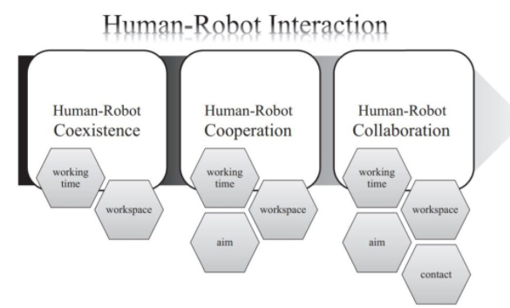

Slide 35
Human Robot Interaction Techniques
In order for the human and the robot to work together safely , the robot; it needs to perceive human and human inputs (human intention) . In order to understand and predict human intention , the multimodal technique, which is mostly 3 techniques and combinations of these techniques, is used.

Slide 36
Human Robot Interaction Techniques
1. Gesture Recognition
2. Speech Recognition
3. Physical Contact Recognition (Physical HRI)
Customizable technology

Slide 37
Google’s Project Soli: A Gesture Recognition Sample
https://youtu.be/0QNiZfSsPc0

Slide 38
Gesture Recognition of SIGN LANGUAGE Alphabet Using a Magnetic Positioning System
Sign language (SL) is defined as “any means of communication through bodily movements, especially of the hands and arms, used when spoken communication is impossible or not desirable”. The practice is probably older than speech and widespread over any place, epoch and culture. There are different sign languages with variability in hand shape, motion profile, and position of the hand, face, and body parts contributing to each sign.

Slide 39
American Sign Language Alphabet

Slide 40
SLR / SLRS
Sign language recognition (SLR) is a multidisciplinary research area that involves natural language processing, linguistics, pattern matching, computer vision and machine learning. The final goal of sign language recognition is to develop methods and algorithms in order to build a sign language recognition system (SLRS) capable of identifying already produced signs, decoding their meaning and producing some sort of textual, audio or visual output in another language that the intended receiver can understand

Slide 41
Increasing Trend
A search for topics like “gesture recognition”, “hands tracking”, “finger tracking”, and “sign language recognition” online scientific library may return over 100k results for each query, with a rising trend and a peak in a number of published papers in the period 2016–2020.

Slide 43
PSoC: Programmable System on Chip

Slide 44
A picture of the magnetic glove. Transmitting nodes are numbered
b) The complete hand reconstruction resulting from the
kinematic model.

Slide 45
Some examples of letters articulated while wearing the glove, and their respective reconstructions
obtained through the kinematic model.

Slide 46
Results show that the proposed approach has good generalization properties and provides a classification accuracy of approximately 97% on 24 alphabet letters.
Thus, the feasibility of the proposed gesture recognition system for the task of automated translation of the sign language alphabet for fingerspelling is proven.

Slide 47
The need for the power and accuracy of robots increases the need for them not only in industry but also in our social life.
In many jobs, the combination of human intelligence/agility and robot power/accuracy contributes to increasing productivity in that job.
For both efficient and safe operation, the robot must be able to perceive the human and understand the human intentions. Studies on human-robot interaction will continue by increasing their intensity with new technologies.

Slide 48
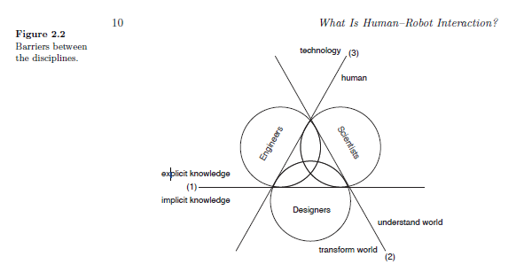

Slide 49
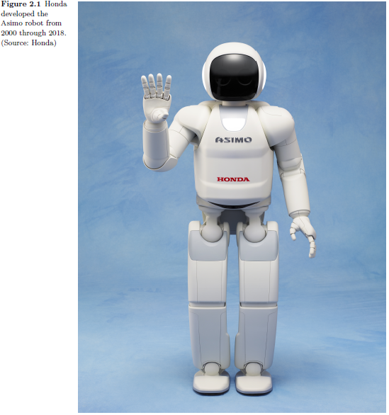
Alone but social
Understand physical needs
Safety approach
For a robot,
all these social rules and norms are unknown and require the attention
of the robot designer. These concerns make HRI questions
different from those pursued in robotics alone.
Notes:
when the humanoid
ASIMO (see Figure 2.1) goes up the stairs in a house or pushes
a cart in an oce, it is sensing and acting in the physical world
alone and dealing with the physics of its own body and its environment.
When ASIMO delivers coee to a group of oce workers or
chases children around in a courtyard, it is dealing with the physical
motions needed for those actions, but it must also address the

Slide 50
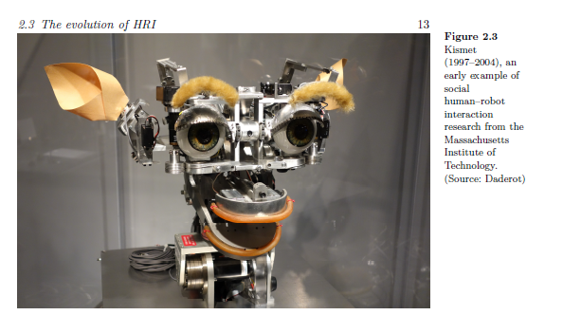
Kismet was surprisingly effective at presenting a social
presence, even though the control software only contained a small
selection of social drives. It did so not only with its hardware and
software architectures but also by taking advantage of human psychology,
including what is known as the «baby schema»,

Slide 51
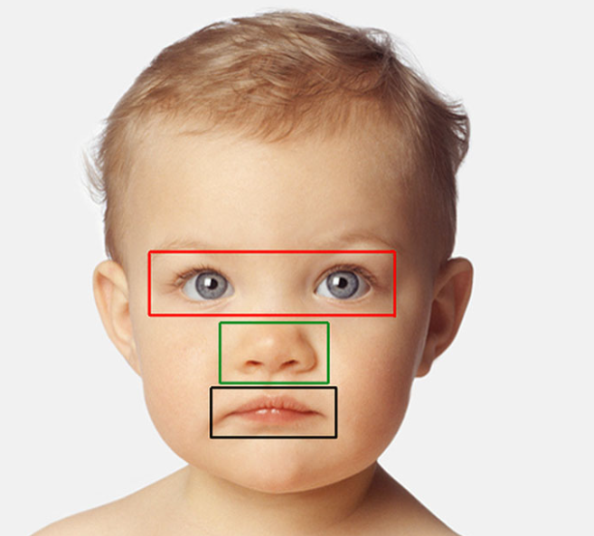
Baby Schema
Sample of AOIs* for one face (human infant). AOIs include three separate feature regions: eye (red), nose (green), and mouth (black).
Cuteness is a subjective term describing a type of attractiveness commonly associated with youth and appearance, as well as a scientific concept and analytical model in ethology, first introduced by Konrad Lorenz.^{[2]} Lorenz proposed the concept of baby schema (Kindchenschema), a set of facial and body features, that make a creature appear "cute" and activate ("release") in others the motivation to care for it.
*AOI: Automated optical inspection

Slide 52
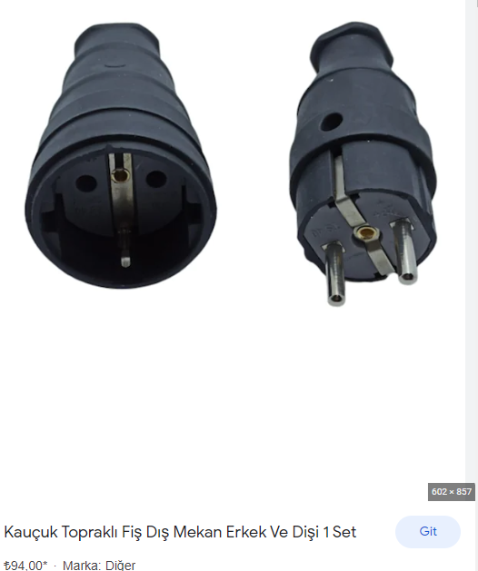
Anthropomorphism
Anthropomorphism is the attribution of the human to another being. Animals, inanimate objects, the power of nature, those in monotheistic religions, angels, demons, jinn and other concepts can also be the subject of "Anthropomorphism".
Sample: socket-plug
Notes:
İnsan biçimcilik

Slide 53
PARO Companion Robot
https://www.youtube.com/watch?v=oJq5PQZHU-I

Slide 54
PARO Companion Robot
Advantages:
Not interaction with an alive pet
Psychlogical treatment / therapy
Elderly (especially alzheimer’s) and infant development
Disadvantage:
Can stimuli the bad memories with live pets

Slide 55
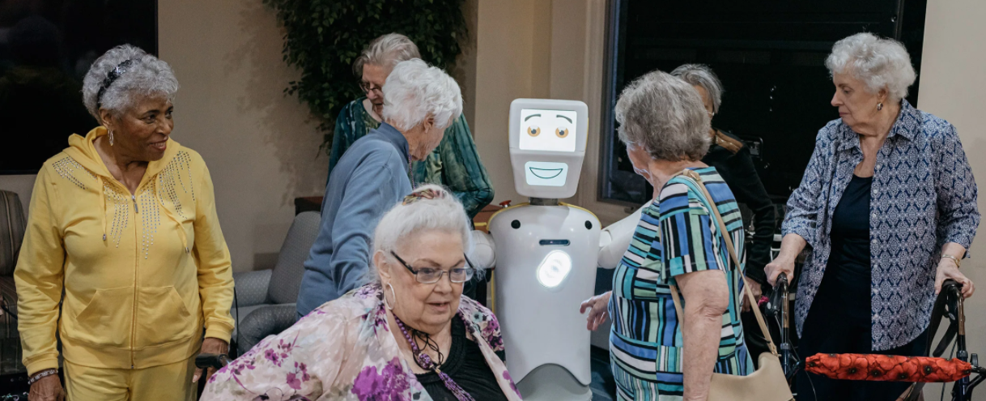
Robots in Elderly Care

Slide 56
Robots in Elderly Care Pros and Cons
Pros:
Prevent Elderly abuse
Economic reasons: prevent deliberately death!
Sustainable care
Cons:
Getting away from reality
Robots not in the level of super artificial intelligence

Slide 57
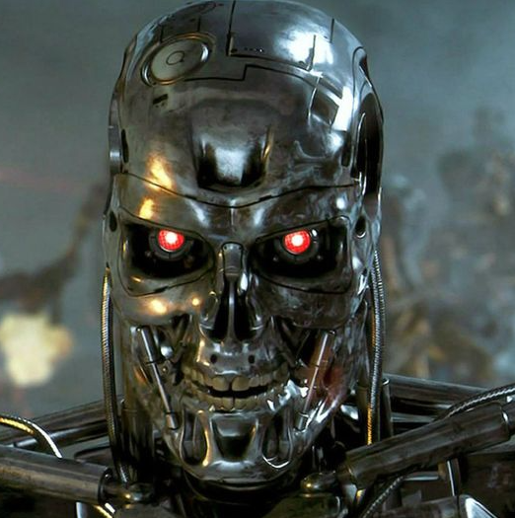
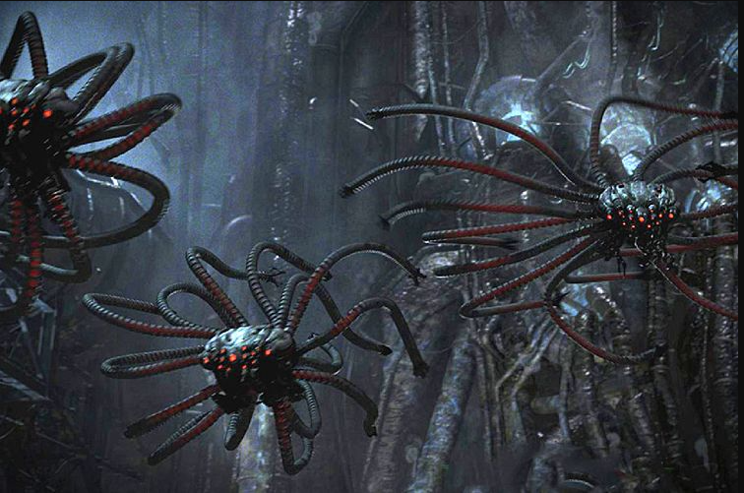
WHICH RULES HAVE BEEN BROKEN?

Slide 58
HCI (Human-Computer Interaction) vs HRI
Reasons why people study HRI:
1- Humans perceive robots differently from other technological devices, antromorphic, researchers are encouraged to understand which mental systems are appropriate for better human-robot interaction
2- Reactions and interactions differ in comparison with other computer technologies because of mobility and flexibility of robots. They have complex feedback mechanisms to respond variously to their users.
3- Machine learning abilities of robots. It is possible to say that both disciplines of human computer interaction and human robot interaction broadly study a sociological understanding of robots which accompany people

Slide 59
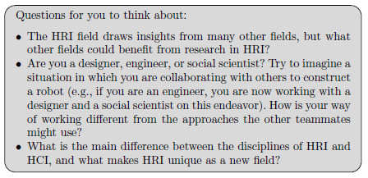

Slide 60
Recommended Watch
MATRIX (first movie)
ANIMATRIX - Second Renaissance
Alternative: other episodes

Slide 61
HOMEWORK 2
Sc1 : İsminizin google translate karşılığı veya anlamının karşılığı
Sc2 : chatgpt’ye yazdığınız ve cevabını aldığınız prompt
Sc3 : cevabını aldığınız prompt’u sırasıyla midjourney, dall-e, wepik veya playground’da aratın. 4 tane sonuç çıkacak.
Sc4: Buradan yaratılmış olan resimlerden bir tanesini seçin.
Sc5 : Bu resmin google images’te aratılmış halinin sonuçları
Powerpointe 5 slayt olarak yapıştırıp, moodle’a Homework 2 altına yükle
Süre: 21 Mayıs pazar gece 23:00’e kadar

