Slide 1
WHAT WE MEAN BY TRANSLATION?
-The discipline of Translation Studies
-Jakobson Model: Three types of translation:
-INTRALINGUAL
-INTERLINGUAL
-INTERSEMIOTIC

Slide 2
MAIN ISSUES OF TRANSLATION STUDIES
The practice of translating is long-established, but the discipline of translation studies is relatively new.
James Holmes’s ‘The Name and Nature of Translation Studies’ is considered to be the founding statement of a new discipline.

Slide 3
Source Text_______Target Text
INTRALINGUAL:
INTERLINGUAL:
INTERSEMIOTIC:
Rewording
Translation Proper
Transmutation,an interpretation of verbal signs. (Jakobson 1959:2012.127)

Slide 4
What is translation studies?
Throughout history, written and spoken translations have played a crucial role in interhuman communication.
The discipline is generally known as ‘Translation Studies’.

Slide 5
-the demand for translation has soared, so;
There has been a vast expansion in specialized translating and interpreting programmes. These include;
Applied translation studies, scientific and technical translation, conference and bilateral interpreting, audiovisual translation, specialized Sign Language and audio description.

Slide 6
-An early history of the discipline
Cicero and Horace (the first century AD)
St. Jerome (the fourth century)
(his approach to translating the Greek Septuagint Bible into Latin would affect later translations)
In Western Europe, the translation of the Bible.(conflicting ideologies for well over a thousand years during the Reformation in the sixteenth century.)

Slide 7
-comparative literature&contrastive linguistics
In 1920s, the translation workshops were intended as a platform for the introduction of new translations into the target culture and for the discussion of principles of translation process and understanding a text.
In the 1950s and 1960s, the more systematic, linguistic-oriented approach to the study of translation began to emerge.

Slide 8
James Holmes put forward an overall framework describing what translation studies cover.
‘The Name and Nature of Translation Studies’ –generally accepted as the founding statement for the field.
Holmes drew attention to the limitations because translation research, lacking a home of its own, was dispersed across other disciplines (languages,linguistics,etc.).

Slide 9
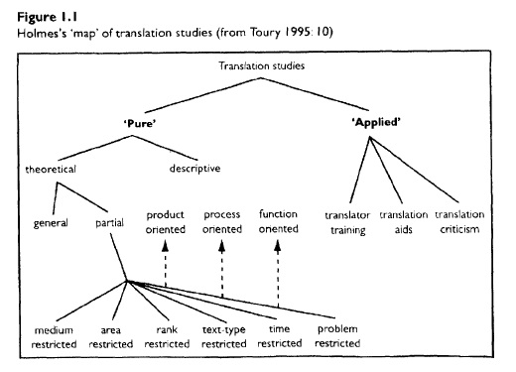
Holmes’s map of translatION

Slide 10
The descriptive branch of pure research in Holmes’s map is known as DTS (Descriptive Translation Studies)
Product-Oriented DTS
-the description or analysis of a single ST-TT pair of comparative analysis of several TTs of the same ST (analysis looking at a specific period/language/text type)
Function-Oriented DTS
-the function of the text in the recipient socio-cultural situation (the study of contexts rather than texts) (the sociology and historiography of tr.)

Slide 11
Process-Oriented DTS
-The psychology of translation (what happens in the mind of a translator during the translation process)
(Translation is the decision-making process!)
Medium-Restricted Theories
Area-Restricted Theories
Rank-Restricted Theories
Text-Type Restricted Theories
Time-Restricted Theories
Problem-Restricted Theories

Slide 12
Developments since J.Holmes:
The linguistics-oriented science of translation has continued strongly in Germany.
The concept of ‘equivalence’ has been questioned and reconceived.
Language as a communicative act in socio-cultural context, came to prominence in the early 1990s.

Slide 13
The rise of theories centered around text types and text purpose (the skopos theory)- by Reiss and Vermeer
The rise of a descriptive approach- that had its origin in comparative literature and Russian Formalism.
The idea of literary polysystem by Itamar Even-Zohar and Gideon Toury. (polysystem-different literatures and genres compete for dominance.)

Slide 14
Susan Bassnett and Andre Lefevere-The Manipulation School
The 1990s saw the incorporation of new approaches and concepts (gender, postcolonial translation theories)
Dynamic and culturally-oriented approaches
Lawrence Venuti called for greater visibility and recognition of the translator.

Slide 15
Interdiscipline or Multidiscipline?
An interdiscipline challenges the current conventional way of thinking by promoting and responding to new links between different types of knowledge.
Linguistics /Modern Languages
Comparative Literature
Cultural Studies
Philosophy
Sociology (as well as history)

