Slide 1
SWAPS
Lecturer Fatih Koç

Slide 2
SWAPS
Change of cash flow contracts.
Usually interest rate swap is being used.
Companies and banks use that for investment and interest rate risk.
Reporting agency : ISDA (International Swaps and Derivatives Association)

Slide 3
MECHANICS of INTEREST RATE SWAP

Slide 4
SAMPLE-1
Company A goes to a swap agreement with Company B. Notional amount is 100 M USD.
Company A would pay to Company B a fixed rate of %5 per year and Comapny B will pay to Company A a floating rate of LIBOR per year.
A. If LIBOR is %6, how much loss or profit for Company A?
B. If LIBOR is %3 how much loss or profit for Company A?

Slide 5
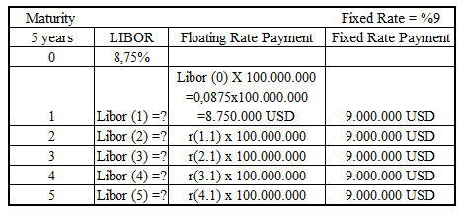
INTEREST RATE SWAP SAMPLE - 2

Slide 6
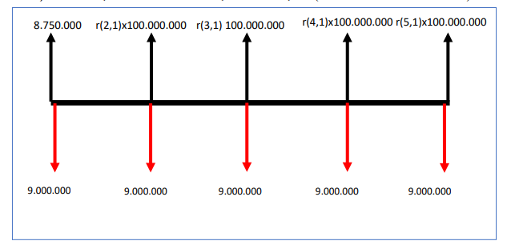
Floating Rate Receiver

Slide 7
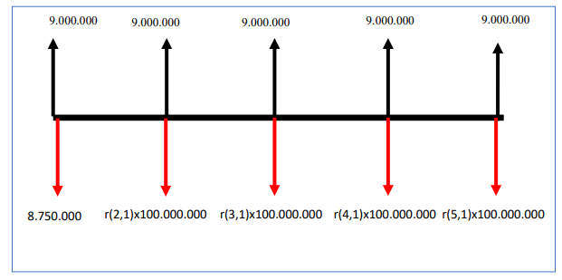
Fixed Rate Receiver

Slide 8
Currency Swap
An important alternative to Interest Rate Swap is CURRENCY SWAP
In such swap agreements, the parties that have agreed make interest payments in different currencies to each other.
On the day the swap starts, the principal (notional amount) changes hands by using the foreign exchange rate.
The principal payment at maturity also changes hands without any currency risk.
In a currency swap agreement, both parties pay interest on the foreign currency they receive.

Slide 9
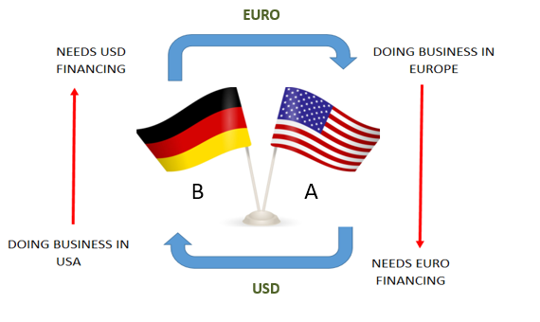
CURRENCY SWAP

Slide 10
CURRENCY SWAP
1. Corporation A can give B a fixed USD interest rate and receive a fixed EURO interest rate from B.
2. Corporation A can give B floating USD interest rate and receive fixed EURO interest rate from B.
3. Corporation A can give B a fixed USD interest rate and receive a floating EURO interest rate from B.
4. Corporation A can give floating USD interest rate and receive floating EURO interest from B

Slide 11
CURRENCY SWAP
1. A and B exchange currency, A gives USD and receives EURO.
2. Interest payments will be made. Firm A pays EURO interest and receives USD interest.
3.A will take the USD and replace it with EURO.

Slide 12
SAMPLE – 3 Fixed vs Fixed Swap
EUR/USD parity = 1,25 (1 USD = 0,8 EUR)
USA Int. Rate = %10, EUR Int. Rate = 8%
LINGER is a company in EUROZONE, and have 25 M EUR, wants to do business in California, USA. Going into a swap arrangement with another textile company SKIRTERUS with a maturity of 5 years.
Draw the cash flow schema in perspective of LINGER.
Draw the cash flow schema in perspective of SKIRTERUS.

Slide 13
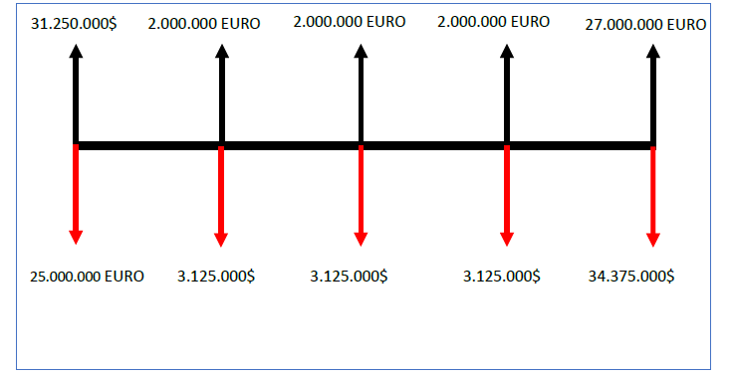
SOLUTION – Sample 3 (LINGER perspective)

Slide 14
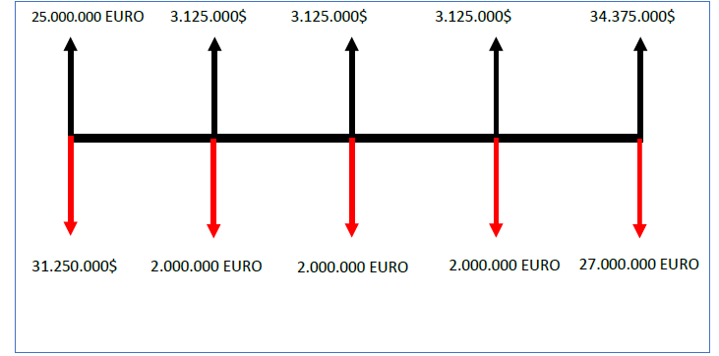
SOLUTION – Sample 3 (SKIRTERUS perspective)

