Slide 1
Product and Service Strategies

Slide 2
Objectives
Define the term product.
Distinguish between goods and services and how they relate to the goods–services continuum/spectrum.
Outline the importance of the service sector in today’s marketplace.
Describe the three classifications of consumer goods and services.

Slide 3
Objectives
Identify the six types of business goods and services.
Discuss how marketers use quality as a product strategy.
Explain why firms develop lines of related products.
Describe the way marketers typically measure product mixes and make product mix decisions.

Slide 4
Objectives
Explain the four stages of the product lifecycle.
Describe the four strategies for extending a product’s lifecycle and why certain products may be eliminated.

Slide 5
Marketing Mix
Blending/combining of the four strategy elements—product, distribution, promotion, and price—to fit the needs and preferences of a specific target market
Marketers develop strategies to sell both tangible goods and intangible services

Slide 6
What is a Product?
People buy want satisfaction, not objects/ things
Product – Bundle/package of physical, service, and symbolic attributes/features designed to satisfy a customer’s wants and needs

Slide 7
What are Goods and Services?
Services - Intangible tasks/works that satisfy the needs of consumers and business users
Goods - Tangible products that customers can see, hear, smell, taste, or touch
Goods–services continuum - Spectrum along which goods and services fall according to their attributes/qualities, from pure/ mere good to pure/mere service

Slide 8
Figure 12.1 – Goods–Services Continuum

Slide 9
Characteristics of Services
Intangible/immaterial
Inseparable/undetachable from the service providers/suppliers
Perishable/spoilable
Cannot be standardized
Buyers play important roles in the creation/ generation and distribution of services
Wide variations/diversities in service standards

Slide 10
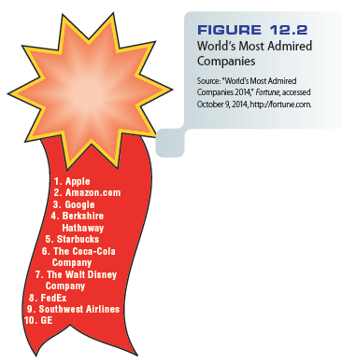
Figure 12.2 – World’s Most Admired Companies (2014)

Slide 11
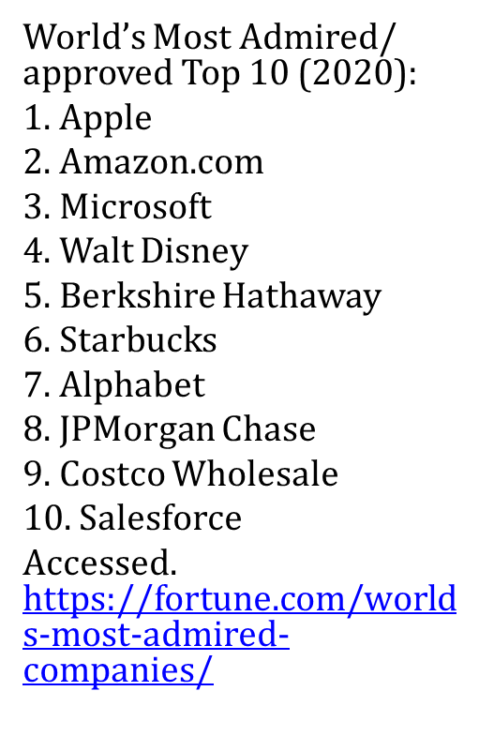
Figure 12.3 – World’s Most Admired Companies (2020)

Slide 12
Importance of the Service Sector
The service sector makes up more than three-fourths of the U.S. economy
Backshoring - Firms return much of their offshore work to the U.S. to save money and improve customer service efficiency
Homeshoring - Hiring workers to do jobs from their homes

Slide 13
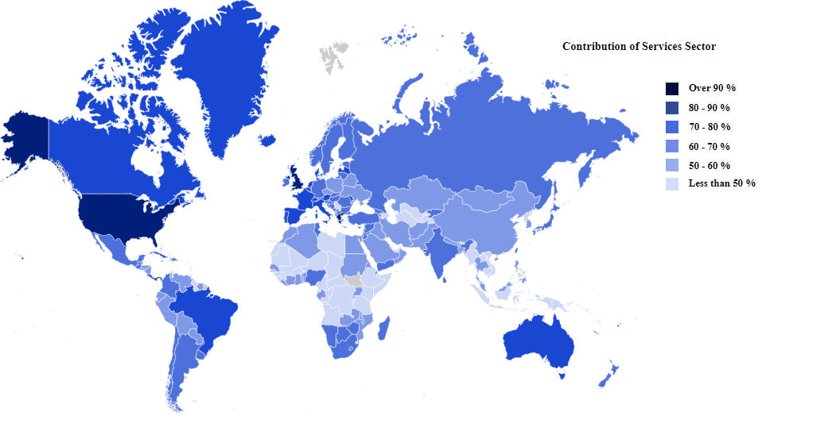
http://statisticstimes.com/economy/countries-by-gdp-sector-composition.php

Slide 14
Importance of the Service Sector
Most service firms emphasize/underline marketing as a significant activity for two reasons
Growth potential of service transactions represents a vast/enormous marketing opportunity
Environment for services is changing

Slide 15
Classifying Goods and Services for Consumer and Business Markets
Consumer (B2C) products - Product destined/allocated for use by ultimate consumers
Business (B2B) products - Product that contributes directly or indirectly to the output of other products for resale; also called industrial or organizational product
Some products fall into both categories –depending on the quantity purchased or the purpose.

Slide 16
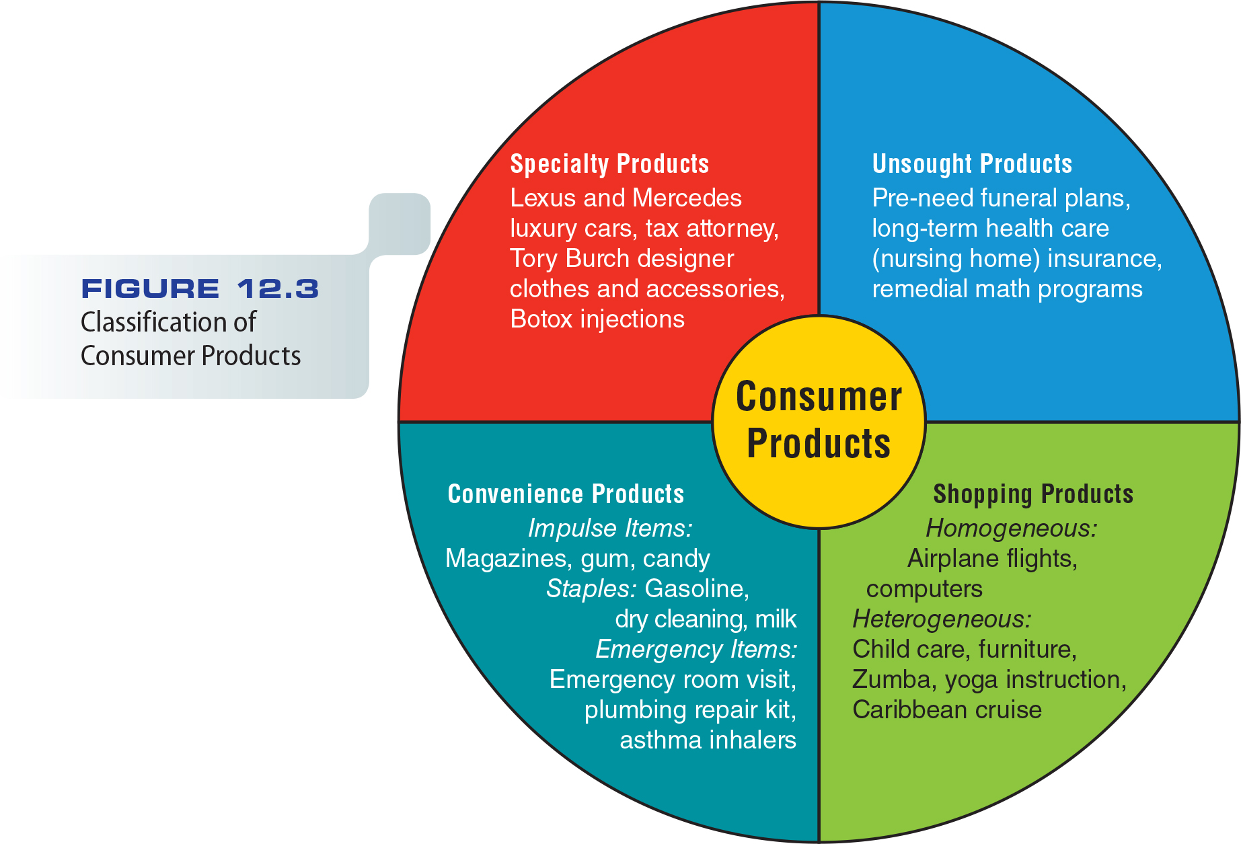
Figure 12.3 – Classification of Consumer Products

Slide 17
Classifying Consumer Services
Marketers rely on five questions to classify services
What is the nature of the service?
What type of relationship does the service organization have with its customers?

Slide 18
Classifying Consumer Services
How much flexibility is there for customization and judgment/decision making on the part of the service provider?
Do demand and supply for the service fluctuate/undulate?
How is the service delivered?

Slide 19
Applying the Consumer Products Classification System
Classification system poses/causes a few problems
Obstacle/objection to implementing/applying this system results from the suggestion that all goods and services must fit within one of the three categories:
Convenience goods
Shopping goods
Specialty goods
Problem emerges/appears because consumers differ in their buying patterns

Slide 20
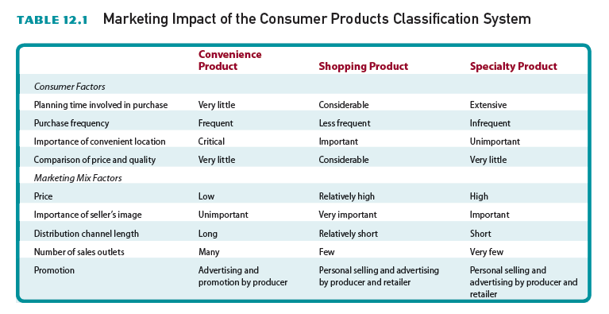
Table 12.1 – Marketing Impact of the Consumer Products Classification System

Slide 21
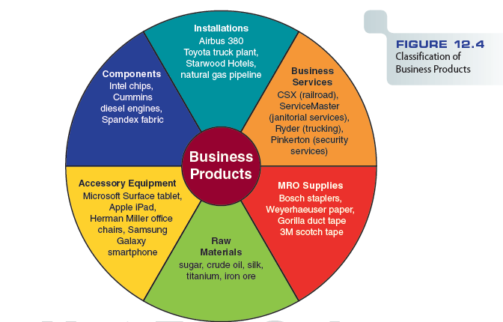
Figure 12.4 – Classification of Business Products

Slide 22
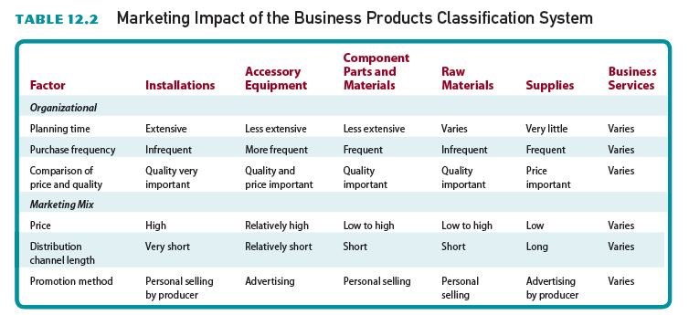
Table 12.2 – Marketing Impact of the Business Products Classification System

Slide 23
Quality as a Product Strategy
Quality is a key component to a firm’s success in a competitive marketplace
Total quality management (TQM) - Continuous effort to improve products and work processes with the goal of achieving customer satisfaction and world-class/best performance

Slide 24
Worldwide Quality Programs
In the 1980s, the quality revolution picked up speed in U.S. corporations
The goal was to better compete with Japanese manufacturers
The U.S. Congress established the Malcolm Baldrige National Quality Award to recognize excellence in quality management

Slide 25
Worldwide Quality Programs
ISO 9001:2008 standards implemented by the European Union define international, generic criteria for quality management and assurance
The U.S. member body of ISO is the National Institute of Standards and Technology
ISO-International Organization for Standardization
https://www.iso.org/home.html
ISO is an independent, non-governmental international organization with a membership of 165 national standards bodies. ISO TODAY:
23534 - International Standards covering almost all aspects of technology and manufacturing.
165 - Members representing ISO in their country. There is only one member per country.
792 - Technical committees and subcommittees to take care of standards development.

Slide 26
Benchmarking/Gold Standart
Measuring quality by comparing performance against industry leaders
Involves three main activities
Identifying manufacturing or business processes that need improvement
Comparing internal processes to those of industry leaders
Implementing changes for quality improvement

Slide 27
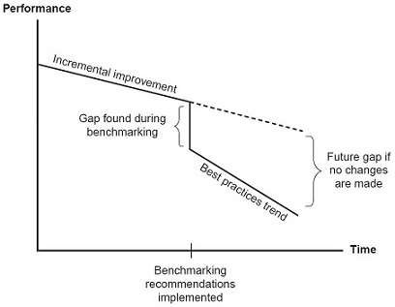
Benchmarking
Benchmarking is defined as the process of measuring products, services, and processes against those of organizations known to be leaders in one or more aspects of their operations. Benchmarking provides necessary insights to help you understand how your organization compares with similar organizations, even if they are in a different business or have a different group of customers.
Benchmarking can also help organizations identify areas, systems, or processes for improvements—either incremental (continuous) improvements or dramatic (business process re-engineering) improvements.
Incremental Quality Improvement vs Benchmarking Breakthroughs/Spurts
https://asq.org/quality-resources/benchmarking, Accessed 11/25/2020

Slide 28
Benchmarking
Requires two types of analyses: internal and external
Company must first analyze its own activities to determine strengths and weaknesses
External analysis involves gathering information about the benchmark partner, to find out why the partner is perceived as the industry’s best

Slide 29
Quality of Services
Service encounter* - Point at which the customer and service provider interact
Service quality - Expected and perceived quality of a service offering
*Service encounter is generally defined as a consumer's direct contact with a service provider, including both face-to-face interaction and experience. Voorhees et al. defines service encounter as “any discrete interaction between the customer and the service provider relevant to a core service offering” (https:// www.ncbi.nlm.nih.gov/pmc/articles/ PMC5800231/#: ~:text= Service%20encounter%20is%20generally%20defined,to%20a%20core%20service%20offering%E2%80%9D, Accessed 11/25/2020).

Slide 30
Quality of Services
Determined by five variables
Tangibles/materials-Appearance of physical facilities, equipment, personnel, and communication materials
Reliability/responsibility-Ability to perform the promised service dependably and accurately
Responsiveness/sensitivity-Willingness to help customers and provide prompt service
Assurance/confidence-Knowledge and courtesy of employees and their ability to convey trust and confidence
Empathy7understanding-Caring, individualized attention the firm provides its customers

Slide 31
Development of Product Lines
Product line - Series of related products
If businesses desire to grow.
Growth potential is limited if a company focuses on a single product

Slide 32
Enhancing the Company’s Market Position
Entire/overall lines of products make a company more important to consumers and marketing intermediaries
Servicing the variety of products a company sells can enhance its position in the market

Slide 33
Optimal Use of Company Resources
Spreading/distributing operations costs over a series of product lines reduces the average –unit– production and marketing costs of each product

Slide 34
The Product Mix (merchandise mix
Assortment/medley (potpourri) of product lines and individual product offerings
Product mix width
Number of product lines a firm offers
Product mix length
Number of different products a firm sells
Product mix depth
Variations in each product that the firm
markets

Slide 36
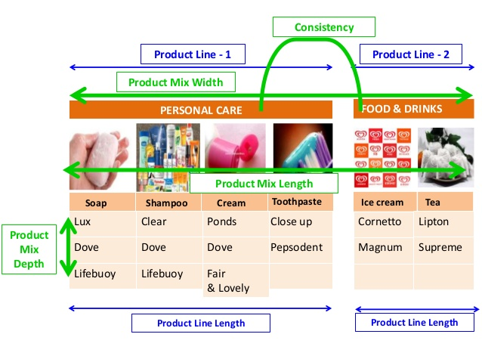

Slide 37
Product Mix Decisions
To evaluate a firm’s product mix, marketers look at the effectiveness of its depth, length, and width
Firms may decide to add to their mixes by purchasing product lines from other companies
Line extension - Development of individual offerings that appeal to different market segments while remaining closely related
to the existing product line

Slide 39
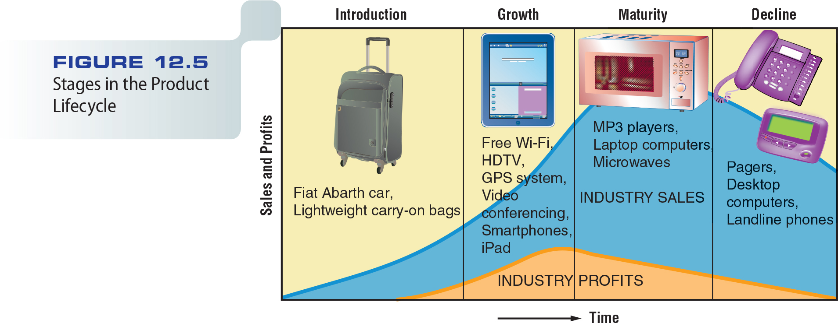
Figure 12.5 – Stages in the Product Lifecycle

Slide 41
The Product Lifecycle
Introductory stage
Products in this stage might bring new technology to a product category
Technical problems and financial losses are common
Growth stage
Sales volume rises rapidly as new customers make initial purchases and early buyers repurchase the product

Slide 44
The Product Lifecycle
Maturity stage
Sales of a product category continue to grow during the early part of this stage but eventually/in the end reach a plateau/tableland as the backlog/accumulation of potential customers dwindles/decreases
Decline stage
Innovations or shifts in consumer preferences bring about an absolute decline in industry sales

Slide 45
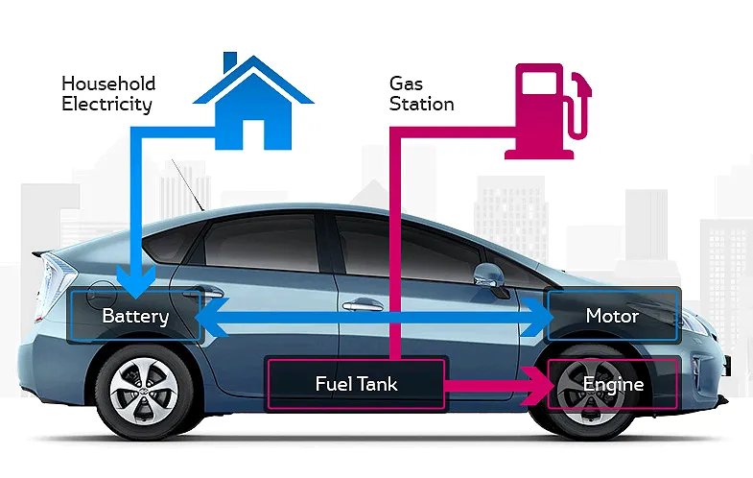

Slide 47
Extending the Product Lifecycle
Increasing frequency of use
Convincing current customers to buy a product more frequently boosts total sales even if no new buyers enter the market
Increasing the number of users
Attracting new customers who have not previously used the product

Slide 48
Extending the Product Lifecycle
Finding new uses
New applications extend a product’s lifecycle
Changing package sizes, labels, or product quality
New packaging and labels with updated images and slogans can help revitalize/recreate a product

Slide 49
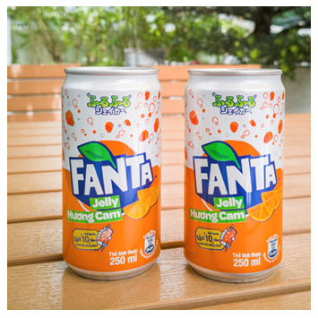
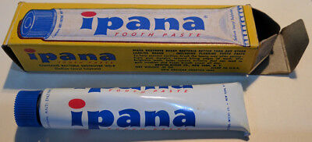
Revitalized Products

Slide 50
Product Deletion Decisions
Marketers prune/trim product lines and eliminate marginal products to preserve limited resources
Firms may carry unprofitable items to carry a complete product line
Shortages or raw materials can prompt/make a firm to discontinue production
Firm may drop products that don’t fit into the direction in which it plans to grow

Slide 51
BoltBus Video
http://www.cengage.com/marketing/book_content/boone_9781133628460/videos/ch12.html

