Slide 1
SPSS FOR CORRELATION

Slide 2
Pearson r Correlation
RQ= Is there a significant relationship among the four variables of assessment perceptions (external attribution, improvement, irrelevant, effect) of students? (Use correlation data.sav file)

Slide 3
How to use SPSS for Correlation
1. Click on Analyze, then select Correlate, then Bivariate.
2. Select your four variables and move them into the box marked Variables (e.g. external, improvement, irrelevant, effect). You can list as many variables as you need.
3. In the Correlation Coefficients section, the Pearson box is the default option. If you need the non-parametric alternative, tick the Spearman box instead (or as well).
4. Click on the Options button. For Missing Values, click on the Exclude cases pairwise box. Under Options, you can also obtain means and standard deviations if you wish.
5. Click on Continue

Slide 4
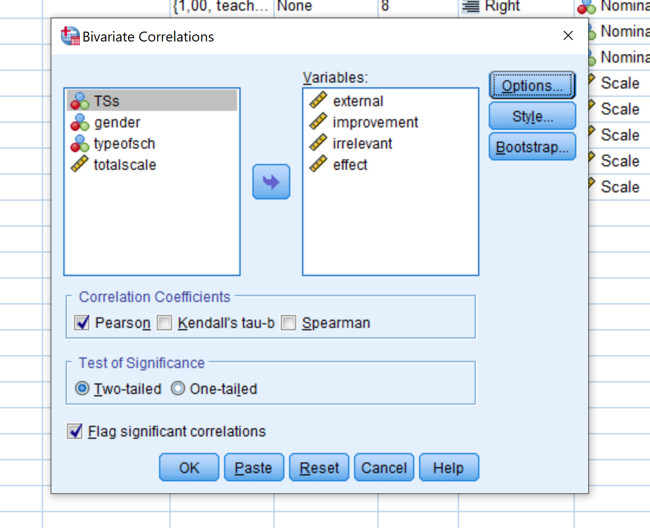

Slide 5
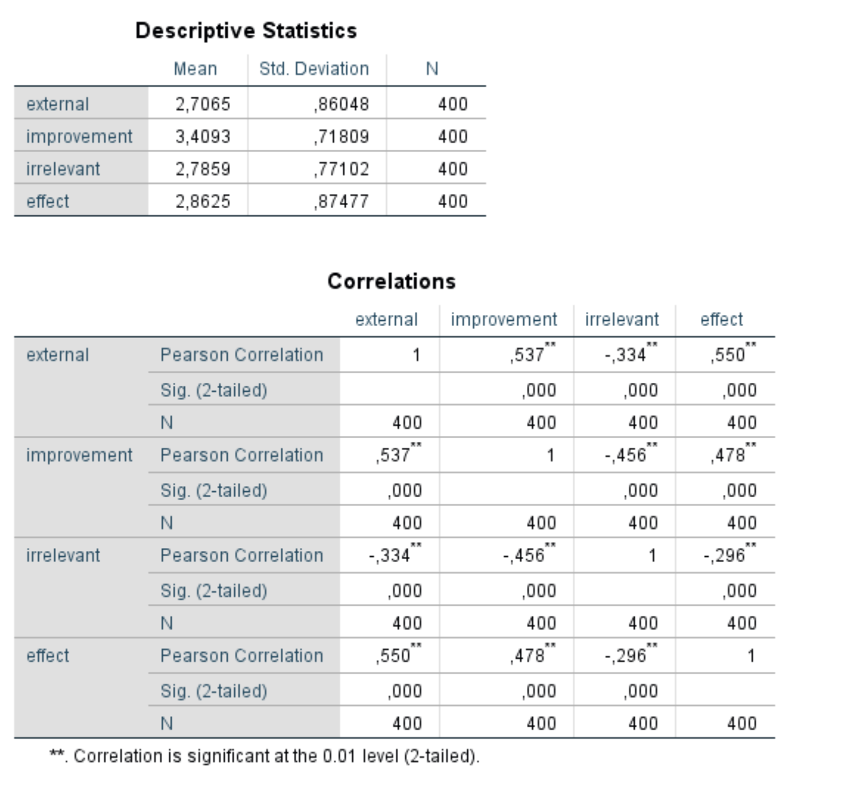
SPSS Output for Pearson r Correlation

Slide 6
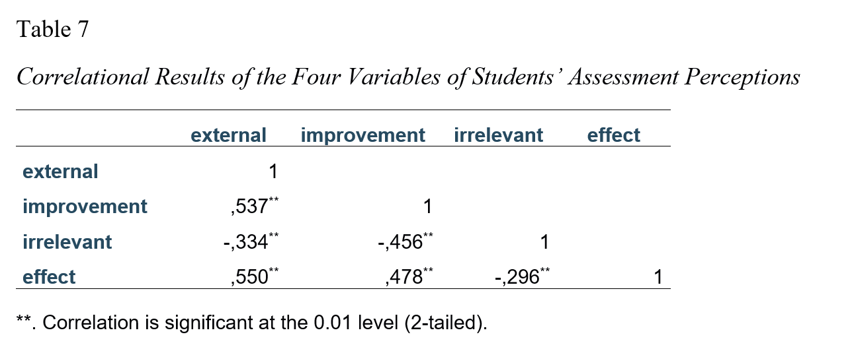
APA Table and Presenting the Results
The relationship among external attribution, improvement, irrelevance, and effect variables of students’ assessment perceptions was investigated using Pearson product-moment correlation coefficient. As seen in Table 7, there was a strong, positive correlation between the external attribution and improvement (r= .537), external attribution and effect (r= .550), and improvement and effect (r= .478), which were all statistically significant (p<.001). Irrelevant variable had negative correlations with all the other variables, having a strong correlation with improvement (r= .456), moderate correlation with external attribution, and weak correlation with effect, all of which were statistically significant (p<.001).

