Slide 1
Integrated Marketing Communications, Advertising, and Public Relations

Slide 2
Objectives
Describe integrated/combined marketing communications and how it relates to the development of an optimal promotional mix.
Describe the communication process and how it relates to the AIDA (Awareness, Interest, Desire and Action) concept.
Identify the seven components of the promotional mix.

Slide 3
Objectives
Name the three basic advertising objectives and the two basic categories of advertising.
Identify the four major advertising strategies.
Describe the various types of advertising appeals/attractions and their uses.

Slide 4
Objectives
Compare the seven different advertising media/mean.
Explain the roles of public relations, publicity, and cross-promotion in an organization’s promotional strategy.
Discuss the five factors that influence the effectiveness of a promotional mix and how marketers measure promotional effectiveness.

Slide 5
Introduction
Promotion - Function of informing, persuading/convincing, and influencing the consumer’s purchase decision
Marketing communications - Messages that deal/concerned with buyer-seller relationships
Integrated marketing communications (IMC) - Coordination of all promotional activities to produce a unified/integrated, customer- focused promotional message

Slide 6
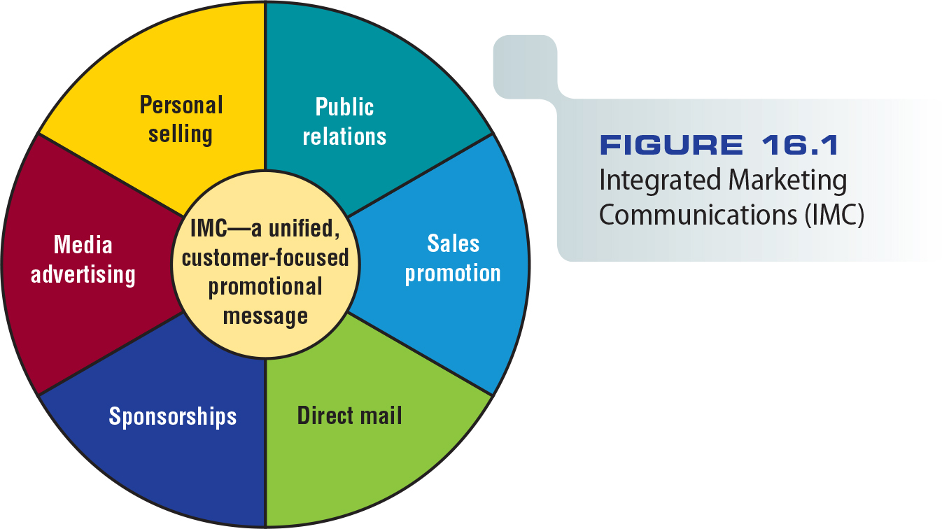
Figure 16.1 - Integrated Marketing Communications (IMC)

Slide 7
Importance of Teamwork
Teamwork involves both in-house resources and outside vendors (advertising agency)
IMC challenges the traditional role of the outside advertising agency

Slide 8
Role/impotance of Databases in Effective IMC Programs
The Internet allows companies to gather information faster and organize it easily
Direct sampling is a frequently used method to obtain customer opinions.
Haphazardly calling clients or asking people walking on the Street. It has got nothing to do with random sampling! It is an informal way of doing sampling.

Slide 9
The Communication Process
Sender - Source of the message communicated to the receiver
Message - Communication of information, advice, or a request by the sender to the receiver

Slide 10
The Communication Process
An effective message does three things
Gains the receiver’s attention
Achieves understanding by both sender and receiver
Stimulates/wakens receiver’s needs and suggests appropriate methods of satisfying them

Slide 11
The Communication Process
AIDA - Steps through which an individual reaches a purchase decision: attention, interest, desire, and action
Encoding/encrypting - Translating a message into understandable terms
Decoding/translation - Receiver’s interpretation of a message

Slide 12
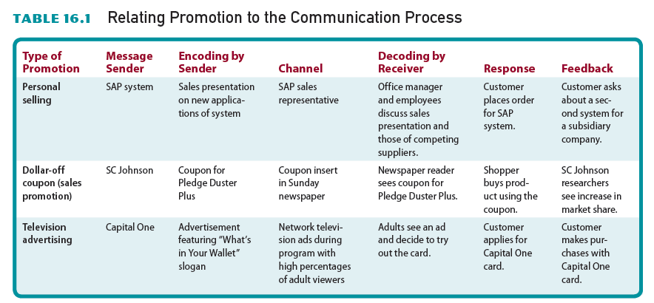
Table 16.1 - Relating Promotion to the Communication Process

Slide 14
The Communication Process
Feedback - Receiver’s response to a message
Noise – Interference/obstruction at some stage in the communication process
Channel - Medium through which a message is delivered

Slide 15
Elements of the Promotional Mix
Promotional mix – Subset/division of the marketing mix in which marketers attempt to:
Achieve the optimal blending/mix of the elements of personal and nonpersonal selling to achieve promotional objectives

Slide 16
Personal Selling
Interpersonal influence process involving a seller’s promotional presentation conducted on a person-to-person basis with the buyer
Oldest form of promotion
Currently, more than about 48 million (2019) people in the U.S. involved in direct selling.
https://www.statista.com/statistics/874793/number-ofpeople-involved-in-direct-selling-us/, Accessed. 12/17/2020

Slide 17
Nonpersonal Selling
Advertising - Any paid, nonpersonal communication about a business good
Product placement - Marketer pays a motion Picture/movie owner a fee to display his or her product prominently/noticeably in the film or show

Slide 18
Nonpersonal Selling
Sales promotion - Marketing activities that stimulate consumer purchasing and dealer effectiveness
Does not include personal selling, advertising, guerrilla marketing, and public relations
Trade promotion - Sales promotion geared/customized to marketing intermediaries such as wholesalers and retailers.

Slide 19
Nonpersonal Selling
Direct marketing - Use of direct communication to a consumer or business recipient/receiver designed to generate a response in the form of:
An order
Lead generation/create prospects
Traffic generation/increase number of shoppers visiting the sales outlet

Slide 20
Nonpersonal Selling
Public relations - Firm’s communications and relationships with its various publics/ people
Publicity/familiarization - Nonpersonal stimulation of demand for a good by unpaid placement of significant news
Guerrilla marketing – Unconventional/ unusual, innovative, and low-cost techniques to get consumers’ attention

Slide 21
Sponsorships
Relationship in which an organization provides funds to an event in exchange for a direct association with that event
Sponsor purchases:
Access/reach to the event’s audience
The image associated with the activity

Slide 22
How Sponsorship Differs from Advertising
Cost-effectiveness
Sponsor’s degree of control versus that of advertising
Nature of the message

Slide 23
Types of Advertising
Product advertising - Nonpersonal selling of a particular good or service
Institutional advertising - Promotion of a concept, an idea, a philosophy, or the goodwill of an industry, company, organization, person, geographic location, or government agency

Slide 24
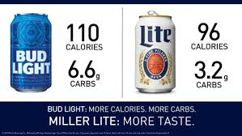
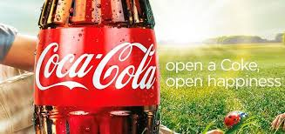
Objectives of Advertising
Informative advertising - Seeks to develop initial demand for a good, service, organization, person, place, idea, or cause
Persuasive advertising - Attempts to increase demand for an existing good, service, organization, person, place, idea, or cause

Slide 25
Objectives of Advertising
Reminder advertising – Reinforces/supports previous promotional activity by keeping the name of a good, service, organization, person, place, idea, or cause before the public

Slide 26
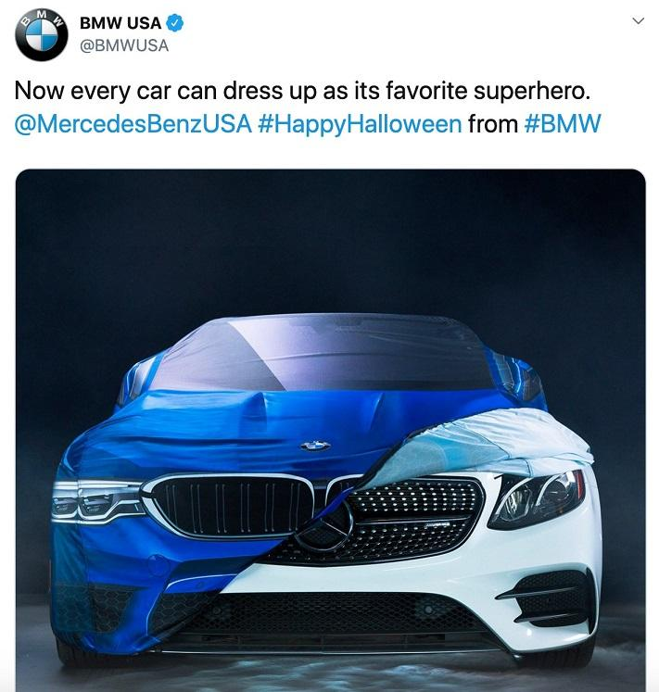
Advertising Strategies
Comparative advertising – Emphasizes/underlines messages with direct or indirect promotional comparisons between competing brands
Used by firms whose products are not market leaders
Advertising by market leaders seldom/rarely acknowledge/accept existence of competing products

Slide 27
Advertising Strategies
Celebrity testimonials/
approvals
Can improve product recognition
A celebrity who endorses/approves too many products may create marketplace confusion/distruction

Slide 28
Advertising Strategies
Retail advertising - Advertising by stores that sell goods or services directly to the consuming public
Cooperative advertising - Retailer shares advertising costs with a manufacturer or wholesaler

Slide 29
Interactive Advertising
Two-way promotional messages transmitted/conveyed through communication channels. Induce/cause message recipients to participate actively in the promotional effort. Provides information throughout the purchase and consumption processes

Slide 30
Creating an Advertisement
Must create effective ads that increase sales and enhance the organization’s image
An ad needs to accomplish:
Educating consumers about product features
Enhancing brand loyalty
Improving consumer perception of the brand

Slide 31
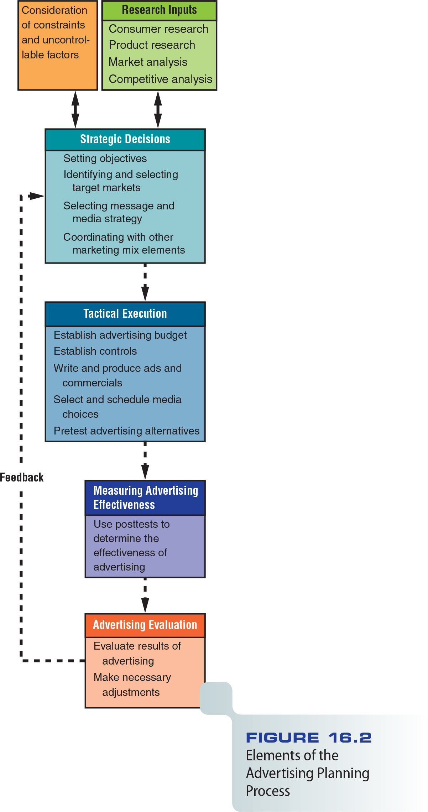
Figure 16.2 - Elements of the Advertising Planning Process

Slide 32
Advertising Messages
Advertising campaign - Series of different but related ads that use a single theme/ motive and appear in different media within a specified time period

Slide 33
Advertising Appeals/attraction/content
Fear/worry appeals
Humor/comedy in advertising messages
Ads based on sex

Slide 34
Developing and Preparing Ads
Goals
Gain attention and interest
Inform or persuade
Lead/cause to purchase or other desired action
After conceiving/creating an idea, ads must be refined/improved from rough sketch/draft to finished/completed layout/ setup.

Slide 35
Figure 16.3 - Elements of a Typical Ad

Slide 36
Creating Interactive Ads
Advergames (advertising in video games)
Missiles/creating curiosity
Keyword ads (Help shoppers find and purchase your products with ads that appear in prominent/ striking positions on Shopee search results.)
Adware/ad-supported software
Social network advertising
Narrowcasting (digital signage)

Slide 37
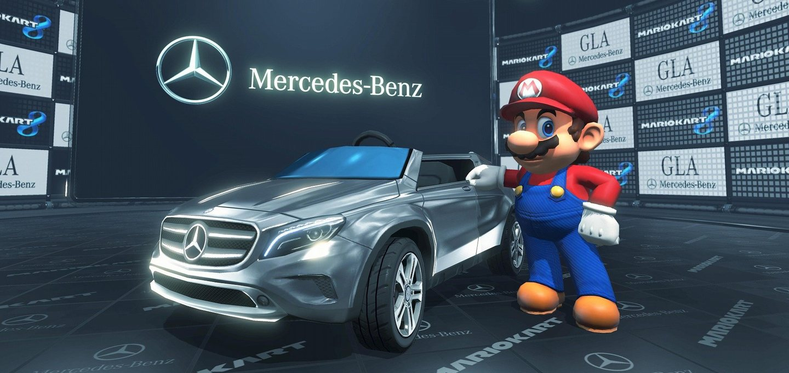
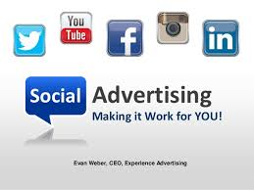
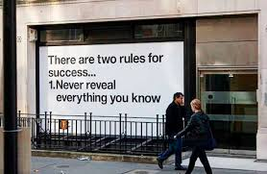
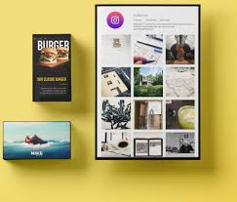
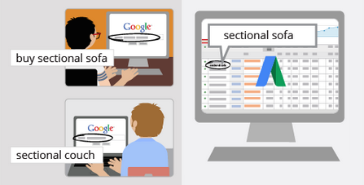

Slide 38
Media Selection and Scheduling
Television
Mass coverage/broadcast area
Powerful impact on viewers, repetition/ rebroadcast of messages
Flexibility, and prestige

Slide 39
Media Selection and Scheduling/ timetabling
Radio
Advantages
Ability to reach people while they drive because they are a captive/obliged audience
Benefits include low cost, flexibility, and mobility
Disadvantages
Highly segmented audiences,
The temporary/old-fashioned nature of messages
A minimum of research information compared with television

Slide 40
Media Selection and Scheduling
Newspapers
Advantages
Flexible
Intensive coverage/content for ads
Can refer/get back to newspaper ads
Disadvantages
Hasty/short time for reading reading
Relatively poor reproduction/remaking quality

Slide 41
Media Selection and Scheduling
Magazines
Consumer magazines and business magazines
Advantages
The ability to reach precise/actual target markets
Quality reproduction (color print)
Long life
Prestige associated with some magazines
Disadvantage
Lack flexibility

Slide 42
Media Selection and Scheduling
Direct mail
Advantages
Ability to segment large numbers of prospective customers
Flexible
Detailed information
Personalization/customization
Disadvantages
High cost per reader
Reliance/depandence on the quality of mailing lists
Consumers’ resistance*
*Consumer resistance refers to a consumer who opposes a certain brand, an organization, or marketing images, norms, and devices that are considered to represent a system of domination.

Slide 43
Media Selection and Scheduling
Outdoor advertising
Traditional - Billboards and painted displays
Transit advertising - Ads placed inside and outside buses, subway trains, commuter trains (a train that people use to get to and from work), and stations

Slide 44
Media Selection and Scheduling
Interactive Media
Internet and social media sites
Augmented reality [an enhanced version of reality created using technology to overlay/cover digital information on an image of something being viewed through a device (such as a smartphone camera)]: Virtual imaging can be incorporated into real-time video on a cell phone

Slide 45
Media Scheduling
Setting the timing and sequence for a series of advertisements
Influenced by a variety of factors
Seasonal sales patterns
Repurchase cycles/patterns
Competitors’ activities

Slide 46
Publicity
Nonpersonal stimulation of demand for a good by unpaid placement of significant news. Many consumers consider news stories more credible than advertisements

Slide 47
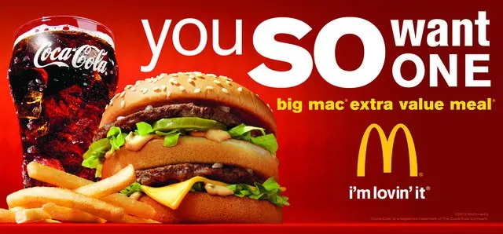
Cross-Promotion
Marketing partners share the cost of a promotional campaign that meets their mutual needs

Slide 48
Ethics and Promotional Strategies
Advertising to children
Use of cookies in online advertising
Insertion/adding of product messages in media programs without full disclosure/ information. i.e. Palmoil usage in Turkey (if less than 2% may not be mentioned)

Slide 49
Puffery/exaggeration and Deception/cheating
Puffery
Exaggerated claims of a product’s superiority
Use of subjective or vague/unclear statements that may not be literally true
The Uniform Commercial Code standardizes sales and business practices throughout the United States

Slide 50
Promotional Mix Effectiveness
Marketers create a promotional mix by:
Blending advertising
Personal selling
Sales promotion
Public relations
Several factors can influence the effectiveness of promotional mix

Slide 51
Nature of the Market
Market’s target audience
Personal selling can be highly effective if the market has a limited number of buyers
Type of customer

Slide 52
Nature of the Product
Consumer products rely/depend more on advertising than business products
Personal selling is important for shopping products
Personal and nonpersonal selling are important in the promotion of specialty items

Slide 53
Stage in the Product Lifecycle
Introduction - Nonpersonal and personal selling
Growth and maturity - Advertising and personal selling
Maturity and early – Reduction/decrease in advertising and sales promotion

Slide 54
Figure 16.4 - Advertising Objectives in Relation to Stage in the Product Lifecycle

Slide 55
Price
Advertising dominates/overweighs for low-unit-value products
Personal selling involves high per-contact costs
A real barrier in implementing any promotional strategy is the size of the promotional budget

Slide 56
Funds Available for Promotion
Percentage-of-sales method
Fixed-sum-per-unit method
Meeting competition method
Task-objective method

Slide 57
Evaluating Promotional Effectiveness
Direct sales results test
Indirect evaluation

Slide 58
Measuring Advertising Effectiveness
Cost per thousand impressions (CPM)
By measuring promotional effectiveness:
Organizations can evaluate different strategies
Prevent/forestall/avoid mistakes before spending money on specific programs
Improve their promotional programs

Slide 59
Media and Message Research
Media research – Assesses/evaluates how well a particular medium delivers a message
Message research - Tests consumer reactions to an advertisement’s creative message

Slide 60
Media and Message Research
Pretesting (before)
Posttesting (after)
Readership tests
Unaided/unhelped recall tests
Inquiry tests (technique used in advertising research where the advertising, brand, or product is tested through random inquiries of respondents. The information acquired is generally used to evaluate the various forms of advertising media).
Split runs - Allow advertisers to test two or more ads at the same time

Slide 61
Measuring Public Relations Effectiveness
The simplest and least costly method
Whether the target audience received messages directed to them
Count the number of media placements and gauge/measure the extent/area of media coverage
Conduct focus groups, interview opinion leaders

Slide 62
Evaluating Interactive Media
Hits/clicks - User requests for a file
Impressions/exposures - Number of times a viewer sees an ad
Click-throughs - User clicks ad for more information
View-through - Measures response over time

Slide 63
Evaluating Interactive Media
Cost per impression - Relates the cost of an ad to every thousand people who view it
Cost per response (click-through) - Relates the cost of an ad to the number of people who click it
Conversion/changeover rate - Percentage of visitors to a Web site who make a purchase

Slide 65
Pepe’s Pizzeria Video
http://www.cengage.com/marketing/book_content/boone_9781133628460/videos/ch16.html

